Slide 1
Client/Server
Why things are as they are

Slide 2
I am going to sketch a bit of the history of client/server as well as consider variations.

Slide 3
Once upon a time…
Notes:
Monolithic, centralized, time-sharing program accessed via dumb terminals

Slide 4
The monolith became 2 pieces and complexity is reduced; maintainability is improved; performance is degraded.

Slide 5
The server could handle many clients
Notes:
Programs were installed on the many “client” machines and data was downloaded from the “server” Productivity was improved because multiple machines were at work but performance was still a problem because of the amount of network traffic.

Slide 6
The communication is decomposed into bi-directional flows…
Notes:
The true client/server architecture may appear on a single machine; testing can be performed this way and even in-house processing can occur.

Slide 7
And then distributed…
Notes:
Most often the client and server are on separate machines. Programs are installed on the clients and only the data are transferred over the network.

Slide 8
And the client was made thinner enabling client machines to be smaller
Notes:
To support smaller, cheaper client machines the client software was standardized to a browser and more of the computation was done on the server machine.What has to be transferred is more modular and smaller for any given transfer but there are more interactions. Communication protocols were specialized for this purpose. See TCP/IP http://www.redbooks.ibm.com/redbooks/pdfs/gg243376.pdf

Slide 9
So if decomposition gives an increase in flexibility and maintainability…
Notes:
An architectural style can be used repeatedly if the desired qualities align.

Slide 10
A server may be a client

Slide 11
Static HTML
Client is a browser
Request an HTML file
Display the page
Server find the file and sends to client

Slide 12
CGI script
Client is a browser
Client asks for a specific script
Server finds the file and passes it the
Data sent with the request
Browser displays the data
CGI script computes and sends data to server
Server sends the data to the client

Slide 13
Server side scripting
Client is a browser
Browser sends request to server
Server checks the file and
executes the embedded script
Browser displays the document
The final formatted document is delivered

Slide 14
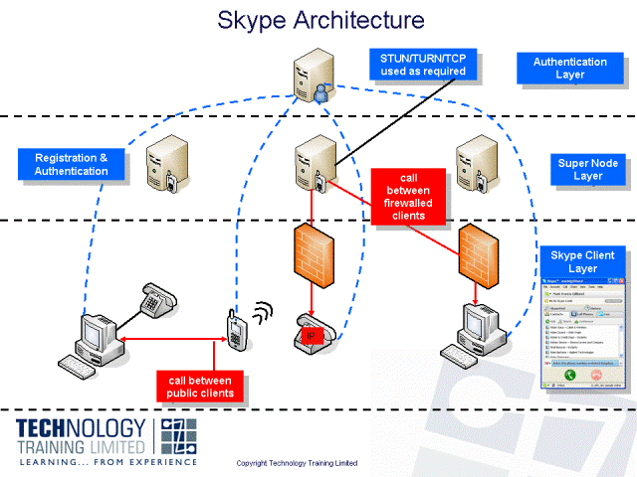
Skype Client/Server
http://www.technology-training.co.uk/skypesroadmapandarchitecture_28.php
Notes:
SKYPE's Roadmap and Architecture
Skype is certainly the most successful of the Internet-based telephony services launched in recent years, if success is defined as numbers of users, acceptance and/or public profile...
Skype was developed by the Danish entrepreneurs behind the KaZaA peer-to-peer file sharing network, and appears to have substantial code in common with the clients and servers developed for that project.
Since Skype was launched in August 2003 it has largely dominated the free Internet telephony application space. Some of the key milestones in Skype’s business development are shown on the slide opposite.
As of January 2008, Skype claim 276 million users accounts. Many of these can be expected to be inactive, and typically users may have more than one account on this (free) service. Annualized revenues of $382 million for 2007 have been reported, and annual SkypeOut minutes for 2007 of 5.4 billion. For reference, a large national fixed or mobile network might carry around 100 billion minutes of total traffic per year.
As well as (free) VoIP calls between Skype clients, the company offers a paid SkypeOut service with termination rates to most countries in the world, and a SkypeIn service which rents a PSTN number to the Skype subscriber on which they can be called by PSTN calling parties.
The Skype architecture includes a central registration server to which all clients register. Unlike most other similar applications and VoIP systems generally, Skype operates on a peer-to-peer, rather than a client-server model, and so buddy lists are managed locally on each machine, and calls are routed via transit nodes only if necessary to circumvent firewalls and NAP/NAPT.
The Skype network consists of conventional nodes and Supernodes, which are themselves Skype endpoints, as well as providing signalling and media proxy services to conventional nodes. Skype applications are provided with a basic set of Supernode addresses when they first register, and maintain a cache of these and additional Supernodes long-term. In common with other VoIP applications, the Skype applications can be adversely affected by firewalls and NAT/NAPT devices, and Skype uses various techniques to traverse such devices, including re-use of conventional HTTP and HTTPS ports (TCP port 80 and port 443), use of TCP instead of UDP where this can traverse firewalls, and client-based techniques for NAT/NAPT traversal, including the use of Simple Traversal of UDP Through NATs (STUN) and Traversal Using Relay NAT (TURN).

Slide 15
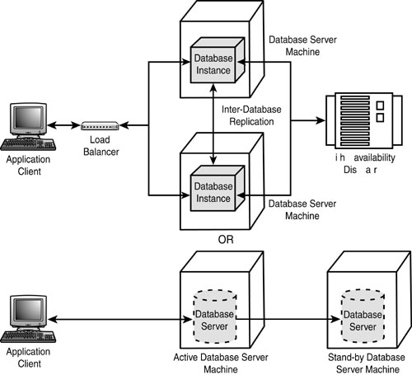
Robustness in C/S

