Slide 1
Software Product Lines
John D. McGregor
Clemson University

Slide 2
My perspectives
Small business owner/consultant
Primarily scientific and
embedded systems for
Honeywell TSI, AT&T, …
Researcher
Professor
Visiting scientist at SEI
Courses in software engineering
and systems engineering

Slide 3
http://www.hulu.com/watch/153568/dilbert-animated-cartoons-new-product-line
Notes:
Dilbert has a useful comment on everything and anything. We will try to have a more substantial basis for our product lines than the pointy headed manager.

Slide 4
Outline
What is it?
What’s different?
What’s REALLY different?
What does it do for your organization?
Does it really work?

Slide 5

It’s a …
business strategy
  A means of accomplishing business goals related to the development of software-intensive products
technical strategy
  Using an assortment of mechanisms to manage the variations among products
toothpaste too!
Notes:
An iconic commercial spoof on Saturday Night Live took a product – floor wax – and gave the usual hyped, over-blown list of features of the product. At the very end Chevy Chase – the pretend announcer – said “And it’s a toothpaste too!”
We have tried very hard not to over sell product lines but this presentation will focus on the fundamentals of product lines so it may seem like a commercial.

Slide 6
The definition
A software product line is a set of software-intensive systems sharing a common, managed set of features that satisfy the specific needs of a particular market segment or mission and that are developed from a common set of core assets in a prescribed way.¹
¹ Clements, P. & Northrop, L. Software Product Lines: Practices and Patterns. Boston, MA: Addison- Wesley, 2001.

Slide 7
Definitions
Core asset – an asset that is used in the building of multiple products in the product line
Product – the final deliverable to a customer; it need not be a stand-alone system
Feature - a product capability that satisfies a specific user/buyer need
Commonality – those behaviors that appear in many products
Variability – the ability to easily, in a pre-planned way, change how an element works or what it does

Slide 8
Framework for Product Line Practice
Architecture Definition
Architecture Evaluation
Component Development
Using Externally Available
Software
Mining Existing Assets
Requirements Engineering
Software System Integration
Testing
Understanding Relevant
Domains
Building a Business Case
Customer Interface Management
Developing an Acquisition Strategy
Funding
Launching and Institutionalizing
Market Analysis
Operations
Organizational Planning
Organizational Risk Management
Structuring the Organization
Technology Forecasting
Training
Technical Management
  Configuration Management
  Measurement and Tracking
  Make/Buy/Mine/Commission
  Analysis
  Process Discipline
  Scoping
  Technical Planning
  Technical Risk Management
  Tool Support
Software Engineering
Organizational Management
http://www.sei.cmu.edu/productlines/frame_report/index.html

Slide 9
A software product line is not…
Family of Systems: “A set or arrangement of independent systems that can be arranged or interconnected in various ways to provide different capabilities. The mix of systems can be tailored to provide desired capabilities dependent on the situation.”
System of systems: is defined as a set or arrangement of systems that results when independent and useful systems are integrated into a larger system that delivers unique capabilities [DoD, 2004(1)].

Slide 10
What’s different – separation of roles
Creating assets to be reusable
  All artifacts have the potential to be reused
  But only within the scope of the product line
Composing products
  There are still some unique aspects of every product
  But product building is faster and more constrained than core asset development or one-off product development

Slide 11


An operating product line organization
Core asset development
Feedback
Useful assets
Products
Product development
Product development

Slide 12
What’s different - variation
Commonality/variability analysis identifies where products differ and where they are the same
  Differ in what they do
  Differ in how they do it
This is not just “select a printer from
the list”
It is fundamental changes in
behavior
  The system has a certain feature or not

Slide 13
What’s different – attached process
Every core asset comes with a user’s manual
The manual describes how to resolve variations in the assets
  Make choices based on the product’s requirements
  Satisfy constraints among the variants
The manual may be a script that automates the selection process or it might be a document that details what to do.

Slide 14
What’s different - management
Strategic approach to software-intensive product production
A production capability that can quickly produce new (similar) products
Mass customization for low cost
Know your domain and its trajectory

Slide 15
What’s different – strategic reuse
This is a strategic reuse scheme
Not just about the software
Core assets include
  The software architecture
  Product documentation
  Tests and test plans

Slide 16
Options
A software product line approach provides options to future opportunities.
  The exact opportunities and their certainty are impossible to predict.
  Organizations need a way to conduct product experiments in low-cost, low-risk ways.
  Software product lines permit those kind of experiments through predefined variation points that can be exercised to meet new needs.
  For example, having the option to add a new data file is a user feature but the option to add new data types is a variation because not every product will have the feature of adding new data types

Slide 17
Example: Data analysis products
Variations -- makes money
  Algorithms
  Data types
  Data formats
  Report formats
Commonality -- saves money
  Database I/O
  User interface structure

Slide 18
How do we do it?
Fixed scope
  We are not building the universally usable asset
  Each asset must only meet the needs of the product line
Flexible architecture
  Variation points limit where the architecture can be changed
Clearly defined variation points
  Each variation point has a specified list of acceptable options
Notes:
Fixed scope means that we are not building assets that are generally reuseful. The asset only needs to satisfy the needs of the products in the scope.
The flexibility in architecture comes from variation points.
Each variation point defines exactly the choices that are possible.

Slide 19
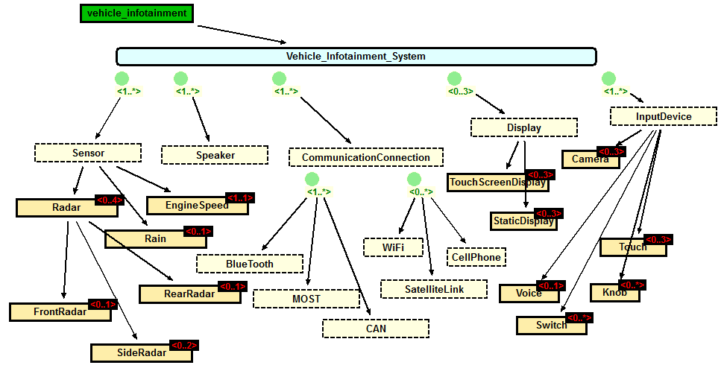
Feature model
Identifies variations at strategic level
optional
mandatory
Notes:
A feature model is created by identifying very high level requirements that characterize a product.
The cardinality indicates how many instances of the feature can be/must be in a product.

Slide 20
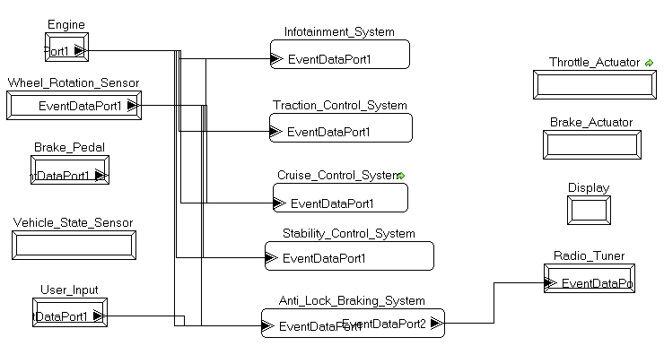
Architecture
Architecture is the structure of a product along with relationships and properties.
No single picture shows the entire architecture.

Slide 21
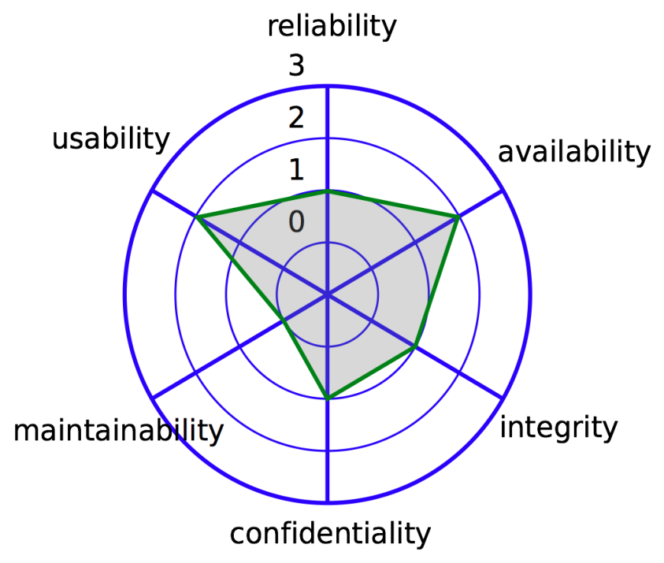
Quality attributes
The functional requirements are necessary but not sufficient for an acceptable product.
We spend much time modifying structures and relationships to achieve acceptable levels of qualities such as maintainability and portability.
“Acceptable level” may be a variation point.
  Secure vs non-secure

Slide 22
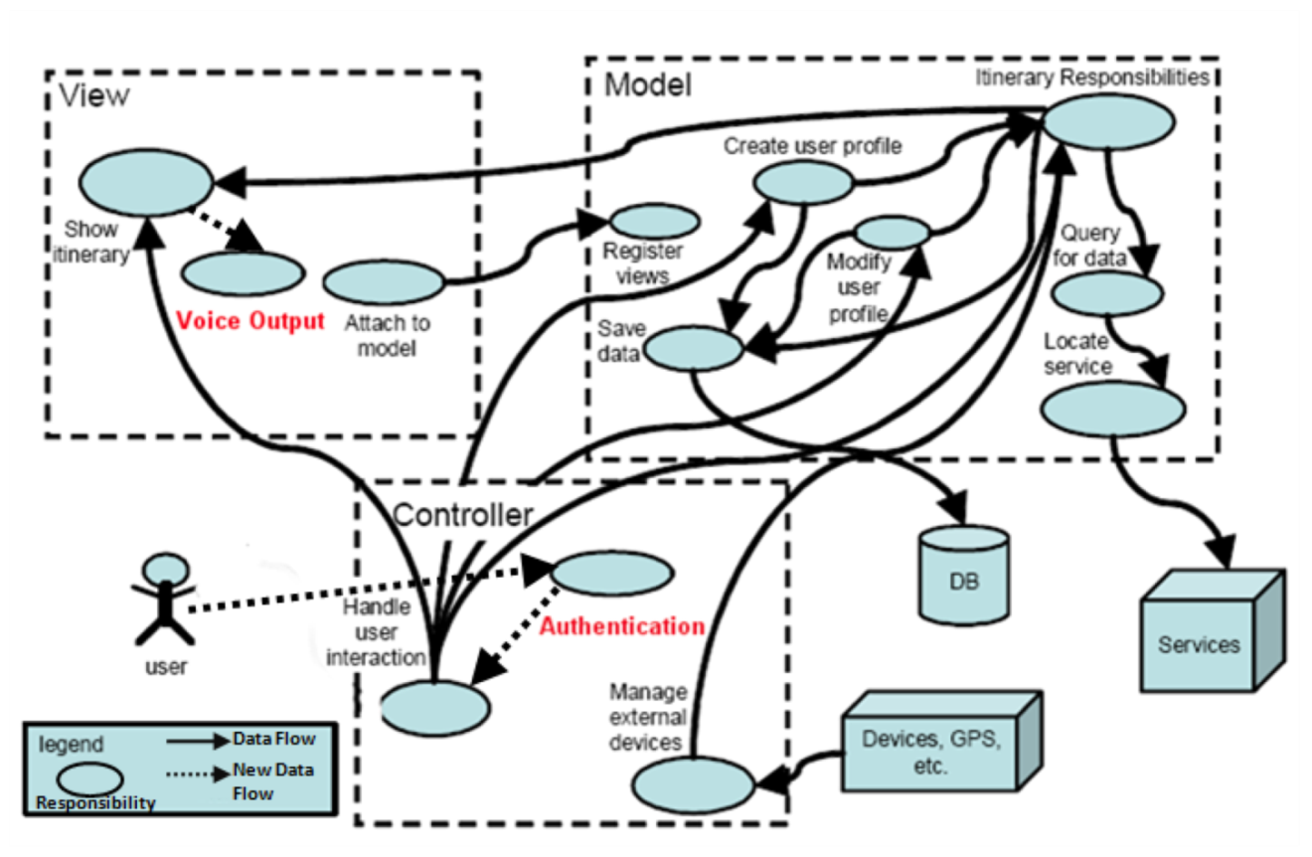
Product line architecture
A product line architecture must
  apply to all members of the product line (even if their functions and qualities differ)
  embody the commonalities and variabilities of the family members
The product line architecture is informed primarily by
  the product line’s scope definition
  the product line requirements specification(s).
Architectural variation mechanisms are used to make the architecture work for the entire set of products.

Slide 23
Architecture variation mechanisms
Common variation mechanisms include
  replacement, omission, and replication of architectural elements
  object-oriented (OO) techniques
    inheritance
    specialization
    delegation
    application frameworks
  parameterization (including macros and templates)
    Special case: compile-time selection of different implementations or implementation fragments (e.g., #ifdef)
  generation and generators
  aspect-oriented programming
    an approach for modularizing system properties that otherwise would be distributed across modules

Slide 24
Everything is under management
Business Plan
Product line-wide core assets
CONOPS
Product-level core assets
Product-unique assets
Production Plan template
Code
Code
Product-specific Production plan
Test plan
Product B
Products
Product A
Notes:
A product line-wide asset is a single asset that satisfies a product line purpose. So every product line has one and only one business plan, but it can still be a core asset because the organization may have more than one product line.
Product level core assets are used in multiple products that belong to the product line. For each product the asset is instantiated. That is, it is the asset’s variation points are resolved by choosing the appropriate variant.
Product-unique assets are developed for use in a specific product.
Products are, of course, the objective. A product is composed of asset instances for which the variation points have been resolved.

Slide 25
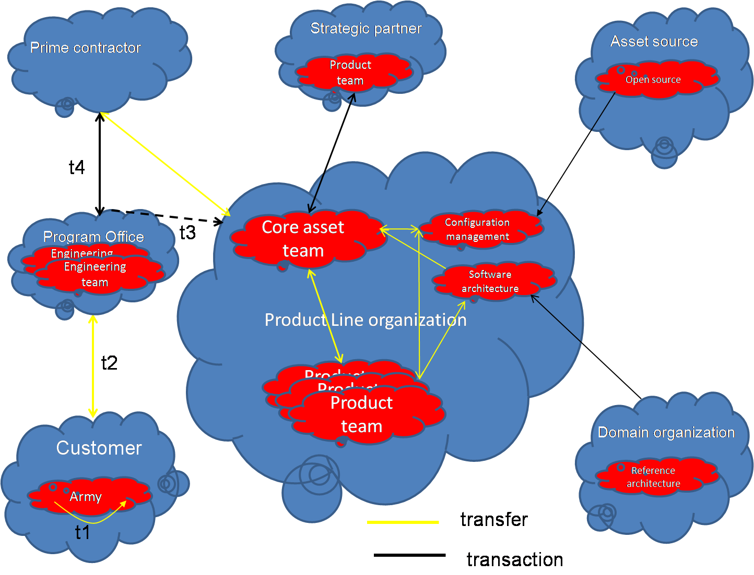
The ecosystem of a DoD product line organization
Many players interact in a large product line organization.
Transactions are transfers that incur a cost. They often occur across some management boundary.

Slide 26

What’s REALLY different
Strategic business level buy-in and participation in a new way of doing business
A manufacturing perspective where product development is predictable.
Software becomes a valued asset to be maximized rather than an expense to be minimized

Slide 27
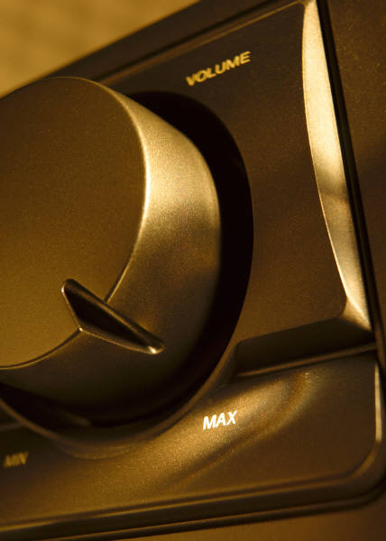
What’s in it for your organization?
Faster
Cheaper
Better
Tune the strategy to meet your business needs.

Slide 28

Does it really work?
Improved productivity by as much as 10x
Increased quality by as much as 10x
Decreased cost by as much as 60%
Decreased labor needs by as much as 87%
Decreased time to market (to field, to launch) by as much as 98%
Ability to move into new markets in months, not years

Slide 29
Who does it work for?
Boeing
Bosch Group
CelsiusTech Systems AB
Cummins, Inc.
Ericsson AXE
General Motors Powertrain (GMPT)
Hewlett Packard
HomeAway
LSI Logic
Lucent
Market Maker
Nokia
Philips (Medical Systems)
Philips (Software for Television Sets)
Philips (Telecommunication Switching System)
Salion, Inc.
Toshiba
U.S. Naval Research Laboratory

Slide 30
Starting a dialog
I hope that this will start a dialog
  About what this would mean to STSCI
  About what it would take to adopt this approach

Slide 31

Questions
Lets start the dialog now …

