Slide 1

An Ultra-large Scale Perspective on Autonomous Vehicles
John D. McGregor
johnmc@clemson.edu

Slide 2
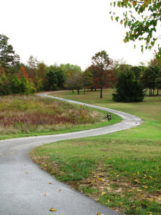
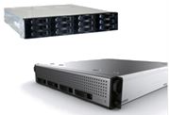
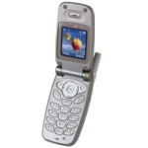
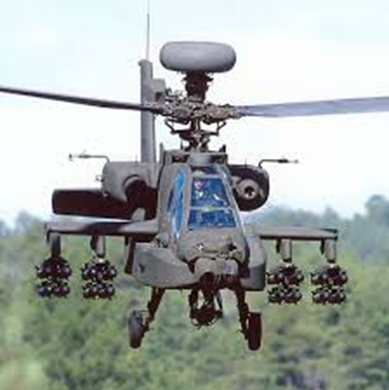
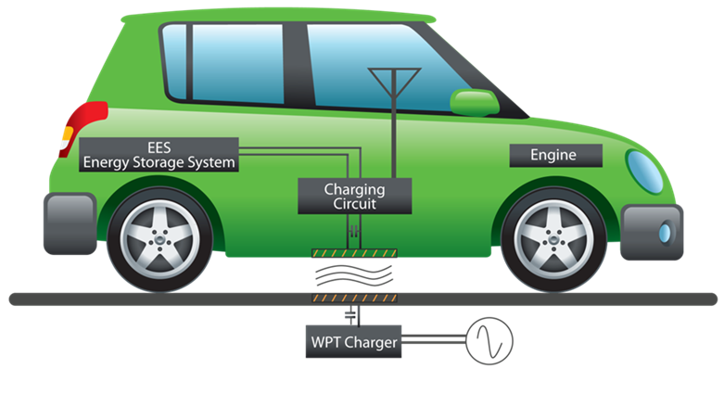
My path
Notes:
http://blogs.visaliatimesdelta.com/alternatingcurrents/2013/07/30/your-old-cell-phone-is-not-a-toy/

Slide 3
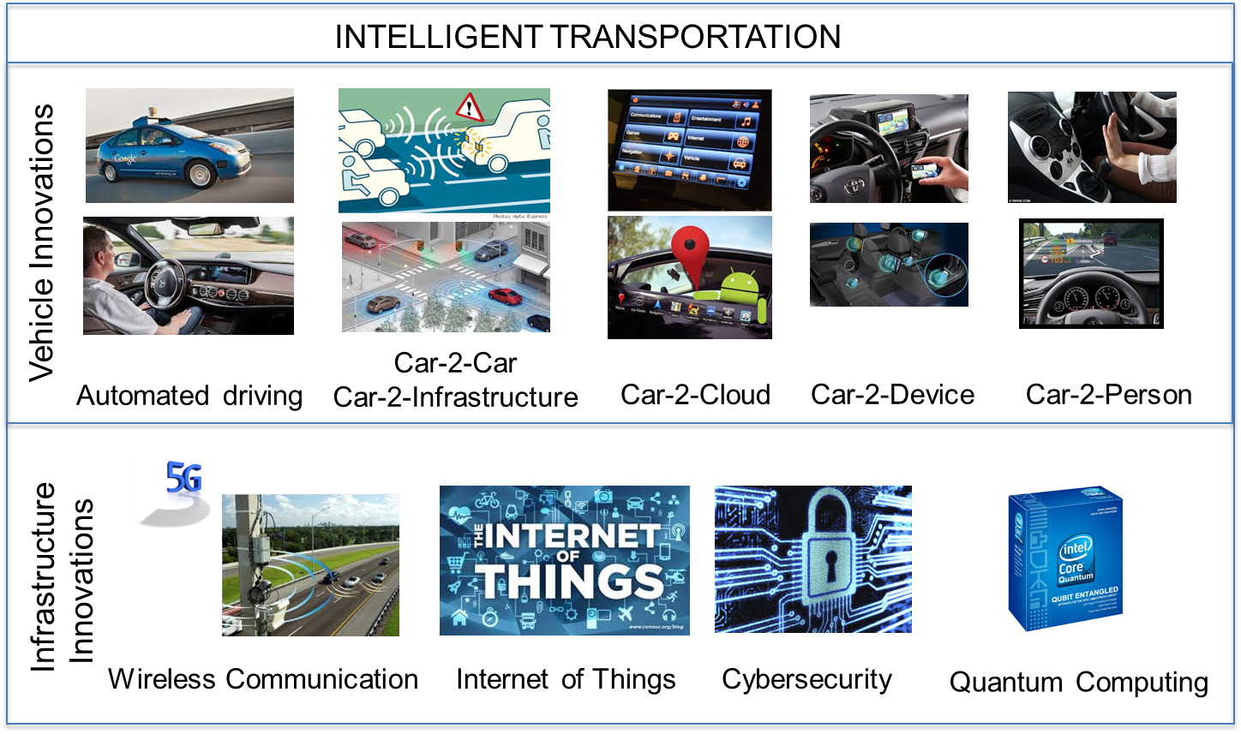
Motivation – disruptive technologies

Slide 4
Perspectives
Those disruptive technologies share one thing: an increased emphasis on software
But, are our software development practices sufficiently robust to take on routinely producing safety critical products?
  ULS systems
  Ecosystems
  Safety critical system development
  Clemson University’s ICAR

Slide 5

Ultra-large scale systems
Scale changes EVERYTHING.
ULS systems are interdependent webs of software-reliant systems, people, policies, cultures, and economics.
Notes:
An integrated health information system that ties together general practitioners with specialists, hospitals, drug stores, …
The Smart Grid
The Internet of Things
Connected, autonomous vehicles on a smart highway
What is different about such systems and how do we approach this scale of opportunity.

Slide 6
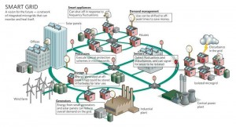

Ultra-large scale systems
Notes:
http://www.smartgrid2030.com/?page_id=445
http://www.zdnet.com/the-internet-of-things-sizing-up-the-business-opportunities-7000009301/

Slide 7
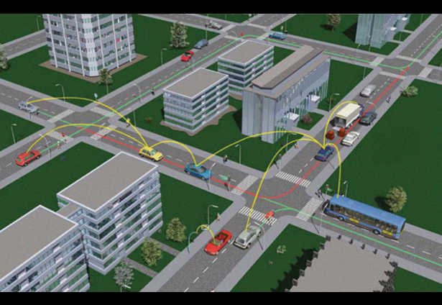
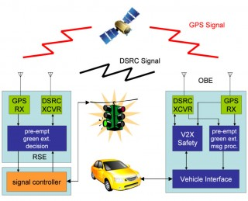
Ultra-large scale systems - 2
Notes:
http://connectedvehicle.challengepost.com/submissions/2892-connected-vehicle-intelligent-driver
http://phys.org/news/2010-10-smart-traffics-fuel-usage-emissions.html

Slide 8
Characteristics of ULS Systems
Decentralized
Conflicting, diverse, unknowable requirements
Continuous evolution
Heterogeneous elements
Erosion of people/system boundary
Failure as the norm
New paradigms for control and policy

Slide 9
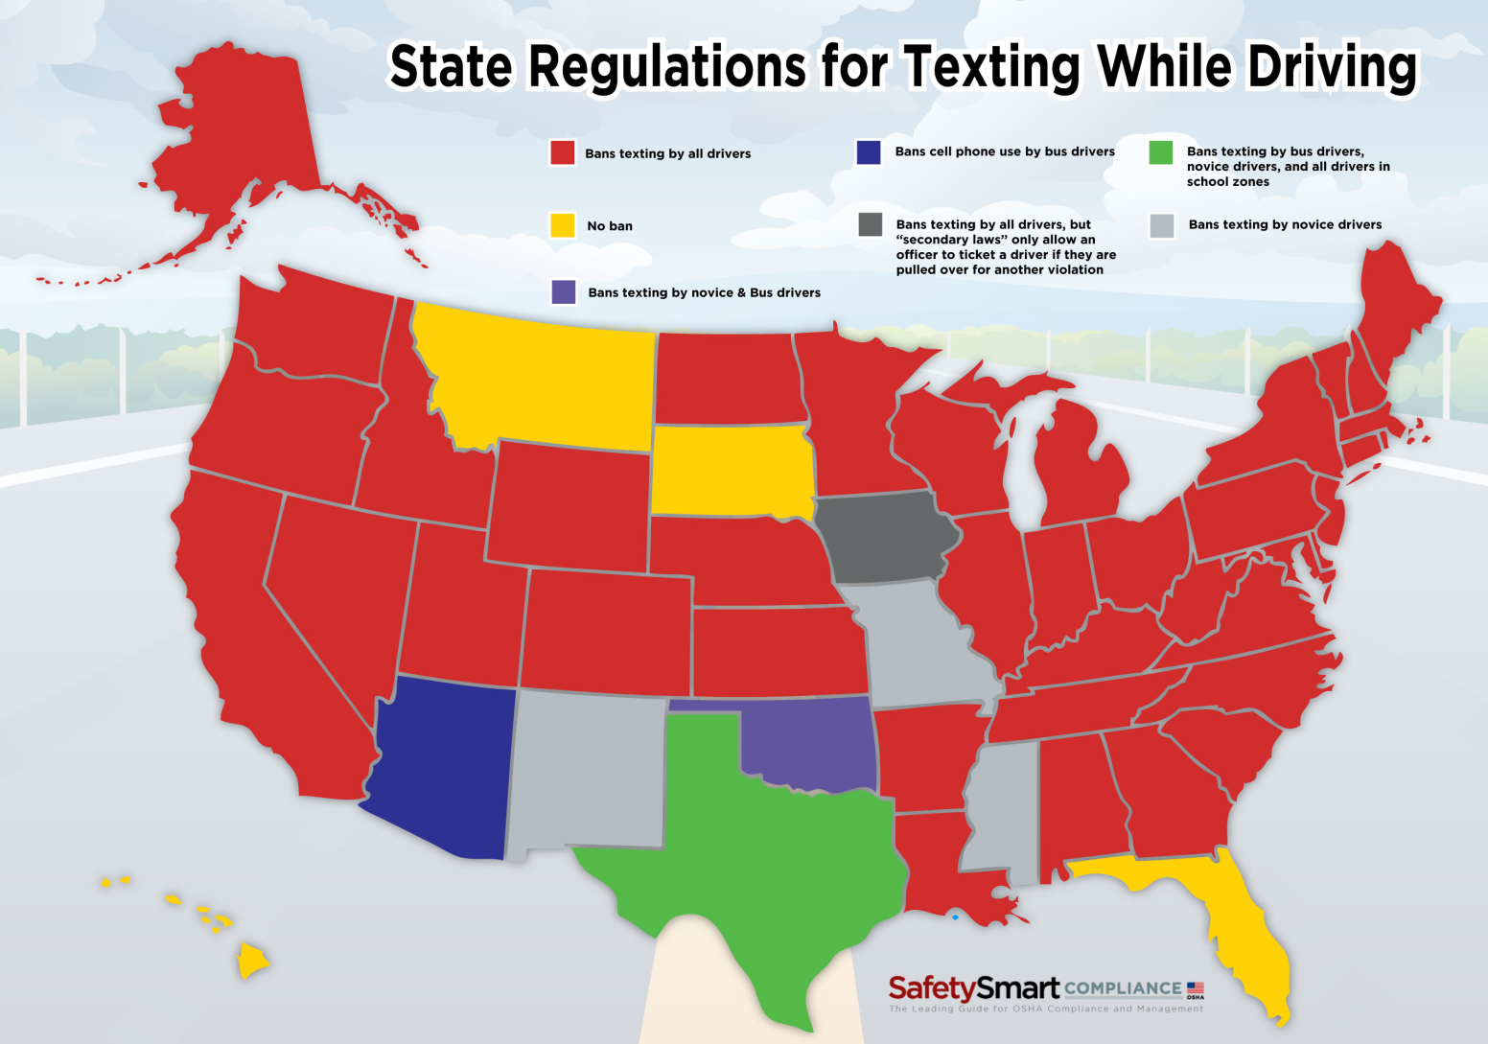
Decentralized
Notes:
http://compliance.safetysmart.com/articles-insight/latest-headlines/infographic-state-by-state-laws-for-texting-while-driving
Similar innovations are made in many places at the same time
visionary leaders
Local management means local success
Local failure not equal
to global failure
Forces the use of
Innovation networks

Slide 10
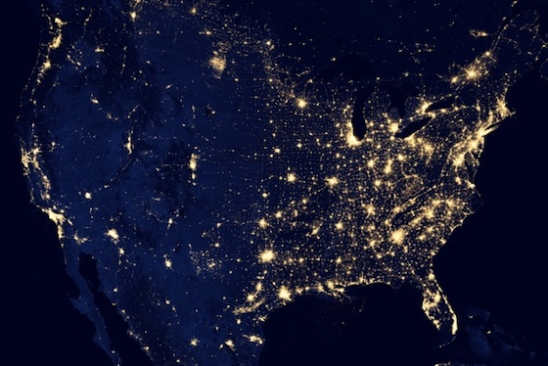
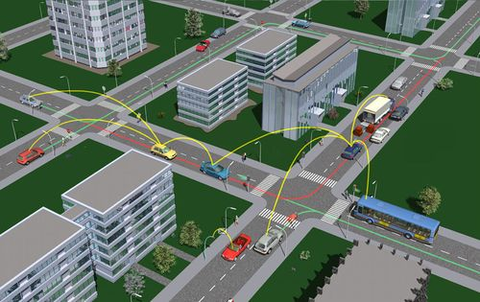
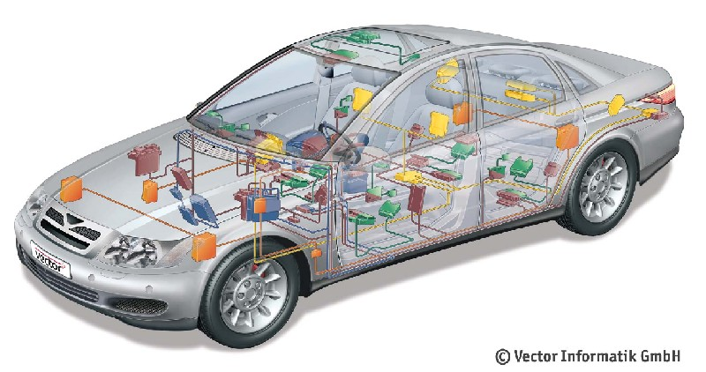
From vehicle to V2V to …
Vehicles connected via various protocols
Notes:
http://people.sabanciuniv.edu/~onat/Files/NCS_intro.htm
http://www.car-to-car.org/
http://www.theverge.com/2012/12/29/3814720/the-census-dotmap-one-dot-for-every-person-living-in-us

Slide 11
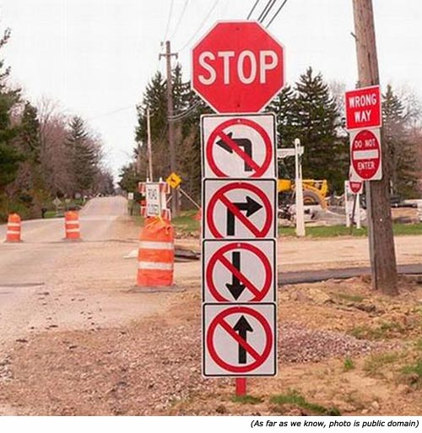
Conflicting, diverse, unknowable requirements
Notes:
http://www.inspirational-quotes-short-funny-stuff.com/funny-traffic-signs.html
Isolated groups will make different assumptions
Not only will we solve the same problem differently we will solve different problems with different scopes
Static/dynamic charging
Autonomous/remote
controlled

Slide 12
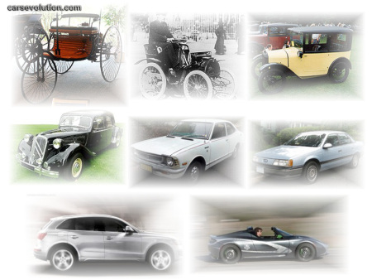
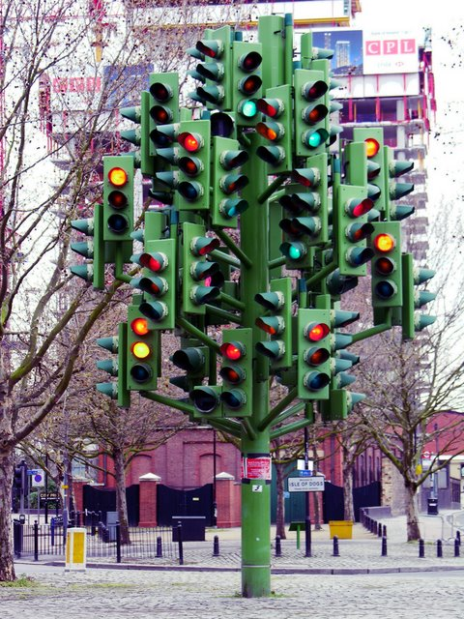
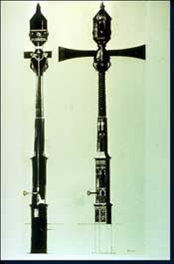
Continuous evolution
Ecosystems of products follow similar evolutionary trajectories with advances in one area influencing other areas.
Often those trajectories operate at vastly different speeds.
Notes:
http://drivingintelligence.wordpress.com/driving-intelligence-defined/
http://www.trafficquagmire.com/2010/04/21/traffic-light-history/
http://www.techtransfer.berkeley.edu/newsletter/07-4/traffic_signals.php
Infotainment can
move faster than
powertrain.
Emergent design

Slide 13
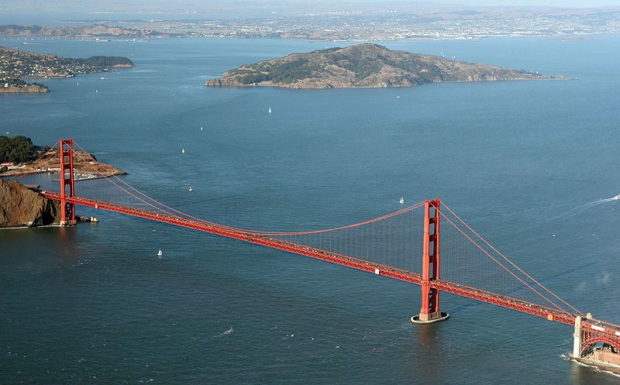
Continuous development
http://commons.wikimedia.org/wiki/File:Golden_Gate_Bridge_Aerial.jpg

Slide 14
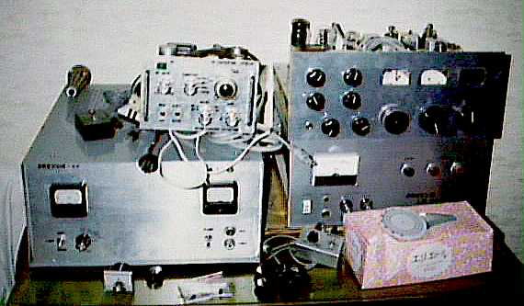
Heterogeneous elements
Notes:
http://www.reocities.com/Heartland/3641/homemade_english.html
A function performed by a traditional electro-mechanical system in one product may be handled by all software in another.

Slide 15

Erosion of people/system boundary
Level 3 - Limited Self-Driving Automation: Vehicles at this level of automation enable the driver to cede full control of all safety-critical functions under certain traffic or environmental conditions and in those conditions to rely heavily on the vehicle to monitor for changes in those conditions requiring transition back to driver control. The driver is expected to be available for occasional control, but with sufficiently comfortable transition time. The vehicle is designed to ensure safe operation during the automated driving mode. An example would be an automated or self-driving car that can determine when the system is no longer able to support automation, such as from an oncoming construction area, and then signals to the driver to reengage in the driving task, providing the driver with an appropriate amount of transition time to safely regain manual control. The major distinction between level 2 and level 3 is that at level 3, the vehicle is designed so that the driver is not expected to constantly monitor the roadway while driving.
Notes:
Nhtsa.gov

Slide 16
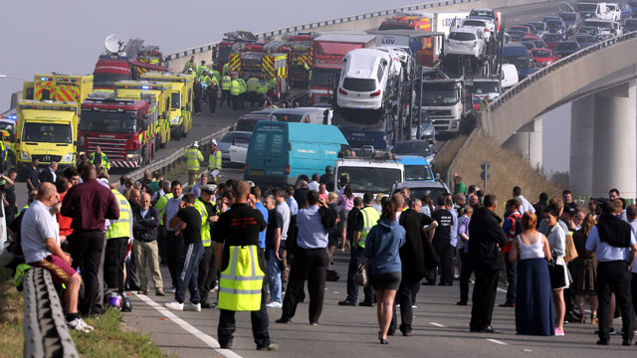
Failure as the norm, but localized
Notes:
http://www.theguardian.com/world/2013/sep/05/shepney-bridge-crash-100-vehicle
No, the rate of failures does not increase.
But the population explodes and the actual number of failures increases.
Failure may not ripple across the entire ULS but it will influence a wide area.
Failure must be localized since there is no central authority.

Slide 17

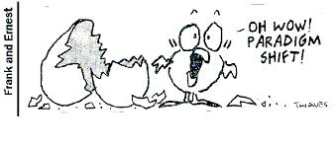
New paradigms for control and policy
Warning -> Assist -> Control
Notes:
http://sqt-fantasy-sci-fi-girl.blogspot.com/2010/04/autopilot.html

Slide 18
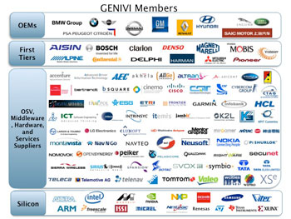
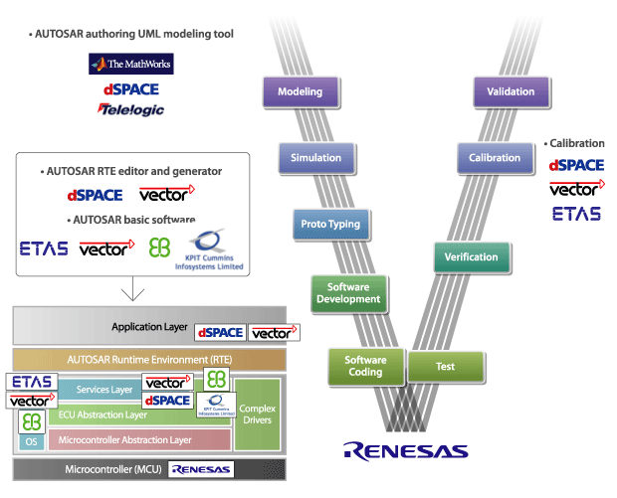
Socio-technical ecosystems
One way to think of ULS systems in a manageable manner is as a set of overlapping, interacting, socio-technical ecosystems.
Notes:
http://sg.renesas.com/applications/automotive/technology/autosar/index.jsp
The use of a platform strategy provides several benefits:[5]
Greater flexibility between plants (the possibility of transferring production from one plant to another due to standardization),
Cost reduction achieved through using resources on a global scale,
Increased use of plants (higher productivity due to the reduction in the number of differences), and
Reduction of the number of platforms as a result of their localization on a worldwide basis

Slide 19
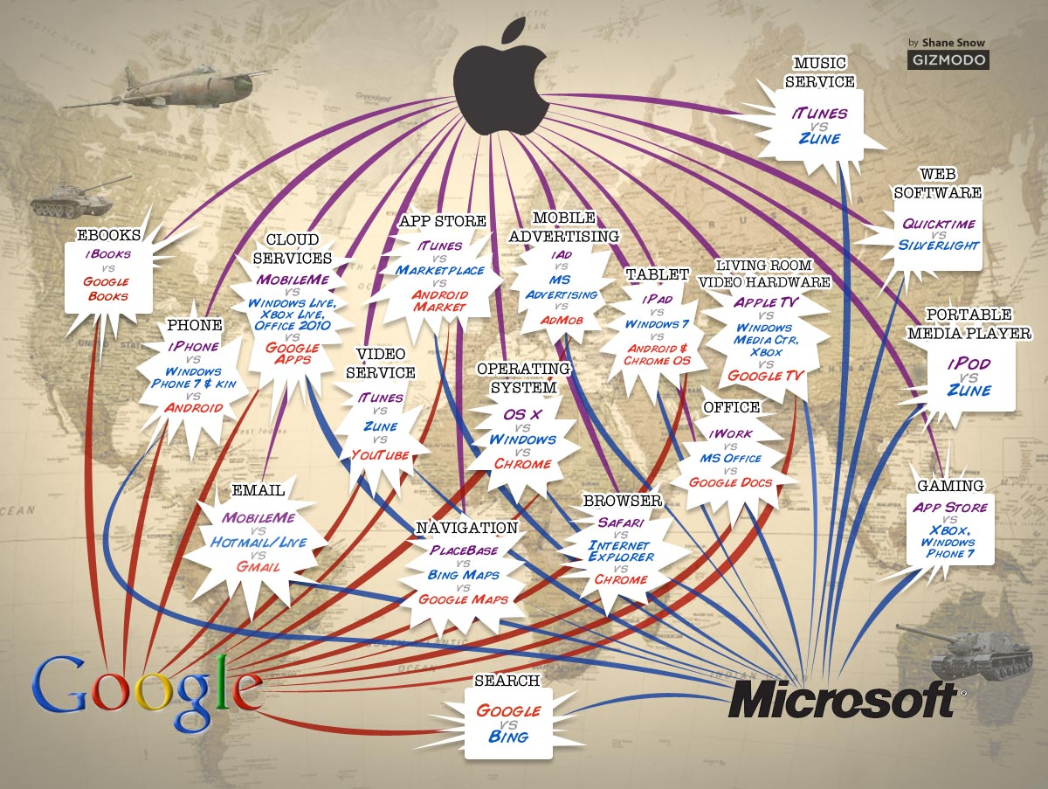
Which ecosystems to support is a strategic decision
Notes:
http://informationstrategyrsm.wordpress.com/2013/10/08/the-war-on-ecosystems/

Slide 20
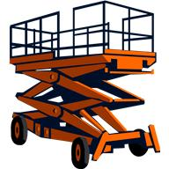
Platform Definition
A platform is a set of resources that give users of the platform a head start toward a completed product.
The resources usually include an architecture for some class of products including constraints and patterns, code assets, tools, and other items.

Slide 21
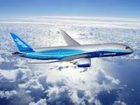
Boeing 787
Flight deck systems on several recent aircraft are “platforms” that support extensibility.
“This redundancy improves dispatch safety and reliability and also provides a platform for growth to support future air traffic initiatives”
http://www.boeing.com/commercial/aeromagazine/articles/2012_q1/3/
Notes:
http://www.boeing.com/commercial/aeromagazine/articles/2012_q1/3/
http://selair.selkirk.bc.ca/Training/systems/power-point/787Dreamliner.pdf
Carriker.5
Copyright © 2006 the Boeing Company
The Boeing Flight Deck Philosophy
•
Reduces costs in the long term but may raise costs in the short term (more testing for a more abstract interface)
Both crew members are ultimately
responsible for the safe conduct of
the flight
•
Flight crew tasks, in order of priority,
are: safety, passenger comfort,
and efficiency
•
Design for crew operations based
on pilots’ past training and
operational experience
•
Design systems to be error-tolerant
•
The hierarchy of design alternatives
is: simplicity, redundancy,
and automation
•
Both crew members are ultimately
responsible for the safe conduct of
the flight
•
Flight crew tasks, in order of priority,
are: safety, passenger comfort,
and efficiency
•
Design for crew operations based
on pilots’ past training and
operational experience
•
Moving to paperless operation

Slide 22
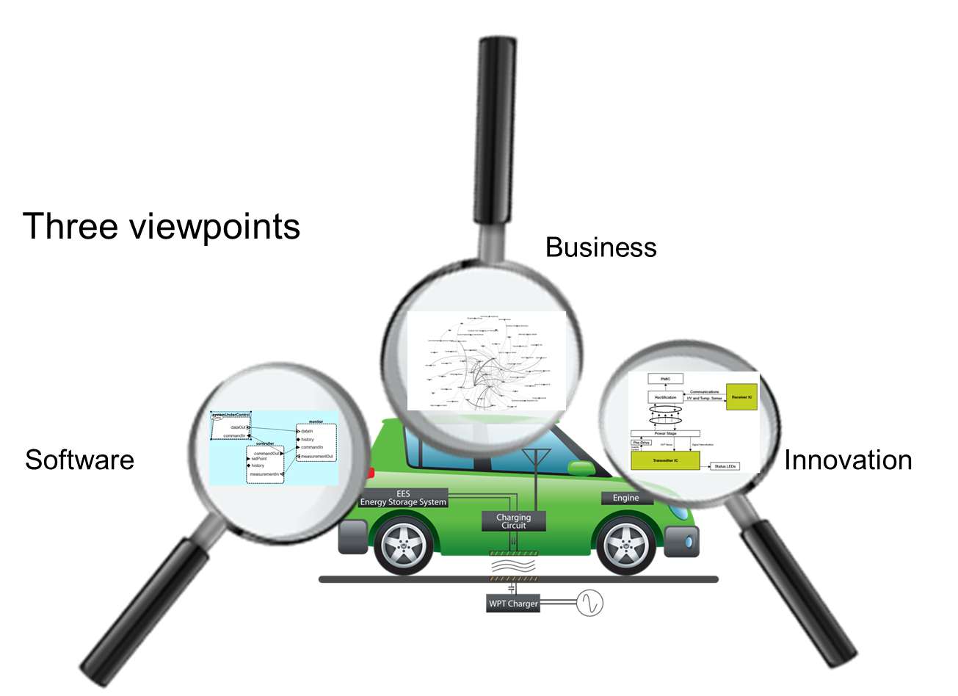
Model your ecosystem
Notes:
http://www.sei.cmu.edu/library/assets/presentations/mcgregor-saturn2013.pdf
Viewpoint – business
B2B connection views
Supply chain views
Viewpoint – software
Dependencies among products views
Software architecture view
Viewpoint – innovation
New feature proposal views
New business model views

Slide 23
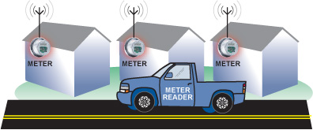
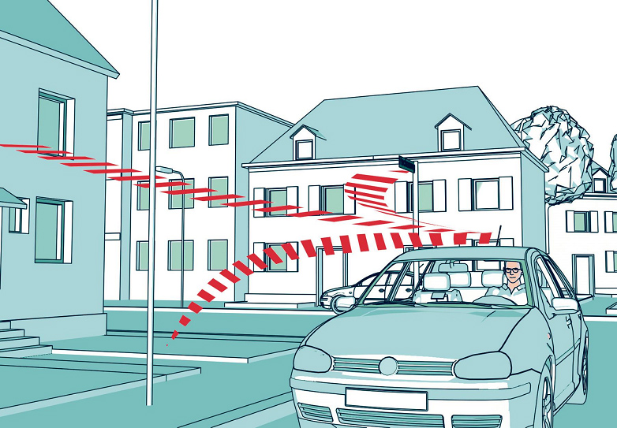
Emergent behavior in ecosystem
Savings on meter reading
Thief sees low level of activity on meter as indication you are away
Notes:
http://www.pcworld.com/article/2103143/how-the-internet-of-things-opens-your-home-to-cyber-threats.html
A criminal who can hack your smart metering utility system can identify when usage drops and assume that means nobody is home.
http://www.analog.com/library/analogdialogue/archives/43-01/smart_metering.html
http://www.enware.com.au/Mobile-Meter-Reading/default.aspx

Slide 24
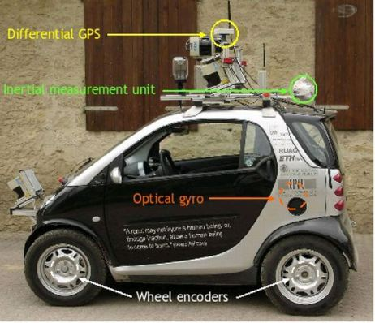
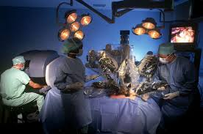
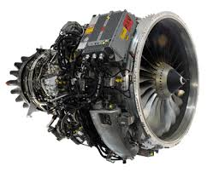
Architecture-based Safety Critical Development
Notes:
http://houseminority.wordpress.com/2012/01/19/ward-unveils-legislation-for-future-highway-safety-and-energy-conservation-driverless-cars/
http://www.whosm.com/robotic-surgery
http://www.safran-group.com/site-safran-en/aerospace/aerospace-propulsion/commercial-aircraft-engines/sam-146/

Slide 25
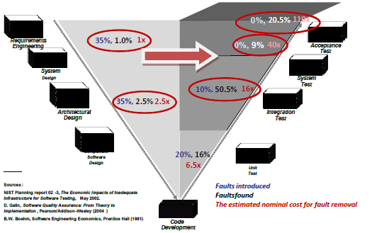
Where are defects injected and detected?

Slide 26

Need immediate feedback for short iterations

Slide 27
Architecture Analysis and Design Language (AADL) - 2
package Demo
public
with platform;
with Client;
with ServerType;
system DemoSystem
end DemoSystem ;
system implementation DemoSystem.impl
subcomponents
clientProcessor1 : processor platform::DefaultProcessor.impl ;
clientProcess1 : process Client::DefaultClientProcess.impl ;
clientMemory1 : memory platform::DefaultMemory.impl ;
clientBus1 : bus platform::DefaultBus.impl ;
serverProcessor1 : processor platform::DefaultProcessor.impl ;
serverProcess1 : process ServerType::DefaultServerProcess.impl ;
connections
connection1 : port clientProcess1.get -> serverProcess1.put {Latency=>5ms..9ms};
connection4 : bus access clientBus1 <-> clientMemory1.busAcc;
properties
Actual_Memory_Binding => (reference (clientMemory1 )) applies to clientProcess1 ;
Actual_Processor_Binding => (reference (clientProcessor1)) applies to clientProcess1.clientThread ;
Period => 120ms;
Compute_Execution_Time => 30ms .. 40ms;
Dispatch_Protocol => Periodic;
end DemoSystem.impl ;
end Demo;

Slide 28
Behavior Annex Example
thread implementation test . default
subcomponents
x : data Behavior : : integer ;
annex behavior specification{∗∗
states
s0 : initial final state ;
transitions
s0−[p in ? (x)]→s0{p out ! (x+1);};
∗∗};
end
test . default ;

Slide 29
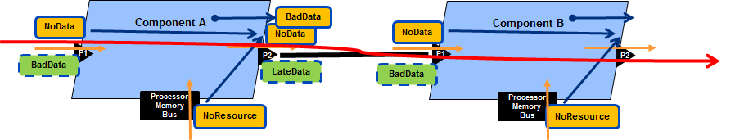
Error Flows
Error flows provide a basis for testing whether the system will do anything it is not supposed to do.
We can trace the propagation of an error to determine that it is handled appropriately.

Slide 30
Error Annex Example
annex Error_Model {**
error behavior Example
events -- both events will have mode-specific occurrence values for powered,unpowered
SelfCheckedFault: error event;
UncoveredFault: error event;
SelfRepair: recover event;
Fix: repair event;
states
Operational: initial state ;
FailStopped: state;
FailTransient: state;
FailUnknown: state;
transitions
SelfFail: Operational -[SelfCheckedFault]-> (FailStopped with 0.7, FailTransient with 0.3);
Recover: FailTransient -[SelfRepair]-> Operational;
UncoveredFail: Operational -[UncoveredFault]-> FailUnknown;
end behavior;
**};

Slide 31
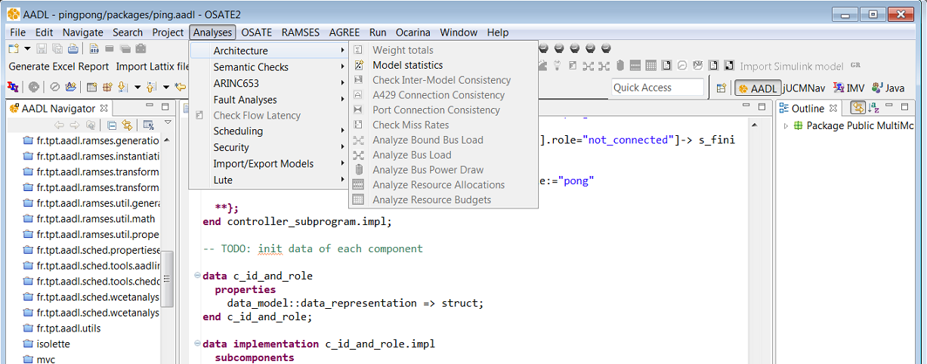
Open Source AADL Tool Environment (OSATE)

Slide 32
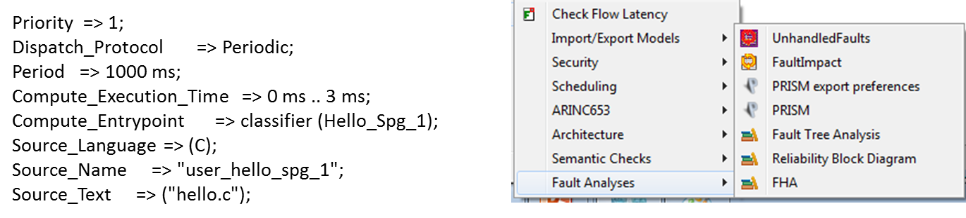
Properties can be simulated and evaluated

Slide 33
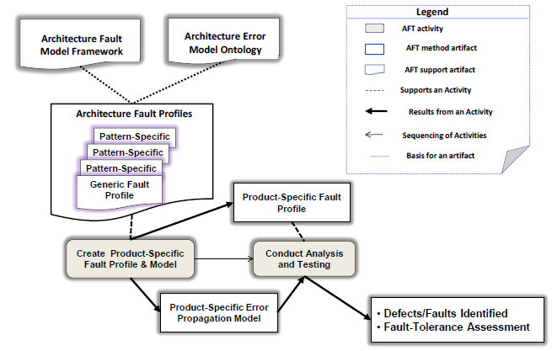
Architecture Focused Testing

Slide 34

Manage the software supply chain
“Failure to adequately manage and coordinate suppliers has led to major rework.”
A well-defined architecture provides clear interface specifications that guide suppliers.
The virtual integration approach supports the “Continuous” integration of models
http://www.boeing.com/commercial/aeromagazine/articles/2012_q1/3/
Notes:
http://www.forbes.com/sites/stevedenning/2013/01/21/what-went-wrong-at-boeing/
“Boeing sent hundreds of its engineers to the sites of various Tier-1, Tier-2, or Tier-3 suppliers worldwide to solve various technical problems that appeared to be the root cause of the delay in the 787′s development. Ultimately, Boeing had to redesign the entire aircraft sub-assembly process.”

Slide 35
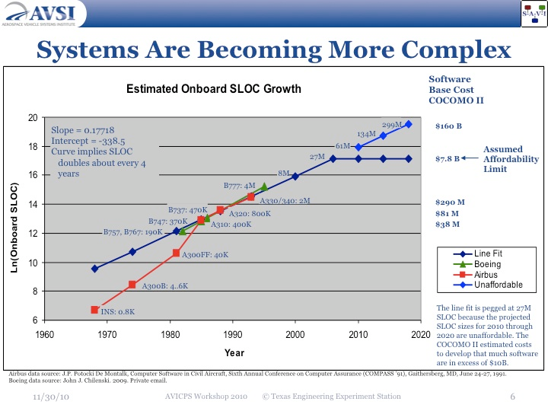
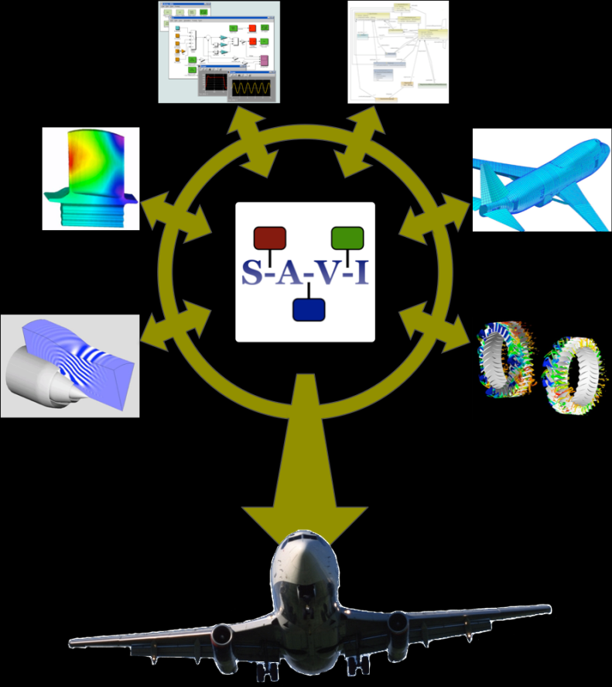
Integrate then Build
System Architecture Virtual Integration (SAVI)
Notes:
http://savi.avsi.aero/

Slide 36
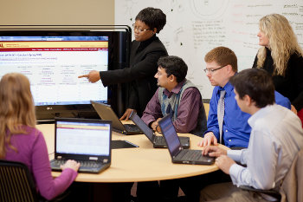
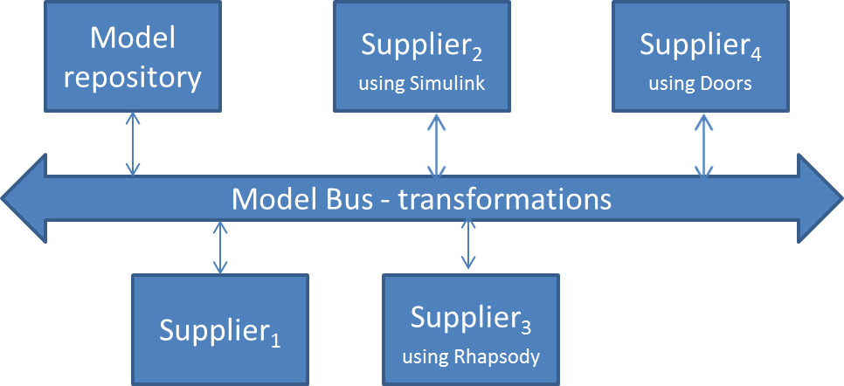
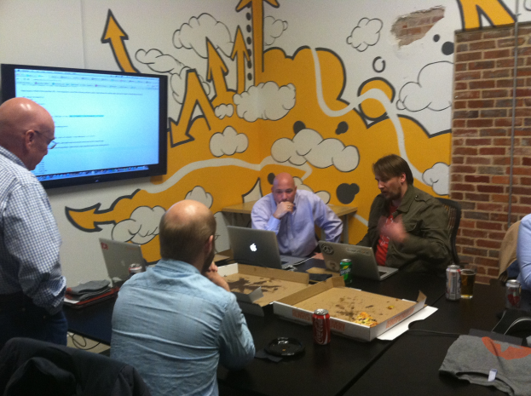
Distributed Model-driven Development
Single source of truth
Notes:
http://r.umn.edu/campus-resources/it/about/staff/web-software-development/
http://hellometa.com/denver-go-language-user-group/
All development groups check their work into the model repository

Slide 37
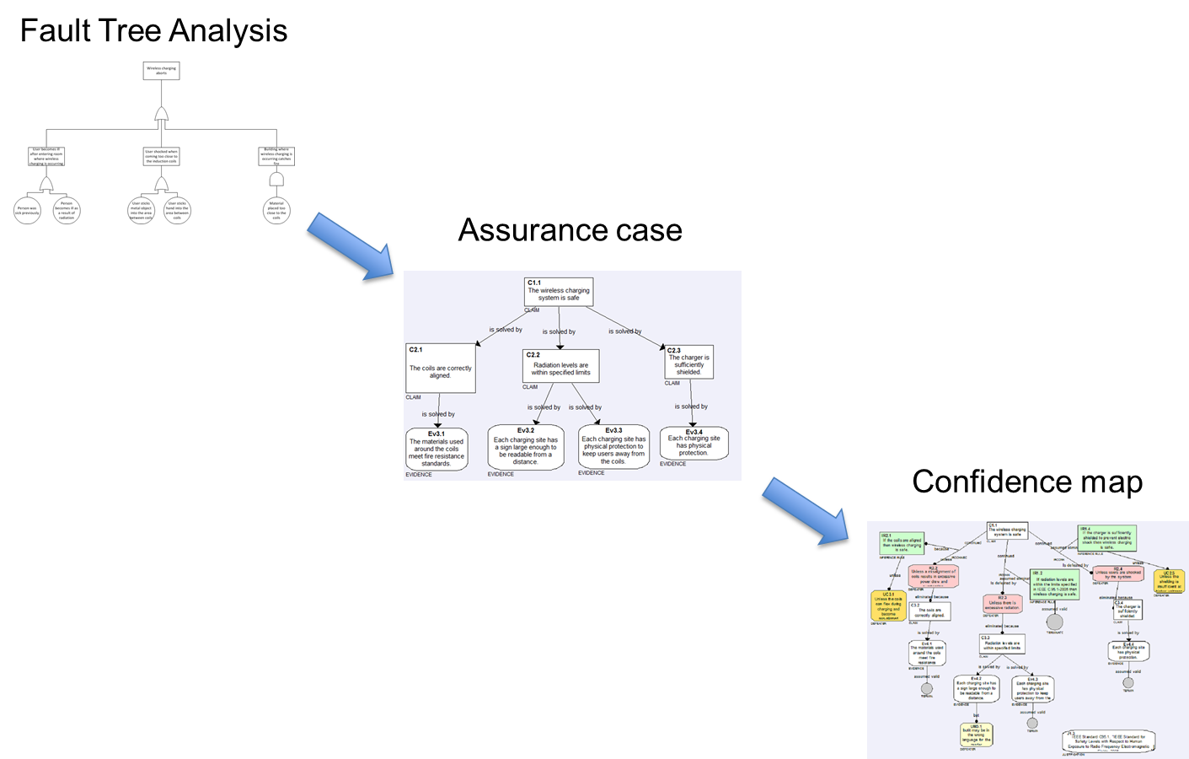
When testing alone simply won’t do

Slide 38

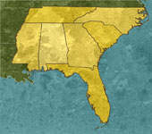
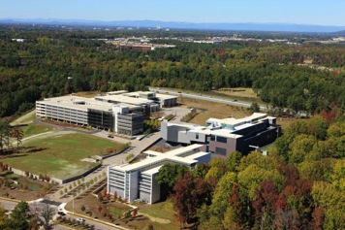


Clemson University International Center for
Automotive Research (CU-ICAR)
Charlotte
Atlanta
South Carolina’s economic development strategy is driven by a cluster
approach to improve competitiveness (inspired by Michael Porter from HBS).
The foundations of CUICAR (Clemson University International Center
for Automotive Research, www.cuicar.com) have been created in 2003
(ground breaking) to develop an Automotive cluster, the first campus
facility was built in 2005 (BMW ITRC).
CUICAR is the largest dedicated research campus focused on
automotive engineering research in the South East. So far more than
250 million USD have been invested in the public-private partnership.

Slide 39
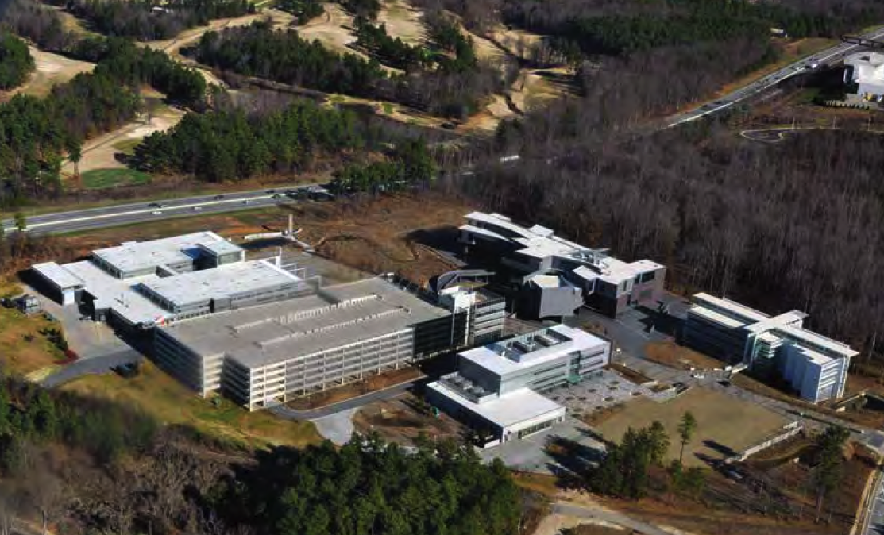
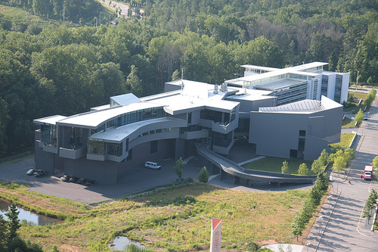
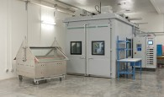
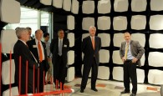
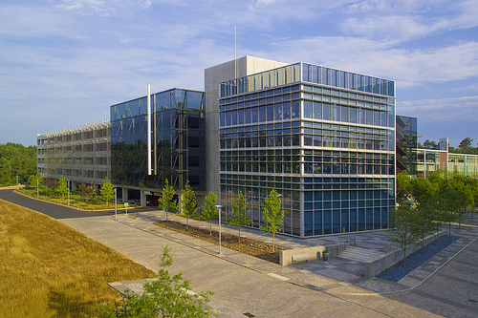



CU-ICAR campus development
www.cuicar.com

Slide 40



CU-ICAR fact sheet

Slide 41




South Carolina Technology and Aviation Center
SC-TAC is with 2’600 acres and
more than 80 companies one of the
largest industry parks in South Carolina
SC-TAC is a FAA certified airport with
an active 8’000 ft and a 5’000 feet
inactive runway (150 feet wide)
SC-TAC is closely located to CUICAR
www.sc-tac.com

Slide 42




The vision
R&D project centers
Conferences & events
Test track landscape
with unique infrastructure
Technology experience
The vision of Project Green is to redevelop a significant part of an inactive
airport structure (650 acres) into a national and internationally known center
for advanced mobility solutions which can be used for testing of vehicles
and related infrastructure, technology events as well as driving events.
A specific focus will be laid on clean transportation solutions as well as
connected vehicle technology. The center will be utilized by both public
and private stakeholders and will attract more industry R&D related activities
in transportation & logistics into the area. In particular the interaction between
vehicle development and infrastructure development (road, energy,
communication) will play a primary role in the further development of
Project Green.

Slide 43







Utilization of Project Green platform to
support sustainable mobility and connected vehicle research
Testing of vehicles and
related infrastructure
Testing of wireless networks
for the connected vehicle
Testing of energy transfer
infrastructure
Testing of autonomous and
remotely controlled
vehicles

Slide 44


Project Green – wireless charging test locations
Static & Quasi-Dynamic Wireless Charging Testing
Static Wireless Charging Testing
Dynamic Wireless Charging Testing
Quasi-Dynamic Wireless Charging Testing

Slide 45


