Slide 1

An Ultra-large Scale Perspective on Autonomous Vehicles
John D. McGregor
johnmc@clemson.edu

Slide 2
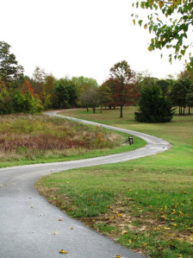
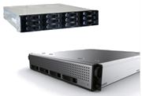
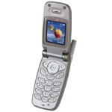
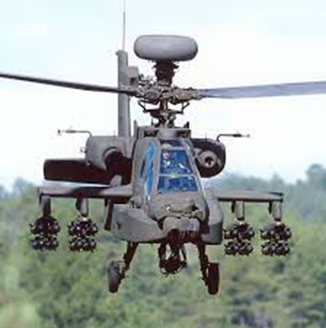
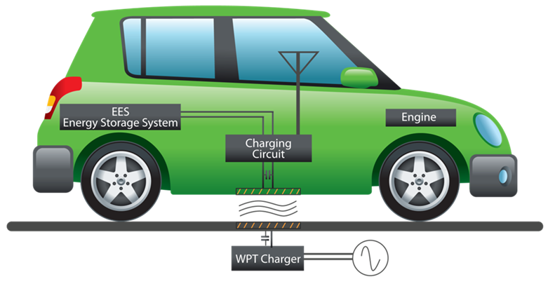
My background
Notes:
http://blogs.visaliatimesdelta.com/alternatingcurrents/2013/07/30/your-old-cell-phone-is-not-a-toy/

Slide 3
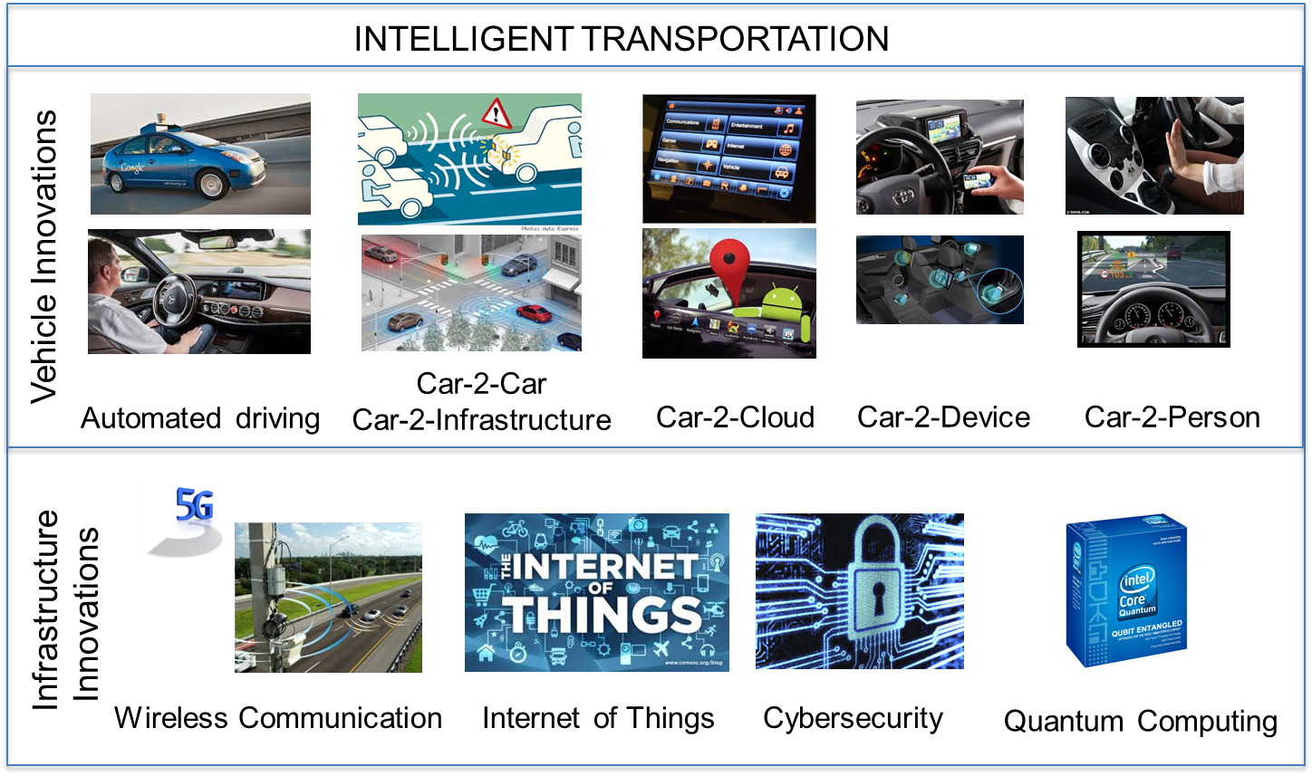
Motivation – disruptive technologies
Source: Dr. Joachim Taiber

Slide 4
Perspectives
Those disruptive technologies share one thing: an increased emphasis on software
But, are our software development practices sufficiently robust to take on routinely producing safety critical products?
Talk outline
ULS systems
Ecosystems
Safety critical system development
Clemson University’s ICAR

Slide 5

Ultra-large scale (ULS) systems
Scale changes EVERYTHING.
ULS systems are interdependent webs of software-reliant systems, people, policies, cultures, and economics.
Billions of lines of code
Millions of users
Notes:
An integrated health information system that ties together general practitioners with specialists, hospitals, drug stores, …
The Smart Grid
The Internet of Things
Connected, autonomous vehicles on a smart highway
What is different about such systems and how do we approach this scale of opportunity.

Slide 6
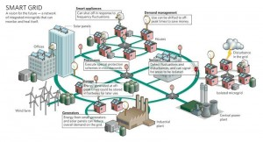

Ultra-large scale systems
Notes:
Smart grid
http://www.smartgrid2030.com/?page_id=445
Internet of Things
http://www.zdnet.com/the-internet-of-things-sizing-up-the-business-opportunities-7000009301/

Slide 7
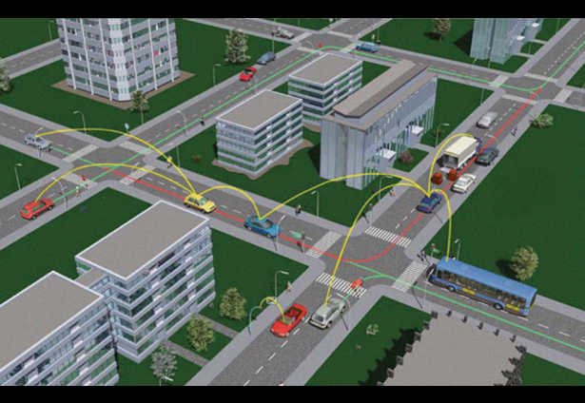
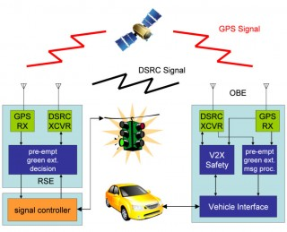
Ultra-large scale systems - 2
Notes:
http://connectedvehicle.challengepost.com/submissions/2892-connected-vehicle-intelligent-driver
http://phys.org/news/2010-10-smart-traffics-fuel-usage-emissions.html

Slide 8
Characteristics of ULS Systems
Decentralized
Conflicting, diverse, unknowable requirements
Continuous evolution
Heterogeneous elements
Erosion of people/system boundary
Failure as the norm
New paradigms for control and policy

Slide 9
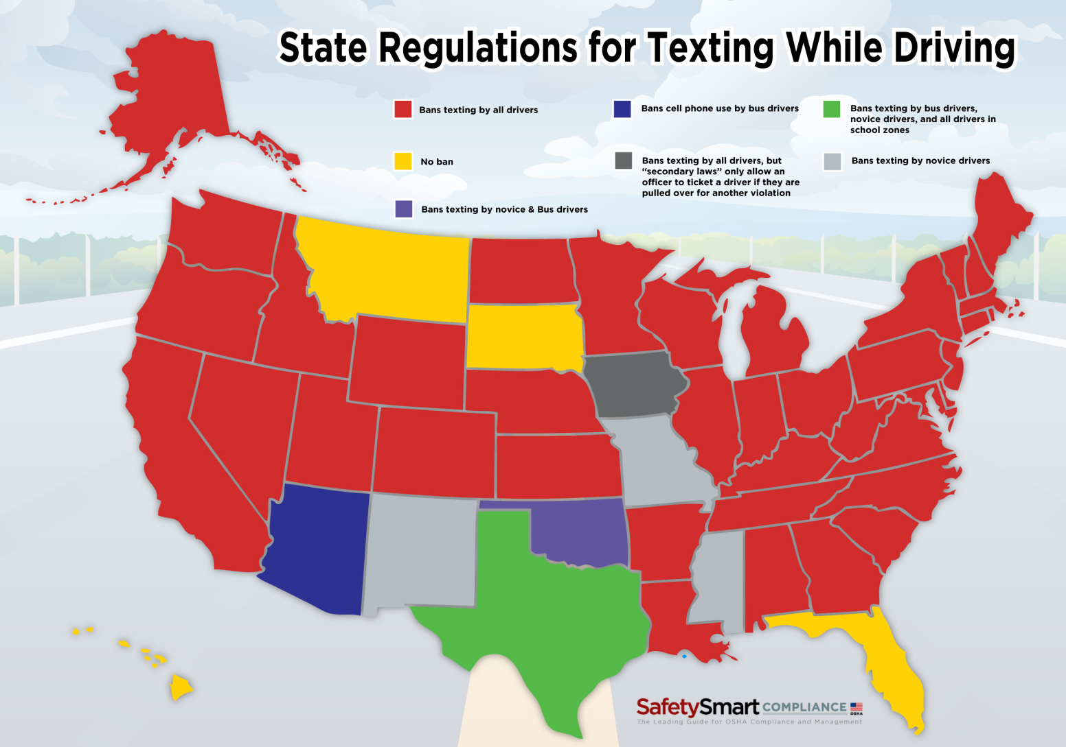
Decentralized – Laws about autonomous driving will evolve in many directions
Notes:
http://compliance.safetysmart.com/articles-insight/latest-headlines/infographic-state-by-state-laws-for-texting-while-driving
Similar innovations are made in many places at the same time
visionary leaders
Local management means local success
Local failure not equal
to global failure
Forces the use of
Innovation networks

Slide 10
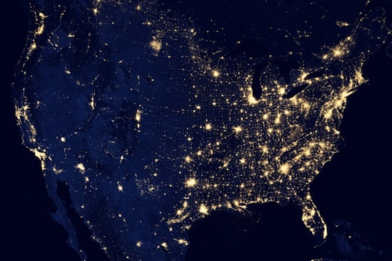
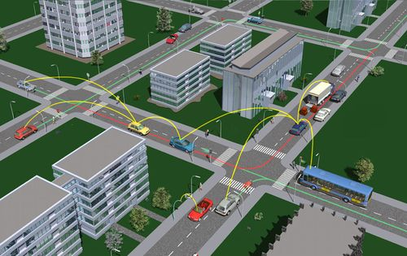
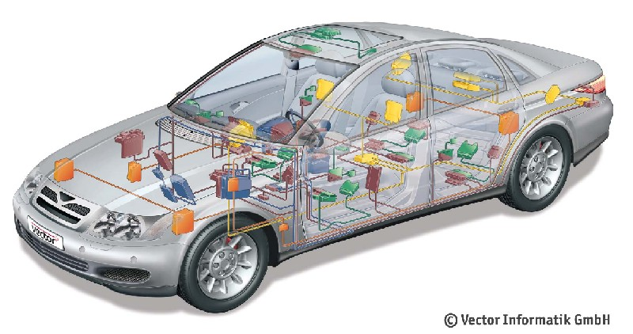
In-vehicle, V2V, V2I …
Vehicles connected via various protocols – WAVE 802.11p; multi-hop broadcast protocols
Notes:
http://people.sabanciuniv.edu/~onat/Files/NCS_intro.htm
http://www.car-to-car.org/
http://www.theverge.com/2012/12/29/3814720/the-census-dotmap-one-dot-for-every-person-living-in-us

Slide 11
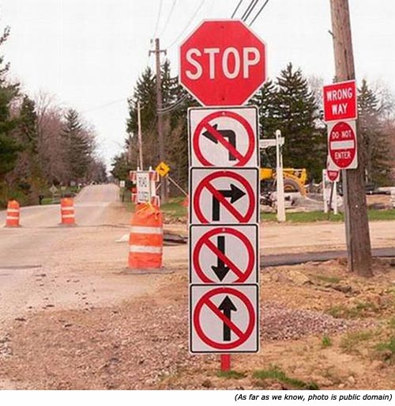
Conflicting, diverse, unknowable requirements – distracted driver regulations
Notes:
http://www.inspirational-quotes-short-funny-stuff.com/funny-traffic-signs.html
Isolated groups will make different assumptions
Not only will we solve the same problem differently we will solve different problems with different scopes
Static/dynamic charging
Autonomous/remote
controlled

Slide 12
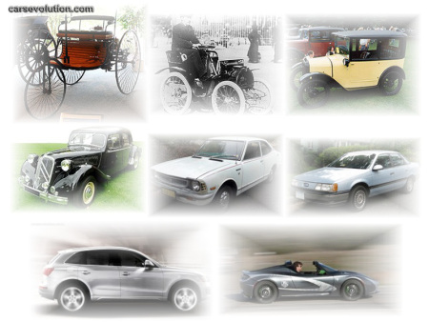
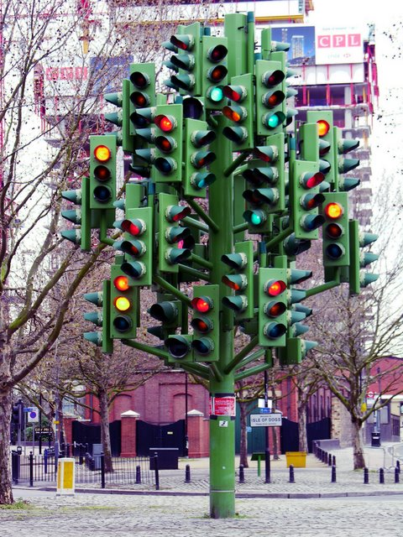
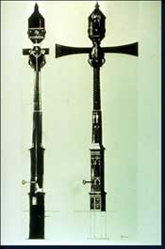
Continuous evolution – by the time one innovation has been propagated it is being replaced with a new idea
Product lines follow multiple evolutionary trajectories that operate at vastly different speeds across products and within product content.
Notes:
http://drivingintelligence.wordpress.com/driving-intelligence-defined/
http://www.trafficquagmire.com/2010/04/21/traffic-light-history/
http://www.techtransfer.berkeley.edu/newsletter/07-4/traffic_signals.php
Infotainment can
move faster than
powertrain.
Emergent design

Slide 13
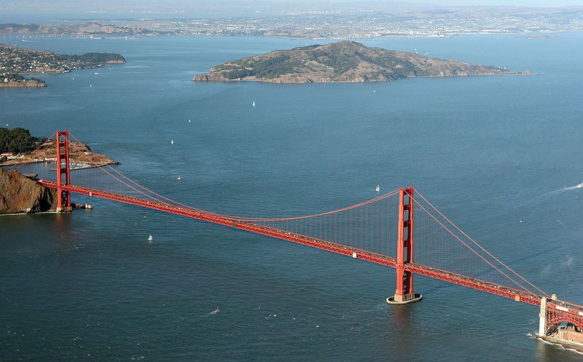
Continuous development
http://commons.wikimedia.org/wiki/File:Golden_Gate_Bridge_Aerial.jpg

Slide 14
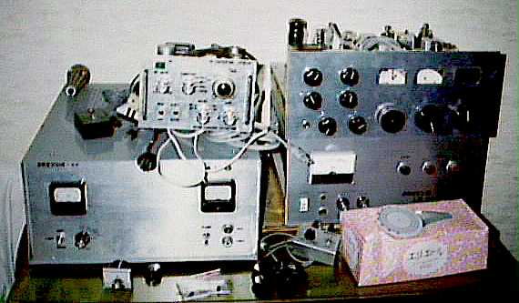
Heterogeneous elements – for a long time to come some vehicles will be only partially automated while others will have more automation
Notes:
http://www.reocities.com/Heartland/3641/homemade_english.html
A function performed by a traditional electro-mechanical system in one product may be handled by all software in another.

Slide 15

Erosion of people/system boundary
Function-specific Automation (Level 1)
Combined Function Automation (Level 2)
People are a part of the system with requirements as to how quickly they must react form here on.
Limited Self-Driving Automation (Level 3)
Full Self-Driving Automation (Level 4)
NHTSA.gov
Notes:
Nhtsa.gov

Slide 16
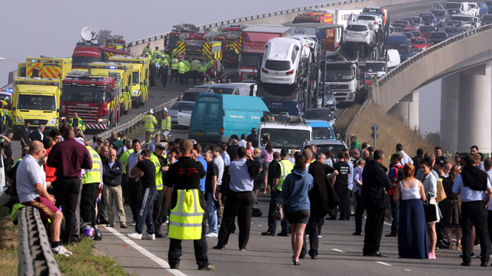
Failure as the norm, traffic signals fail, sensors fail, fault tolerance is essential
Notes:
http://www.theguardian.com/world/2013/sep/05/shepney-bridge-crash-100-vehicle
No, the rate of failures does not increase.
But the population explodes and the actual number of failures increases.
Failure may not ripple across the entire ULS but it will influence a wide area.
Failure must be localized since there is no central authority.

Slide 17

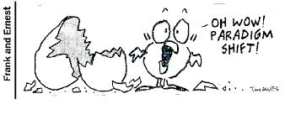
New paradigms for control and policy – might the car take control from an impaired driver?
Warning -> Assist -> Control
Notes:
http://sqt-fantasy-sci-fi-girl.blogspot.com/2010/04/autopilot.html
Airbus and Boeing have different policies about automation . It is the default on Airbus while the human pilot is the default for Boeing.

Slide 18
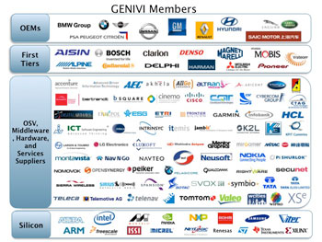
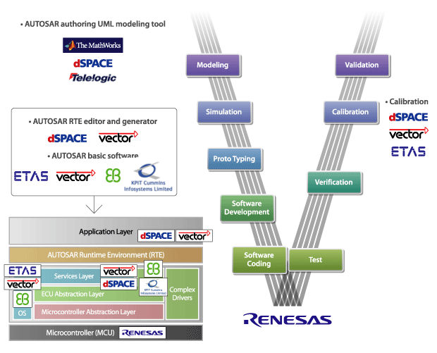
Socio-technical ecosystems
One way to think of ULS systems in a manageable manner is as a set of overlapping, interacting, socio-technical ecosystems.
A socio-technical ecosystem is an ecosystem whose elements are groups of people together with their computational and physical environments
Notes:
http://sg.renesas.com/applications/automotive/technology/autosar/index.jsp
The use of a platform strategy provides several benefits:[5]
Greater flexibility between plants (the possibility of transferring production from one plant to another due to standardization),
Cost reduction achieved through using resources on a global scale,
Increased use of plants (higher productivity due to the reduction in the number of differences), and
Reduction of the number of platforms as a result of their localization on a worldwide basis

Slide 19
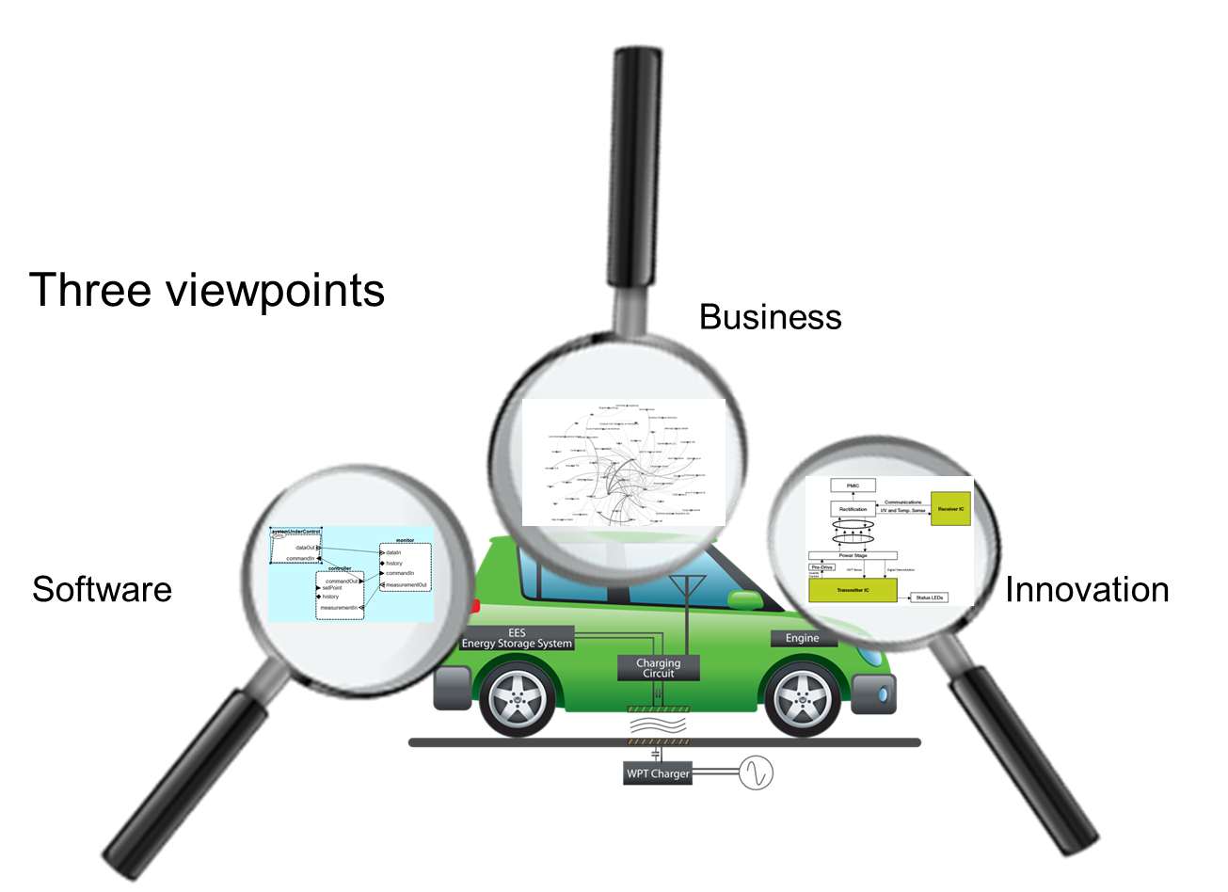
Capturing all aspects of the ecosystem
Notes:
http://www.sei.cmu.edu/library/assets/presentations/mcgregor-saturn2013.pdf
Collaborators, competitors, suppliers, buyers
Viewpoint – business
B2B connections
Supply chains
Viewpoint – software
Dependencies among products and versions of products
Software architecture view provides basis for variation management
Viewpoint – innovation
New feature proposals
New business models

Slide 20
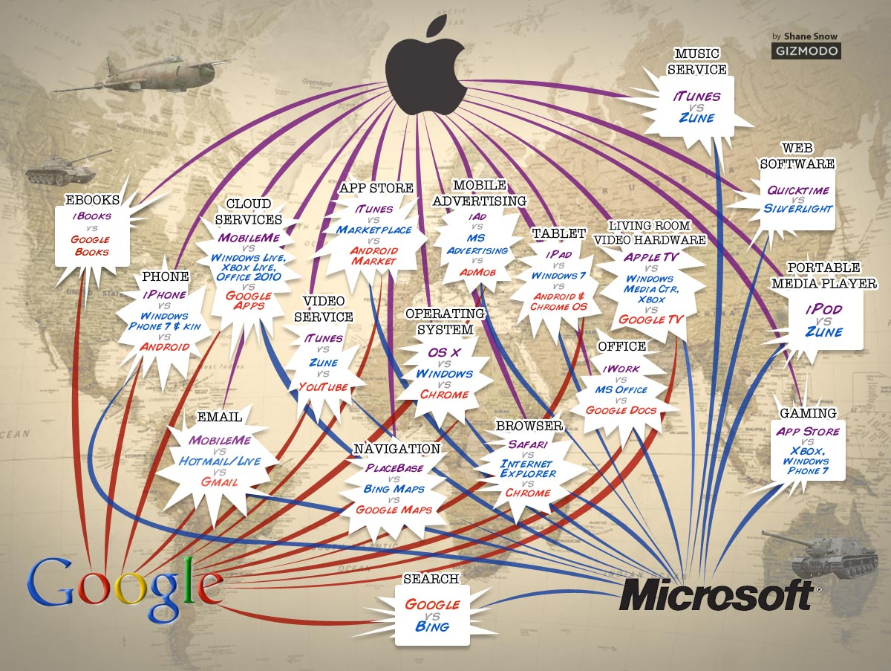
Which ecosystems to join is a strategic decision
Notes:
http://informationstrategyrsm.wordpress.com/2013/10/08/the-war-on-ecosystems/

Slide 21
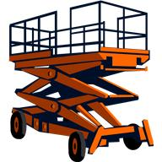
Platform Definition
A platform is a set of resources that give users of the platform a head start toward a completed product.
The resources usually include an architecture for some class of products including constraints and patterns, code assets, tools, and other items.
Notes:
The platform gives a head start on development through reuse but also increases the possibility of a single defect affecting multiple products.
The platform is the infrastructure beneath the “apps.” A different skill set is needed to create the platform from that needed to create apps.
The real-time embedded systems community will have to expand to have the capacity to produce the amount of software needed for automotive ecosystems.
This represents an evolution of the current automotive software ecosystem to a new ecosystem with different demands on quality.

Slide 22
Services of different levels of criticality
Safety critical infrastructure requires more rigor and abstraction than most apps,
But are more human centered than most current infrastructure.
Ecosystem evolution!
Clemson’s ICAR is a catalyst.
Notes:
A popular way of looking at the platform is as part of a continuum from Infrastructure as a service to Platform as a service to Software as a service.
The deeper you go the more essential the need for rigor.

Slide 23
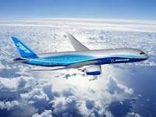
Boeing 787
Flight deck systems on several recent aircraft are “platforms” that support extensibility.
“This redundancy improves dispatch safety and reliability and also provides a platform for growth to support future air traffic initiatives”
http://www.boeing.com/commercial/aeromagazine/articles/2012_q1/3/
Notes:
http://www.boeing.com/commercial/aeromagazine/articles/2012_q1/3/
http://selair.selkirk.bc.ca/Training/systems/power-point/787Dreamliner.pdf
Carriker.5
Copyright © 2006 the Boeing Company
The Boeing Flight Deck Philosophy
•
Reduces costs in the long term but may raise costs in the short term (more testing for a more abstract interface)
Both crew members are ultimately
responsible for the safe conduct of
the flight
•
Flight crew tasks, in order of priority,
are: safety, passenger comfort,
and efficiency
•
Design for crew operations based
on pilots’ past training and
operational experience
•
Design systems to be error-tolerant
•
The hierarchy of design alternatives
is: simplicity, redundancy,
and automation
•
Both crew members are ultimately
responsible for the safe conduct of
the flight
•
Flight crew tasks, in order of priority,
are: safety, passenger comfort,
and efficiency
•
Design for crew operations based
on pilots’ past training and
operational experience
•
Moving to paperless operation

Slide 24
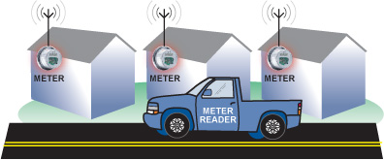
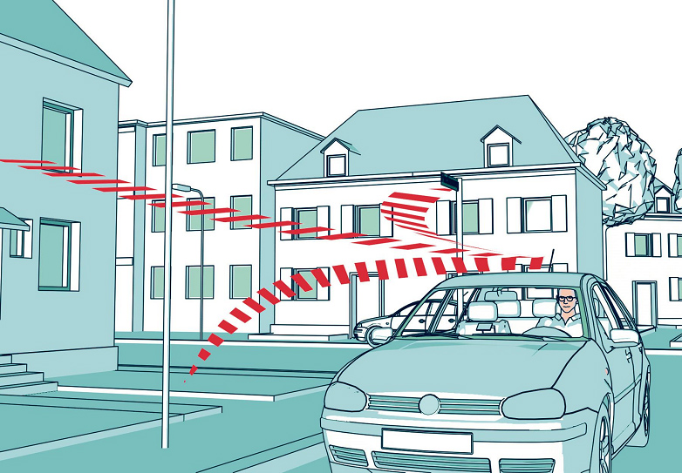
Emergent behavior in ecosystem
Savings on meter reading
Thief sees low level of activity on meter as indication you are away
Notes:
http://www.pcworld.com/article/2103143/how-the-internet-of-things-opens-your-home-to-cyber-threats.html
A criminal who can hack your smart metering utility system can identify when usage drops and assume that means nobody is home.
http://www.analog.com/library/analogdialogue/archives/43-01/smart_metering.html
http://www.enware.com.au/Mobile-Meter-Reading/default.aspx
“emergent behavior” is the unexpected behavior that emerges as a product is composed by interacting modules, some of which were not necessarily intended to work in this environment.

Slide 25
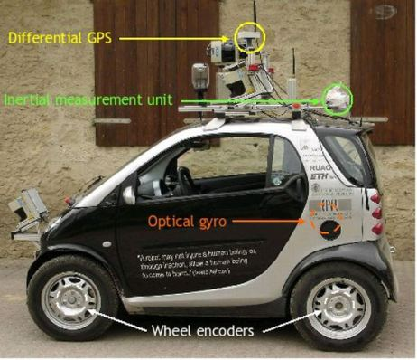
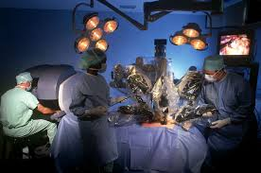
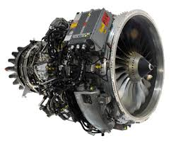
Architecture-based Safety Critical Development
Notes:
http://houseminority.wordpress.com/2012/01/19/ward-unveils-legislation-for-future-highway-safety-and-energy-conservation-driverless-cars/
http://www.whosm.com/robotic-surgery
http://www.safran-group.com/site-safran-en/aerospace/aerospace-propulsion/commercial-aircraft-engines/sam-146/

Slide 26
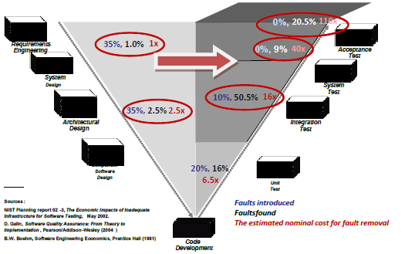
Where are defects injected and detected?

Slide 27

Need immediate feedback for short iterations

Slide 28
Architecture Analysis and Design Language (AADL) - 2
package Demo
public
with platform;
with Client;
with ServerType;
system DemoSystem
end DemoSystem ;
system implementation DemoSystem.impl
subcomponents
clientProcessor1 : processor platform::DefaultProcessor.impl ;
clientProcess1 : process Client::DefaultClientProcess.impl ;
clientMemory1 : memory platform::DefaultMemory.impl ;
clientBus1 : bus platform::DefaultBus.impl ;
serverProcessor1 : processor platform::DefaultProcessor.impl ;
serverProcess1 : process ServerType::DefaultServerProcess.impl ;
connections
connection1 : port clientProcess1.get -> serverProcess1.put {Latency=>5ms..9ms};
connection4 : bus access clientBus1 <-> clientMemory1.busAcc;
properties
Actual_Memory_Binding => (reference (clientMemory1 )) applies to clientProcess1 ;
Actual_Processor_Binding => (reference (clientProcessor1)) applies to clientProcess1.clientThread ;
Period => 120ms;
Compute_Execution_Time => 30ms .. 40ms;
Dispatch_Protocol => Periodic;
end DemoSystem.impl ;
end Demo;

Slide 29
Behavior Annex Example
thread implementation test . default
subcomponents
x : data Behavior : : integer ;
annex behavior specification{∗∗
states
s0 : initial final state ;
transitions
s0−[p in ? (x)]→s0{p out ! (x+1);};
∗∗};
end
test . default ;

Slide 30
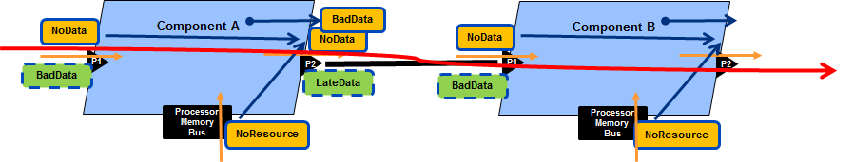
Error Flows
Error flows provide a basis for testing whether the system will do anything it is not supposed to do.
We can trace the propagation of an error to determine that it is handled appropriately.

Slide 31
Error Annex Example
annex Error_Model {**
error behavior Example
events -- both events will have mode-specific occurrence values for powered,unpowered
SelfCheckedFault: error event;
UncoveredFault: error event;
SelfRepair: recover event;
Fix: repair event;
states
Operational: initial state ;
FailStopped: state;
FailTransient: state;
FailUnknown: state;
transitions
SelfFail: Operational -[SelfCheckedFault]-> (FailStopped with 0.7, FailTransient with 0.3);
Recover: FailTransient -[SelfRepair]-> Operational;
UncoveredFail: Operational -[UncoveredFault]-> FailUnknown;
end behavior;
**};

Slide 32
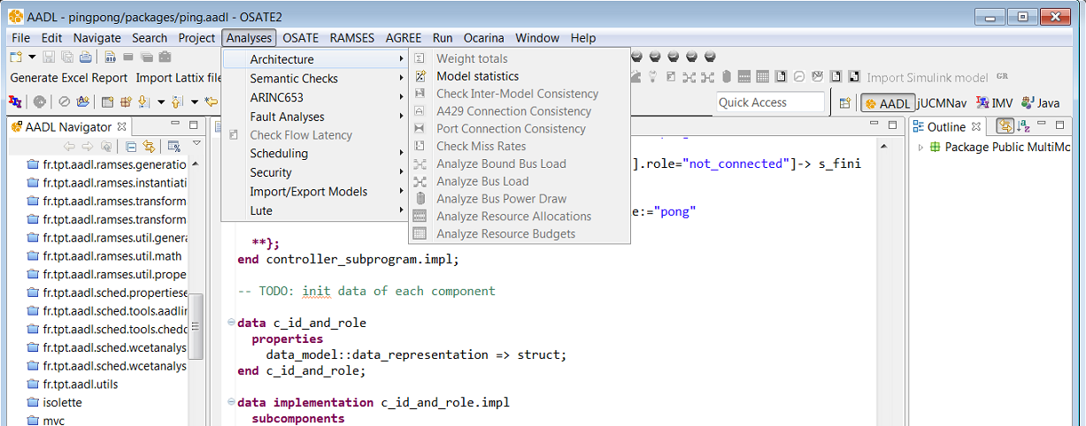
Open Source AADL Tool Environment (OSATE)

Slide 33
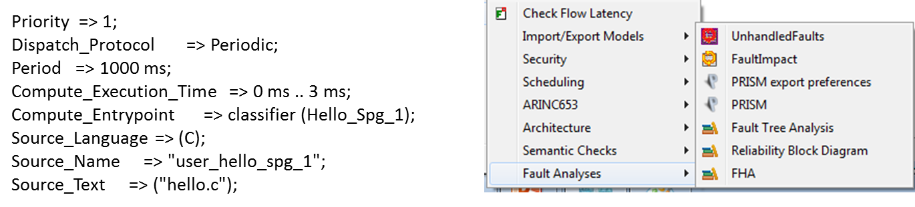
Properties can be simulated and evaluated

Slide 34
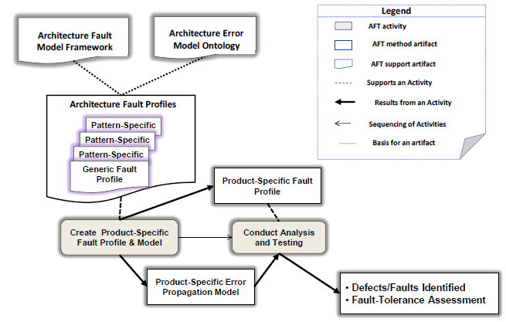
Architecture Focused Testing

Slide 35

Manage the software supply chain
“Failure to adequately manage and coordinate suppliers has led to major rework.”
A well-defined architecture provides clear interface specifications that guide suppliers.
The virtual integration approach supports the “Continuous” integration of models
http://www.boeing.com/commercial/aeromagazine/articles/2012_q1/3/
Notes:
http://www.forbes.com/sites/stevedenning/2013/01/21/what-went-wrong-at-boeing/
“Boeing sent hundreds of its engineers to the sites of various Tier-1, Tier-2, or Tier-3 suppliers worldwide to solve various technical problems that appeared to be the root cause of the delay in the 787′s development. Ultimately, Boeing had to redesign the entire aircraft sub-assembly process.”

Slide 36
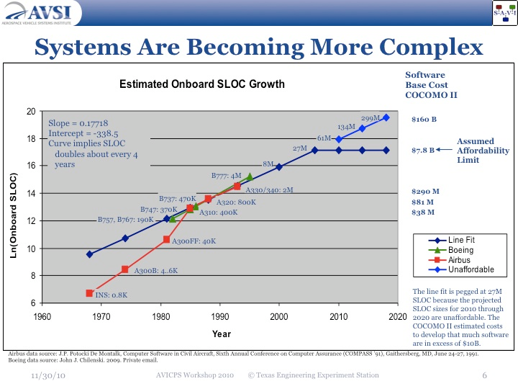
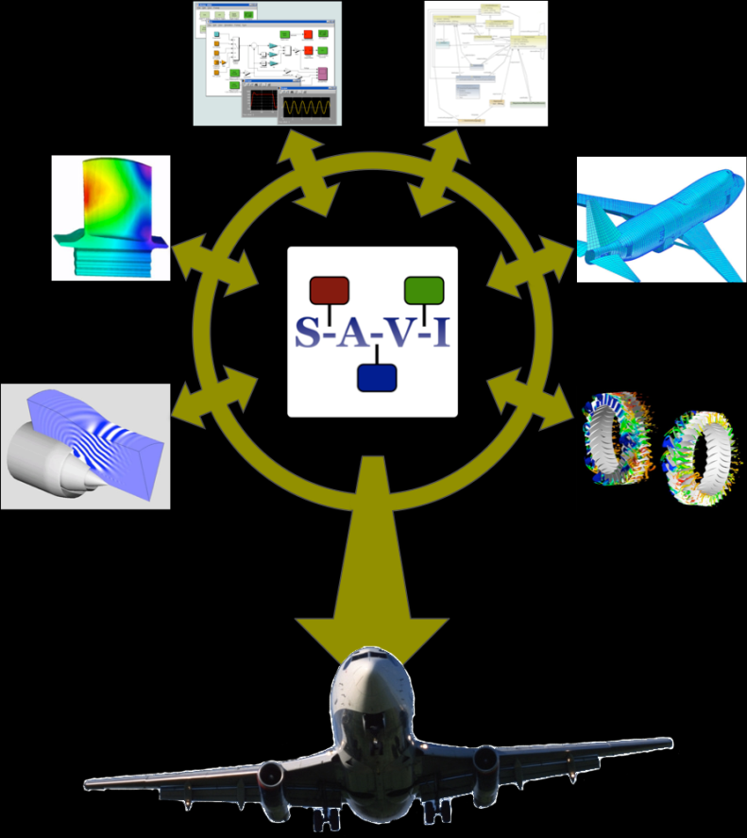
Integrate then Build
System Architecture Virtual Integration (SAVI)
Notes:
http://savi.avsi.aero/

Slide 37
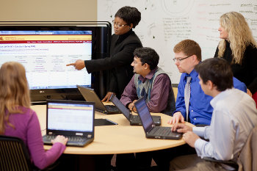
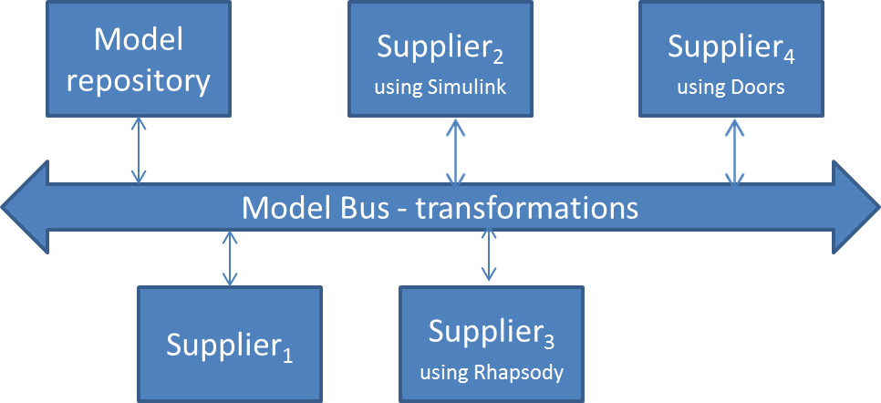
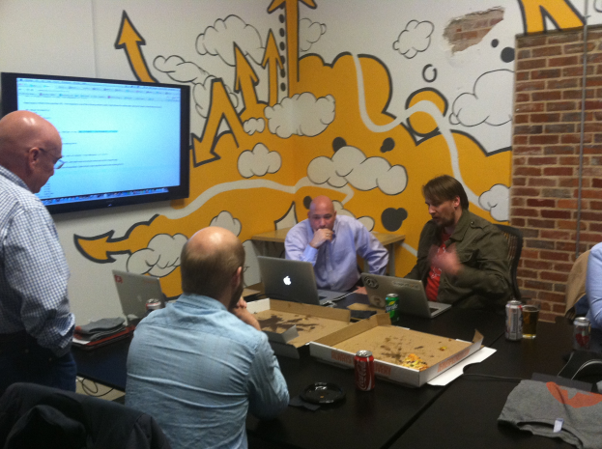
Distributed Model-driven Development
Single source of truth
Notes:
http://r.umn.edu/campus-resources/it/about/staff/web-software-development/
http://hellometa.com/denver-go-language-user-group/
All development groups check their work into the model repository

Slide 38
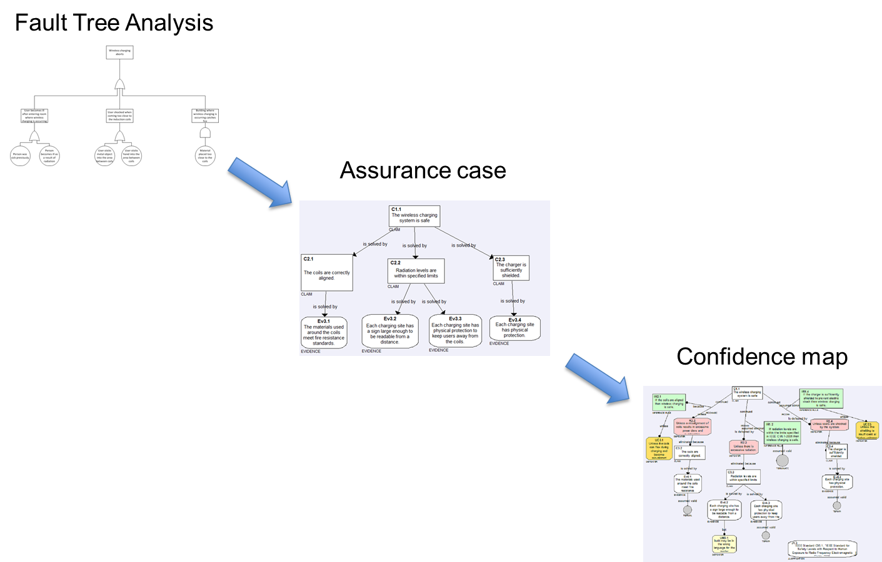
When testing alone simply won’t do

Slide 39
Testbed
Techniques such as these just shown have been validated in domains such as US Army helicopters but they must be validated for the more commercially competitive environment.
Clemson’s International Center for Automotive Research provides the environment in which such a validation can be accomplished.
Project Green is currently validating wireless charging technologies.

Slide 40

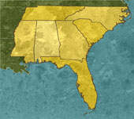
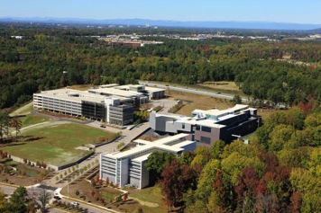



Clemson University International Center for Automotive Research (CU-ICAR)
Charlotte
Atlanta
South Carolina’s economic development strategy is driven by a cluster approach to improve competitiveness (inspired by Michael Porter from HBS).
The foundations of CUICAR (Clemson University International Center for Automotive Research, www.cuicar.com) have been created in 2003 (ground breaking) to develop an Automotive cluster, the first campus facility was built in 2005 (BMW ITRC).
CUICAR is the largest dedicated research campus focused on automotive engineering research in the South East. So far more than 250 million USD have been invested in the public-private partnership.

Slide 41
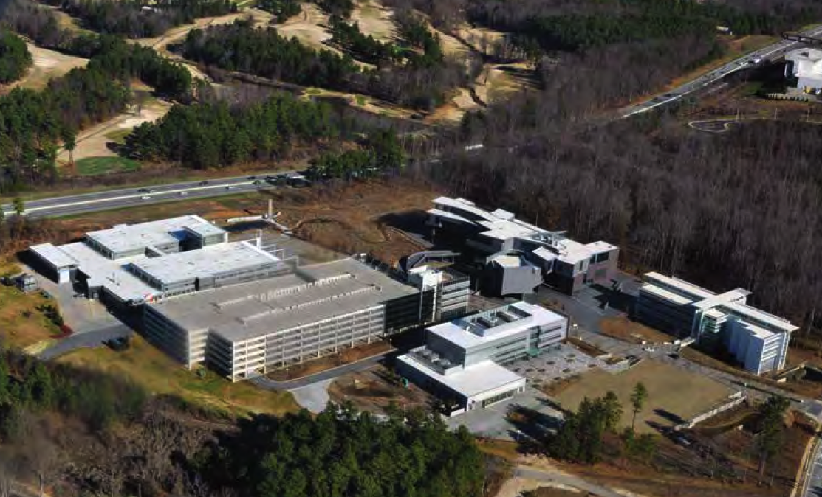
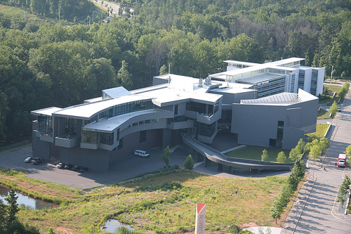
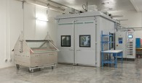
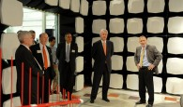
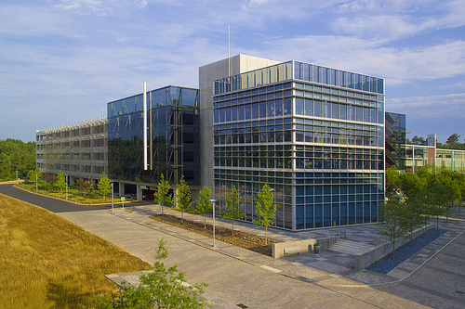



CU-ICAR campus development
www.cuicar.com

Slide 42



CU-ICAR fact sheet

Slide 43




South Carolina Technology and Aviation Center
SC-TAC is with 2’600 acres and more than 80 companies one of the largest industry parks in South Carolina SC-TAC is a FAA certified airport with an active 8’000 ft and a 5’000 feet inactive runway (150 feet wide) SC-TAC is closely located to CUICAR
www.sc-tac.com
Source: Dr.
Joachim Taiber

Slide 44




The vision
R&D project centers
Conferences & events
Test track landscape with unique infrastructure
Technology experience
The vision of Project Green is to redevelop a significant part of an inactive airport structure (650 acres) into a national and internationally known center for advanced mobility solutions which can be used for testing of vehicles and related infrastructure, technology events as well as driving events. A specific focus will be laid on clean transportation solutions as well as connected vehicle technology. The center will be utilized by both public and private stakeholders and will attract more industry R&D related activities in transportation & logistics into the area. In particular the interaction between vehicle development and infrastructure development (road, energy, communication) will play a primary role in the further development of Project Green.
Source: Dr. Joachim Taiber

Slide 45







Utilization of Project Green platform to support sustainable mobility and connected vehicle research
Testing of vehicles and related infrastructure
Testing of wireless networks for the connected vehicle Testing of energy transfer infrastructure Testing of autonomous and remotely controlled vehicles
Source: Dr. Joachim Taiber

Slide 46


Project Green – wireless charging test locations
Static & Quasi-Dynamic Wireless Charging Testing
Static Wireless Charging Testing
Dynamic Wireless Charging Testing
Quasi-Dynamic Wireless Charging Testing
Source: Dr. Joachim Taiber

Slide 47


