Slide 1

SYSE 802
John D. McGregor
Module 2 Session 2
Method Tailoring

Slide 2
Methods
A method for doing some activity can be divided into two parts
Content – how to do specific actions
Process – the order in which to do those activities
The Eclipse Process Framework (EPF) uses that split to build reusable, tailorable methods.
Each method plug-in has a method content section and a process section.

Slide 3
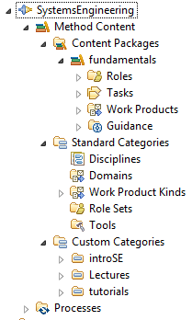
Methods - 2
The method content is divided into 4 parts as seen to the right.
The standard categories correspond to elements in the SPEM.
These categories are used to define new “types” of content so that concrete artifacts of that type can be handled in a type safe way.
The custom categories allow the user to group information for reuse.

Slide 4
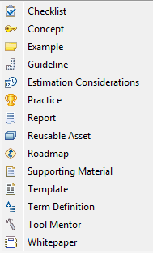
Methods - 3
Guidance includes numerous different types of information ranging from term definitions to best practices. These are attached to processes to guide the task performer.
This is the place where the expertise of the organization can be captured in a form that new employees or people assigned a new task can use to understand their responsibilities.

Slide 5

Methods - 4
The process section provides constructs to immediately define a process using work break down structures to relate tasks (defined in the method content section) to each other in specific orders.
There is also a “pattern” construct that allows a chunk of a process to be captured and then reused across multiple projects. For example, here is an analysis pattern.

Slide 6
Tailoring
Any large project has factors and influences that make it unique from other projects.
The processes for such a project need to be modified to address these unique factors.
The EPF makes this tailoring efficient.
The tailoring is not just changing the amount of time devoted to specific activities, it is a change in which activities are included.

Slide 7
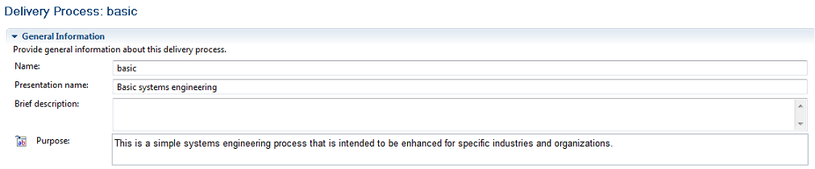
Tailoring - 2
A new process can be defined by composing method content.
I have defined a basic process, named basic
Note near the bottom are tabs for additional pages as shown here.

Slide 8
Hierarchy
The systems engineer is responsible for breaking down artifacts that overarch the project into smaller artifacts until the artifacts are of a size to assign to a single team.
This can be approached by using the team structure, the deliverables or the tasks.
In the next slides I will show how to do this using the tasks.

Slide 9
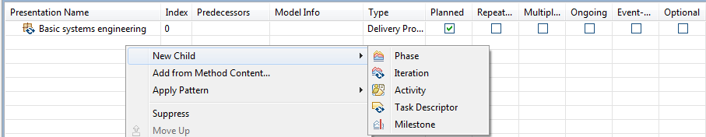
Workbreakdown structure (WBS)
Each entry in the WBS is one of the item types shown in the menu below.
Phases, iterations, and activities are shown in the order of decreasing scope and increasing detail.
A Task Descriptor links to a specific task.

Slide 10
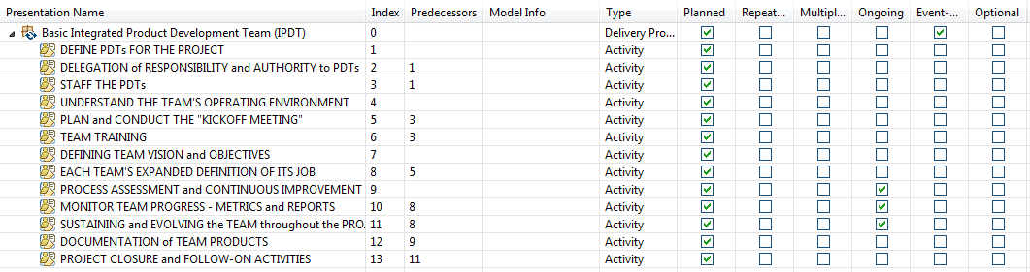
WBS
I have placed a partial order on the activities by adding predecessors
This process is kicked-off by an event – a charter being granted
Three of the activities are on-going rather than do it one time and done

Slide 11
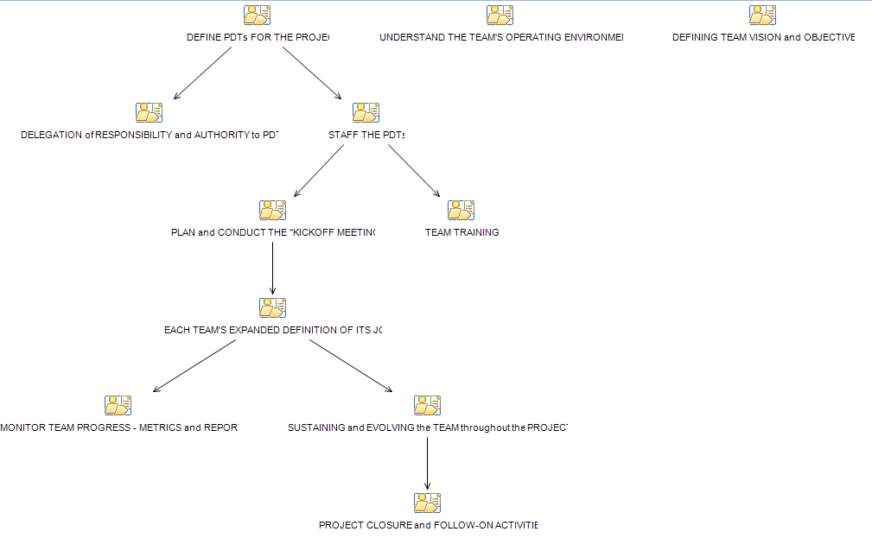
Activity diagram from WBS

Slide 12
Activity diagram
The activity diagram is automatically drawn by right clicking on the WBS page of the process definition.
It shows the possibilities for parallelism

Slide 13
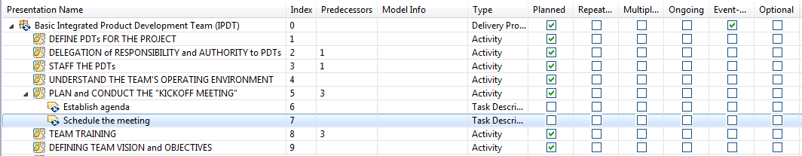
Hierarchy
SPEM defines a hierarchy that can be followed to decompose required actions.
Phases, iterations, activities, and tasks allow the systems engineer to decide
how deep to take the decomposition.

Slide 14
Metamodel
The underlying metamodel provides implicit relationships among elements of the process model.
A model that has properly linked content, i.e., roles, tasks, and workproducts, will automate some of the activities during process definition. The method author will be prompted about possible connections given existing relationships.
On the next slide you will the dialog opened when a role is added to an activity description.

Slide 15
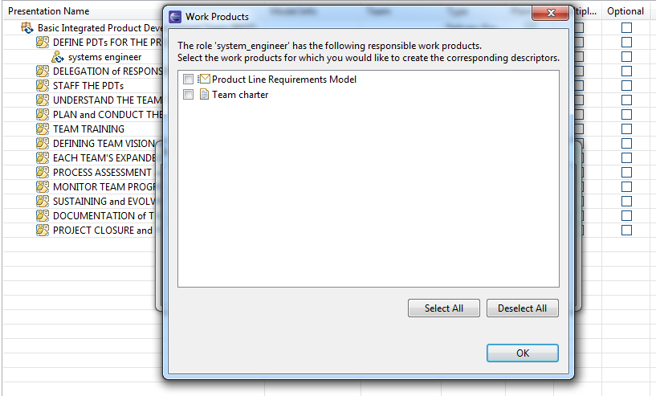

Slide 16
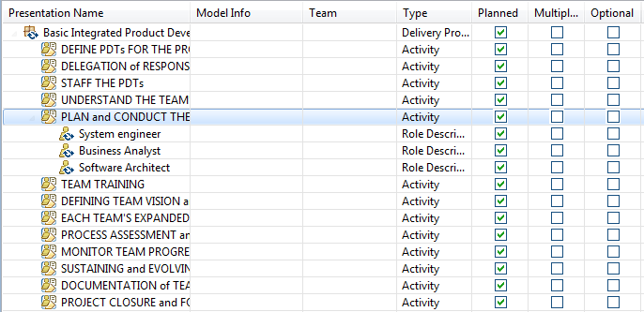
Team allocation
People assigned to activities are entered in the Team allocation view.

Slide 17
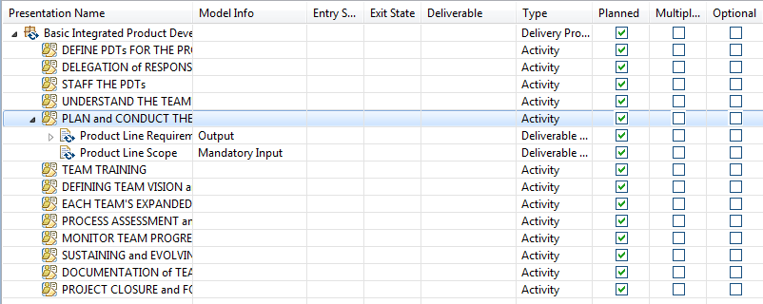
Work Products View
Work products required by the activities or produced by the activities are entered in the work products view.

Slide 18
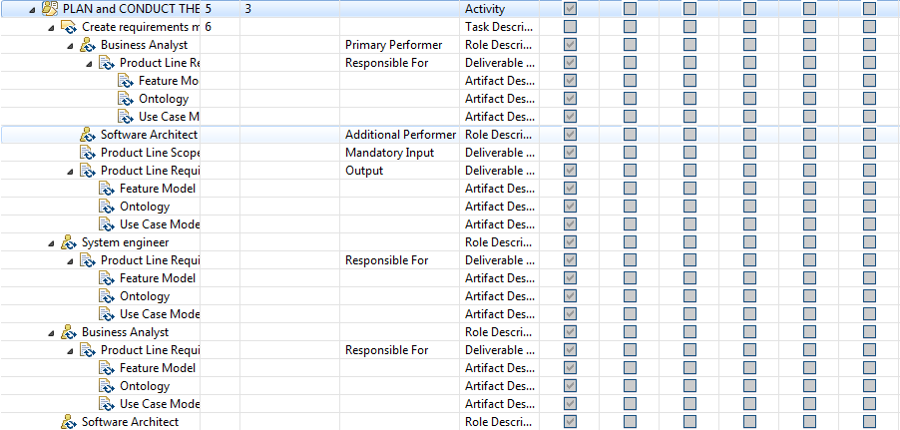
Consolidated view
The consolidated view rolls out all the dependencies among the elements.

Slide 19
Previously existing material
Remember that in your initial setup of EPF you imported a set of plug-ins.
There are a large number of definitions that have been started. Some contain a good bit of information and some are just place holders.
Also remember that for us to work together, do not make changes to those plug-ins. Only add pages and make changes to those pages you create in your plug-in which references mine.

Slide 20
Additional note
Much of the material in the imported EPF is based on a software product line approach.
We will dive into this later in the semester but for now:
Core assets are the reusable pieces that are used to implement products
Products are assembled from core assets with additional product-unique assets
Activities always anticipate multiple products

Slide 21
Summary
The systems engineer needs an easy means of tailoring processes to meet specific needs.
EPF allows the rapid definition of processes by composing method content elements.

