Slide 1

SYSE 802
John D. McGregor
Module 3 Session 2
AADL

Slide 2
AADL
The Architecture Analysis and Design Language (AADL) is a systems architecture description language
AADL is a standard of the Society of Automotive Engineers
We will use this language as representative of architecture description languages.
I have used this on projects such as a set of helicopters for the Army.

Slide 3
AADL - 2
The Software Engineering Institute (SEI) has done much to support the development and use of AADL.
The SEI has developed a toolset, OSATE, that supports developing architectural models using AADL. OSATE ships with Topcased.
Much information can be found on www.aadl.info

Slide 4
AADL intro
I suggest you read at least chapters 2, 3, and 4 in the tech report at this url to get an overview:
http://www.sei.cmu.edu/library/abstracts/reports/06tn011.cfm

Slide 5
Three classes of elements in AADL
1. application software
a. thread: a schedulable unit of concurrent execution
b. thread group: a compositional unit for organizing threads
c. process: a protected address space
d. data: data types and static data in source text
e. subprogram: callable sequentially executable code
2. execution platform
a. processor: components that execute threads
b. memory: components that store data and code
c. device: components that interface with and represent the external environment
d. bus: components that provide access among execution platform components
3. composite
a. system: a composite of software, execution platform, or system components

Slide 6
Basic pieces
Control and data flow through ports at the interface of each module (system in AADL syntax)
Determined by port type: event port, event data port, data port
pt1
A
System implementation S1.impl
ADL
Process P2
C1
flow path F5
C3
Connection
C5
Process P1
flow path F7
www.sei.cmu.edu

Slide 7
Port groups
Avionics System
A
ADL
A
Page Content
Manager
A
ADL
A
ADL
ADL
Warning Annunciation
Manager
Flight Manager
A
A
Display
Manager
ADL
ADL
A
Flight
Director
ADL
A
A
Weapons
Manager
ADL
ADL
A
A
A
ADL
Situation
Awareness
A
Comm.
Manager
ADL
ADL
ADL
A
ADL
G PS
Auto-Pilot
Nav Radio
www.sei.cmu.edu

Slide 8
Redundancy schemes
Passive Backup
Continuous State Exchange
Hot Standby
CSS1
A
CSS1 Primary
A
CSS1 Primary
A
ADL
ADL
ADL
SS1.1
SS1.1
SS1.1
State
SS1.2
SS1.2
SS1.2
A
CSS1 Backup
A
CSS1 Backup
ADL
ADL
Voted Output
SS1.1
SS1.1
A
CSS1
ADL
SS1.2
SS1.2
SS1.1
SS1.2
SS1.3
www.sei.cmu.edu

Slide 9
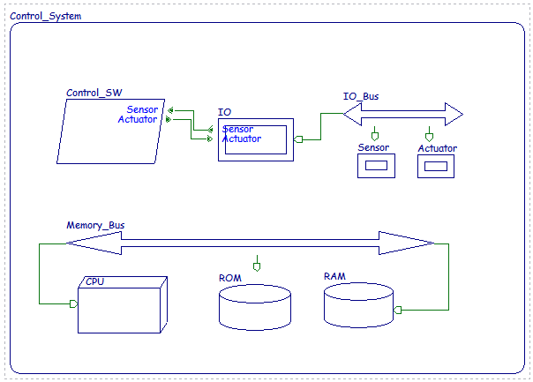
Operational system
SYSTEM Control_System
END Control_System;
SYSTEM IMPLEMENTATION Control_System.others
SUBCOMPONENTS
CPU : PROCESSOR CPU;
Memory_Bus : BUS Memory_Bus;
RAM : MEMORY RAM;
ROM : MEMORY ROM;
Control_SW : PROCESS Control_SW;
IO : DEVICE IO;
IO_Bus : BUS IO_Bus;
Sensor : DEVICE Sensor;
Actuator : DEVICE Actuator;
CONNECTIONS
EVENT DATA PORT Control_SW.Actuator -> IO.Actuator;
EVENT DATA PORT IO.Sensor -> Control_SW.Sensor;
BUS ACCESS Memory_Bus -> CPU.Memory_Bus;
BUS ACCESS Memory_Bus -> RAM.Memory_Bus;
BUS ACCESS Memory_Bus -> ROM.Memory_Bus;
BUS ACCESS IO_Bus -> IO.IO_Bus;
BUS ACCESS IO_Bus -> Sensor.IO_Bus;
BUS ACCESS IO_Bus -> Actuator.IO_Bus;
END Control_System.others;
Prespolei_r_04dec07_ellidiss_1J1kz7.ppt
www.ellidiss.com

Slide 10
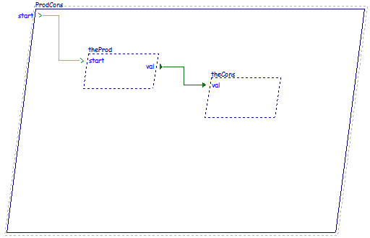
Connections
process implementation ProdCons.default
subcomponents
theProd: thread Prod.Impl;
theCons: thread Cons.Impl;
connections
EventConnection1: event port start -> theProd.start;
DataConnection1: data port theProd.val -> theCons.val;
end ProdCons.default;
Prespolei_r_04dec07_ellidiss_1J1kz7.ppt

Slide 11
Property set
property set Clemson is
MbitPerSec : type units (MPS, GPS => MPS*1000);
Band_width: type aadlinteger units Clemson::MbitPerSec;
Radio_band_width: Clemson::Band_width applies to (all);
Band_width_802_11g: constant Clemson::Band_width => 54 MPS;
Band_width_802_11n: constant Clemson::Band_width => 300 MPS;
Band_width_fast_ethernet: constant Clemson::Band_width => 100 MPS;
end Clemson;

Slide 12
Use of Property Set
package infoSys
public
system Infotainment
features
radio : requires bus access;
end Infotainment;
system implementation Infotainment.basic
properties
Clemson::Radio_band_width => value (Clemson::Band_width_802_11g) applies to radio;
end Infotainment.basic;
end infoSys;

Slide 13
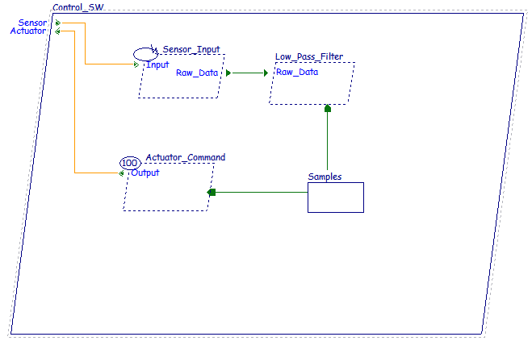
Real time
PROCESS Control_SW
FEATURES
Sensor : IN EVENT DATA PORT T_Flow;
Actuator : OUT EVENT DATA PORT T_Flow;
END Control_SW;
PROCESS IMPLEMENTATION Control_SW.others
SUBCOMPONENTS
Sensor_Input : THREAD Init;
Low_Pass_Filter : THREAD Low_Pass_Filter;
Actuator_Command : THREAD Actuator_Command;
Samples : DATA Samples;
CONNECTIONS
EVENT DATA PORT Sensor -> Sensor_Input.Input;
EVENT DATA PORT Actuator_Command.Output -> Actuator;
DATA PORT Sensor_Input.Raw_Data -> Low_Pass_Filter.Raw_Data;
DATA ACCESS Samples -> Low_Pass_Filter.Samples;
DATA ACCESS Samples -> Actuator_Command.Samples;
END Control_SW.others;
THREAD Actuator_Command
FEATURES
Output : OUT EVENT DATA PORT T_Flow;
Samples : REQUIRES DATA ACCESS Samples;
PROPERTIES
Dispatch_Protocol => Periodic;
Period => 100 ms;
END Actuator_Command;
Prespolei_r_04dec07_ellidiss_1J1kz7.ppt

Slide 14
Simulation
AADL can describe a completely bound system
One that has a complete hardware description as well as software so that a system can be “executed” to the degree of accuracy of the architectural design.

Slide 15
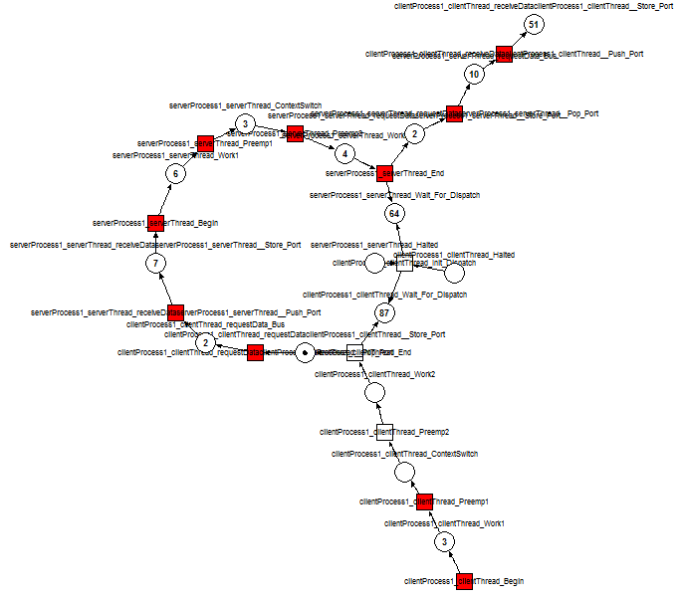
Simulation
Ocarina, a set of plug-ins for Eclipse converts AADL code into timed petri nets.
Existing petri net simulators execute the net by firing tokens and traversing all places in the net.
These executions determine whether the system defined by the AADL code could achieve live lock or dead lock.
www.sei.cmu.edu

Slide 16
AADL Tutorials
http://ebooks-online24.com/download/AADL-ppt-38.html
http://www.aadl.info/aadl/documents/AADLpattern82004.pdf
http://people.cs.kuleuven.be/~stefan.vanbaelen/public_html/deptcw/ACES-MB/2009/ACES-MB11.pdf
https://wiki.sei.cmu.edu/aadl/images/7/78/Vogl_Hecht_Lam_Aerotech_09.pdf

