Slide 1

SYSE 802
John D. McGregor
Module 10 Session 1
Human Systems Engineering

Slide 2
Session Objective
To develop an understanding of basic principles of Human Factors in product design

Slide 3
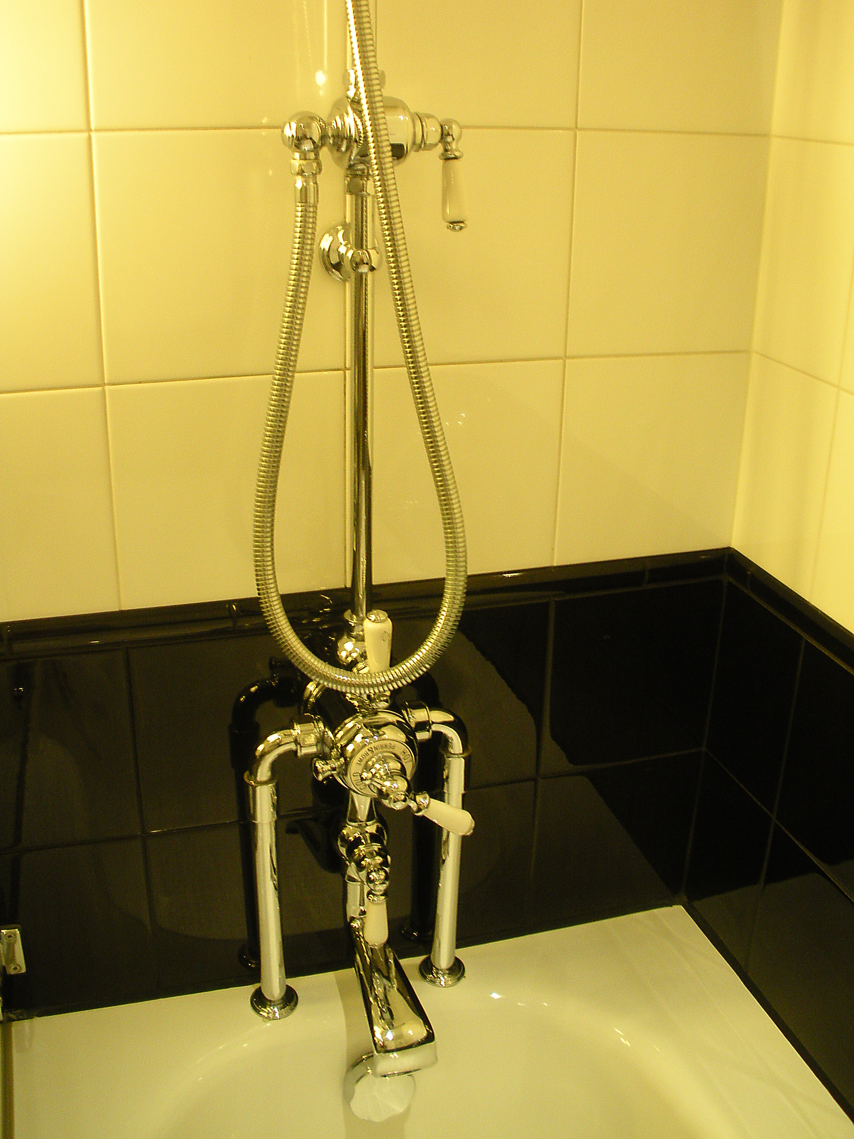
Shower at my London hotel
The idea is to control water flow to three
outlets: the main faucet into the tub, a
handheld spray nozzle, and a fixed rain
forest nozzle, D.
A turns on the water; B sets the temperature
of the water. When C is in the position
shown the water only comes out of the main
faucet, but once it is turned so that water
comes out of the handheld turning A to the
off position no longer turns off the water.
C must be turned back to its original position
in order for A to control the flow.
There may be other stateful behavior but I
was only there three nights.
D
C
B
A

Slide 4
Definitions
Human factors engineering is the discipline that studies human-system interfaces and interactions and provides requirements, standards, and guidelines to ensure the entire system can function as designed with effective accommodation of the human component [NASA SE Handbook].
http://www.hf.faa.gov/docs/508/docs/cami/0117.pdf
There are several urls in this module. They are just in case you want more information.
The SE allocates responsibilities to hardware, software, and humans. This module is about the case when the allocation is made to the human.

Slide 5
What happens?
In early 2001, Microsoft suffered a nearly 24-hour outage in its Web properties as a result of a human error made while configuring a name resolution system.
Later that year, an hour of trading on the Nasdaq stock exchange was disrupted because of a technician’s mistake while testing a development system.

Slide 6
What happens? - 2
Three Mile Island
March 28th, 1979
Main feedwater pump failure, caused reactor to shut down
Relief valve opened to reduce pressure but became stuck in the open position
No indication to controllers
Valve failure led to a loss of reactant coolant water
No instrument showed the coolant level in the reactor
Operators thought relief valve closed & water level too high
High stress
– Overrode emergency relief pump

Slide 7
What happens? - 3
System worked as designed, automation worked correctly
Confirmation bias: people seek out information to confirm a prior belief and discount information that does not support this belief
Operators selectively filtered out data from other gauges to support their hypothesis that coolant level was too high

Slide 8
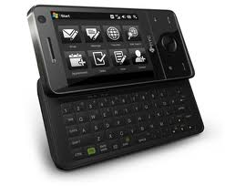
Human factors
This is the design discipline that maps the capabilities, biases, and limitations of humans into the system design.
For example, unless you are a thirteen year old girl this is an unacceptable keyboard for rapid, accurate data entry.

Slide 9
More “ilities”
We have talked about a variety of quality attributes that drive architecture design.
For the displays that are part of a product here are some more related to humans:
Visibility
Conspicuousness: Ability to attract attention and distinguishability from background interference and distraction
Legibility
Interpretability: Meaningfulness to the intended observer within the environment

Slide 10
Functional allocation
Task analysis
Design for maintainability
Hardware and software design
Usability testing
Human reliability engineering
Devices

Slide 11
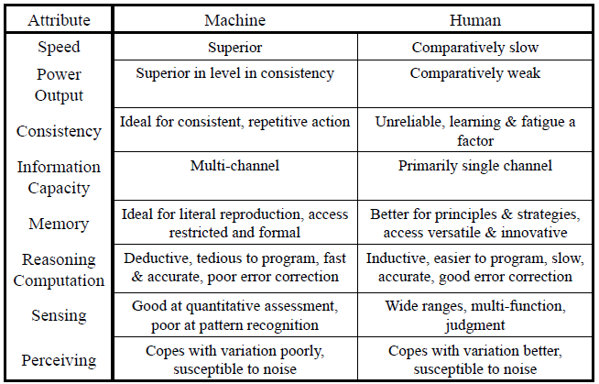
Functional allocation
Hollnagel, 2000

Slide 12
Adaptability
A human can adapt to a new situation much more rapidly than a system revision can be deployed
In a changing environment allocate to humans those things that are least stable.

Slide 13
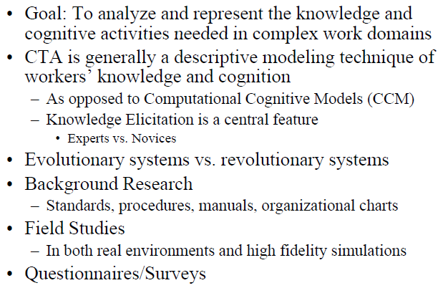
Cognitive Task Analysis

Slide 14
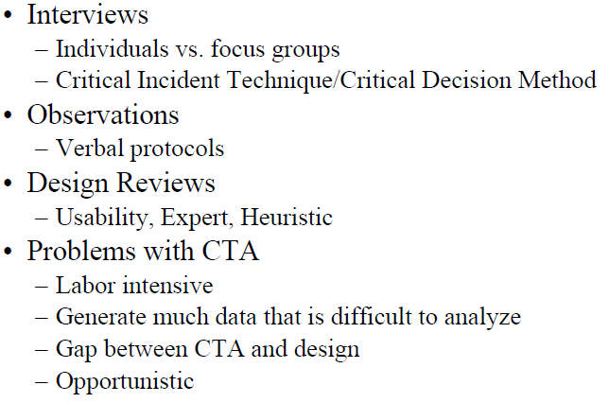
Cognitive Task Analysis - 2

Slide 15
Design for maintainability
Goals of Designing for Maintainability - The following are goals for optimizing crew involvement in both preventive and corrective maintenance.
1. Reduce training requirements of crew.
2. Reduce certain skill requirements of crew.
3. Reduce time spent on preventive and corrective maintenance.
4. Increase maintenance capabilities during mission (especially corrective maintenance).
Corrective Maintenance - The following factors should be considered when designing for corrective maintenance tasks.
1. The benefit gained from repair should be worth the time and effort expended on repair.
2. The time and effort involved in corrective maintenance should be weighed against the cost and feasibility of carrying replacement units.
3. Required calibration, alignment, or adjustment should be easily and accurately accomplished.
4. Automate fault detection and isolation tasks whenever possible.
http://www.hq.nasa.gov/office/codeq/87291.pdf

Slide 16
Design for maintainability - 2
a. Growth and Update - Facilities, equipment, and software design shall allow reconfiguration and growth during the mission.
b. Independence - Systems and subsystems shall be as functionally, mechanically, electrically, and electronically independent as practical to facilitate maintenance.
c. Maintenance Support Services - Maintenance support services ( e.g., electrical outlets) shall be accessible at potential problem locations or at a designated maintenance location.
d. Reliability - Equipment design shall reduce to a minimum the incidence of preventive and corrective maintenance.
e. Simplicity - Equipment design shall minimize maintenance complexity.
f. Time Requirements - Equipment design shall minimize the time requirements for maintenance.
g. Equipment - Maintenance equipment and tools shall be kept to a minimum.
h. Hazardous Conditions - System design shall preclude the introduction of hazardous conditions during maintenance procedures.
i. Critical Operations - Critical systems shall be capable of undergoing maintenance without the interruption of critical services and shall be maintained.
j. Non-Critical Operations - Non-critical systems shall be designed to operate in degraded modes while awaiting maintenance. Degraded mode operation shall not cause additional damage to the system or aggravate the original fault.
k. Redundancy Loss - Notification of loss of operational redundancy shall be provided immediately to the crew

Slide 17
Design for maintainability - 3
m. Plug-In Installation - Plug-in type hardware installation and mounting techniques shall be employed.
n. Quick Release Fasteners - Quick release fasteners shall be used where consistent with other requirements (e.g., strength, sealing).
o. Replacement Capabilities - Capacity of replaceable or reserviceable items (filters, screens, desiccant units, battery power supplies, etc.) shall be higher than the minimum functional requirements of the system.
p. Automation - Fault isolation, inspection, and checkout tasks shall be automated to the extent practical.
q. Restraints - Personnel and equipment mobility aids and restraints shall be provided to support maintenance.
r. Special Skills - Maintenance requiring special skills shall be minimized.
s. EVA - Maintenance requiring EVA shall be minimized.
t. Soldering, Welding, and Brazing - Soldering, welding, brazing, and similar operations during maintenance shall be minimized.

Slide 18
Man Machine Interface Design Principles
Feedback to user - signal that selection has been made
The user should be in control – no situation where the user can not abort an action
Predictability – avoid modes that change the action invoked by an input
Transparency – the user can “see” what is happening
Never interrupt the user – avoid pop-ups that change the action
http://www.eit.ihk-edu.dk/subjects/mmi/general.php?e=0,3

Slide 19
Man Machine Interface Design Principles - 2
Can I guess what the user wants? – use text continuations carefully
Error tolerance – the computer can not guess incorrectly
WYSIWYG – the user may want to see actual as well as processed
Speak the user's language – messages should use terms the user will understand
Design should reflect the user's logic, not the constructor's logic – the design reflects how work is done

Slide 20
Man Machine Interface Design Principles - 3
The design of a button should reflect its importance – make often used buttons bigger
Provide alternative ways out of a situation – this allows the user to choose the best one for them
Accessibility to handicapped users - each action has multiple means of invocation
Novices versus experienced users – different levels of interface for different users
Standardization – standard arrangements of buttons or other input devices
Open standards – standards such as de facto and proprietary

Slide 21
Design for usability
Applications should attempt to anticipate the user’s wants and needs.
Use status mechanisms to keep users aware and informed.
Keep status information up to date and within easy view
Any time you use color to convey information in the interface, you should also use clear, secondary cues to convey the information to those who won't be experiencing any color coding today.
The most important consistency is consistency with user expectations.
Look at the user's productivity, not the computer's.
Keep the user occupied.
The great efficiency breakthroughs in software are to be found in the fundamental architecture of the system, not in the surface design of the interface.
http://www.asktog.com/basics/firstPrinciples.html

Slide 22
Design for usability - 2
The time to acquire a target is a function of the distance to and size of the target.
Wherever possible, use multi-threading to push latency into the background.
Choose metaphors well, metaphors that will enable users to instantly grasp the finest details of the conceptual model.
Text that must be read should have high contrast.

Slide 23
Usability testing
http://www.usability.gov/pdfs/chapter18.pdf
Develop and test prototypes through an iterative design approach to create the most useful and usable Web site.
Solicit usability testing participants’ comments either during or after the performance of tasks.
Conduct ’before and after’ studies when revising a Web site to determine changes in usability.

Slide 24
Usability testing - 2
Give high priority to usability issues preventing ‘easy’ tasks from being easy.
Distinguish between frequency and severity when reporting on usability issues and problems.
Select the right number of participants when using different usability techniques. Using too few may reduce the usability of a Web site; using too many wastes valuable resources.

Slide 25
Usability testing - 3
Create prototypes using the most appropriate technology for the phase of the design, the required fidelity of the prototype, and skill of the person creating the prototype.
Use inspection evaluation results with caution.
Beware of the ’evaluator effect’ when conducting inspection evaluations.
Use appropriate automatic evaluation methods to conduct initial evaluations on Web sites.

Slide 26
Usability testing - 4
Use cognitive walkthroughs with caution.
Testers can use either laboratory or remote usability testing because they both elicit similar results.
Use severity ratings with caution.

Slide 27
Human error
Human error is more devastating in some situations than others.
Aviation, nuclear power plants, emergency vehicle dispatch are a few examples.
A system can be designed to reduce the probability of loss due to human error.
It is a blend of safety (Module 4, Session 1) and usability engineering.

Slide 28
Handling human error
Error prevention
take certain decisions out of the hands of humans
GUI design and the use of wizards
Spatial replication
multiple representations of the same thing
Majority voting
Temporal replication
repeat a display over time
Can “fix” current state by rolling back to previous state
Temporal replication with re-execution
give the opportunity to redo an operation
For example, “undo”

Slide 29
Human reliability analysis
Calculating the reliability of human actions uses the same approaches as reliability of software or hardware.
The reliability equation is very simple if the actions are independent, which often they are if the granularity is sufficiently large.
Simply the product of the probabilities:

Slide 30
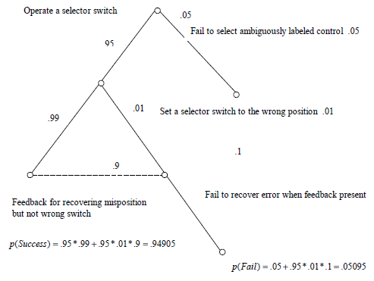
Tree of possible actions
This is one approach to computing the reliabilities for a set of scenarios.
Each scenario is a trace through the tree.

Slide 31
Recovering from an error
A device may refuse to accept invalid data.
A device may go into a special mode (blinking lights) and allow re-entry.
If an error is made at a rate, a, and recovered at a rate of (1-b), then the probability of is now a*b.

Slide 32
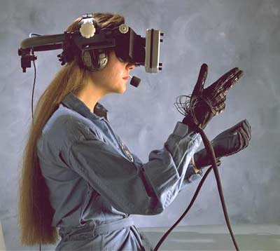
Interaction devices
Metaphor – the interface is a metaphor for the real world
The greater the difference between the real world and the computer world the more errors and less productivity
Devices such as exo-skeleton gloves stay very close to the natural action of reality.

Slide 33
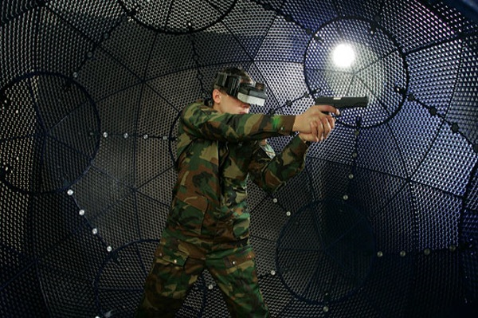
Devices
Movements within the field are detected and input into

Slide 34
Summary
The human part of a system is the least predictable and controllable.
There are a large number of guidelines and a growing array of devices for human computer interaction.
The SE may have access to experts in the area but still has responsibility for producing a usable system.

Slide 35
Sources
One widely used source for estimates of human error probabilities is the nuclear power industry.
EPRI/NRC-RES Fire Human Reliability Analysis Guidelines
http://www.nrc.gov/reading-rm/doc-collections/nuregs/staff/sr1921/sr1921.pdf
Also their technique uses a set of worksheets
http://www.nrc.gov/reading-rm/doc collections/nuregs/ contract/ cr6883/ cr6883.pdf

