Slide 1

SYSE 802
John D. McGregor
Module 12 Session 1
Summary

Slide 2
Session Objective
To summarize the semester’s content

Slide 3
Systems 2020
The DoD’s Systems 2020 program illustrates the forces driving SE in the directions we have taken this semester:
  Development takes too long.
  Change takes too long.
  Replacement takes too long.
  The environment is highly uncertain and complex.
  System complexity is growing.
http://www.ndia.org/Divisions/Divisions/SystemsEngineering/Documents/Committees/M_S%20Committee/2010/June%202010/Lucero_NDIA-SE-MS_2010-06-15.pdf

Slide 4
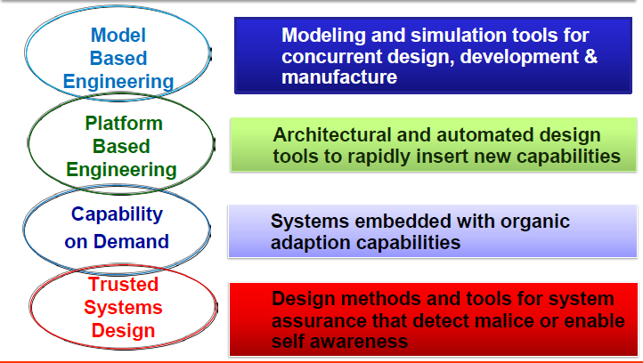
Research areas for Systems 2020
http://www.ndia.org/Divisions/Divisions/SystemsEngineering/Documents/Committees/M_S%20Committee/2010/June%202010/Lucero_NDIA-SE-MS_2010-06-15.pdf

Slide 5
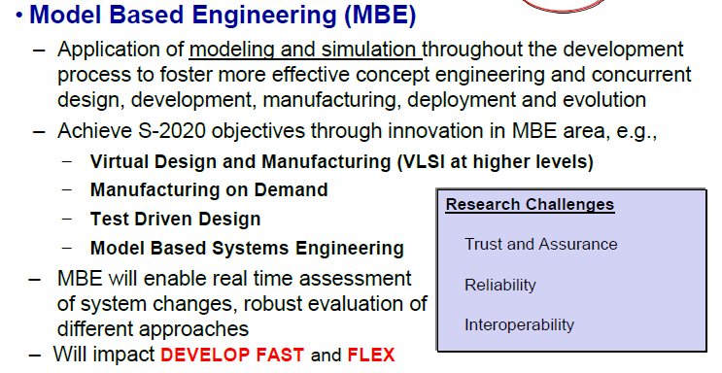
Research area

Slide 6
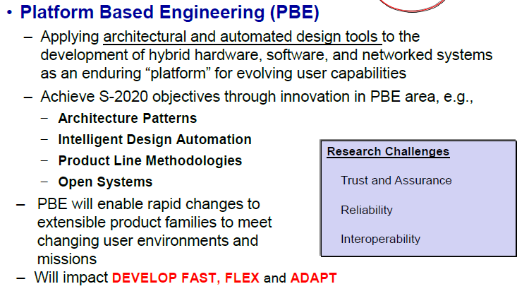
Research area

Slide 7
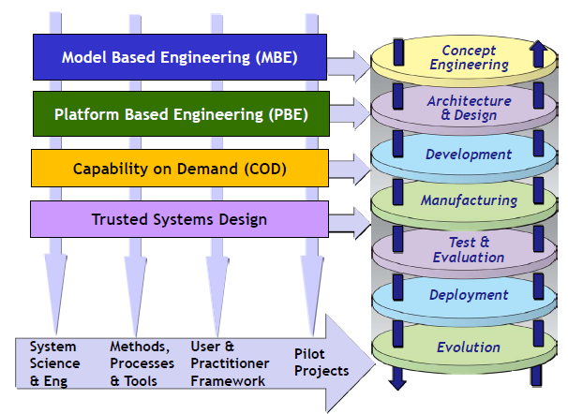
Research approach

Slide 8
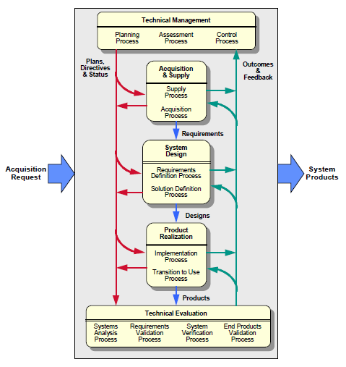
INCOSE’s SE Process

Slide 9
MDD
Model-driven development starts at the earliest stages of the development process
We have considered a number of tools and techniques this semester that begin with use case or feature models of the products and the chain of models continues to the architecture design and detailed design.
We only touched on the issue of automatic generation of code but that is certainly the goal. Raise the target of maintenance to the models instead of detailed lines of code.

Slide 10
MDD-2
What makes MDD successful?
  When the most time-consuming steps in development are as automated as possible
  When a sufficiently common or flexible representation such as XML allows data from one program to be used in another.
  When project personnel can raise their level of focus to the higher abstractions of meta-models

Slide 11
Product Production
We have considered briefly software product lines, a perfect environment for MDD.
One of the issues that we did not touch on is “product production”
For one-off systems this is not an issue but for an organization that intends to regularly produce products it is useful to consider how a software-intensive product is built from these reusable assets.
Obviously if products are built from assets, the assets have to be designed using the appropriate techniques to allow the products to be built in the way the organization intends.

Slide 12
Product Production-2
For example, one product line I have worked with wanted its subject matter experts to be able to write programs even though the experts are not technical people.
Our production strategy was to create a domain specific language (DSL) as the main asset. Model-driven development techniques were used to produce context-sensitive editors and compilers.
Then the production plan described how to
  Create a project
  Import libraries, and
  Write the program logic in the DSL.
This “production capability” achieves specific objectives for the organization.

Slide 13
Platforms
We touched on the notion of a platform as the basis for establishing a product line of products.
The standard architecture of the platform facilitates the development of reusable elements that can be composed to form products rapidly.

Slide 14
Analyses
We have surveyed a number of analyses for various purposes
The SE is most directly responsible for early stages of development but those responsibilities do not go away as development proceeds
The SE owns the requirements models and is involved whenever the requirements are impacted.

Slide 15
Analyses-2
We have considered analyses that assist with product definition:
  QFD
  Value engineering
We have considered analyses that assist with decomposition
  Functional analysis
  Attribute-driven design

Slide 16
Summary
As systems become larger and more complex the role of the SE becomes ever more important.
The SE has a central role in many of the activities that make or break a project. Remember that only about 10% of a project’s effort is related to code while almost 80% is related to the requirements and product definition.

Slide 17
Assignment
Simply email me that you have read through the slides for this module and Module 12 will be accepted.
Much success in the future!

