Slide 1

SYSE 802
John D. McGregor
Module 1 Session 1
Concept Elaboration & Requirements Elicitation

Slide 2
Session objective
This session explores the activities associated with concept elaboration and requirements elicitation for a system.
We began the development of our example system described initially in Module 0 Session 4.

Slide 3
Before we start…
There are several “flavors” of systems engineering. Some systems engineers are really project managers or in related areas.
If you are working in a company that has systems engineers, what you see in this course may or may not be what they do.
Those of you who are in the certificate program will see other perspectives in other courses.
This course will follow the INCOSE standard approach, albeit using a model-driven approach. We will engineer products that are a blend of hardware and software.

Slide 4
Concept Elaboration
In the earliest stage of system development, actions are less structured and less rigorous than in the later stages.
A feasibility study may have been executed or marketing information gathered to identify the need or opportunity that the system is intended to address.
A business case may be constructed at this time to determine go/no go for building a production product or this effort may be chartered as an investigation.

Slide 5
Early steps
Early in the product’s life cycle the system engineer gathers information about the problem/need.
The system engineer may create domain models or at least a domain dictionary that capture relevant concepts in the domain of the system and their meaning.
The system engineer will definitely create a requirements model.

Slide 6
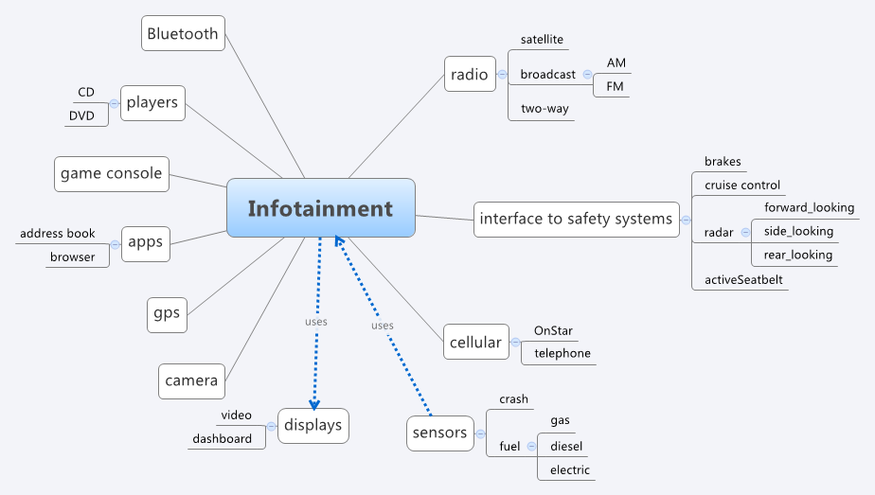
Mind map
Brainstorming relationships and concepts is one way to populate the
domain model. This was done using Xmind.

Slide 7
Early steps - 2
Stakeholder requirements give the stakeholders’ view of what the product should do and properties the system should possess.
These will be translated by the SEs into system (derived) requirements.
The stakeholder requirements are stated in terms of their interest in the product. The SEs translate these into more specific, more objective, more modular, and less ambiguous statements.

Slide 8
For example,
For our example system, the system will allow the user to use a radio, a video system, and other devices.
The system must use a reasonable amount of power of the type found in a vehicle.
A requirement might read:”The system shall support the user tuning the radio to any station on the standard AM broadcast band.”

Slide 9
Stakeholders
Initially each stakeholder has their own objectives.
Each stakeholder must advocate for their view of the need and show how it is of more importance than the views of others.
Ultimately a common mission is established.

Slide 10
Domain models
A domain model can be thought of as a structured glossary.
The boxes in the diagram on the following slide represent concepts in the domain.
The lines between boxes represent relationships among concepts.
This diagram uses the block diagram notation of SysML.
The words enclosed in «» are called stereotypes. Like a type they define what properties the concept may have.

Slide 11
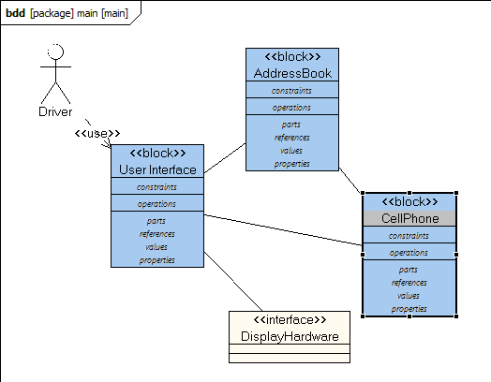
Domain models - 2
Blocks, in a SysML block diagram can be used for concepts.

Slide 12
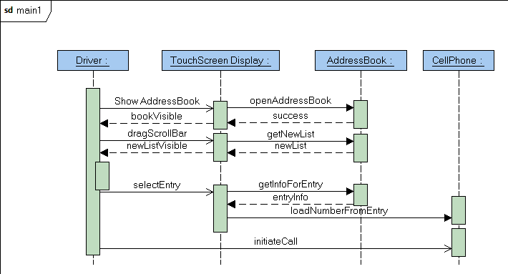
Domain models - 3
A domain model also captures standard interactions, which are characteristic
of the problem not the solution, using SysML sequence diagrams.

Slide 13
Domain models - 4
The purpose of a domain model is to establish a common vocabulary among members of a project team.
This is particularly important if several specialties are being integrated to solve a problem or if several organizations are collaborating.
Even a term like “project” can have different meanings if the solution is distributed over several countries.

Slide 14
Domain model - 5
Professional societies and governmental organizations are good starting points for these models. They produce general models that represent the thinking of large numbers of people.
These domain models will also serve as the basis for domain specific languages (DSLs) for later stages of model-driven development

Slide 15
Features
For many efforts the size and complexity of the product is too much to think of as a single list of requirements statements. 10,000 items is too many.
One way of dividing the problem into manageable pieces is to use a high level unit termed a “feature”. By high-level I mean broadly encompassing. Vehicle is more encompassing than automobile.
A feature can represent any aspect of a system. A very vague definition I know but a very flexible one.
Having a GPS device is a feature of our system.

Slide 16
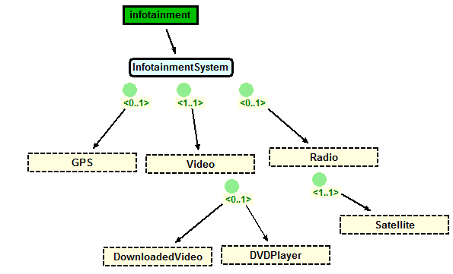
Features - 2
The <0..1> cardinality means the feature is either part of the system or not.
The <1..1> cardinality means the feature must be part of the system.
Notice that many of these features are directly from the mind map.
http://www.pnp-software.com/XFeature/

Slide 17
Features - 3
Satellite radio is a mandatory feature if we have a radio.
A product we build may have a GPS component or not (indicated by 0..1). This is an optional feature.
There is a video feature in every product and there is a choice of two players.

Slide 18
Features - 4
These statements are very high level requirements but each one represents many of the individual requirements statements. The features are sufficiently different that building a detailed requirements model for each feature will minimize the amount of interactions between requirements in one feature and those in another.
Non-functional aspects may be addressed as well with features such as security or performance levels.

Slide 19
Features - 5
Notice that a feature model gives more than just the requirements for A product.
It gives requirements for a family of products.
More about this later in the course.

Slide 20
Functional vs Non-functional requirements
Functional requirements describe WHAT a product must do
  The system shall be able to receive SMS (short message service) messages.
Non-functional describe HOW the product will do it
  The system shall be able to receive at a rate of 100 messages per minute.
Both are essential to building an acceptable product.

Slide 21
Two operations
The systems engineer
  elicits requirements from many sources, and
  analyzes the compete set of requirements
In order to elicit, the systems engineer identifies those who have an interest in the product - the stakeholders
Not all stakeholders have the same priority. Some are clients while some are the people creating the product.

Slide 22
Implicit and Explicit
Standards documents and spec sheets for former products are examples of explicit knowledge which is the easiest to convert into requirements
Implicit knowledge such as the experience of a 20 year veteran in a company is harder to capture completely and correctly
Just recently a doctor tried uploading data for a medical research project and we found that he had forgotten to tell me that each MRI scan was 120 separate files.

Slide 23
Many techniques
There are many different techniques for eliciting requirements
  Interviews – structured and non-structured
  Story boards
  …
We will focus on use cases. A use case is a description of a use of the system by some external entity termed an actor.

Slide 24
The chicken and the egg
People have different opinions about whether requirements come from use cases or vice versa.
I think it is easier to start with use cases because the external actors are usually easy to identify and it is usually easy to verify completeness of the actor model.
But, sometimes you have a legacy set of traditional requirements which also is a good starting point.

Slide 25
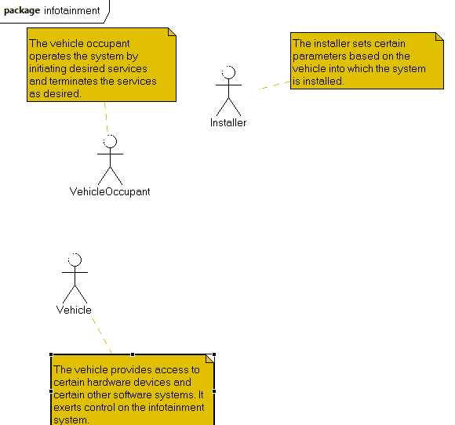
Elicitation
The stakeholders can be represented as “actor”s in a SysML Use Case model. The figure below is an early version of the model for our continuing example. The actors may be people or other systems. What outside forces act on the system?

Slide 26
Scenarios
A scenario is a very short story.
A use case is a set of scenarios that all describe related uses of the system being developed.
A number of software development methods use scenarios for a variety of models.
Some methods just use simple story boards while others are structured by fill-in the blanks style statements.

Slide 27
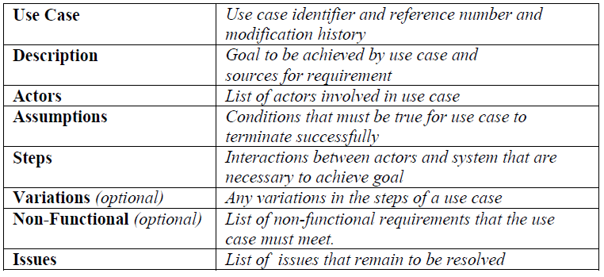
Use case template
If you are not using a tool such as Topcased this is a nice outline to follow.

Slide 28
Use case structure
Typically there may be several variations on a use and so multiple scenarios are grouped together under a single use case. There are types of scenarios that routinely are used:
  Sunny day (everything goes well)
  Rainy day (something does not work)
  Exceptional (rare situations that require specific handling)

Slide 29
Use case model structure
The use case model is not just a list of uses
The model has structure resulting from relationships between uses
  Extends – The use is written so that new uses can be incrementally defined by adding to an existing use; the original use case must indicate what can be extended
  Generalizes – Similar to inheritance
  Includes – Similar to composition

Slide 30
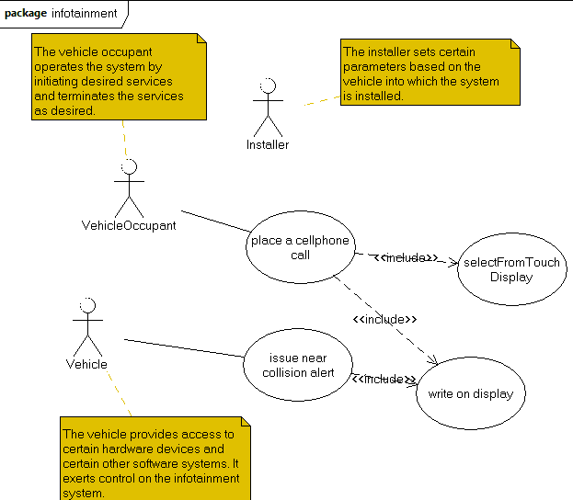
Use cases
Use cases give a means of decomposing actors’ actions.

Slide 31
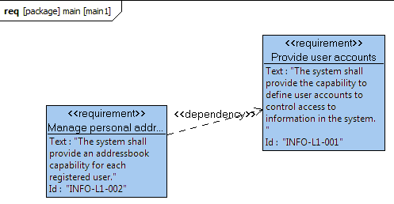
Requirement diagram
From a single use case usually several requirements can be created. The
Model is structured by adding relationships between the requirements.

Slide 32
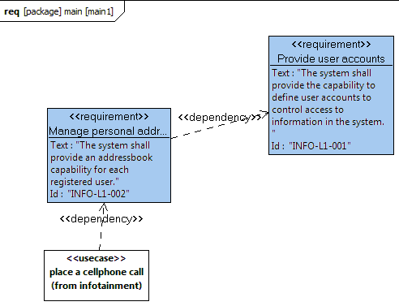
Traceability
In a modeling environment such as Topcased, placing several diagrams
within the same model makes it possible to drag elements of one diagram
into another and explicitly show dependencies.

Slide 33
Traceability - 2
Traceability means that we can trace through a series of diagrams and follow paths within those diagrams to reach a desired definition. Here we show a box representing a use case from another diagram with a dependency on a requirement. If a requirement changes, traceability information makes it possible to determine which other elements must change.

Slide 34
A note on modeling
A model in Topcased contains packages
A package contains diagrams
Currently we are building a requirements model that contains a single package. The package has a use case diagram and a requirements diagram. They are in the same diagram because the requirements are derived from the use cases.
Because they are in the same model you can associate elements in diagrams by dragging an element in one diagram from the outline to the other diagram and then associating the two.

Slide 35
Testing and requirements – a brief digression
Every requirement that is in the requirements model will be the source of one or more test cases.
Each requirement has to be sufficiently exact that expected result for a test case can be specified.
The exact description of a requirement is also necessary so that the requirement can be verified.

Slide 36
Testing and requirements - 2
Traceability goes beyond identifying the relationships between use cases and requirements.
Test cases should have an association relationship with the requirement(s) they are intended to verify.
The SysML requirements diagram notation provides a means for defining test cases and associating them with specific requirements.

Slide 37
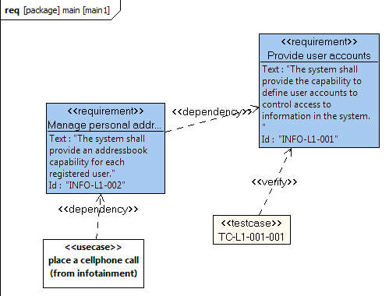
Test traceability
The SysML requirements diagram supports the definition of test cases.
although it does not show on the graphic the tool provides fields for
capturing much information about the test.

Slide 38
Example
The system shall be able to send SMS messages.
This is verifiable because SMS is a well-defined messaging standard.
The system shall be able to send messages.
Is not verifiable directly but if it is listed as an abstract requirement this is acceptable. The abstract nature is useful in a reusable design.
Another more concrete requirement would be derived from this abstract one.

Slide 39
Plain old requirements
Many organizations simply use plain old requirement statements
  The system shall …
One problem we have already seen is that individual requirements are too numerous and fine-grained to be easy to manage
A second problem is that the traditional requirements “model” does not provide any help to determine the validity of the model.
Tools such as Topcased provide a means to export the requirements defined in the diagram into lists usable by programs such as Excel.

Slide 40
Derived requirements
The term “derived” is used for the action of modifying a requirements statement for a specific purpose.
Usually the modification is to create a more specific requirement from some aspect of the original, more general, requirement.

Slide 41
Did you get them all?
A single pass over the actors probably will not identify all of the relevant requirements, but how can you tell?
Evaluating a requirements model requires an external benchmark against which to measure.
One approach is a user jury. More about this later, but think how your company currently evaluates the validity of product requirements.

Slide 42
Iterative
Humans forget; circumstances change.
Different people have different pieces of the information that you need.
Each requirement is visited multiple times. We move to a more specific level of detail in the statements with each “iteration” or pass over the material.
At first there will be a lot of change from one iteration to another; this will subside until a major upgrade kicks off another round of changes.

Slide 43
Iterative - 2
As you take a second pass, and beyond don’t forget the domain model.
The concepts in this model should be clarified as you gain understanding and new concepts added as your scope expands.
The domain model should be easily viewable by all members of the project and most, if not all, of the stakeholders.

Slide 44
One iterative hierarchy
For DoD and other governmental agencies there often is a fairly standard requirements hierarchy.
  L0 – This might be the customer requirements provided to the SEs by some business group
  L1 – Derived, high-level user requirements
  L2 – Further derived (maybe specific product) requirements that will drive product testing
  L3 – Most explicit, software or hardware specs written from these

Slide 45
Iterating
A hierarchy usually is structured from the most broad to most specific
This often corresponds to a hierarchy from broad wishes of users to specific directions to developers.
Iteration happens when someone at a lower level wants to ensure they are following the intent of the stakeholders and they trace to higher level requirements.

Slide 46
Incremental
Large complex projects are broken into increments that are intellectually feasible.
There may be parallel teams deriving (relatively) isolated requirements
There may be sequential iterations by a single team
The requirements model is the integration of all increments
One team might address the GPS subsystem while another team addresses the radio.

Slide 47
Forces against elicitation
problems of scope, the requirements may address too little or too much information;
problems of understanding, within groups as well as between groups such as users and developers; and
problems of volatility, i.e., the changing content of the requirements model.

Slide 48
Resolving those forces
Scope – When using a hierarchy of requirements like L1, L2, etc develop a clear definition of the purpose for each level. This will make it easier to determine what to include.
Understanding – the domain model can capture synonyms and provide a focus for sharing
Volatility – anticipate it; only go as deep as is necessary for the stage of development; delaying detail will give more time for issues to be resolved

Slide 49
The human factor
People with different skills often do not communicate well with each other because they are used to the shorthand way of talking with others with the same skills
Recently, a month into a requirements effort it became clear that while everyone was saying “yes”, each had a different idea of what the question was.
The project finally agreed to do a glossary.

Slide 50
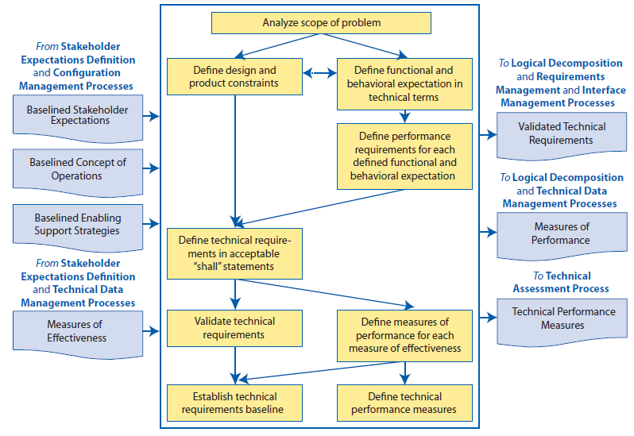
NASA’s requirements process – Fig 4.2-1

Slide 51
Overview
The following is a good overview of elicitation techniques:
https://buildsecurityin.us-cert.gov/bsi/articles/best-practices/requirements/533-BSI.html
Section 4.3 of the INCOSE Handbook describes these actions in more detail.

Slide 52
Summary
The use case technique is designed to make elicitation easier, less error prone, and more systematic. It provides a sequence of first finding the actors and then interactions of each actor with the system.
Each use case can then be mined for specific requirements statements. Many projects now skip this step with the use case serving as the primary representation of the requirements.

