Slide 1

SYSE 802
John D. McGregor
Module 1 Session 2
Requirements Modeling in SysML

Slide 2
Session objective
This session will describe how to model requirements in SysML in more detail.
This session will also give more experience with Topcased.

Slide 3
Three diagrams, one model
We want to have a single requirements model.
We use two different diagrams that complement each other. And then we use a third diagram that complements the use case diagram.
The requirements diagram provides a direct statement of a requirement as an isolated fact.
The use case diagram provides a context for that requirement and shows how it relates to other uses of the system.

Slide 4
Digression: A bit of history
The Unified Modeling Language was created from three earlier design notations. Eventually it was standardized by the Object Management Group (OMG).
SysML, also a standard of OMG, is a “profile” of UML. This means we begin with certain aspects of UML and add the unique items needed for systems engineers to define a new language.

Slide 5
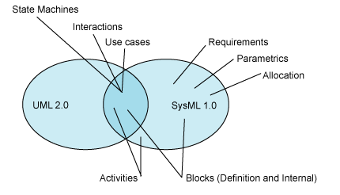
A bit of history - 2
This diagram from the IBM tutorial referenced at the end shows the overlap and differences between UML and SysML. Where the lines from a diagram type touch both the overlap and the SysML specific areas denote additions to the existing diagrams.

Slide 6
Modeling for Systems Engineers
One of the differences between a “design” notation like UML and a “systems engineering” notation such as SysML is the scope of what is captured.
A SysML model will include both hardware and software entities allowing the systems engineer to describe the entire problem and solution.

Slide 7
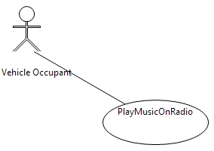
A basic use case
The stick figure is an actor.
An actor is any outside stimulus that interacts with the system.
The oval represents a use of the system by the actor(s) associated with the use case.
There is a documentation window into which text that explains the use can be entered.

Slide 8
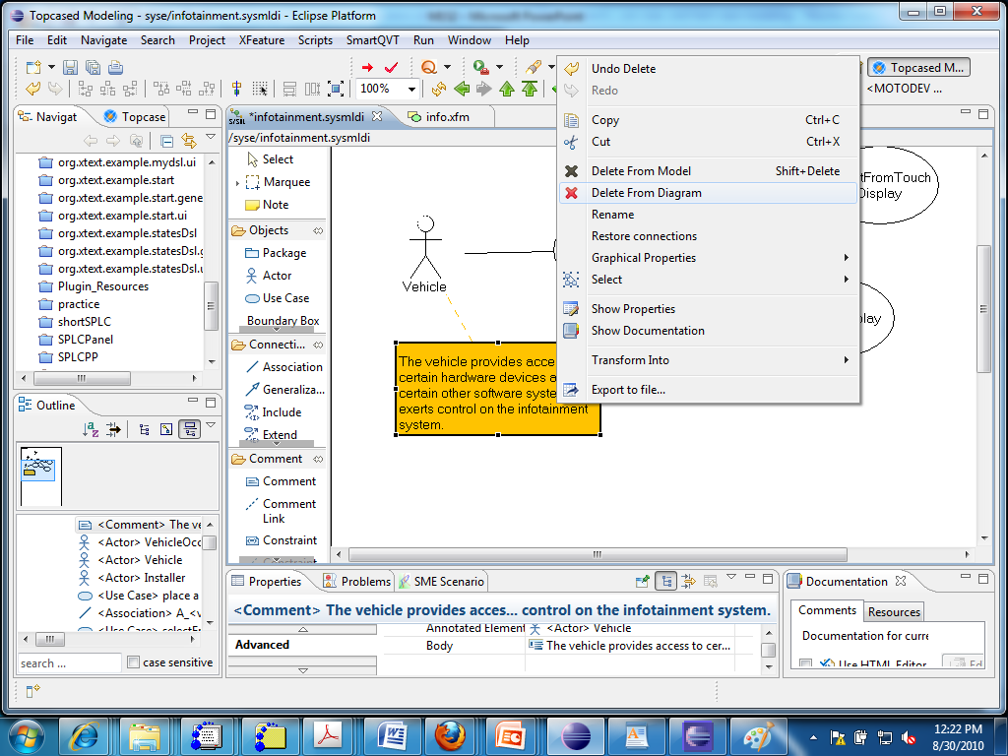
Remove comments from the display and not the model

Slide 9
Model vs diagram
The “model” we are building is an xml document that captures all information.
A specific diagram is shown in either a graphical or text editor and contains some subset of the model.
You can hide elements in a diagram so they are not visible on screen without deleting them from the model.

Slide 10
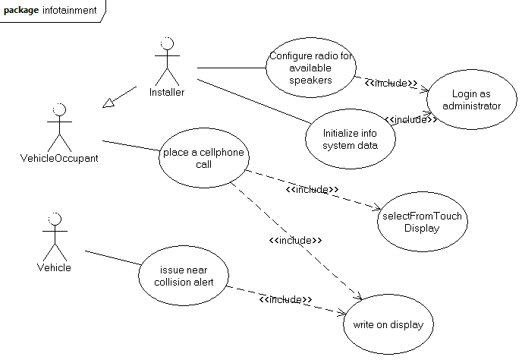
More use cases
Text on next slide

Slide 11
More use cases - 2
The relationship between the Installer and the Vehicle Occupant is “generalization”
That is, an Installer can perform all of the uses associated with a Vehicle Occupant plus those reserved for the Installer.
Work with the TopCased use case diagram a bit. In the Properties box at the bottom of the screen there are numerous fields that can be used to capture info.

Slide 12
More use cases - 3
The <<include>> relationship indicates that executing one use case includes an execution of the other.
This decomposition of multiple use cases to identify partial uses that can be included in multiple places makes the use case model more maintainable.

Slide 13
More use cases - 4
A more detailed description of a use case is created by adding a sequence diagram
To preserve traceability the sequence diagram can be embedded in the use case diagram
Double left click on a use case in the use case diagram and a dialog will allow you to create a sequence or an activity diagram

Slide 14
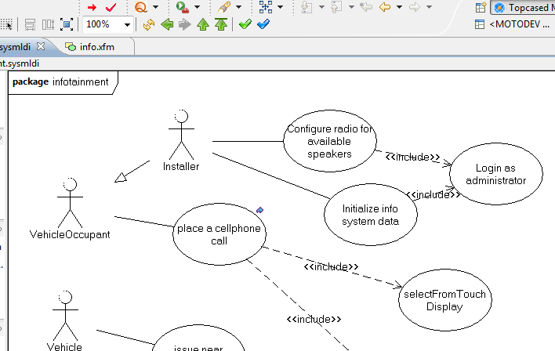
Embedded diagrams
At #1 is the arrow that indicates an embedded diagram. The arrows at #2 moves up/down in layers of diagrams.
#2
#1

Slide 15
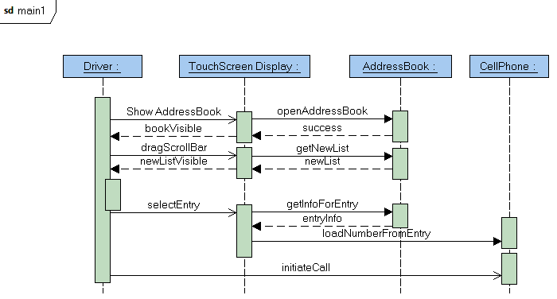
Embedded diagrams - 2
This is embedded in the use case.
It shows elements (hardware pieces and software pieces) that perform actions to carry out the use.
The sequence diagram has different arrows for synchronous and asynchronous messages.

Slide 16
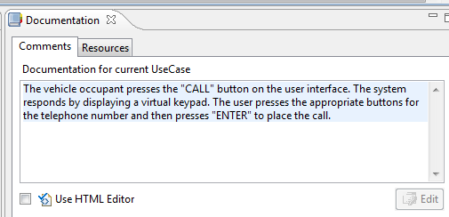
Full use case
The documentation window for a selected use case allows you to enter the full text of one of the use case’s scenarios.

Slide 17
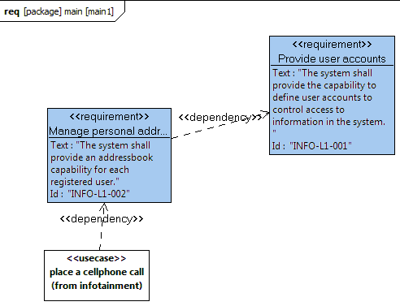
Use cases -> Requirements
A mapping like the one in Session 1 on the Traceability model should be completed.
The mapping allows
  Maintenance when either model changes
  Verification of completeness

Slide 18
Requirements
The requirement diagram does several things:
  Captures statements of functional and non-functional requirements
  Establishes traceability between requirements and test cases
  Forms the basis for development
The requirement statements must eventually be sufficiently specific to guide a developer in creating code.

Slide 19
Requirements - 2
Non-functional requirements can be handled in one of two ways
  There can be stand-alone requirements statements
    The system shall boot to a stable, usable state in 2 seconds from power on.
  The functional and non-functional requirements can be integrated
    The system shall reach a stable state in which a call can be made in 2 seconds from power on.

Slide 20
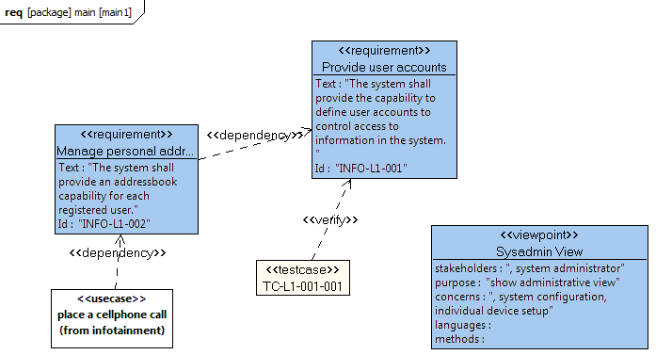
Viewpoint specification
The <<viewpoint>> stereotype specifies a perspective for creating a view (a portion of the model) that relates to a stakeholder

Slide 21
Requirements - 3
As can be seen in the next slide, a requirements diagram can be labeled with a Viewpoint.
When you select the use case slot in the properties dialog, a dialog pops up with all available use cases from within the same model.
This provides another means of associating a use case to all related requirements.

Slide 22
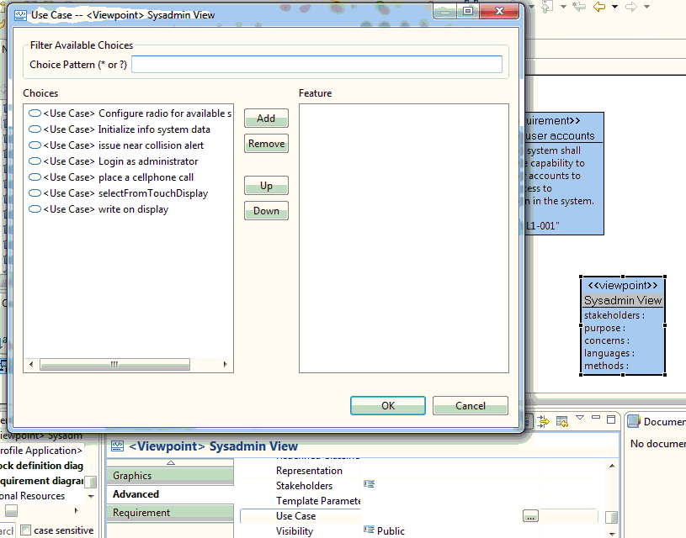
Requirements - 4
#1
#2

Slide 23
Additional tutorials
These tutorials give information about the syntax of SysML.
  Use case diagram (and other diagrams)
http://www.visualcase.com/tutorials/use-case-diagram.htm
  Requirements diagram (and others)
http://www.ibm.com/developerworks/rational/library/aug06/balmelli/
  Sequence diagram
http://www.ibm.com/developerworks/rational/library/3101.html
The construction of these diagrams in Topcased is described in the tutorials found at:
  http://www.topcased.org/index.php?documentsSynthesis=y&Itemid=59
  Use both the QuickStart editor tutorial and the UML/SysML editor tutorial

