Slide 1

SYSE 802
John D. McGregor
Module 2, Session 1
Requirements Analysis and Management

Slide 2
Session Objective
In this session we will take the requirements gathered using the elicitation process and critically examine that model.

Slide 3
Elicitation vs Analysis
Elicitation is the collection of information
Analysis is the detailed examination of that collection
Like elicitation, analysis is an iterative process. The analysis will point out areas that are weak and further elicitation is required.
So at this point we have elicited input from a spectrum of stakeholders and that input needs to be organized and modified to be useful
Some people use “analysis” to cover the entire requirements engineering process. We treat them separately to provide an in-depth explanation.

Slide 4
Quality attributes
A non-functional requirement addresses attributes about HOW a product will perform its function.
The requirements address desired values for these “quality attributes” of the product.
For example, “The system shall be maintainable” is not a good requirement because it is not verifiable. “It shall be possible to add a new service within 14 working days.” is verifiable.
There are many such attributes. For a thorough analysis see
http://www.sei.cmu.edu/library/abstracts/reports/95tr021.cfm

Slide 5
Some common quality attributes
Correctness
Reliability
Efficiency
Integrity
Usability
Survivability
Maintainability
Verifiability
Flexibility
Portability
Reusability
Interoperability
Expandability
IEEE Std. 1061 and ISO Std. 9126
2 standards that provide definitions
for all these terms

Slide 6
Example definitions
Modifiability encompasses two aspects:
“Maintainability. (1) The ease with which a software system or component can be modified to correct faults, improve performance or other attributes, or adapt to a changed environment. (2) The ease with which a hardware system or component can be retained in, or restored to, a state in which it can perform its required functions.”
“Flexibility: The ease with which a system or component can be modified for use in applications or environments other than those for which is was specifically designed.”

Slide 7
Usability
“Usability. The ease with which a user can learn to operate, prepare inputs for, and interpret outputs of a system or component.”
[IEEE Std. 610.12]

Slide 8
Some standard sources
There may be no stakeholder who feels responsible for some types of requirements
Inputs/outputs
Identify and capture as requirements all required inputs and outputs
Technologies
There often are specific technologies that must be used. Write a requirement for each.

Slide 9
Analysis
Analysis is the act of digesting the raw information obtained from stakeholders and producing a coherent picture of a problem.
Analysis techniques differ in what fundamental structures are created or identified.
Structured analysis attempts to form a hierarchy in which lower level elements are pieces of higher level elements.

Slide 10
Object-oriented analysis
Object-oriented analysis uses a set of notations to represent the domain knowledge and requirements.
The representation is an “object” and the relationships among objects.
This representation is intended to provide a bridge between a set of problem-space concepts and a set of solution space concepts.
The idea being that a solution should embed the problem within itself. Then as the problem changes, changes to the solution are a natural consequence.

Slide 11
Object-oriented analysis - 2
We want to capture the problem domain as a set of objects.
For our infotainment example the easiest place to start is with the hardware entities that are typically a part of such a system.
From there we can add the more conceptual objects which relate how these hard objects are tied together.
A first step in o-o analysis is domain analysis, understanding the problem domain.

Slide 12
Domain analysis
Usually a company does not solve one problem and then move on to a completely unrelated new problem.
They develop expertise in one domain (body of knowledge).
Domain analysis captures that body of knowledge.
It is largely about the problem domain but standard solution elements creep in as well.

Slide 13

Domain analysis - 2
Concepts, such as device, radio, and television, are represented as “entities” using the UML class diagram or the SysML block diagram. Each concept is represented in a box that includes the name of the concept, data that characterizes the concept, and behaviors related to the concept.
The class definition “encapsulates,” i.e. groups together the elements that are used together.

Slide 14
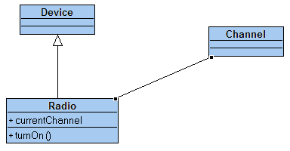
Domain analysis - 3
Concepts are related to one another.
“Device” is a concept that is more general than “Radio” and so the relationship is generalization.
“Channel” is a property of a “Radio” so the relationship is association.

Slide 15
Domain analysis - 3
In domain analysis we capture “what is” - the actual structure of the domain we are analyzing.
We will see later that in designing a solution we elaborate on “what is” to get a design of what we need to solve the problem.
“What is” includes concepts but also algorithms, the deployment of software to hardware, and the stateful behavior of the entities in the domain.

Slide 16
Stateful behavior
Lets consider the Radio as a stateful entity in our domain.
What significantly different modes of operation does it have?
It can be turned on or off. Its sound can be muted or not.
It can be on one of three bands: AM, FM-1, and FM-2.

Slide 17
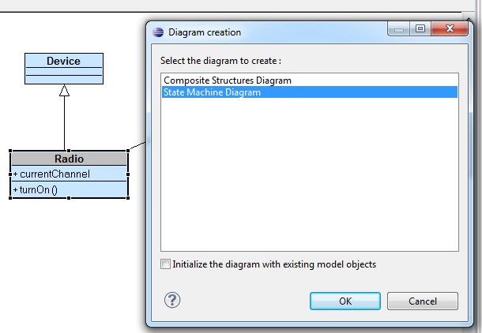
Embedded state machine
Double click on Radio and the dialog looks like below. Select State
Machine Diagram.

Slide 18
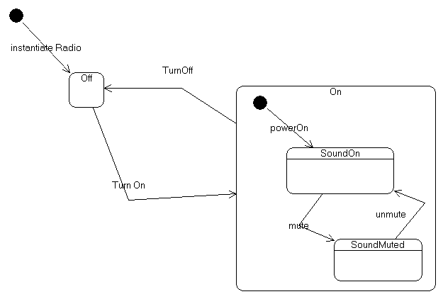
Radio
The state machine for the mute button is nested inside the state machine for the radio.
This is in the domain analysis part of our work because we are capturing how the underlying hardware works.

Slide 19
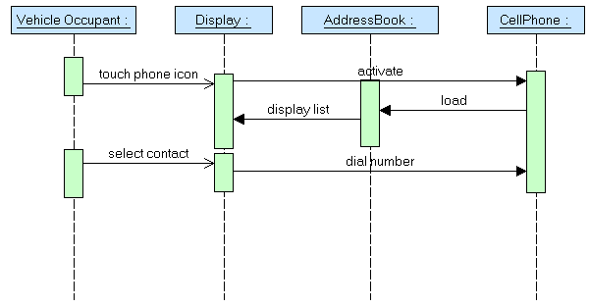
Algorithms
The sequence diagram allows us to capture common sequences of operations.
Here we capture how to make a phone call.
This is domain information because it is how most cell phones work so it is basic information.

Slide 20
The complete model
The complete model involves numerous diagrams of several diagram types.
Remember that SysML stands for the System Modeling LANGUAGE. Think of the modeling of a domain as telling a story written in this language. Think of the diagrams as communication with others.
The domain information is used in conjunction with the requirements model to be certain that the requirements are understood in the context of the domain.

Slide 21
General analysis techniques
Requirements analysis digests the requirements, adds detail, and may modify the structure of the requirements model.
  CONOPS
  Hierarchical structuring by ranking
  Linear structuring via operational concept
  Test-driven development
  Risk
  Restructure by Re-factoring

Slide 22
CONOPS
The concept of operations for a product translates between stakeholders and developers.
The CONOPS describes how the product will be operated.
It gives structure to the web of stakeholder needs and desires.
It is particularly useful for products that are complex to operate such as vehicles
IEEE 1362 gives the basic form of a CONOPS
The NASA handbook is also a good source on CONOPS
Here is a link to the HHS CONOPS for emergency response:
http://web.archive.org/web/20080408092628/http://www.hhs.gov/disasters/discussion/planners/conops.html

Slide 23
CONOPS - 2
The CONOPS for an infotainment system that includes traffic management might describe how a vehicle and an intersection interact as the vehicle approaches the intersection.
“Using info about location and speed the vehicle informs the intersection of its arrival time. The intersection, using its information about signal states and waiting traffic, informs the vehicle of possible states upon arrival. The vehicle requests the possible state that is most favorable and waits to see if it occurs.”

Slide 24
CONOPS - 3
Essentially the CONOPS is a scenario of scenarios with information about the frequency and criticality of the scenarios.
The CONOPS focuses on a complete picture of the product over some lifecycle of use.

Slide 25
Prioritizing
Often there is insufficient time to examine every requirement in detail.
Requirements (or use cases) can be ranked to determine the most valuable ones to focus on
Different criteria can be used
  Stakeholder importance
  Value to the user

Slide 26
Prioritizing - 2
Ranking is best used on use cases or features since these are logical groupings of requirements
In several of the techniques developed by the SEI, stakeholders are given a certain number of votes (sometimes a variable number based on priority)
The ranking is the vote of the stakeholders

Slide 27
Prioritizing - 3
Requirements concerning the vehicle infotainment system might be ranked as:
  Braking information and control
  Steering and propulsion
  Location
  Outbound communication
  Inbound communication and displays

Slide 28
Operational profile
An operational profile attempts to summarize the first two kinds of analyses into a smaller, less complex representation.
Using the use case diagram that contains all uses, each branch can be annotated with the relative frequency with which that branch will be taken.
This is useful in weighting scenarios for reliability and availability testing in addition to specifying the system.

Slide 29
Test-driven development
Test-driven development (TDD) is an agile practice intended to improve quality and speed
Test cases take the place of requirements.
A test is written that the product can not yet pass; code is written; the test is rerun and should now pass
During test development the question is whether the requirement is sufficiently clear to support test development; whether the requirement should be split into additional requirements and whether there are tests for which there are no requirements.

Slide 30
Specification
The output of requirements analysis is a requirements specification
This defines the product to be built, or it should
Remember that this is an iterative process so a completed set of L1 requirements is a specification but not a specification from which we can directly build a product; its too high level

Slide 31
IEEE Guide to Software Requirements Specification
unambiguous
complete
verifiable
consistent
modifiable
traceable
usable during operations and maintenance

Slide 32
Risks
There are numerous risks associated with requirements elicitation and analysis as illustrated by the criteria:
  Complete – risk is missing an important requirement
  Correct – incorrect information will be inserted into the product
  Consistent – two mutually exclusive requirements may both be included in the model and not properly qualified

Slide 33
Factoring requirements
Usually the first requirements that are captured are very concrete because they represent the stakeholder’s basic needs
These should be factored into requirements that have a broader, more abstract scope
One way to do that is to establish a relationship in which one use case extends the behavior defined by another; this is only allowed in anticipated ways: via an extension point

Slide 34
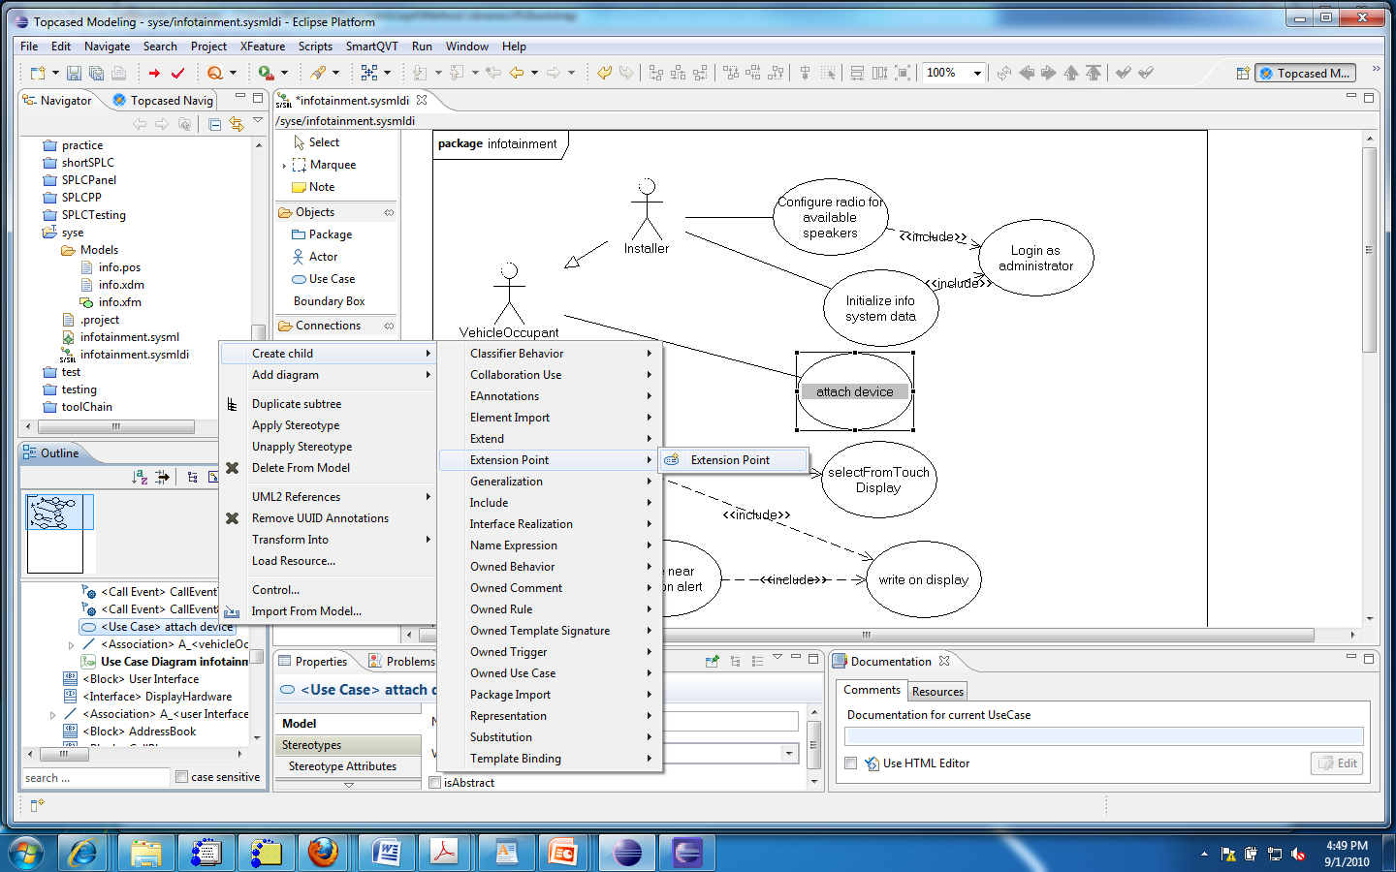
Adding an extension point
#2
#1

Slide 35
Extension points
To be able to use the “extends” relationship, you first create an extension point in the use case to be extended
This can only be done in the Outline view (as is true for several operations)
Select the use case in the outline view (#1)
Select Create child | Extension point | Extension point
Give the extension point a name

Slide 36
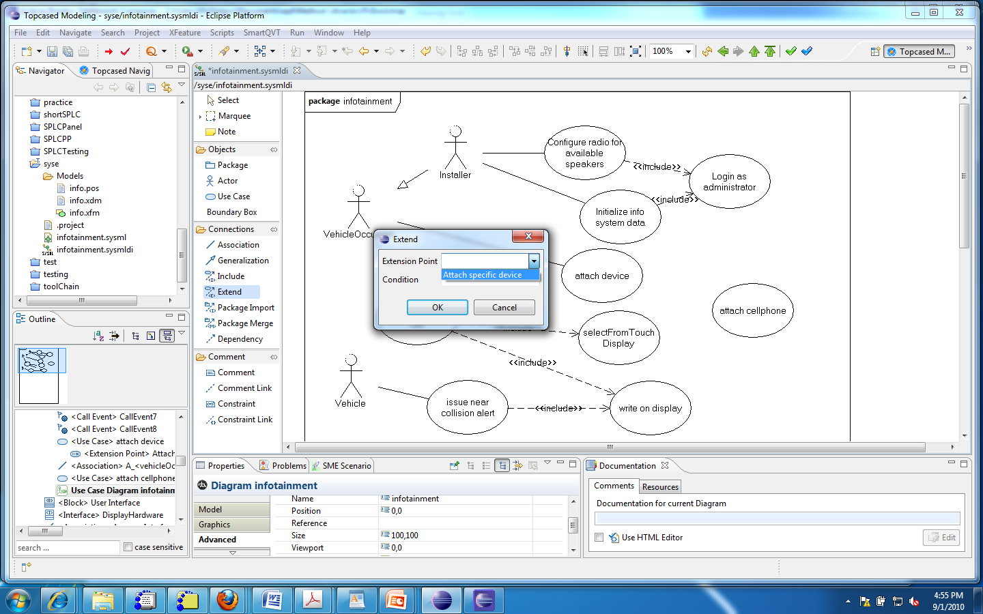
Using the extension point

Slide 37
Using
Create the new use case
Select the “extends” relationship and drag from the extending to the extended use case
Select the extension point you created previously
The relationship will be created as shown in the next slide

Slide 38
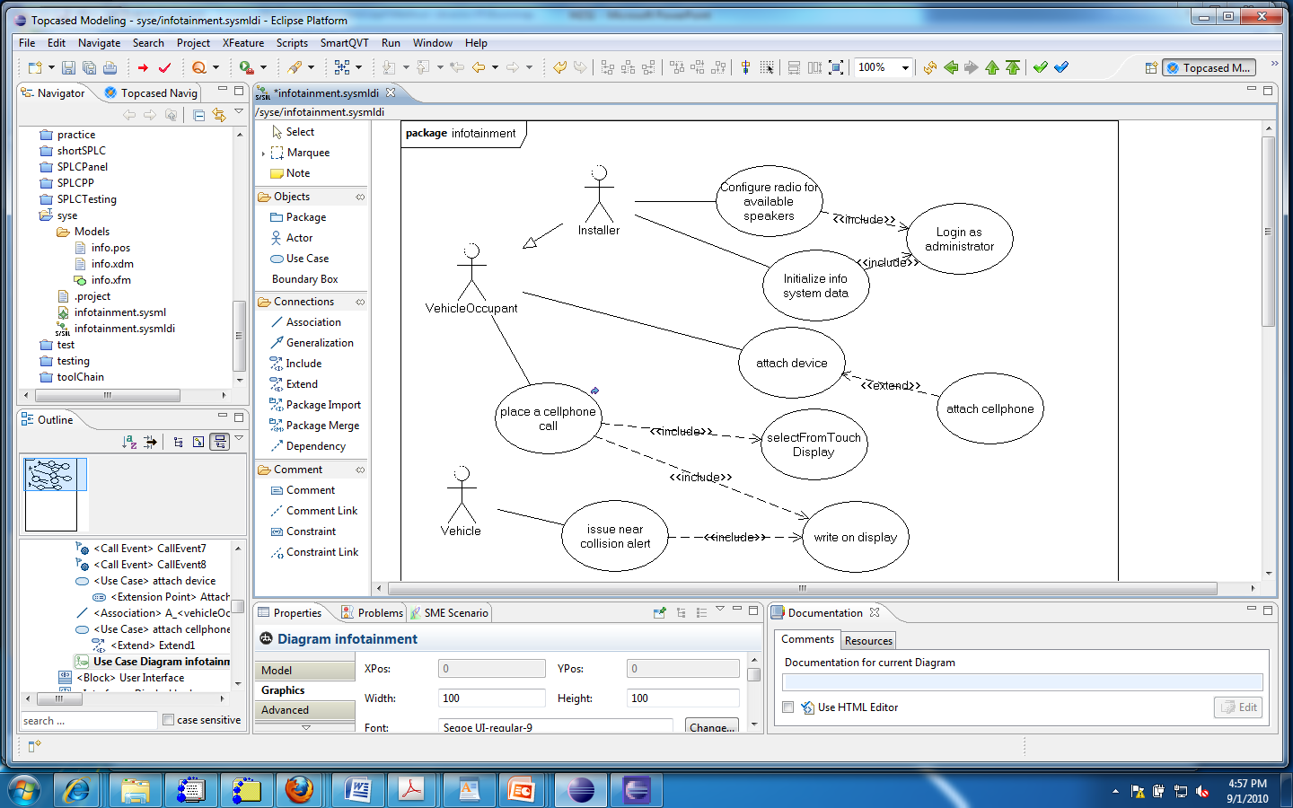
The added use case

Slide 39
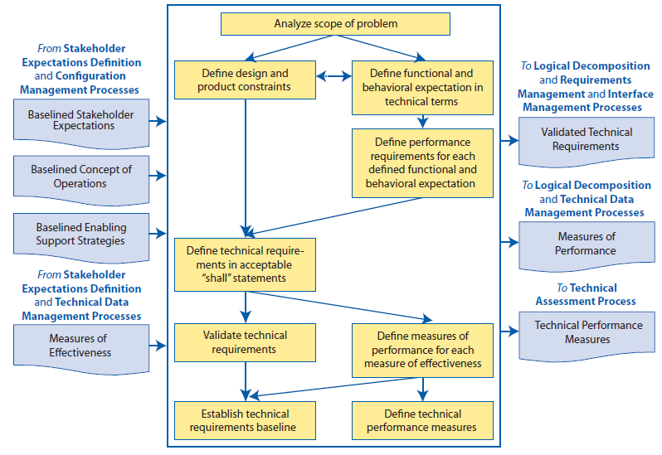
NASA requirements process - Fig 4.2-1

Slide 40
Baselined
The term baselined is used in the NASA process to denote artifacts that have been completed to a sufficient level of detail that further change will be managed.
There may be a formal evaluation or some other milestone to mark the change from free changes by the developers of the artifact to changes that are “managed”.

Slide 41
Management
Change happens for many reasons during product development
  Customers change their minds
  Context changes (maybe the market climate)
  Mistakes are discovered
The requirements model must change in reaction to these changes, but all dependencies must change as well.

Slide 42
Change
A change control board (CCB) analyzes each change for impact on the web of dependencies among requirements, tests, constraints, and other relationships.
The approved change is managed in the change management system. The initial change may be decomposed into several smaller changes being defined in the change management system.

Slide 43
Change - 2
The smaller changes are carried out by people who own the affected artifacts.
For example, a change to a use case will result in changes to one or more requirements. Each change to a requirement will likely affect one or more tests.
Using tools such as Bugzilla, for change requests, Topcased, for its diagrams, and DOORS, used for requirements databases, makes this process manageable.

Slide 44
Tailoring the requirements process
Any general process must be tailored to fit the specific situation in a given development effort.
Moving from one customer to another may require changes;
Moving from one domain to another will definitely require changes
See Module 2 Session 2 for more on tailoring

Slide 45
Summary
Section 4.5 of the INCOSE Handbook lists a large number of different types of analysis. See which ones apply to your project.
The systems engineer selects the analyses that are useful in their domain.
The requirements statements must provide sufficient information to support those analysis techniques.

