Slide 1

SYSE 802
John D. McGregor
Module 4, Session 1
Architecture process

Slide 2
Session Objective
To investigate the process by which the system architecture is created.

Slide 3
Systems thinking
Remember that we are applying systems thinking in every step of the process
That means at all levels we consider the integrated system not just isolated portions
The systems engineer is overseeing all aspects of the project
It does not mean that the systems engineer has deep knowledge of every specialty

Slide 4
Total life cycle management
Begins with ideation
Takes an integrated approach even though the teams are separated by hardware/software, perhaps by geography, and legal boundaries
The systems engineer is a key player in this integrated effort
The systems architecture is the major vehicle for coordination among teams and entities

Slide 5
Architecture definition approaches
Traditionally systems engineers have used a hierarchical functional decomposition
Other approaches are used now such as object-oriented design call for a different approach.
First we will take a fundamental look at identifying units to compose
Then we will consider the attribute driven approach in more detail.

Slide 6
Architecture
The embodiment of concept, and the allocation of physical/informational function to elements of form, and definition of interfaces among the elements and with the surrounding context.
http://www.scribd.com/doc/26874927/Introduction-to-System-Architecture
Form
Concept

Slide 7
Form
The physical/informational embodiment which exists, or has the potential to exist.
The sum of the elements which are segments (of the whole of) the form
The structure of form – the formal relationships among the elements
Form is elements + structure

Slide 8
Abstraction
Abstraction defined as:
  Expression of quality apart from an object
  Having only the intrinsic nature rather than the form
Abstraction hides complexity to present a simple surface

Slide 9
Concept
Embodies the principle of operation
Includes abstraction of form
Concept is the mapping of function to form

Slide 10
Function
What is the value related operand?
What transformation is needed for the solution neutral statements
The actions for which the product exists
operand
processing

Slide 11
Architecture
Has both form and function
Function is related by concept to form
Attribute driven design is one approach to determining the mapping
Form
Function
Concept

Slide 12
Fundamental Processes (Crawley)
Create (and Destroy)
Transport–In place -from A to B, or to “spatial storage”and recover from “storage”–In time –only delays allowed since time is causal “temporal storage”
Transform–In type or form–In quantity –magnitude for continuous attributes, number for discrete artefacts
Compare –Any of the place, time, type or quantity [not sure it is independent of Transform]

Slide 13
The systems architect
The systems architect works closely with the systems engineer
The systems architect defines and maintains the architecture vision of a product
The systems architect works to reduce complexity and ambiguity through the definition of modules and connections
The systems architect tailors an existing architecture to fit the current project

Slide 14
Systems architecture process
Domain knowledge
Reference architectures
Architectural patterns
See Module 1
See Module 3
Architecture definition process
Viewpoints

Slide 15
Reference architectures
A reference architecture is usually domain specific but it is a generalization of the architectures typically used in a domain.
For example, the J2EE, 3 or 4 tiered, architecture is a reference architecture for e-commerce systems.
A reference architecture should speak to most, if not all stakeholders, and should guide the development of the product architecture.

Slide 16
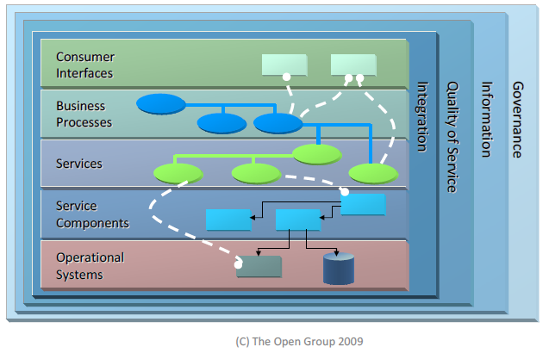
Reference architectures - 2
Open Group’s SOA reference architecture solution view

Slide 17
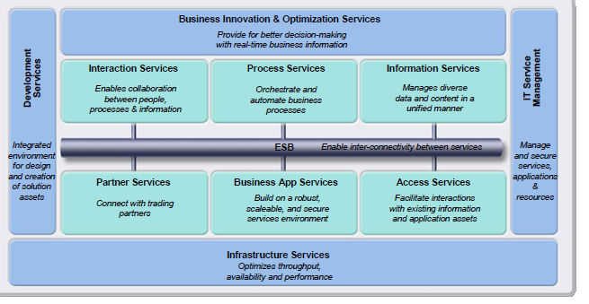
Reference architectures - 3
Middleware view of the SOA reference architecture

Slide 18
Views and Viewpoints
A view of the architecture is some subset of the information about the structure of the product.
A viewpoint is a perspective from which the view is seen.
The architecture of a house might have a view of the plumbing. The viewpoint might be looking down or from the source of water entering the house.
The following reference gives a very good description of possible views and the stakeholders for whom they are appropriate.
http://www.opengroup.org/architecture/togaf8-doc/arch/chap31.html

Slide 19
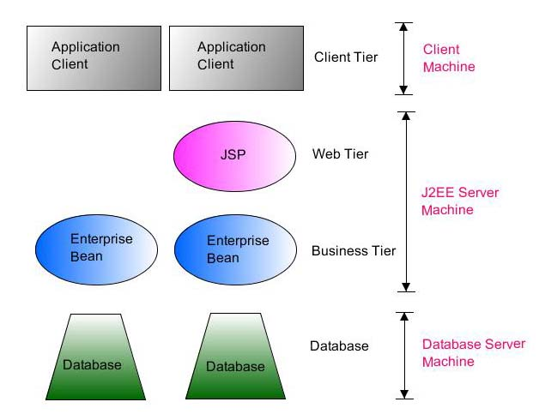
Deployment View
http://www.exforsys.com/tutorials/j2ee/j2ee-overview.html

Slide 20
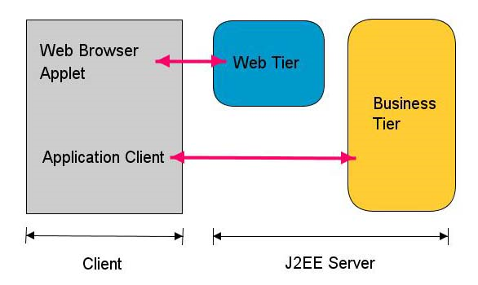
Logical view

Slide 21
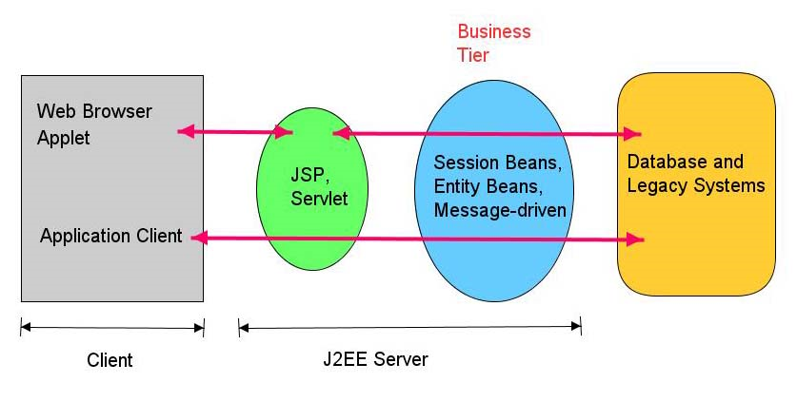
Technology view

Slide 22
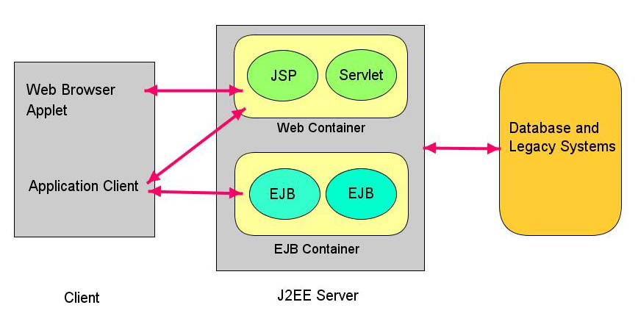
Process view

Slide 23
Quality attributes
Quality attributes are the attributes referenced in non-functional requirements. The performance of a system is a quality attribute of the system and corresponds to nonfunctional requirements that specify specific levels of each attribute that is desirable in the system. For example: The telephone switching system shall be capable of handing 500 calls per minute while only dropping 5 of those calls. This is a statement of performance (500 calls per minute) and reliability (only 5 in 500)
http://www.softwarearchitectures.com/go/Discipline/DesigningArchitecture/QualityAttributes/tabid/64/Default.aspx
http://www.bth.se/tek/besq.nsf/%28WebFiles%29/B339B908DC4E9D2BC12570690032868B/$FILE/chapter_5.pdf
http://www.gaudisite.nl/SystemArchitectureProcessPaper.pdf
http://www.mentor.com/resources/techpubs/upload/mentorpaper_40800.pdf

Slide 24
Quality attributes
Quality attributes are used in attribute-driven design (ADD) as the major basis for analysis and decision making.
Architectural tactics are patterns that define transformations on architectures that change specific attributes in specific ways
For example: “a tactic to make a design more maintainable decompose large modules into smaller ones”
Maintainability is a static attribute; performance is a dynamic attribute

Slide 25
Process - 1
The systems architecture definition process begins with an idea. Often it is an idea from a marketing person or an influential person.
The process does not wait until there is a complete requirements model to begin.
We know how others are architecting similar systems and we begin to study similar patterns and reference architectures while requirements are refined.

Slide 26
Process - 2
We know the domain, or we study it, and so we know the culture of system development used in our company and other similar ones.
Embedded systems are designed differently from e-commerce systems, etc.
De facto standards and official standards give constraints
These inputs set us up to interpret the requirements in an appropriate context

Slide 27
Process - 3
The requirements model will give both functional and non-functional requirements.
The non-functional requirements set desired values for specific quality attributes.
The architect uses those requirements as a driving force for architecture decisions
Combined with existing patterns, they sequence decisions as well as determining what is the “correct” decision.

Slide 28
Process - 4
4 views give us a guide for starting
  Interface’s behavior - Design the interfaces defined in use cases; human and machine – actions in and results back out
  Static behavior – Define modules that separate concerns that represent domain abstractions; some relationships such as generalization/ specialization are static; specialization incrementally defines a new module; for example, a Tom Tom GPS is a special kind of Navigation Aid

Slide 29
Process - 5
  Dynamic behavior – Identify relationships among the modules that reflect communication during operation;
  Interaction behavior – Modules that have a communication relationship often exchange multiple messages/data; these interactions often need to be choreographed to ensure appropriate sequencing and synchronization ; more on this shortly

Slide 30
Process - 6
The views document the architecture and allow its communication to the general population of stakeholders.
This documentation also supports evaluation of the architecture against its purpose.
The architect continues to monitor a project to ensure that construction is faithful to the architecture.

Slide 31
Diagrams
Languages such as AADL and SysML are both used to capture design information as we described in the previous module.
Sequence
Activity
State

Slide 32
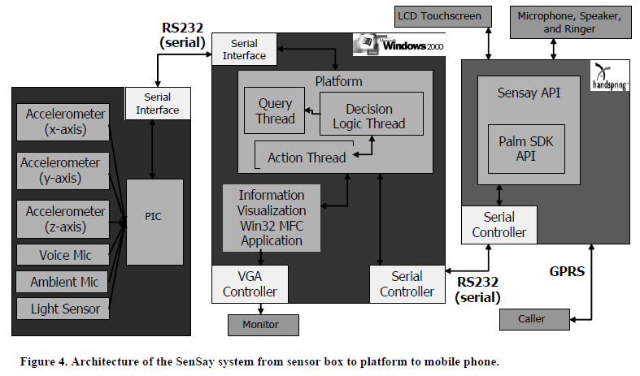
SenSay architecture
doi=10.1.1.70.4047

Slide 33
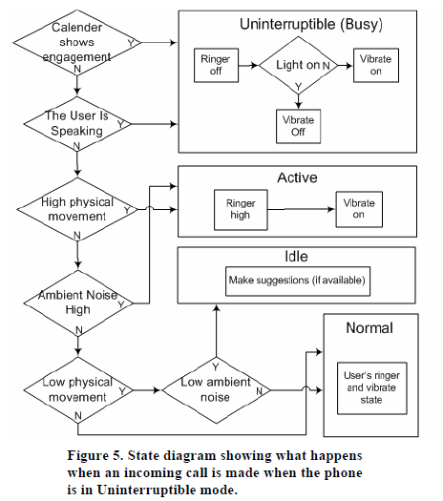
State Diagram

Slide 34
Logical/Physical Architecture
The logical design covers the structure of the software
The physical design covers the tangible aspects such as processors and buses.
A “bound” system has a mapping that associates elements between these two
In AADL this is an “Actual Binding”

Slide 35
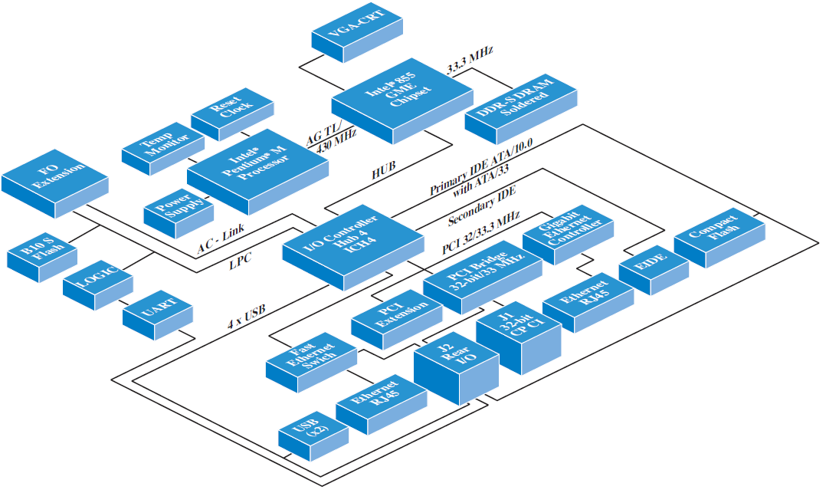
Portion of vehicle network
http://download.intel.com/design/network/ica/downloads/31200501.pdf

Slide 36
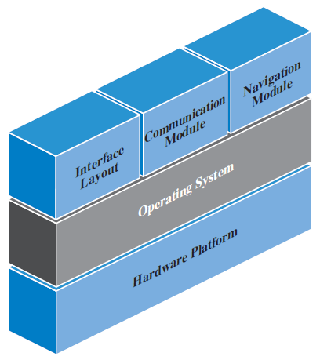
OS
The OS maps the logical onto the physical architecture.

Slide 37
Separation of concerns
Much of architecture can be summarized as “separation of concerns”
A module should address one concern.
Specification is separated from implementation
Input, output, and computation are all separate modules
http://www.aspiringcraftsman.com/2008/01/art-of-separation-of-concerns/

Slide 38
Safety requirements
Life critical systems require very formal design and verification processes
This should start with the architecture
Function Hazard Analysis
Assurance cases
http://www-users.cs.york.ac.uk/~tpk/wwuissc06.pdf

Slide 39
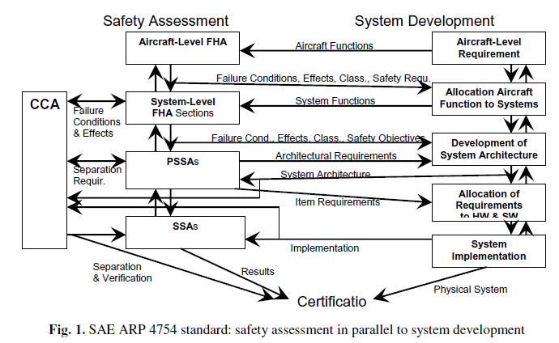
Safety and System
It’s not just for aircraft.

Slide 40
Function Hazard Analysis
A hazard is defined in FAA Order 8040.4 as a "Condition, event, or circumstance that could lead to or contribute to an unplanned or undesirable event.“
A large number of different types of analyses are used in different domains.
Fault Tree Analysis is a graphical technique that shows all ways a particular fault can lead to failure.

Slide 41
FTA
Function | Hazard | Constraint | Effect
Cellular connection | When connection is active all sounds including alarms are silenced | No redundant signals | Driver does not hear collision alarm
 |  |  | Driver does not hear lane crossing alarm
 | Internal networks have minimal bandwidth resulting in delays when many sensors fire at once | Power and weight constraints | In an accident multiple sensors fire and delay 911 calls
GPS | No map is available to visually show route | Memory requires power | Driver may make dangerous maneuvers to follow incorrect directions.

Slide 42
Analysis
One technique for FTA is to use a Bayesian Belief Network to calculate probabilities of failure. The article below gives a simple example.
https://www.eetimes.com/design/embedded/4206019/Bayesian-Fault-Tree-Analysis-of-Safety-Critical-Software
This allows an on-going evaluation as additional failure information is collected.

Slide 43
Infotainment
Part of a larger safety critical system
One possibility is to have an operating system that has partitions that guarantee isolation
Identity authentication is informal and relates to stored settings concerning seat position, etc
The architecture process must consider the volatility of this domain with new devices appearing rapidly
Mechanisms must be selected that allow dynamic discovery of new device types based on standard interfaces.

Slide 44
Infotainment - 2
Increasing interactions among functions as data from one subsystem such as collision detection is used to initiate events such as an automatic 911 call.
The data will be carried on the appropriate bus: CAN or MOST type buses
The architecture must avoid tight coupling among the interacting subsystems

