Slide 1

SYSE 802
John D. McGregor
Module 4 Session 2
System of Systems

Slide 2
System of Systems
System of Systems (SoS): any system that is a relatively large and complex, dynamically evolving, and physically distributed system of pre-existing, heterogeneous, autonomous, and independently governed systems, whereby the system of systems exhibits significant amounts of unexpected emergent behavior and characteristics
This is a huge topic that we can only sample but we will examine current issues about these systems.

Slide 3
Examples
Phone system
Electrical grid
Automobile
…

Slide 4
System of Systems
scale—increases the flexibility required of system-of-systems constituents while increasing the constraints imposed on the engineered solution
multi-domain—constituents from different domains may belong to different domains and a capability may be used in different domains
varied operational context—users operating with different workflows and under different business processes may use the same capability
decentralized control—a system of systems has more than one decision-making authority
rapidly evolving contexts—changes in technology, unpredictable user demands, and other modifications ripple through a system of systems
continuous and often disconnected execution of multiple life-cycle phases—constituents often are in different phases of their life cycles and those life cycles may differ from one another
opportunistic needs to collaborate and integrate—new demands create new opportunities that require more adaptation by constituents and the system of systems

Slide 5
Management Issues
$
$
$
$
SoS:
Within
Single
Organization
Joint SoS:
Interdependencies
Across
Multiple
Organizations

Slide 6
Survival in SoS
Dynamism of the participating entities and the effects they are trying to achieve and the environment they are working in
The participating organizations need agility along multiple dimensions
The demand environment – where you’re trying to have an effect – is at least as dynamic as the supplier environment
Autonomy of both the technical and organizational entities
The organizations participating are not likely to be operating by the same rules— they have different, often incompatible, governance frameworks
Effects that cannot be generated from the designed repertoire of individual entities and are only seen in the system of systems as a whole
Unanticipated behaviors could be positive or negative
Impossible to trace the behavior back to a single entity
http://www.sei.cmu.edu/library/assets/survivalinsos.pdf

Slide 7
DoD SE Guide for SoS
“The SoS architecture provides an integrated view of the ensemble of systems within the SoS. The development of the architecture of an SoS is an important core element for SoS SE because it frames and supports design changes to the SoS over time.”

Slide 8
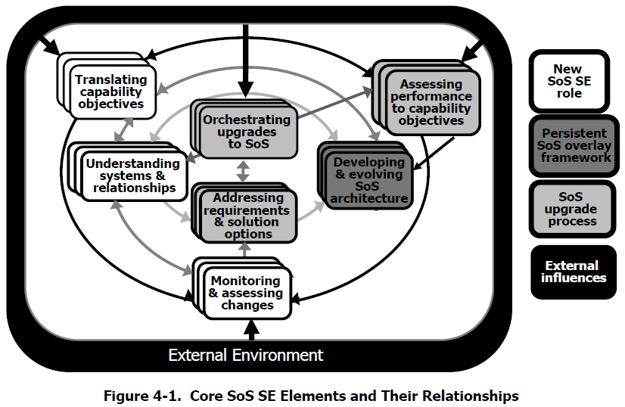
SoS SE

Slide 9
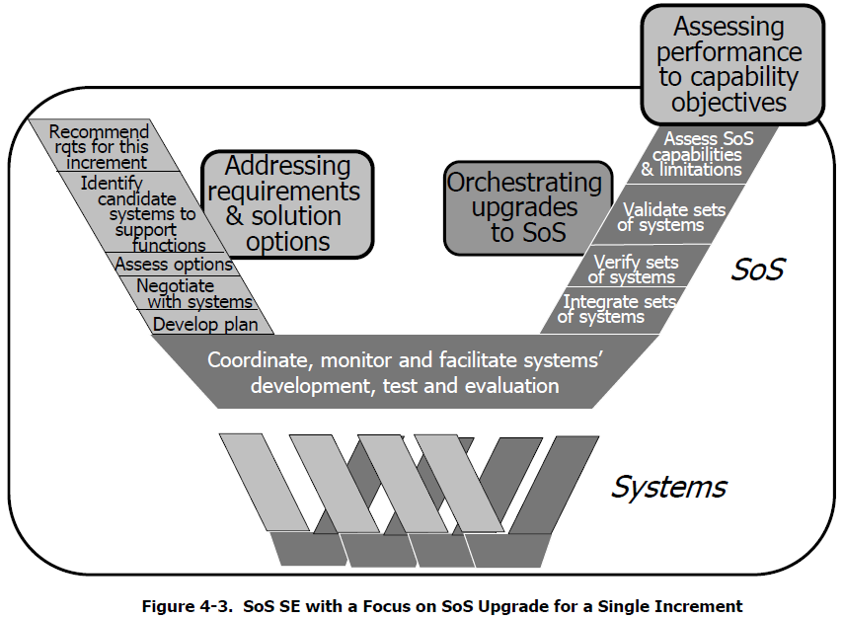
Upgrade SoS

Slide 10
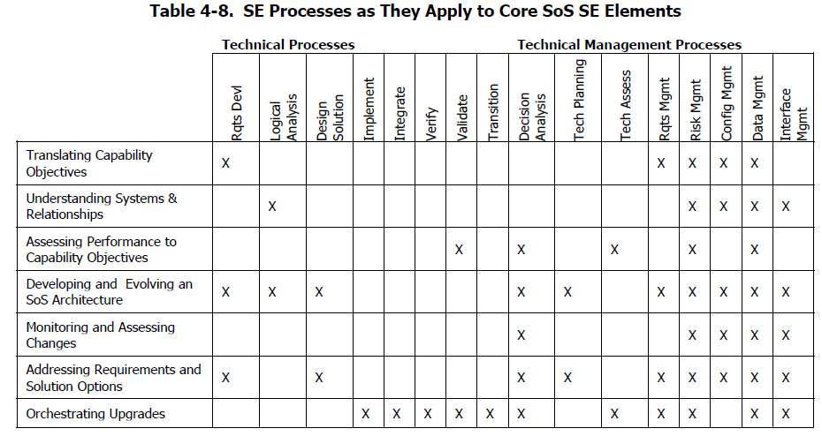
SE SoS Responsibilities

Slide 11
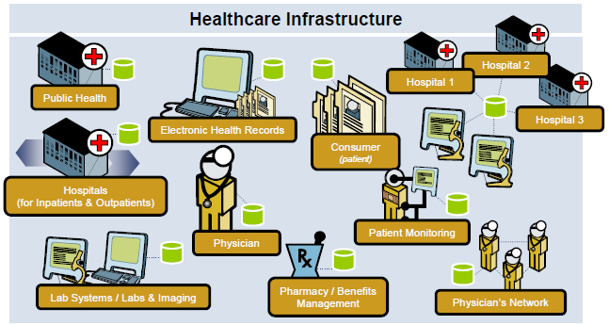
Ultra-Large Scale Systems
http://www.sei.cmu.edu/library/abstracts/presentations/icgse06.cfm

Slide 12
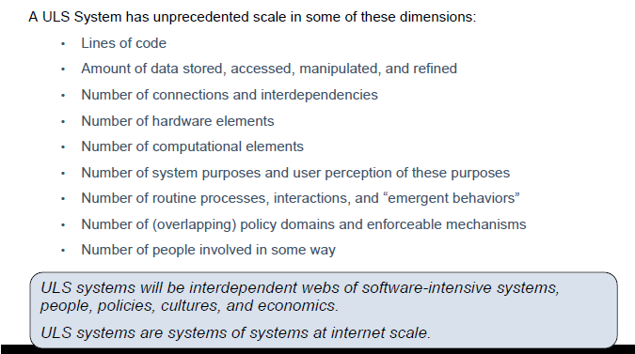
Ultra-Large Scale Systems
http://www.sei.cmu.edu/uls/

Slide 13
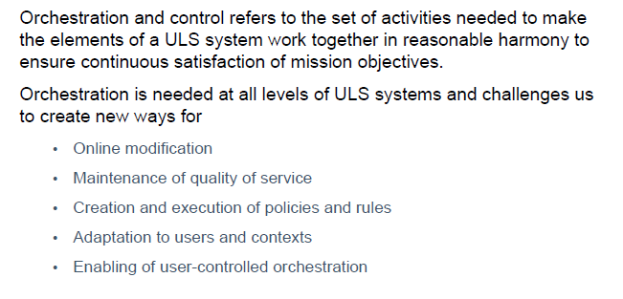
Ultra-large Scale Systems
The SE plays a central role in orchestration and control

Slide 14
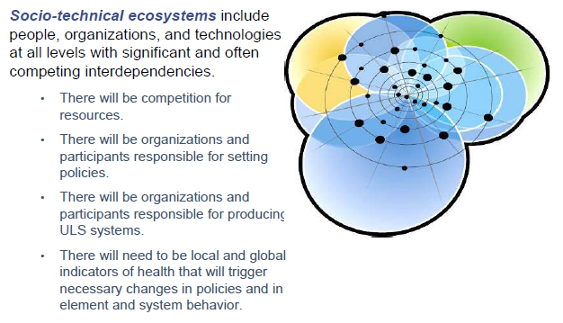
Ecosystems
http://www.sei.cmu.edu/library/assets/ICGSE06.pdf

Slide 15
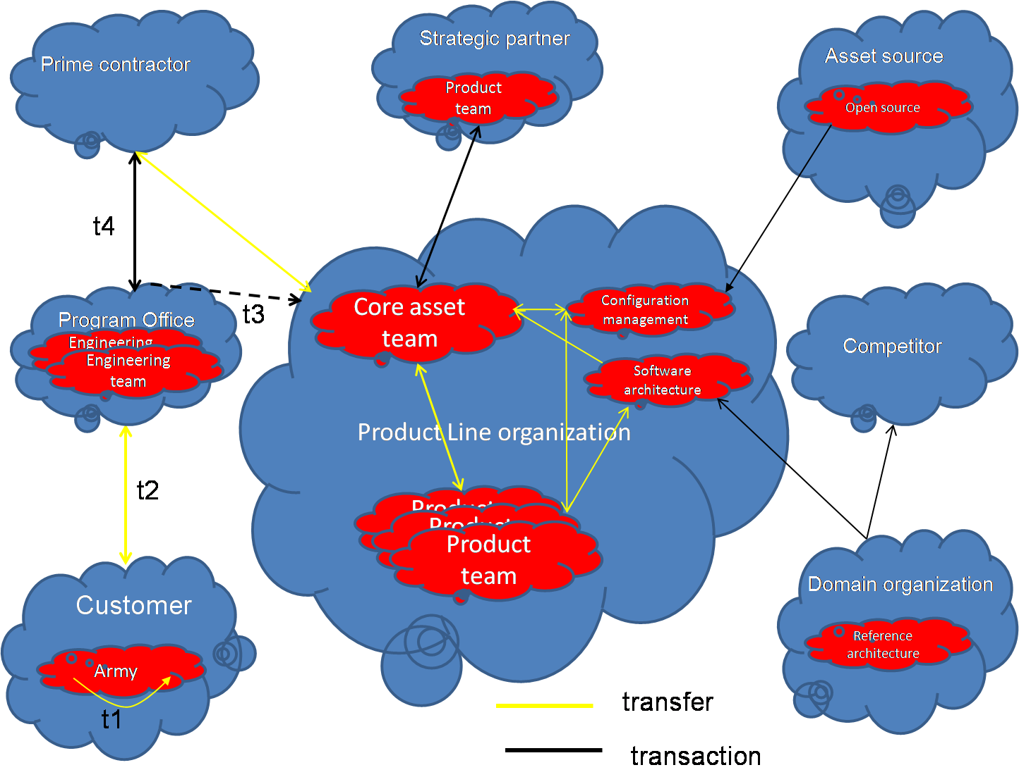
Ecosystems
A software product line organization is a focal point in its own ecosystem.
This is some of my research into strategic engineering

Slide 16
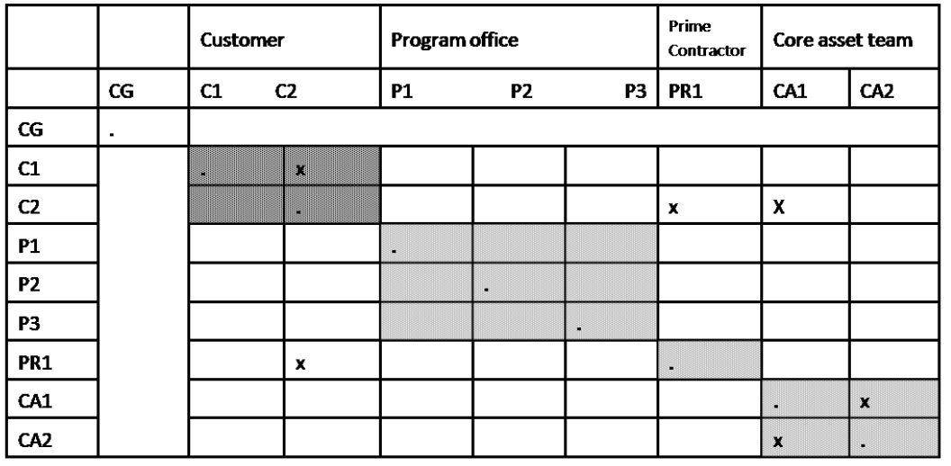
Task Structure Matrix

Slide 17
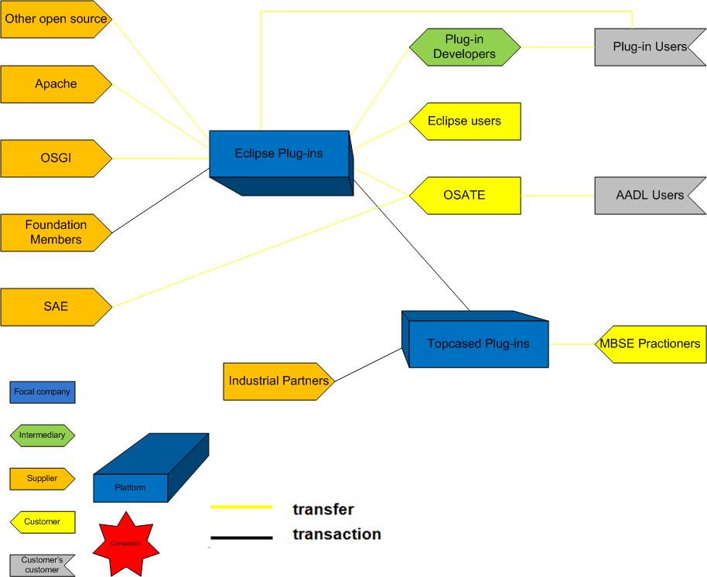
Ecosystem for Eclipse

Slide 18
Infotainment system
Works in the context of the overall automotive environment
Some subsystems are in control of life critical subsystems.
The interactions with the other subsystems are kept to a minimum for safety reasons but these interactions are a growing source of value

