Slide 1

SYSE 802
John D. McGregor
Module 4 Session 4
Solution

Slide 2
Expectations
Context – Add a few use cases about at least two systems that are “around” your system.
Qualities – Try to get representative values for the qualities you have defined in this and the previous assignment. Use fact sheets, specs or standards.
Views – Think about each actor in the use case diagram and maybe a stakeholder that does not directly interact with the system. What do they need to know about the architecture?

Slide 3
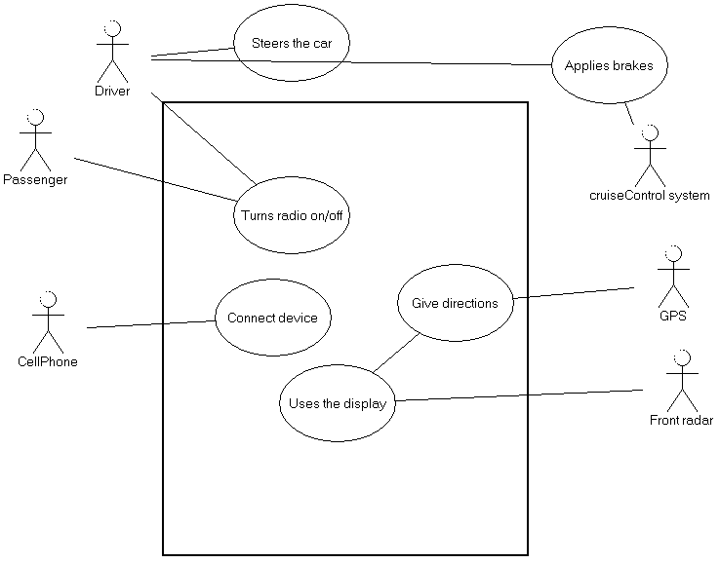
Context
This shows a few of the other systems running on the vehicle. Several others
could be added to the diagram.
This diagram shows use
cases outside the boundary
to show that our system is a
system within a System.
This is an anticipated SoS
meaning that we design the
infotainment system with
vehicles in mind.

Slide 4
Qualities
Power: 8 – 20 V
Physical size: 165 cm by 175 cm
Temperature levels: -25C to 45C
Vibration levels to 2,940m/s2
Memory – 1GB

Slide 5
Views
For the infotainment system
Developers of products that use the infrastructure of the infotainment to incorporate their products into the vehicle need the standard structural and dynamic views of the architecture; also interface definitions
Developers of products that interact with the infotainment system need interface information; a set of interface definitions; also need receiver and transmitter protocol definitions
Vehicle marketers and users need a high-level schematic to show the features of the system to buyers
Automotive engineers need quality attribute requirements that specify the power needs, the heat generated, the weight, the network interfaces.

