Slide 1

SYSE 802
John D. McGregor
Module 6 Session 1
Systems Engineering Analyses II

Slide 2
Session Objective
In this session we will explore another analysis technique: Quality Function Deployment.

Slide 3
Goals
Capture the Voices of the Customer and the Engineer
Three main goals
Prioritize spoken and unspoken customer needs
Match those needs to technical characteristics
Focus everyone on customer satisfaction

Slide 4
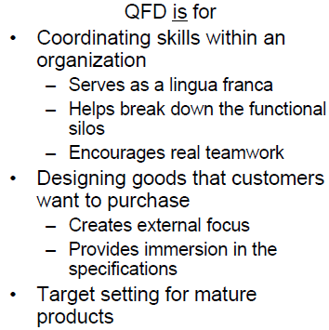
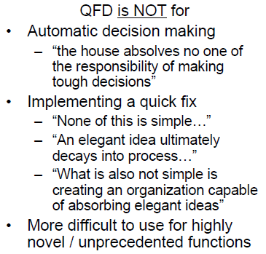
QFD

Slide 5
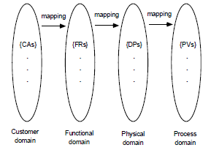
QFD - 2
Takes elicited information from customers and uses it to drive a chain of transformations.
The chain cuts across the entire organization and serves as a focus for getting everyone focused on meeting customer needs.

Slide 6
QFD Phases
Product Planning
Captures customer requirements
Product Design
Product concepts defined
Process Planning
Manufacturing processes are laid out
Process Control
Production planning creates measures used to control the production process

Slide 7
Product Planning
The systems engineer will lead this process.
The systems engineer will ensure the comprehensiveness of the information.
It will bring together product managers, marketing personnel, and other front-end people.

Slide 8
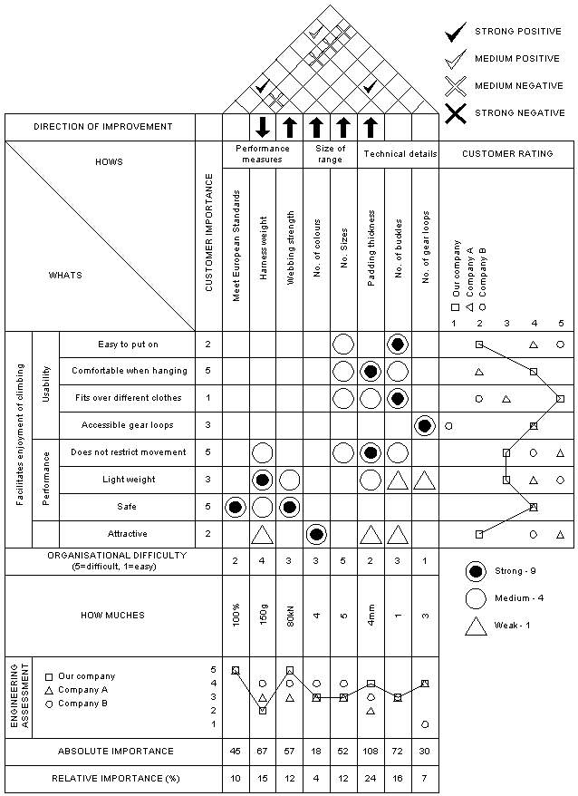
House of Quality
The House is intended to capture a large number of measures in one figure.
The idea is to start with customer needs and move to engineering considerations of those needs.
Figures here and on the next pages from: http://www.ciri.org.nz/downloads/Quality%20Function%20Deployment.pdf

Slide 9
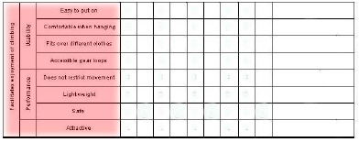
Voice of the Customer
Individual requirements are elicited and captured in this matrix.
They can be grouped as shown in the second column from the left in the table.
The source can be whatever the project wants: use cases, statements, feature models…
Note: red shading
Is the focus of the text.

Slide 10
Voice of the Customer - 2
This should be a comprehensive list
Functional and non-functional
Requirements from regulatory agencies, laws, professional standards, …
Company policies may also be reflected in this matrix: “we use only Intel chips”

Slide 11
Voice of the customer - 3
Three categories of customer needs:
Linear satisfier – the usual “good” ideas that are not revolutionary but …
Must have – essential to the product
Delighter – a characteristic that will delight a customer

Slide 12
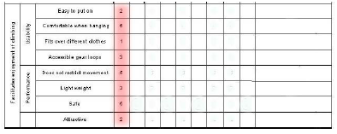
Priority ratings
Customer data can be used to obtain a priority rating. Any required elements are given the highest possible rating. This is not a ranking.
Different customers can be given different numbers of votes and they can vote more than once for a particular requirement.

Slide 13
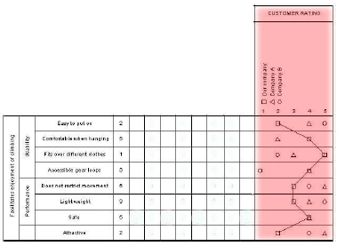
Competition
Customers can be asked to rate competitors on each requirement. The picture shows multiple clients but there are techniques for combining the scores into one value.

Slide 14
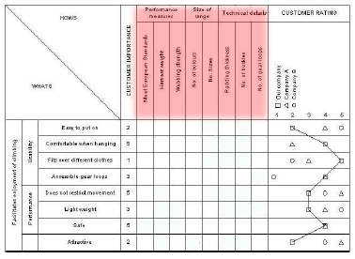
Voice of the Engineer
This matrix captures technical expectations that address the customer requirements. There is not a one-to-one match but each customer requirement is used to drive the identification of engineering factors.

Slide 15
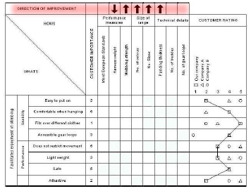
Improvement
The direction of change is captured for each technical factor. That is, do we intend for our efforts to make the value larger or smaller?

Slide 16
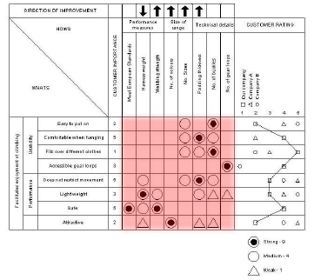
Relationships
The relationship matrix relates each customer need to appropriate technical needs. Usually on a binary scale, but sometimes on an odd-numbered scale such as high, medium, and low.

Slide 17
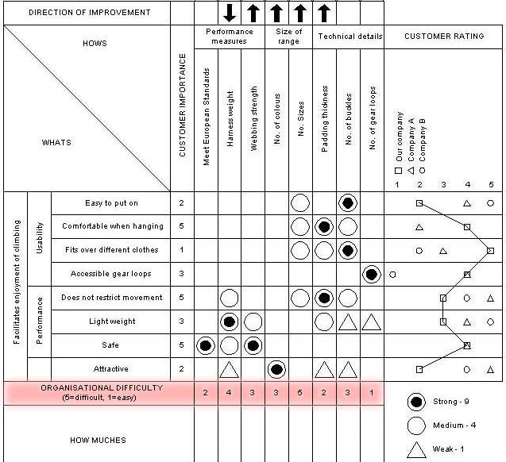
Difficulty
There are many potential difficulties that could affect the use of specific technical factors.
This row allows an estimate of those to be included in the analysis.

Slide 18
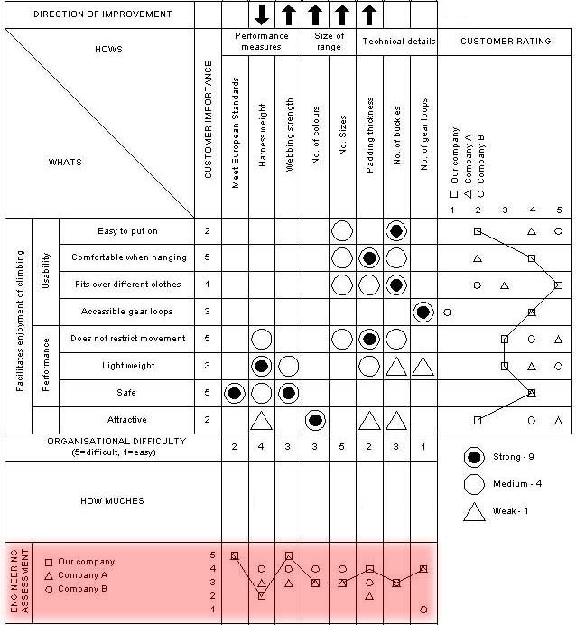
Engineering assessment
The engineering staff makes the same assessment as customers have but against the technical factors.

Slide 19
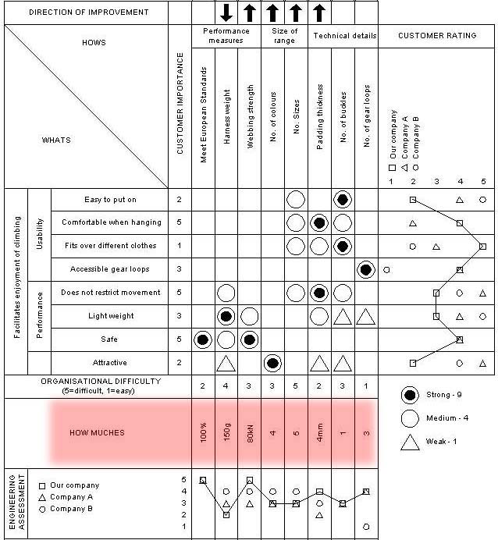
Target Values
Goals are set for each of the technical factors.

Slide 20
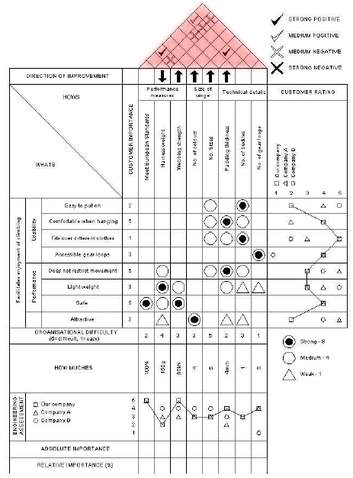
Correlation matrix
In the correlation matrix, a mark in a cell indicates a relationship between the two factors. Positive and negative relationships can be shown.

Slide 21
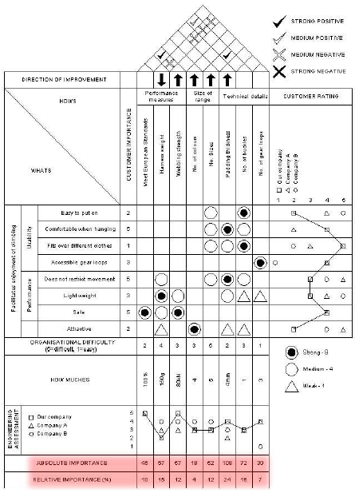
Absolute importance
This is the product of the cell value and the customer importance.
For example, “Meet European Standards” has only one cell marked. It is a “9” and “safe” is a “5” so the importance is 45.

Slide 22
Product Planning
We have completed the form for Product Planning and can now consider the information.
In the relationship matrix, look at the rows and columns.
A full (or nearly full) row indicates several system requirements are related to the customer need. Check that the customer need has a high importance rating since it requires much effort to implement.

Slide 23
Product Planning - 2
A full (or nearly full) column indicates that a system requirement cuts across several customer needs.
Check whether these customer needs are similar or need to be refactored.
Check the difficulty of this requirement. Special attention will be needed if this “high”.
The literature is full of analyses that can be run on this data.

Slide 24
Other Phases
The majority of companies that use QFD only use the “House of Quality”, this first sheet we have completed.
Each succeeding phase takes the elements on the horizontal axis of the preceding relationship matrix as its vertical axis.
Product Design
Voice of the engineer mapped to part design specification
Process Planning
part design specification mapped to manufacturing planning
Process Control
manufacturing planning mapped to production planning

Slide 25
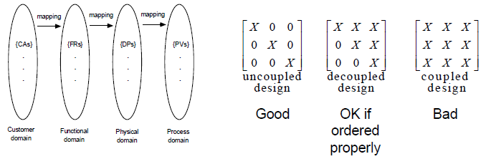
Axiomatic design
Functional requirements are
transformed into design parameters.
Design parameters are
transformed into process variables.

Slide 26
Progression
These 4 domains correspond to the house transformations that are made.

Slide 27
Product families
For a software product line, a Master House of Quality has been developed.
Then each product development team starts with that data and derives the House of Quality for their product.
The Master House of Quality does not differ in terms of fields but in what the information represents.
Ratings about the competition can be reused.
Groups of customer needs will apply (or not) to a product. This corresponds to a feature.

Slide 28
QFD
http://www.ciri.org.nz/downloads/Quality%20Function%20Deployment.pdf
http://does.eng.buffalo.edu/DOES_Publications/2008/Olewnik.IJQRM.HoQ.2008.pdf

Slide 29
Summary
QFD provides a method for gathering and interpreting data about the entire life cycle but primarily about customer needs.
It provides the basis for several analyses that may be useful to specific types of projects.

