Slide 1

SYSE 802
John D. McGregor
Module 6 Session 2
Tailoring Processes

Slide 2
Session Objective
The objective of this session is to explore techniques for tailoring processes to meet the specific needs of an individual project.

Slide 3
Method
A method is a combination of tools, models, and processes that accomplish a specified task, such as the object-oriented development method.
A method provides structure to how a task is to be accomplished.
The Software and Systems Process Engineering Meta-Model provides a means of expressing methods. www.omg.org
Note: Many people use “process” when they really mean “method”

Slide 4
Need for models of methods
Different customers may require different levels of maturity – NASA requires Level 3 CMMI
Certain customers may require special techniques such as a particular performance measurement or a specific design tool
Certainly new tools, models, and process models will emerge over time and should be used to upgrade the existing method
Applying a “one size fits all” approach is inefficient and often inadequate

Slide 5
Method Engineering
“Method engineering (ME) and situational method engineering (SME) focus on formalizing the use of methods for systems development. The broader term, method engineering, is defined as the engineering discipline to design, construct and adapt methods, techniques and tools for systems development…”
We need technique deciding what makes a method “good” or at least better, tools to support tailoring, and processes for tailoring. In short we need a method for tailoring methods.
Situational Method Engineering: State-of-the-Art Review by Brian Henderson-Sellers and Jolita Ralyté. Journal of Universal Computer Science, vol. 16, no. 3 (2010), 424-478.
In CMMI, Generic Practice 2.2 Planning the Process, gives an entry point into the CMMI for method engineering .
http://www.sei.cmu.edu/reports/94tr024.pdf
These references are only for your curiosity. No requirement to read.

Slide 6
ME, Tailoring and Improving
Method engineering addresses building a method from scratch.
Process improvement, as described in the literature such as CMMI, is a technique for introspecting on the actions taken during product development and making changes to improve the process but may not affect the rest of the method.
Tailoring, a special case of method engineering, creates a variant of a general process model for the purpose of satisfying the specific objectives of a specific project.
Tailoring is the focus of this session.

Slide 7
Tailoring Process
Many regulations such as MIL-STD-499B include sections that specify tailoring mechanisms and considerations.
This model illustrates…
Project’s
Defined
Process
Project Information
Process (method) definition process
Organizational Input
External Input
Lessons Learned

Slide 8
Project Information
Size and Complexity:
Software Product (estimated SLOC or FP)
Documentation (estimated # of pages)
Development Team (estimated # of people)
System Product Mix:
Number of HWCIs
Number of CSCIs
Number of Interfaces (External)
Type of Software (Command & Control, Embedded, MIS, ATE)
Type of System (Centralized, Distributed, etc.)
Intent (Feasibility study, research, operational system, incrementally developed operational system, upgrade to an existing system, etc.)
Criticality (Life Critical, Safety Critical, etc.)
Number of Users
Type of Users
Local or Distributed
Number of Installations
Life of Product (Number of months or years)
Upgrade Interval
Formality
Development requirements
Formal reviews and audits
Formal approval of deliverables and baselines
Control
Management visibility level required
Development Organization
Acquirer Organization
Project Risk Management
Cost
Schedule
Technical

Slide 9
Organizational Input
Business goals
Product goals
Production goals
Measures of method effectiveness

Slide 10
External Input
Legal regulations – DO178B for air worthiness; Mil-std-498; DO 254
De facto or formal standards – IEEE 1074
Business/operational context

Slide 11
Meta-models for method definition
ISO 24774
ISO 15288
ISO 24744
SPEM 2
BPMN 2
ISO 15926
We have been using SPEM 2, which is the basis for EPF.

Slide 12
How much method is enough?
RTCA DO-178B or
FDA 21 CFR part 820
Time to market

Slide 13
Method Chunks
Method engineering begins with pieces of a method being collected. (Method Content in EPF)
Then method engineering takes a basic framework, such as iterative or agile, and fills it with the “right” method chunks.

Slide 14
Method Chunks - 2
The “right” pieces depend upon many factors including:
Time lines
Available personnel
Size of the product
Initiatives underway in the organization
For internal use or external sale

Slide 15
Method Chunks - 3
A good approach to identifying appropriate chunks is to use an appropriate meta-model.
For chunks use these primitives from SPEM:
Role
Task
Workproduct
Guidance
Delivery Process

Slide 16
Method Composition
The method chunks are composed into a recognizable process with appropriate sequencing.
iterative uses a feedback loop to repeatedly process the same material into increasingly specific information.
Incremental repeats process steps but with different material
Agile opportunistically addresses material quickly
EPF provides a “repeatable” check box for tasks on the process definition pages.

Slide 17
Method Composition - 2
Exit and entry criteria are used to wire together chunks according to the process model being followed (iterative, etc)
The work breakdown structure provides a natural structure for organizing into a process.

Slide 18
SPL & Tailoring
In a software product line organization, differences among products are anticipated and managed by including variation points at the places where the products differ.
The production method for the product line is no exception.
The method has variation points.
There may be different verification techniques for different products or other differences

Slide 19
SPL & Tailoring - 2
In EPF this is done by having a page that provides an abstract description of an element and then a product team “extends” that page to give a project-specific definition for the element.

Slide 20
Example
There are beginning to be process frameworks that support discipline-specific method definitions.
MFESA is a framework for defining system architecture definition methods
FYI:http://www.sei.cmu.edu/library/assets/mfesatutorialoneday20090420.pdf

Slide 21
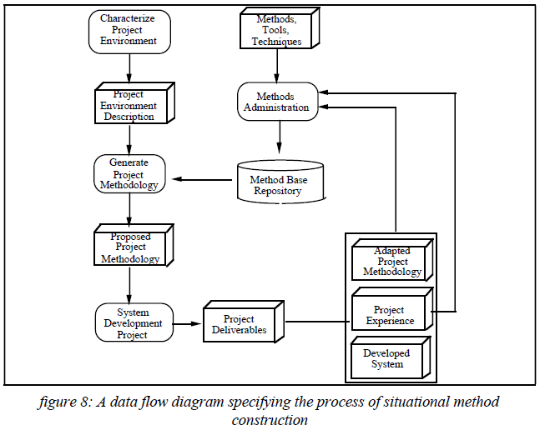
Example - 2
This model lays out the process for defining a new method.
Tailoring a method is similar

Slide 22
Tailoring
This is a brief paper on method tailoring. Take a quick read.
http://www.springerlink.com/content/j120572885131602/fulltext.pdf

Slide 23
Summary
Method engineering, including tailoring, is an increasingly important discipline in a systems development organization.
Selecting the right pieces and combining them in the best way is still an art but it is at least an explicitly articulated art now rather than implicit.

