Slide 1

SYSE 802
John D. McGregor
Module 7 Session 2
State Machines

Slide 2
Session Objective
To explore the use of state machines in specifying behavior

Slide 3
State machines
State machine – a set of states and the transitions among them including conditions for traversing the transitions
State – a particular combination of data values in variables that are referenced by functions to determine how to behave; variables that are used in control statements (if, while, …)

Slide 4
State machines - 2
Transition – a directed link between states that is annotated with three elements:
  Trigger – an event that initiates the change from one state to another
  Guard – a boolean expression that must be true for the change from one state to another to occur
  Action – a behavior that occurs as a result of successful change

Slide 5

transition
Call is an event
OCL expression (Object Constraint Language)
Function behavior

Slide 6
States/Modes
Most definitions of state and mode sound just about the same.
Essentially modes divide the requirements into sets where the requirements are active when the system is in a particular state (has a particular data configuration)
Using modes simplifies the system since only a subset of requirements needs to be analyzed at any point in time.

Slide 7
AADL Example
system implementation Gps.Dual
subcomponents
Main_Gps: process Gps_Sender.Basic in modes (Dualmode, Mainmode);
Backup_Gps: process Gps_Sender.Basic in modes (Dualmode, Backupmode);
Monitor: process GPS_Health_Monitor;
connections
data port Main_Gps.Position -> Position in modes (Dualmode, Mainmode);
data port Backup_Gps.Position -> Position in modes (Backupmode);
data port Backup_Gps.Position -> Main_Gps.SecondaryPosition
in modes (Dualmode);
Components and connections may only exist when the product is in a particular mode
The mode definition covers all of the behavior of the “system”
From the AADL on-help in OSATE

Slide 8
AADL Example
modes
Initialize: initial mode;
Dualmode : mode;
Mainmode : mode;
Backupmode: mode;
Initialize –[ Init_Done ]-> Dualmode;
Dualmode –[ Monitor.Backup_Stopped ]-> Mainmode;
Dualmode –[ Monitor.Main_Stopped ]-> Backupmode;
Mainmode, Backupmode –[ Monitor.All_Ok ]-> Dualmode;
end Gps.Dual;
This section defines the modes and the transitions.
Inside the [] is the function in some system that is invoked to move from one state to another.
From the AADL on-help in OSATE

Slide 9
Common states
There are some states that are commonly used:
  Initialized/Off/on
  Normal/error
  powerUp/on/off
  Active/standby

Slide 10
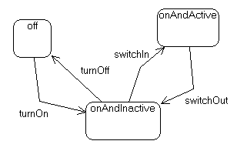
Flat machine
States often have something in common and the more states usually the more commonality.
Use of hierarchical machines simplifies the diagram.

Slide 11
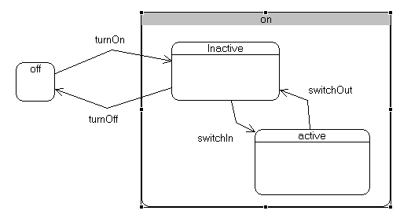
Hierarchical state machines
Nesting states reduces complexity and separates concerns

Slide 12
Traces
A trace through a sequence of states gives a sequential path of execution.
Using regions in a state allows a representation of parallel actions.
This specifies parallel actions but they may actually be represented as concurrent actions in the implementation.

Slide 13
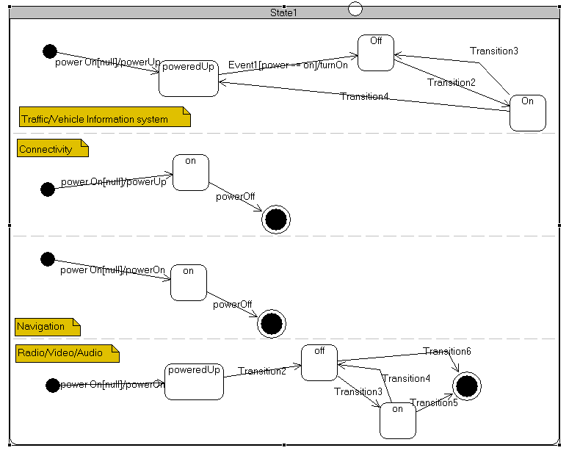
Concurrent states

Slide 14
Resources
There is a demo of the simulation capability using state machines in Topcased available on the module page.
For reference, no requirement to read: This is a report on state machines in the automotive domain.
http://delivery.acm.org/10.1145/1140000/1138482/p37-schnieders.pdf?key1=1138482&key2=0681228821&coll=GUIDE&dl=GUIDE&CFID=107561142&CFTOKEN=65623825

Slide 15
Hierarchy
Topcased and other IDEs use hierarchy to visually reduce the complexity.
On the next slide is the top level machine. Notice the oval in the upper right corner. These arrows are used to move from one diagram to attached diagrams. (You can also double click on the “on” state in the connectivity region)
On the following slide the activate machine shows the submachine. The oval shows the navigation arrows.

Slide 16
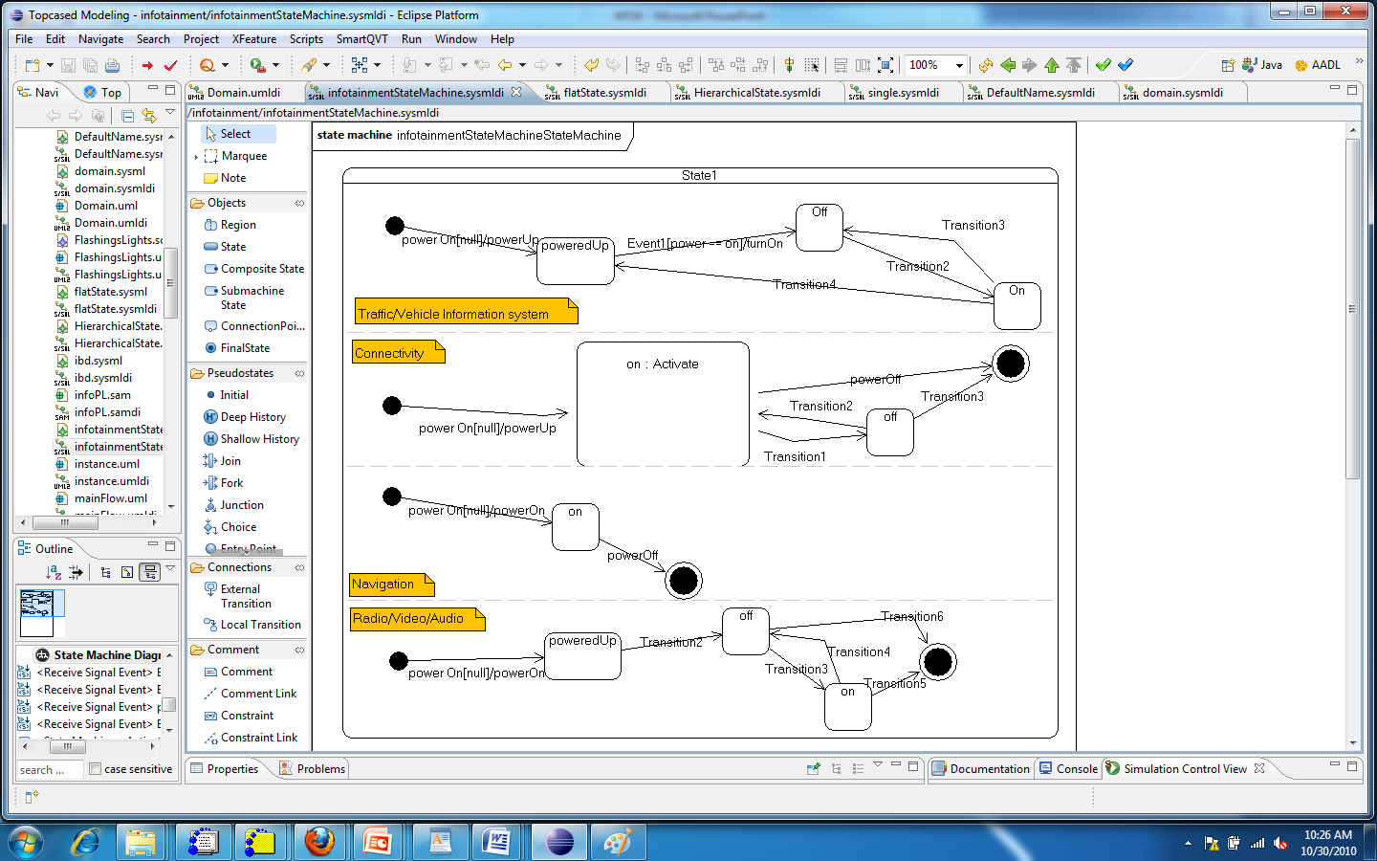

Slide 17
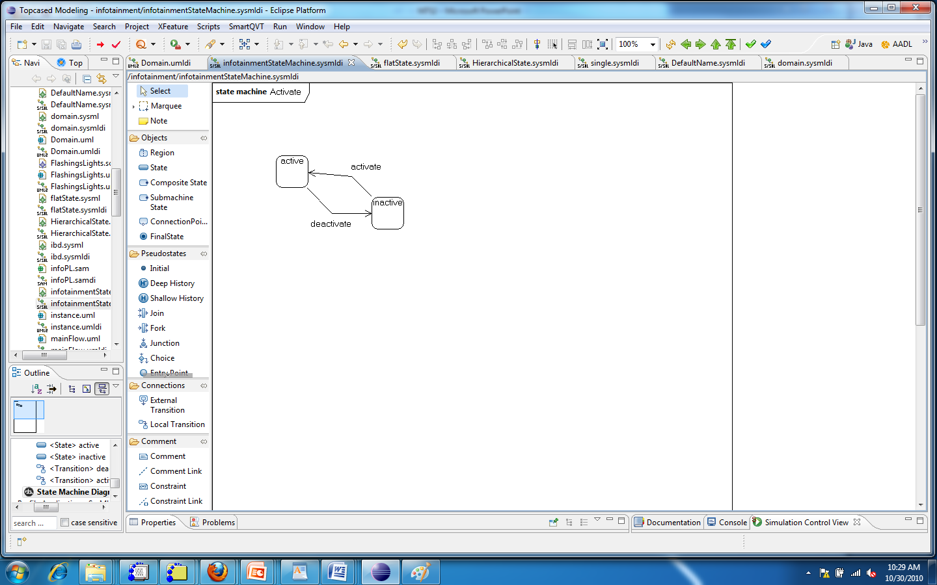

Slide 18
Summary
State machines are often used to convey the part of a specification that is reactive; i.e., that responds to a trigger.
The theory behind state machines (finite state automata) give the basis for automating consistency checks and checks for other properties.

