Slide 1

SYSE 802
John D. McGregor
Module 8 Session 2B
Cost Estimation

Slide 2
Introduction
These slides present a technique for effort/cost estimation: COSYSMO (Constructive Systems Engineering Cost Model)
As you go through think about how you (in your company) would be able to obtain the data you need in order to apply this technique

Slide 3
Why estimate cost?
Estimates of effort and cost are needed to decide the viability of a project.
If an organization has a defined process which is repeatable, the cost of creating a product that satisfies 50 requirements will be repeated as well.
A particular estimation technique has a theory and a formula that takes a set of project characteristics as the basis for computing an estimate.

Slide 4
Estimating
One approach to estimating is to base an estimate on previous experience
If there is no change in the development process then the cost to develop 5 similar requirements should be the same now as a few weeks/months ago
The parameters on this model are estimates that reflect a “type” of project

Slide 5
Estimating - 2
For example: a project that has 100 requirements takes more than twice the effort of a project with 50 requirements. There is a non-linear relationship.
The parameters are Size drivers and Effort Multipliers
The parameters are estimated from previous measurements and the formula is evaluated; the result is the effort estimate.

Slide 6
references
This is a paper about the technique
http://web.mit.edu/rvalerdi/www/COSYSMO%20A%20Systems%20Engineering%20Cost%20Model.pdf
This is a very good tutorial on the method
valerdi.com/cosysmo/COSYSMO%20Tutorial%20H01%20INCOSE2003.ppt
This is a tool from the developers of COSYSMO
http://csse.usc.edu/tools/ExpertCOSYSMO.php

Slide 7
CMMI and SE Effort Estimation
From CMMI-SE/SW/IPPD/SS, v1.1
Level 2: Project Planning
SP 1.4 Determine Estimates of Effort and Cost
Estimate effort and cost using models and/or historical data
Level 2: Measurement and Analysis
SP 1.2 Specify Measures
Estimates of actual measures of effort and cost (e.g., number of person hours)

Slide 8
Definitions
Calibration: the tuning of parameters based on project data
CER: a model that represents the cost estimating relationships between factors
Cost Estimation: prediction of both the
person-effort and elapsed time of a project
Driver: A factor that drives the amount of Systems Engineering effort
Parametric: an equation or model that is approximated by a set of parameters
Rating Scale: a range of values and definitions for a particular driver
Understanding: an individual’s subjective judgment of their level of comprehension

Slide 9
COSYSMO Operational Concept
# Requirements
# Interfaces
# Scenarios
# Algorithms
+
Volatility Factor
Size
Drivers
COSYSMO
Effort
Effort
Multipliers
Application factors
8 factors
Team factors
6 factors
Schedule driver
Calibration
WBS guided by
ISO/IEC 15288

Slide 10
COCOMO-based Parametric Cost Estimating Relationship
Where:
PM_{NS} = effort in Person Months (Nominal Schedule)
A = constant derived from historical project data
Size = determined by computing the weighted average of the (4) size drivers
E = could represent economy/diseconomy of scale, currently equals 1
n = number of cost drivers (14)
EM = effort multiplier for the i_{th} cost driver. The geometric product results in an overall effort adjustment factor to the nominal effort.

Slide 11
4 size drivers
Number of System Requirements
Number of Major Interfaces
Number of Operational Scenarios
Number of Critical Algorithms
Each weighted by complexity, volatility, and degree of reuse

Slide 12
Number of System Requirements
This driver represents the number of requirements for the system-of-interest at a specific level of design. Requirements may be functional, performance, feature, or service-oriented in nature depending on the methodology used for specification. They may also be defined by the customer or contractor. System requirements can typically be quantified by counting the number of applicable “shall’s” or “will’s” in the system or marketing specification. Do not include a requirements expansion ratio – only provide a count for the requirements of the system-of-interest as defined by the system or marketing specification.
Easy | Nominal | Difficult
- Well specified | - Loosely specified | - Poorly specified
- Traceable to source | - Can be traced to source with some effort | - Hard to trace to source
- Simple to understand | - Takes some effort to understand | - Hard to understand
- Little requirements overlap | - Some overlap | - High degree of requirements overlap
- Familiar | - Generally familiar | - Unfamiliar
- Good understanding of what’s needed to satisfy and verify requirements | - General understanding of what’s needed to satisfy and verify requirements | - Poor understanding of what’s needed to satisfy and verify requirements

Slide 13
Number of Major Interfaces
This driver represents the number of shared major physical and logical boundaries between system components or functions (internal interfaces) and those external to the system (external interfaces). These interfaces typically can be quantified by counting the number of interfaces identified in either the system’s context diagram and/or by counting the significant interfaces in all applicable Interface Control Documents.
Easy | Nominal | Difficult
- Well defined | - Loosely defined | - Ill defined
- Uncoupled | - Loosely coupled | - Highly coupled
- Cohesive | - Moderate cohesion | - Low cohesion
- Well behaved | - Predictable behavior | - Poorly behaved

Slide 14
Number of Operational Scenarios
This driver represents the number of operational scenarios that a system must satisfy. Such threads typically result in end-to-end test scenarios that are developed to validate the system and satisfy all of its requirements. The number of scenarios can typically be quantified by counting the number of unique end-to-end tests used to validate the system functionality and performance or by counting the number of high-level use cases developed as part of the operational architecture.
Easy | Nominal | Difficult
- Well defined | - Loosely defined | - Ill defined
- Loosely coupled | - Moderately coupled | - Tightly coupled or many dependencies/conflicting requirements
- Timelines not an issue | - Timelines a constraint | - Tight timelines through scenario network

Slide 15
Number of Critical Algorithms
This driver represents the number of newly defined or significantly altered functions that require unique mathematical algorithms to be derived in order to achieve the system performance requirements. As an example, this could include a complex aircraft tracking algorithm like a Kalman Filter being derived using existing experience as the basis for the all aspect search function. Another example could be a brand new discrimination algorithm being derived to identify friend or foe function in space-based applications. The number can be quantified by counting the number of unique algorithms needed to support each of the mathematical functions specified in the system specification or mode description document.
Easy | Nominal | Difficult
- Existing algorithms | - Some new algorithms | - Many new algorithms
- Basic math | - Algebraic by nature | - Difficult math (calculus)
- Straightforward structure | - Nested structure with decision logic | - Recursive in structure with distributed control
- Simple data | - Relational data | - Persistent data
- Timing not an issue | - Timing a constraint | - Dynamic, with timing issues
- Library-based solution | - Some modeling involved | - Simulation and modeling involved

Slide 16
14 Cost Drivers
Application Factors (8)
Requirements understanding
Architecture complexity
Level of service requirements
Migration complexity
Technology Maturity
Documentation Match to Life Cycle Needs
# and Diversity of Installations/Platforms
# of Recursive Levels in the Design

Slide 17
Cost Drivers
Team Factors (6)
Stakeholder team cohesion
Personnel/team capability
Personnel experience/continuity
Process maturity
Multisite coordination
Tool support

Slide 18
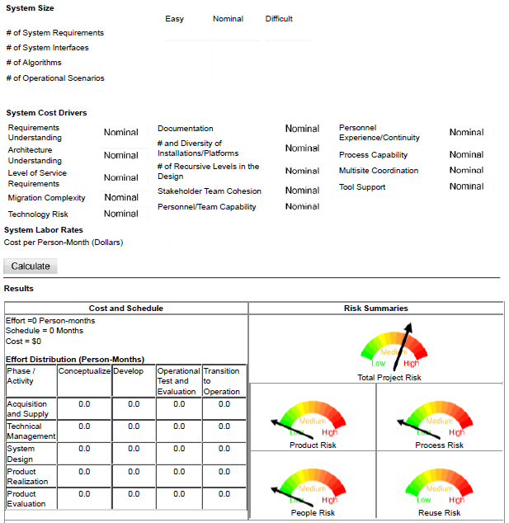
http://csse.usc.edu/tools/ExpertCOSYSMO.php

Slide 19
Conclusion
This is just one technique for cost estimation but it illustrates the general approach

