Slide 1

SYSE 802
John D. McGregor
Module 9 Session 1
Integration, verification, and validation

Slide 2
Session Objective
To explore the SE’s role in integration, verification, and validation.

Slide 3
Definitions
Integration is the assembling of pieces into a whole
  Subsystems into a system or systems into a system of systems
Verification is determining that an element performs its functions without fault
Validation is determining that what the element does is what it should do.

Slide 4
Relationship
verification
element
element
Integrated system
element
verification
element
element
element
validation
Integrated system
verification
element
element
element
element
verification
element
element
Verification techniques are applied before an element is released. When
a specific set of elements has been verified they are integrated into a larger
element. The functionality of the integrated system is validated before the system
is made available for use.

Slide 5
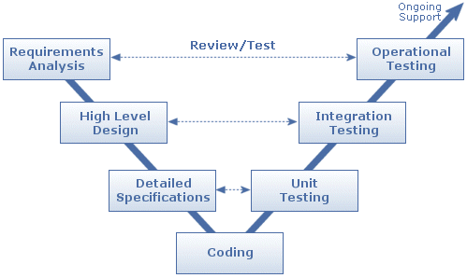
V model
Verification covers activities until we get to “Operational Testing”
Validation happens at “Operational Testing” by referencing the requirements (the customer’s view of the product)

Slide 6
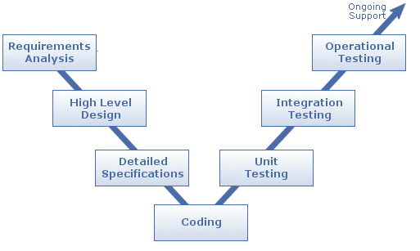
Modified V Model
Each stage references the requirements for validation
Each stage provides an opportunity to ensure customer satisfaction.

Slide 7
V & V
Verification and validation use very similar techniques but from totally different perspectives
Some processes delay validation until the right hand side of the V model but employ verification techniques at each stage.
We will consider validation techniques on the left hand side by referencing the requirements.

Slide 8
Interfaces are key
Interfaces are key to all three of these activities. (Modules 7 and 8)
Interfaces are the basis for the verification activity for each element
The interfaces of the these elements are the basis for the functionality of the integrated system and hence the content of the system’s interface
The system interface is the basis for the validation activity

Slide 9
Interfaces - 2
Each behavior in an interface should be documented with
  Pre-conditions that define what must be true before the behavior can happen
  Post-conditions that define what will be true after the behavior
  Invariants that are always true, and must remain so.
Test cases come from selecting combinations of data that make pre-conditions true.

Slide 10
Top down
The SE decomposes system functionality and allocates it to subsystems or architectural modules. This is documented initially in the SysML Block diagram.
The extended scenarios discussed in the last module (also called system threads) are also decomposed and allocated in the same way.
This decomposition drives the definition of lower level scenarios.

Slide 11
Bottom up
Integration occurs bottom up
Elements are verified and integrated
Integrated units are integrated into larger units and verified
Ultimately the top is reached and the final integration results in the system that must be validated and then deployed
The architecture and then the work breakdown structure determine the hierarchy

Slide 12
SE’s role
The SE manages the system-level integration, verification, and validation processes.
The SE leads the processes that result in an integration plan and a system test plan.
From previous modules we know that the SE is responsible for allocating requirements to subsystems so the SE breaks apart and then builds up the system pieces.

Slide 13
Integration
The integration plan is the sequence in which units will be merged.
The plan needs to be as flexible as possible to allow for delays and re-engineering.
The plan relies on the architecture as a guide to interfaces.
Often the plan is sequenced in such a way to achieve the maximum earned value as early as possible.

Slide 14
Threads
A system thread (not to be confused with operating system thread) is a single sequence of the actions taken by the system for some se of the system.
These threads will support verification and validation efforts.
As they are decomposed along with the requirements they also serve as threads through subsystems.

Slide 15
Test threads
A test thread pairs a system thread with the data needed to realize that thread and the outputs expected from the system thread given the inputs.

Slide 16
Verification techniques
inspection,
analysis,
simulation,
demonstration, and
test
The verification matrix, part of the test plan, shows each artifact and how that artifact will be verified at various levels

Slide 17
Hardware verification/validation
Hardware verification follows the same process as software verification but the test harnesses are hardware.
Simulation
Test rig
http://www.open-vera.com/technical/thompson_final.pdf
http://embedded-computing.com/embedded-software-driven-hardware-verification

Slide 18
Software verification
SE’s role typically is to approve verification plans
Static techniques
  Code reviews
  Program analysis
Dynamic techniques
  Testing of running software
    Unit
    Integration
    System
  Testing of simulated operation

Slide 19
Verification - 2
For each verification action
  Plan what to verify by defining the output from the development process
  Select the test cases that will be applied
  Construct a test environment
  Apply the test cases
  Analyze the output of the tests
  Reach a verdict on pass/fail
  Provide information back to development

Slide 20
Verification - 3
Test harnesses need to be designed and implemented with the same care as the products.
The harnesses are different for each level of test.
As the level increases, the harnesses are more complex, using multiple threads, accessing networks, and tying into protocol stacks.
The good news is that there is more reuse of these and companies can invest in testing tools and expect a good ROI.

Slide 21
Reviews and inspections
Architecture and design reviews provide a means of early V & V if they are systematically applied.
Code reviews take into consideration the language and tool set
  Java and C++ programs do not need many of the detailed checks that scripting languages or C need
  The typing system and the type checking of the language allows logical errors to be traced, relying on compilers to flag syntax errors.

Slide 22
Guided Inspection
Reviews are more likely to find defects if they are systematically guided by test scenarios.
System threads can be used as the source of the test scenarios.
An inspection uses these scenarios to trace through the architecture.
An inspection is looking for missing, incomplete, or incorrect models.

Slide 23
Guided Inspection
“Guided” inspections search systematically for all necessary elements
Process
  The inspection team creates scenarios from use cases
  The inspection team applies the scenarios to the artifact under test
  For each scenario the design team traces the scenario through their design for the inspection team
  The inspection team may ask for a more detailed scenario
  The inspection report describes any defect discovered by tracing the scenario.
  Inspection coverage is measured by the % of requirements “covered” by scenarios.

Slide 24
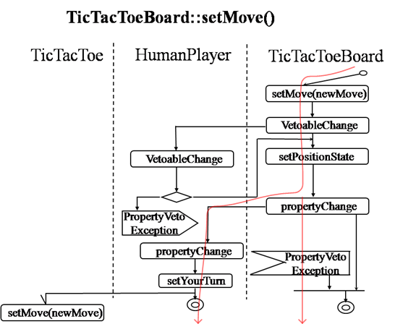
Mapping from scenario to design

Slide 25
Program analysis
These are techniques that are applied without running the software
At interfaces, program analysis is concerned with verifying that the types required of data being passed is really what is being passed.
Tools such as Java PathFinder use a model checking approach to identify concurrency faults such as race conditions or deadlock.

Slide 26
Program
1: void ProcessString(wchar_t *str)
2: {
3: wchar_t buf[100];
4: wchar_t *tmp = &buf;
5:
6: int len = wcslen(str) + 1;
7: if (len > 100)
8: Alloc(&tmp, len * sizeof(wchar_t));
9:
10: StringCopy(tmp, str, len);
11: ...
12: }
13:
14: void StringCopy(wchar_t *dst, wchar_t *src, int size)
15: {
16: wchar_t *dtmp = dst, *stmp = src;
17:
18: for (int i = 0; i < size - 1 && *stmp; i++)
19: *dtmp++ = *stmp++;
20: *dtmp = 0;
21: }
22:
23: void Alloc(void **buf, int size)
24: {
25: *buf = malloc(size);
26: }
http://research.microsoft.com/pubs/70226/tr-2005-139.pdf

Slide 27
Primitive Annotations
void ProcessString(
__pre_notnull __pre_zread wchar_t *str);
void StringCopy(
__pre_notnull __pre_ewrite(size) __post_zread wchar_t *dst,
__pre_notnull __pre_zread wchar_t *src,
int size);
void Alloc(
__pre_notnull __pre_ewrite(1) __post_eread(1)
__post_deref_notnull __post_deref_bwrite(size) void **buf,
int size);
http://research.microsoft.com/pubs/70226/tr-2005-139.pdf

Slide 28
Buffer annotations
void ProcessString(__in_zterm wchar_t *str);
void StringCopy(__out_zterm_ecap(size) wchar_t *dst,
__in_zterm wchar_t *src,
int size);
void Alloc(__out __dret_bcount_bcap(0,size) void **buf,
int size);
http://research.microsoft.com/pubs/70226/tr-2005-139.pdf

Slide 29
Software testing
This is a huge topic (in fact one of my books is about testing), but the
SE’s role in testing is planning and managing
This means the SE participates in
  Selecting test cases
  Defining test plans
  Establishing test data and facilities
Includes system testing and customer-side acceptance testing

Slide 30
Software testing
Test plans
  During the early product planning activities the amount of testing is determined based on domain culture and regulations
  For the system test plan, the validation techniques require traceability back to the requirements
  The SE maintains the traceability matrix

Slide 31
Software testing - 2
Test cases
  Test cases are selected based on “coverage criteria” established in test plan.
  For example, “branch coverage” requires that every path leaving a decision statement be executed by some test case.

Slide 32
Software testing - 3
Test data is selected to achieve the coverage that has been planned
Two issues
  What data will execute a particular branch?
    Start at the site of the coverage measure and trace back to determine values needed at each statement
  How can the data be obtained/maintained?
    May need staff to manufacture identities or even work with other companies so that “live” validation can be processed in networked environment.

Slide 33
Risk mitigation and testing
There is never enough time to do all the verification and validation activities that can be identified.
One approach to test planning is to use a risk-based approach.
Test resources are allocated to investigate the riskiest areas first. Risk may be financial or life critical.

Slide 34
Risk and Testing
Risk management | Test process
Risk strategy | Test plan
Risk identification | Test item tree
Risk assessment | Test matrix
Risk mitigation | Testing
Risk reporting | Test metrics
Risk prediction | Test metrics

Slide 35
Software validation
http://www.infosys.com/research/publications/Documents/SETLabs-briefings-software-validation.pdf
http://www.fda.gov/downloads/MedicalDevices/DeviceRegulationandGuidance/GuidanceDocuments/ucm085371.pdf

Slide 36
Validation
Validation takes on the customer’s perspective as the basis for examining the product.
Validation goes back to the CONOPS.
The system threads should be consistent with the CONOPS and are a rich source of test cases.

Slide 37
Coverage
A measure that can be used to compare validation (and verification) techniques.
An item is “covered” when it has been touched by at least one test case.
An inspection technique that uses a scenario as a test case will touch several artifacts including interfaces and implementation designs. Then the next scenario should be selected to touch other artifacts. The more disjoint the sets of “touched artifacts” are, the better the coverage per set of scenarios.

Slide 38
Coverage - 2
The domain determines how much coverage is sufficient.
Airworthy systems need a much more complete coverage than a business system where faults can be recovered from.
But coverage is not the whole story…

Slide 39
Testability
Testability is how likely a system is to reveal its faults under validation or verification actions.
The same level of coverage for 2 systems will result in more confidence in the system that is more testable.
The SE can measure the testability and make decisions about levels of coverage while the test plan is being developed.

Slide 40
Validation
Validation continues into the client side by having the customer perform acceptance tests.
These are defined as part of the contract.
Planning for system validation should closely reflect the context of the acceptance tests.

Slide 41
Summary
V & V begins the first day of a project and continues until the last day.
It covers everything the project must deliver software and/or hardware.
Planning determines the levels of coverage needed to achieve an acceptable level of confidence.
Applying V&V early and often is the key to a high quality product.

