Slide 1

SYSE 802
John D. McGregor
Module 0 Session 1
Course Introduction

Slide 2
Session objective
The objective of this session is to cover basic information for running the course during the Fall 2010 semester.

Slide 3
Course Objective
To guide the student through the concepts, techniques, and issues related to the systems engineering function in an organization that produces products that combine hardware and software.

Slide 4
John D. McGregor
Associate Professor of Computer Science
Contact info:
  johnmc@cs.clemson.edu (the best way)
  (864) 656-5859 (office phone)
  McAdams 312 (office location)
  www.cs.clemson.edu/~johnmc
30+ years of software/systems consulting on large-scale technical projects

Slide 5
High-level Course Outline
Basic definitions and context
Problem space
  Modeling problems
Solution space
  Mapping solutions onto problems
A complete life cycle
Systems of systems
But we will iterate over these topics

Slide 6
Outline of session
Course requirements/issues
Course infrastructure
EPF
Topcased

Slide 7
Course Requirements
The course page can be found at:
www.cs.clemson.edu/~johnmc/courses/syse802.html
The course page has the details of the course requirements but essentially a specific number of modules must be completed for each of the letter grades.
Module assignments – you will be given assignments related to each of the modules
Class participation – even in this environment there will be opportunities for participation

Slide 8
Project
You will identify a suitable project from your current context and use that as the basis for completing assignments. It can not be a current product or one in production but it can be one under discussion. Instructor must approve the project.
Scope the problem appropriately. It may be a piece of a product that would be produced by your company but it should not be one that has been produced.

Slide 9
Project - 2
The project has two main components.
  You will produce those deliverables a systems engineer would produce for the chosen project.
  You will develop a method definition for the work that you do (or would do) as a systems engineer for the project if it was developed in your organization.

Slide 10
Textbook
The textbook Is not required but I will be following its sequence starting with Part 2
The Engineering Design of Systems, 2nd Ed. by Dennis M. Buede; published by Wiley
ISBN: 978-0-470-16402-0
We will use primary source documents such as the handbooks for professional societies and large government agencies.
We will create a textbook using an Eclipse-based tool as a way of organizing notes and on-line documents.

Slide 11
Model-driven
We will take a model-driven approach to the work we do. That is, we will build models of the information in the project and use tools to transform the models to create the information we need to solve the problem.
Our first work is to setup the infrastructure needed for the course.

Slide 12
Required Tools
Topcased modeling IDE found at www.topcased.org; current version is 4.
The Eclipse Process Framework that can be found at www.eclipse.org/epf; current version is 1.5.4.

Slide 13
Interaction
We will have a discussion board which we will use to promote interaction.
You do not have to wait for those times. Send email any time: syseng802@clemson.edu
You must either participate in a chat session or send email at least once a week.

Slide 14
Eclipse Process Framework
The Object Management Group (OMG) approved a Software Process Engineering Metamodel (SPEM). More about metamodeling later.
The metamodel defines a set of concepts that are needed to describe the processes used by software development organizations.
A metamodel is sufficiently conceptual that many different implementations are possible.

Slide 15
EPF - 2
The Eclipse Process Framework (EPF) (www.eclipse.org/epf ) was developed as an open source implementation of the SPEM on top of the Eclipse (www.eclipse.org) platform.
We will compile a textbook using EPF.
We will engineer processes from fragments that we define as modular pieces of technique.
Tutorials on EPF can be found at:
http://www.eclipse.org/epf/general/getting_started.php

Slide 16
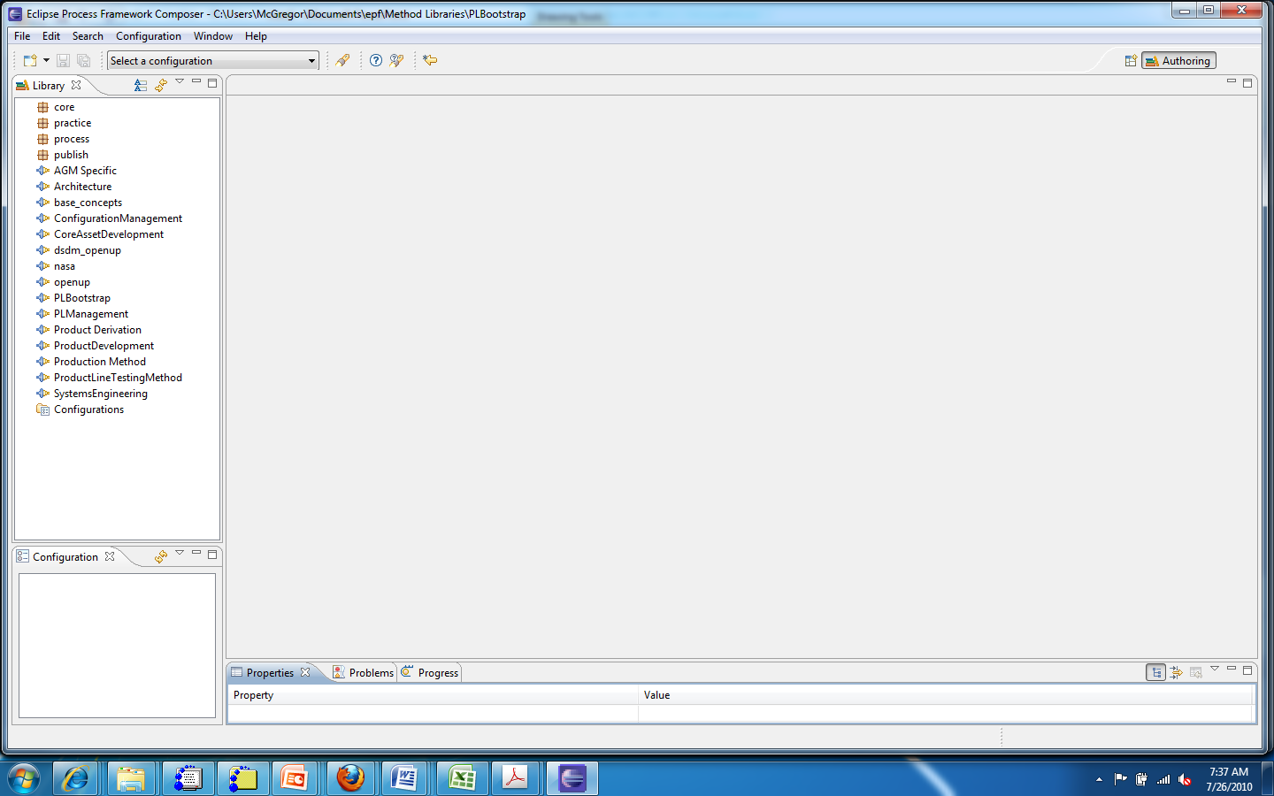
EPF - 3

Slide 17
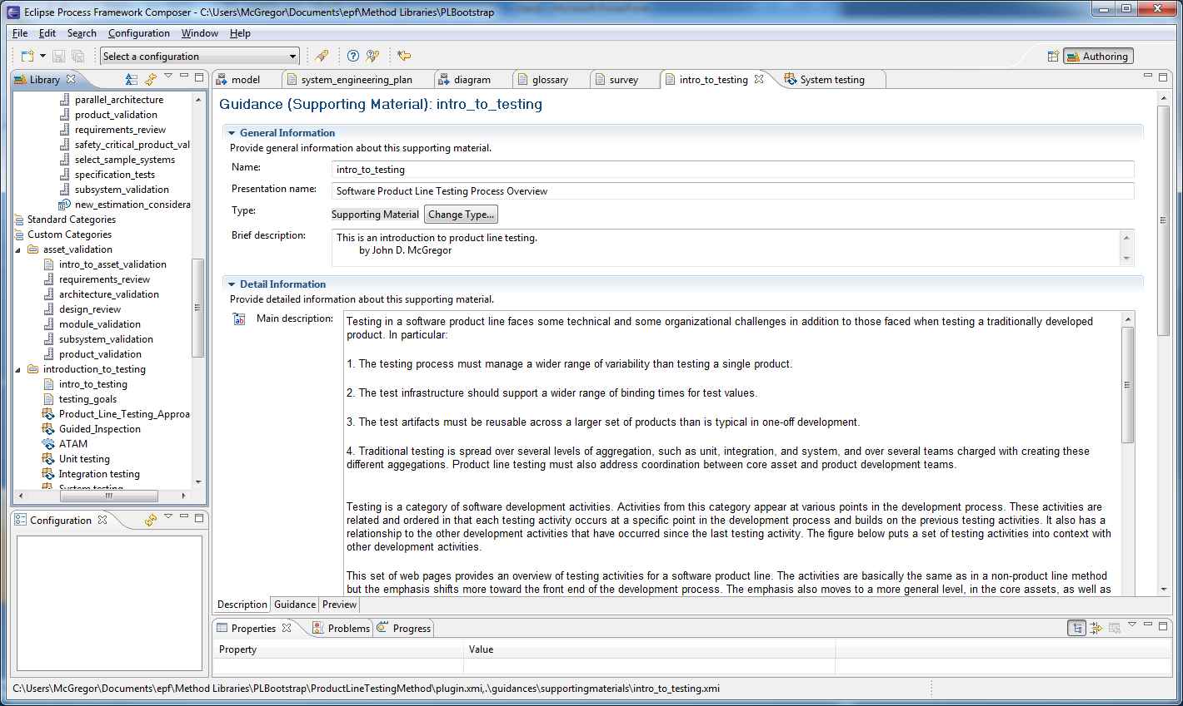
EPF - 4

Slide 18
EPF - 5
I will build a plug-in and add information to it as the semester progresses
You will build a plug-in and add information you find and you can extend pages that I start using the “extends” relationship.

Slide 19
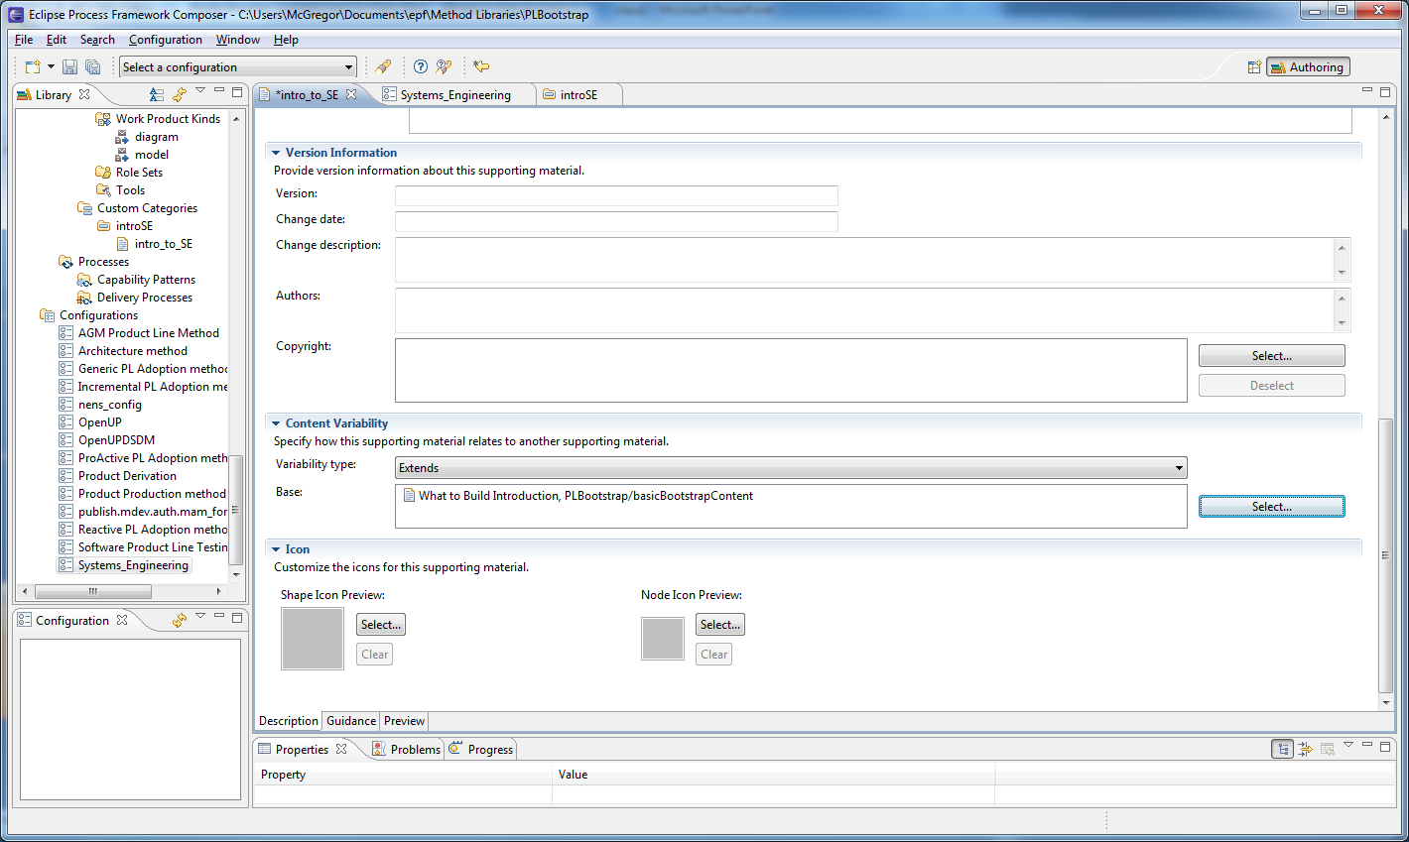
EPF - 6

Slide 20
Topcased
A few years ago Airbus experienced some devastating errors in their design process leading up to the Airbus 380.
The Topcased consortium was formed to build design tools that would provide the robustness required for building life-critical systems.
We will use several aspects of their tools to help do our work.

Slide 21
Topcased - 2
The Topcased team decided that for maximum productivity they would adopt the Eclipse product line as the basis for their work.
The Eclipse Foundation produces open source software plugins that are the building blocks for modeling tools. www.eclipse.org
Integrated tool sets can be found at www.topcased.org or if you are already an Eclipse user go to the same address but find the update url and use the Eclipse update facility to add Topcased.

Slide 22
Topcased - 3
Go to topcased.org
Select “Download Topcased”
Download “linux” or “win” RCP version
Download org.topcased.experimental-4.0.0.zip
Download org.topcased.toolkit-4.0.0.zip
Unzip the RCP version first
Then unzip each of the others into the RCP directory

Slide 23
SysML
We will use the System Modeling Language (SysML) as a tool to capture information about the system under development.
SysML is a standard from the Object Management Group (OMG – www.omg.org)
A tutorial about several aspects of SysML can be found at:
http://www.uml-sysml.org/documentation/sysml-tutorial-incose-2.2mo

Slide 24
Topcased
Several useful tutorials can be found at :
http://www.topcased.org/index.php?documentsSynthesis=y&Itemid=59
We will use many sources this semester. There is an initial list in the material provided to you in the EPF plug-in.

Slide 25
First Assignment
Send an email to
  syseng802@clemson.edu
  with a brief professional bio
Setup your work environment
Get Topcased installed and work through the general tutorial
Download EPF from the given address and the initial EPF configuration found on the resources page of the course web site and import into EPF.
Create your own, basically empty, EPF plug-in.

Slide 26
Summary
Systems engineering is an important area of study because of its central role in complex projects.
We will use a number of tools in our study of engineering techniques and techniques for defining the systems engineering process for your context.
I hope this will be an interesting and rewarding semester of work.

