Slide 1

SYSE 802
John D. McGregor
Module 0 Session 4
Example problem

Slide 2
Running example
I will use one example through out the semester
It will be used to illustrate the various techniques we encounter

Slide 3
Example
A company wants to enter the automotive infotainment business. They want to provide a complete solution to the automotive OEMs.
The infotainment system includes various systems that provide entertainment such as radio and information such as GPS.
The infotainment system in an automobile is changing rapidly. Not only are more types of systems being supported but the support is becoming more generic.

Slide 4
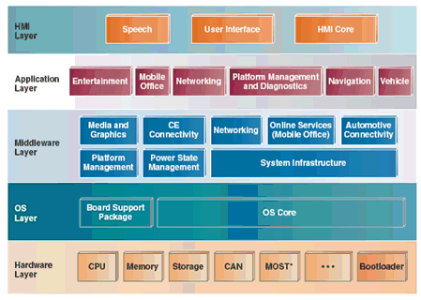
Example - 2
Dr. Dobbs January 2009

Slide 5
Constraints
The infotainment system must not affect the control of the vehicle.
The infotainment system must allow for additional, unanticipated services to be added.
Power consumption must be minimized.
Space in the vehicle is limited.

Slide 6
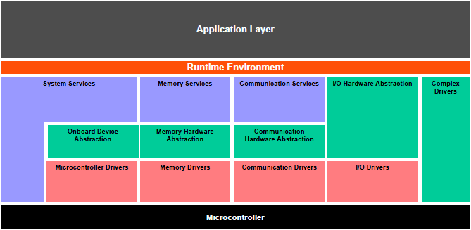
Context
Autosar layered architecture view

Slide 7
The need
Any passenger vehicle’s information system needs to provide basic features such as display of status of various sensors, cameras, and other health information.
It provides basic entertainment services such as radio.
It provides additional services such as GPS.
It accepts external inputs such as music from an Ipod and routes the music to the speakers.

Slide 8
Summary
This problem will be used to illustrate concepts over the course of the semester.
It was chosen because most people can relate to the basic context if not the issues involved.

