Slide 1

SYSE 802
John D. McGregor
Module 11 Session 1
Functional analysis and allocation

Slide 2
Session Objective
In this session we will explore value analysis, earned value analysis and functional analysis and we will see some threads come together.

Slide 3
Types of decomposition analyses
Each type of analysis has a set of rules about how to break the system into pieces
Functional analysis
Object-oriented analysis
Structured analysis
Each decomposition decision involves Logical Solution Trade-Off Analyses
“Value” is a vague quality that can be made sufficiently specific to be useful in analyses

Slide 4
Object-oriented decomposition
The object-oriented approach views the system as a set of objects that interact. The objects represent real world entities or conceptual constructs in some domain.
The system functions are those that are needed by the individual objects to accomplish their objectives.
An object is decomposed if it can be viewed as a set of objects itself.

Slide 5
Object-oriented decomposition-2
Object-oriented design pays attention to a variety of relationships between objects and classes of objects.
These relationships are either
definitional as in inheritance from one class definition to another (not found in most decompositions) or
Operational such as aggregation where one object contains other objects

Slide 6
Object-oriented decomposition-3
An object-oriented decomposition runs orthogonal to “functional analysis” since the product functions are broken into pieces and distributed over the objects.
This is somewhat like functions being distributed over subsystems but the rich set of relationships means that the object hierarchy is not strictly hierarchical.

Slide 7
Functional analysis
In functional analysis the system functions are created based on some analysis.
In structural analysis the basis is almost totally on hierarchy or subsetedness.
Another approach is to use some notion of value as the decomposition rule.

Slide 8
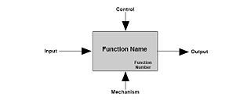
IDEF0
We have shown SysML as the new standard.
IDEF0 is an older, more mature standard for representing functions.
Below is the basic building block.
SysML takes the more general approach of blocks which can represent several different decomposition approaches.

Slide 9
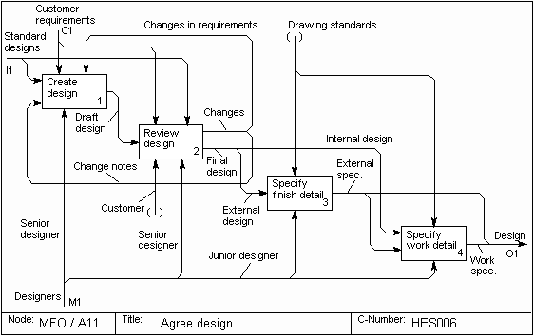
IDEF0-2
An example diagram
http://www.syque.com/quality_tools/toolbook/IDEF0/example.htm

Slide 10
Principles of Value Engineering
‘User-First’ Attitude
Functional Approach
Team Approach
Creative Approach
Value Engineering uses Value Analysis which gave way to Function Analysis System Technique (FAST)
http://www.scribd.com/doc/18049571/Value-Analysis-and-Value-Engineering

Slide 11
Value Analysis vs Cost Reduction
Cost Reduction
Aim: Reduce cost of present product
Value = cost
Questions
What is it?
How can we make it for less?
Value Analysis
Aim: Provide user-required functions at lowest cost
Value = worth/cost
Questions
What is it?
What does it do?
What must it do?
How can its functions be performed for less?
http://www.scribd.com/doc/18049571/Value-Analysis-and-Value-Engineering

Slide 12
Value Analysis
Value = (Performance + Capability)/Cost = Function/Cost
Functions are noted as verb-noun pairs
Dials phone number
Stops the car
The “basic” function is required for it to be a product – the microwave in a microwave oven
“Secondary” functions support – set a timer
http://www.npd-solutions.com/va.html

Slide 13
Determining worth
1. What is the cost of achieving the basic function as the item is presently
designed?
2. Do you think the performance of the basic function should cost that
much?
3. If no, what do you consider would be a reasonable amount to pay for the performance of the function (assuming for the moment that the function is actually required) if you were to pay for it out of your own pocket.
4. What is the cost of achieving this function if some other known item is used?
5. Is this a common, easily accomplished function or one that is rare and difficult to achieve?
6. What is the price of some item that will almost but not quite, perform the function?
http://www.scribd.com/doc/18049571/Value-Analysis-and-Value-Engineering

Slide 14
Value Analysis - 2
When the system is complex this is hard to determine
Function Analysis System Technique provides a means of decomposing a complex system
It begins with verb – noun pairs and places them in context of each other as well as supporting functions

Slide 15
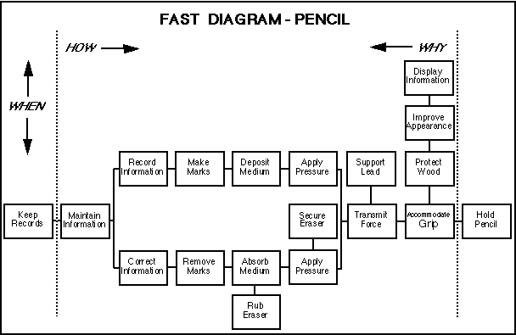
FAST Diagram
This diagram elaborates on the Value Analysis matrix for complex systems.
http://www.npd-solutions.com/va.html

Slide 16
Creating FAST
Begin with verb-noun pairs like from VA and sequence them from left to right.
The horizontal direction on the diagram defines how the task is accomplished.
The vertical direction on the diagram defines time in that it defined causal relationships.
The diagram provides a visual list of functions that can individually or in groups be examined to determine if costs can be lowered.

Slide 17
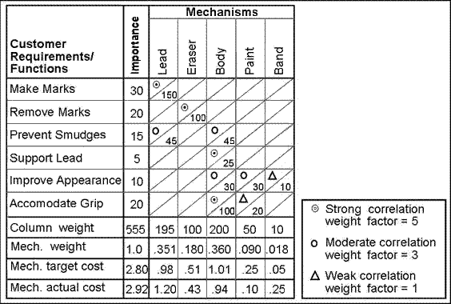
QFD/FAST
The Value Analysis matrix corresponds to the FAST diagram and is used in the House of Quality
http://www.npd-solutions.com/va.html

Slide 18
How to combine the techniques
Capture customer requirements and perform QFD product planning with the product planning matrix. Translate customer needs into directly into verb-noun functions or use a second matrix to translate technical characteristics into verb-noun functions.
Prepare a FAST diagram and develop the product concept in conjunction with the QFD concept selection matrix. Review the verb-noun functions in the QFD matrix and assure that they are included in the FAST diagram. Revise verb-noun function descriptions if necessary to assure consistency between the QFD matrix and the FAST diagram.
Dimension the system in the FAST diagram into subsystems/assemblies/parts. These are generically referred to as mechanisms.
Develop value analysis matrix at system level. The "what's" or system requirements/function in the value analysis matrix are derived from either a customer (vs. technical) FAST diagram or by selecting those function statements that correspond to the customer needs or technical characteristics in the product planning matrix. The importance rating is derived from the product planning matrix as well.
Complete the value analysis matrix by relating the mechanisms to the customer requirements/functions and calculate the associated weight. Summarize the column weights and normalize to create mechanism weights. Allocate the target cost based on the mechanism weights. This represents the value to the customer based on the customer importance. Compare with either estimated costs based on the product concept or actual costs if available.
Identify high cost to value mechanisms / subsystems by comparing the mechanism target costs to the mechanism estimated/actual costs
http://www.npd-solutions.com/va.html

Slide 19
Trade-off analyses
Value can be the subject of trade-off analyses just as any desired quality can be.
Two decompositions differ in the amount of value they offer. They are examined and one is selected.
If the “value” being used is straight forward then the choice is usually quickly made.

Slide 20
Prototyping approaches
Use the development approach used for products. Don’t elaborate error handing routines and keep I/O rudimentary
Helps with exploring logic of algorithms
Completeness issues
Use a GUI builder to simulate the frontend.
Useful for showing clients
Useful for design and layout

Slide 21
Prototyping approaches-2
Use a special purpose scripting language to rough out the logic but again no error handling.
Scripting allows for shortcuts for the parts that are irrelevant
Use special tools such as Simulink with its libraries to model technical operations.
Quick to construct
Useful for continuous data

Slide 22
Prototyping
Modelica is a challenger to Simulink and is an open source product.
What makes these systems useful for prototyping is
Large number of pre written elements
An architecture that allows elements to be plugged together
Both Simulink and Modelica make investigation of qualities such as latency more accurate
www.ida.liu.se/projects/OpenModelica

Slide 23
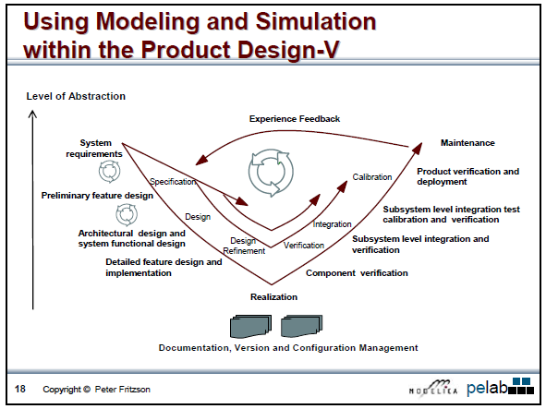
Prototyping-2
http://www.ida.liu.se/labs/pelab/modelica/OpenModelica/releases/1.5.0/doc/ModelicaTutorialFritzson.pdf

Slide 24
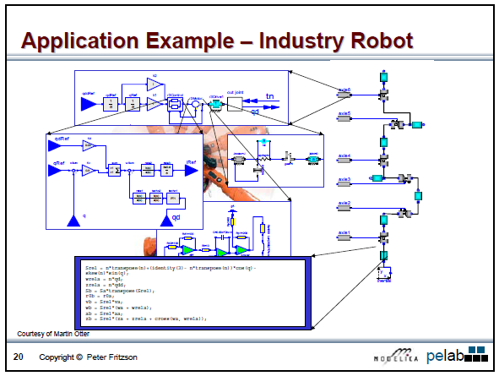
Prototyping-3
http://www.ida.liu.se/labs/pelab/modelica/OpenModelica/releases/1.5.0/doc/ModelicaTutorialFritzson.pdf

Slide 25
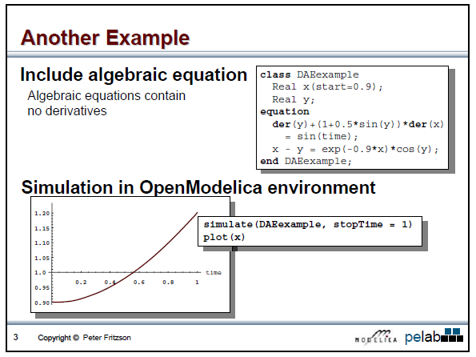
Prototyping-4
http://www.ida.liu.se/labs/pelab/modelica/OpenModelica/releases/1.5.0/doc/ModelicaTutorialFritzson.pdf

Slide 26
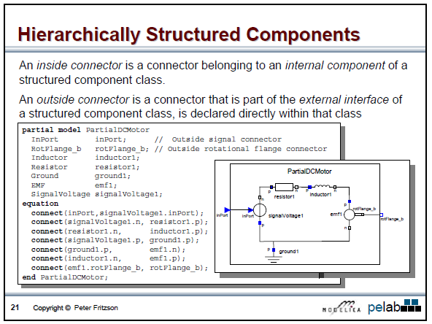
Prototyping-5
http://www.ida.liu.se/labs/pelab/modelica/OpenModelica/releases/1.5.0/doc/ModelicaTutorialFritzson.pdf

Slide 27
Earned Value
While you may work in an industry that does not require EV calculations, some of you may find it a useful tool.
All project steps “earn” value as work is completed.
The Earned Value (EV) can then be compared to actual costs and planned costs to determine project performance and predict future performance trends.
Physical progress is measured in dollars, so schedule performance and cost performance can be analyzed in the same terms.
http://evm.nasa.gov/tutorialb.html
http://www.kidasa.com/ebook/EVM.pdf

Slide 28
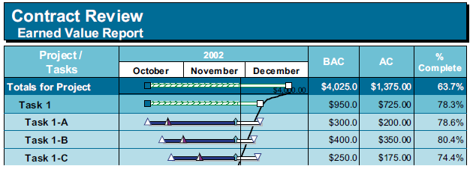
Prerequisites
Budget at Completion (BAC) = Overall approved budget for a task.
Actual Costs (AC) = Total amount spent on a task up to the current date.
Percent Complete = Task progress, related as either EV/BAC, or simply physical progress shown by the fill of the task bar.
http://www.kidasa.com/ebook/EVM.pdf

Slide 29
EV computation
Earned Value (EV) = BAC x Percent Complete. The budgeted cost of completed work as of the current date. (Or each milestone can have a negotiated value.)
Planned Value (PV) = The point along the time-phased budget that crosses the current date. Shows the budgeted cost of scheduled work as of the current date.
http://www.kidasa.com/ebook/EVM.pdf

Slide 30
Then you can compute
Schedule Variance (SV) = Earned Value – Planned Value. The difference between what was planned to be completed and what has actually been completed as of the current date.
Cost Variance (CV) = Earned Value – Actual Costs. The difference between the work that has been accomplished (in dollars) and how much was spent to accomplish it.
http://www.kidasa.com/ebook/EVM.pdf

Slide 31
But …
The measures used to compute EV may be meaningless
Using the systems engineering workproducts is one approach

Slide 32
Integrating EV and SE
IEEE 1220
Requirements baseline
Validated requirements baseline
Physical architecture
Validate physical architecture
Functional architecture
Validated functional architecture
http://pmknowledge.gsfc.nasa.gov/docs/SupplementalLinks/Article0001.pdf

Slide 33
Integrating EV and SE-2
EIA 632
System technical requirements
Logical solution representations
Physical solution representations
Specified requirements
Validated system technical requirements
Validated logical solution representations
Verified design solution

Slide 34
Integrating EV and SE-3
Using some of the workproducts from the previous two slides as the items that are measured to compute %Complete provides a solid basis

Slide 35
Summary
In this module we have considered additional analyses.
Functional analysis helps determine the function-level structure of the system but does so from a cost perspective.
This high-level representation can be used as the basis for prototyping.
Finally, we considered how Earned Value can be integrated with systems engineering workproducts to make EV calculations more true indicators.

