Slide 1

SYSE 802
John D. McGregor
Module 1 Session 1
Concept Elaboration & Requirements Elicitation

Slide 2
Session objective
This session explores the activities associated with concept elaboration and requirements elicitation.
We begin the development of our example system described initially in Module 0 Session 4.

Slide 3
Concept Elaboration
In the earliest stage of product development, actions are less structured and less rigorous than in the next stages.
A feasibility study may have been executed or marketing information gathered that address the earliest issues.
A business case may be constructed at this time to determine go/no go or this effort may be chartered as an investigation.

Slide 4
Early steps
Early in the product’s life cycle the system engineer gathers information about the problem/need.
The system engineer may create domain models that capture relevant concepts.
The system engineer will definitely create a requirements model.

Slide 5
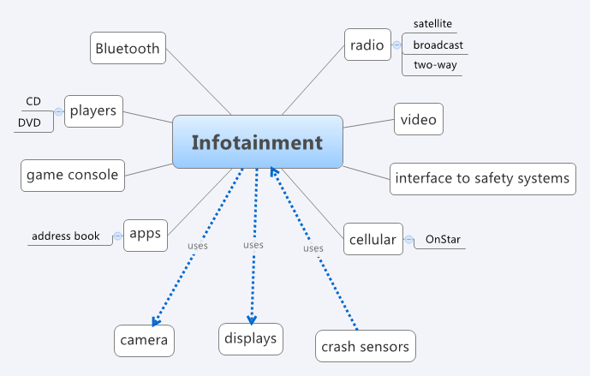
Mind map
Brainstorming relationships and concepts is one way to populate the
domain model.

Slide 6
Early steps - 2
Stakeholder requirements give the stakeholders’ view of the product.
These will be translated by the SEs into system (derived) requirements.
The stakeholder requirements are stated in terms of their interest in the product. The SEs translate into more specific, more modular, and less ambiguous statements.

Slide 7
Stakeholders
Initially each stakeholder has their own objectives at this point.
Each stakeholder must advocate for their view of the need and show how it is of more importance than the views of others.
Ultimately a common mission is established.

Slide 8
Domain models
A domain model can be thought of as a structured glossary.
The boxes in the diagram on the following slide represent concepts in the domain.
The lines between boxes represent relationships among concepts.
This diagram uses the block diagram notation of SysML.

Slide 9
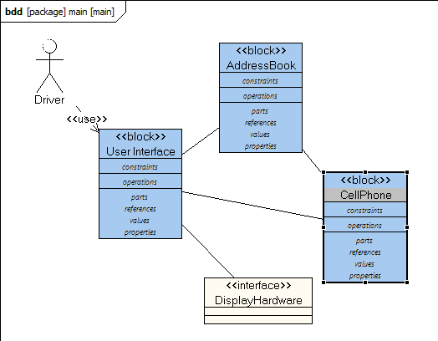
Domain models - 2
Blocks, in a SysML block diagram can be used for concepts.

Slide 10
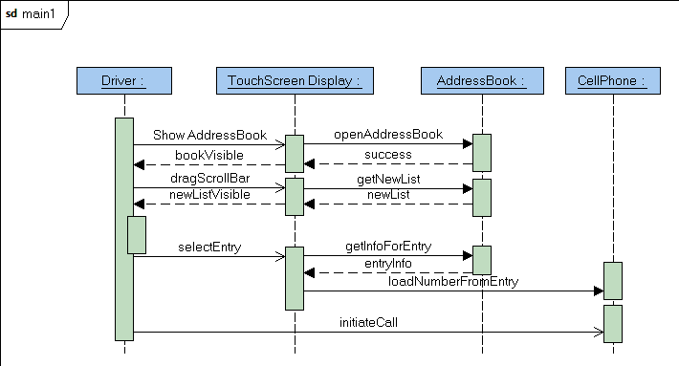
Domain models - 3
A domain model also captures standard interactions using SysML
sequence diagrams.

Slide 11
Domain models - 4
The purpose of a domain model is to establish a common vocabulary among members of a project team.
This is particularly important if several specialties are being integrated to solve a problem or if several organizations must cooperate.

Slide 12
Domain model - 5
Professional societies and governmental organizations are good starting points for these models.
These domain models will also serve as the basis for domain specific languages (DSLs) for later stages of model-driven development

Slide 13
Features
For many efforts the size and complexity of the product is too much to think of as a single list of requirements statements.
One way of dividing the problem into manageable pieces is to use a high level unit termed a “feature”.
A feature is any aspect of a system. A very vague definition I know but a very flexible one.

Slide 14
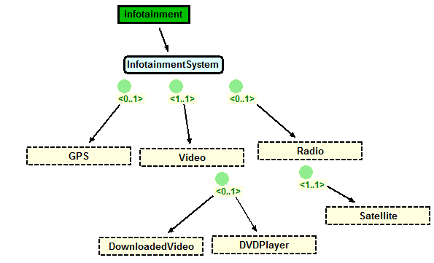
Features - 2
The <0..1> cardinality means the feature is either part of the system or not.
The <1..1> cardinality means the feature is part of the system.
http://www.pnp-software.com/XFeature/

Slide 15
Features - 3
Satellite radio is a mandatory feature.
A product we build may have a GPS component or not (indicated by 0..1). This is an optional feature.
There is a video feature in every product and there is a choice of two players.

Slide 16
Features - 4
These statements are very high level requirements but are sufficiently different that building a detailed requirements model for each feature will minimize the amount of interactions between requirements in one feature and those in another.
Non-functional aspects may be addressed as well with features such as security or performance levels.

Slide 17
Features - 5
Notice that a feature model gives more than just the requirements for A product.
It gives requirements for a family of products.
More about this later in the course.

Slide 18
Functional vs Non-functional requirements
Functional requirements describe WHAT a product must do
The system shall be able to receive SMS (short message service) messages.
Non-functional describe HOW the product will do it
The system shall be able to receive at a rate of 100 messages per minute.
Both are essential to building an acceptable product.

Slide 19
Two operations
The systems engineer
elicits requirements from several sources, and
analyzes the compete set of requirements
In order to elicit, the systems engineer identifies those who have an interest in the product - the stakeholders
Not all stakeholders have the same priority. Some are clients while some are the people creating the product.

Slide 20
Implicit and Explicit
Standards documents, spec sheets for former products are examples of explicit knowledge which is the easiest to convert into requirements
Implicit knowledge such as the experience of a 20 year veteran in a company is harder to capture completely and correctly
Just recently a doctor tried uploading data for a medical research project and we found that he had forgotten to tell me that each MRI scan was 120 separate files.

Slide 21
Many techniques
There are many different techniques for eliciting requirements
Interviews – structured and non-structured
Story boards
…
We will focus on use cases. A use case is a description of a use of the system by some external entity termed an actor.

Slide 22
The chicken and the egg
People have different opinions about whether requirements come from use cases or vice versa.
I think it is easier to start with use cases because the external actors are usually easy to identify and it is usually easy to verify completeness of the actor model.
But, sometimes you have a legacy set of traditional requirements which also is a good starting point.

Slide 23
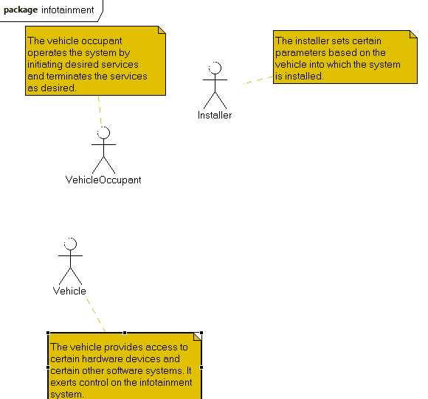
Elicitation
The stakeholders can be represented as “actor”s in a SysML Use Case model. The figure below is an early version of the model for our continuing example. The actors may be people or other systems. What outside forces act on the system?

Slide 24
Scenarios
A scenario is a very short story.
A use case is a set of scenarios that all describe similar ways of using the system being developed.
A number of software development methods use scenarios for a variety of models.
Some methods just use simple story boards while others are structured by fill-in the blanks style statements.

Slide 25
Use case structure
A use case illustrates a use of the system by an actor.
Typically there may be several variations on a use and so multiple scenarios are grouped together under a single use case. There are types of scenarios that routinely are used:
Sunny day (everything goes well)
Rainy day (something does not work)
Exceptional (rare situations that require specific handling)

Slide 26
Use case model structure
The use case model is not just a list of uses
The model has structure resulting from relationships between uses
Extends – The use is written so that new uses can be incrementally defined by adding to an existing use; the original use case must indicate what can be extended
Generalizes – Similar to inheritance
Includes – Similar to composition

Slide 27
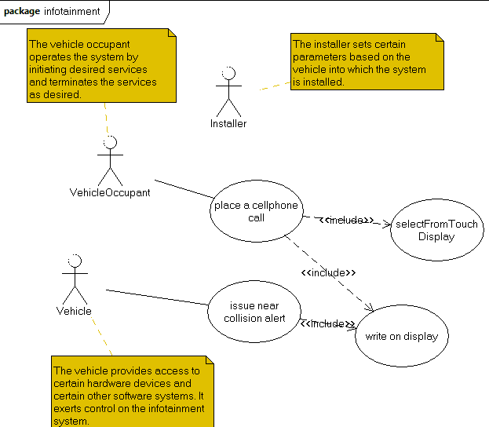
Use cases
Use cases give a means of decomposing actors’ actions.

Slide 28
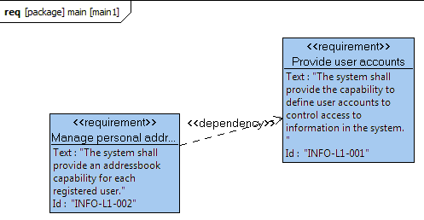
Requirement diagram
From a single use case usually several requirements can be created. The
Model is structured by adding relationships between the requirements.

Slide 29
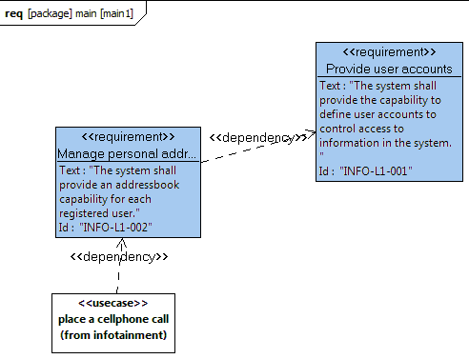
Traceability
In a modeling environment such as Topcased, placing several diagrams
within the same model makes it possible to drag elements of one diagram
into another and explicitly show dependencies.

Slide 30
A note on modeling
A model in Topcased contains packages
A package contains diagrams
Currently we are building a requirements model that contains a package. The package has a use case diagram and a requirements diagram.
Because they are in the same model you can associate elements in diagrams by dragging from the outline to the diagram.

Slide 31
Testing and requirements – a brief digression
Every requirement that is in the requirements model will be the source of one or more test cases.
Each requirement has to be sufficiently exact that expected results from test cases can be specified.
The exact description of a requirement is also necessary so that the requirement can be verified.

Slide 32
Testing and requirements - 2
Traceability goes beyond identifying the relationships between use cases and requirements.
Test cases should be associated with the requirement(s) they are intended to verify.
The SysML requirements diagram notation provides a means for defining test cases and associating them with specific requirements.

Slide 33
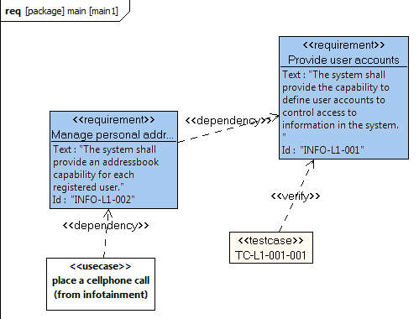
Test traceability
The SysML requirements diagram supports the definition of test cases.
although it does not show on the graphic the tool provides fields for
capturing much information about the test.

Slide 34
Example
The system shall be able to send SMS messages.
This is verifiable because SMS is a well-defined messaging standard.
The system shall be able to send messages.
Is not verifiable directly but if it is listed as an abstract requirement this is acceptable. The abstract nature is useful in a reusable design.

Slide 35
Plain old requirements
Many organizations simply use plain old requirement statements
The system shall …
One problem we have already seen is that individual requirements are too numerous and fine-grained to be easy to manage
A second problem is that the traditional requirements “model” does not provide any help to determine the validity of the model.
Tools such as Topcased provide a means to export the requirements defined in the diagram into lists usable by programs such as Excel.

Slide 36
Derived requirements
The term “derived” is used for the action of modifying a requirements statement for a specific purpose.
Usually the modification is to capture a more specific statement about some aspect of the original, more general, requirement.

Slide 37
Did you get them all?
A single pass over the actors probably will not identify all of the relevant requirements, but how can you tell?
Evaluating a requirements model requires an external benchmark against which to measure.
One approach is a user jury. More about this later, but think how your company currently evaluates the validity of product requirements.

Slide 38
Iterative
Humans forget; circumstances change.
Different people have different pieces of the information that you need.
Each requirement is visited multiple times. We move to a more specific level of detail in the statements with each iteration.
At first there will be a lot of change from one iteration to another; this will subside until a major upgrade.

Slide 39
Iterative - 2
As you take a second pass, and beyond don’t forget the domain model.
The concepts in this model should be clarified as you gain understanding and new concepts added as your scope expands.
The domain model should be easily viewable by all members of the project and most stakeholders.

Slide 40
One iterative hierarchy
For DoD and other governmental agencies there often is a fairly standard requirements hierarchy.
L0 – This might be the customer requirements provided to the SEs by some business group
L1 – Derived, high-level user requirements
L2 – Further derived (maybe specific product) requirements that will drive product testing
L3 – Most explicit, code written from these

Slide 41
Iterating
A hierarchy usually is structured from the most broad to most specific
This often corresponds to a hierarchy from broad wishes of users to specific directions to developers.
Iteration happens when someone at a lower level wants to ensure they are following the intent of the stakeholders and they trace to higher level requirements.

Slide 42
Incremental
Large complex projects are broken into increments that are intellectually feasible.
There may be parallel teams deriving (relatively) isolated requirements
There may be sequential iterations by a single team
The requirements model is the integration of all increments

Slide 43
Forces against elicitation
problems of scope, in which the requirements may address too little or too much information;
problems of understanding, within groups as well as between groups such as users and developers; and
problems of volatility, i.e., the changing nature of requirements.

Slide 44
Resolving those forces
Scope – When using a hierarchy of requirements like L1, L2, etc develop a clear definition of the purpose for each level. This will make it easier to determine what to include.
Understanding – the domain model can capture synonyms and provide a focus for sharing
Volatility – anticipate it; only go as deep as is necessary for the stage of development

Slide 45
The human factor
People with different skills often do not communicate well with each other because they are used to the shorthand way of talking with others with the same skills
Recently, a month into a requirements effort it became clear that while everyone was saying “yes”, each had a different idea of what the question was.
The project finally agreed to do a glossary.

Slide 46
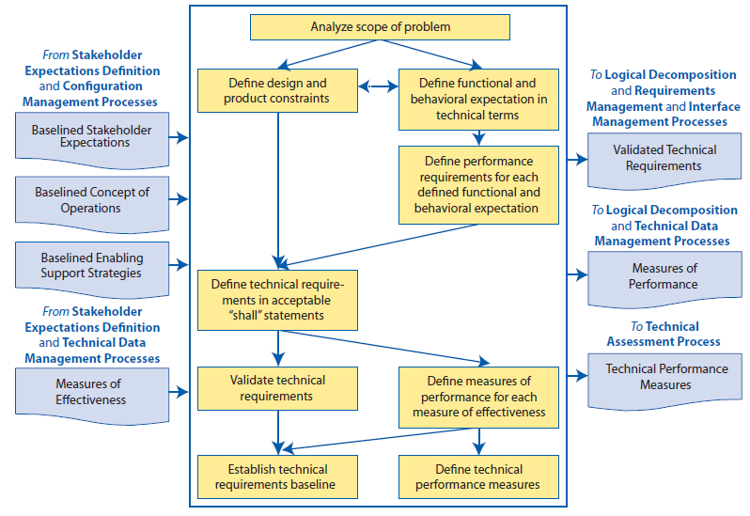
NASA’s requirements process – Fig 4.2-1

Slide 47
Overview
The following is a good overview of elicitation techniques:
https://buildsecurityin.us-cert.gov/bsi/articles/best-practices/requirements/533-BSI.html
Section 4.3 of the INCOSE Handbook describes these actions in more detail.

Slide 48
Summary
The use case technique is designed to make elicitation easier, less error prone, and more systematic. It provides a sequence of first finding the actors and then interactions of each actor with the system.
Each use case can then be mined for specific requirements statements. Many projects now skip this step with the use case serving as the primary representation of the requirements.

