Slide 1

SYSE 802
John D. McGregor
Module 2, Session 1
Requirements Analysis and Management

Slide 2
Session Objective
In this session we will take the requirements gathered using the elicitation process and critically examine that model.

Slide 3
Elicitation vs Analysis
Elicitation is the collection of information
Analysis is the detailed examination of that collection
Like elicitation, analysis is an iterative process. The analysis will point out areas that are weak and further elicitation is required.
So at this point we have elicited input from a spectrum of stakeholders and that input needs to be organized and modified to be useful
Some people use “analysis” to cover the entire requirements engineering process. We treat them separately to provide an in-depth explanation.

Slide 4
Quality attributes
A non-functional requirement addresses attributes about HOW a product will perform its function.
The requirements address desired values for these “quality attributes” of the product.
There are many such attributes. See
http://www.sei.cmu.edu/library/abstracts/reports/95tr021.cfm
for a thorough analysis.

Slide 5
Some common quality attributes
Correctness
Reliability
Efficiency
Integrity
Usability
Survivability
Maintainability
Verifiability
Flexibility
Portability
Reusability
Interoperability
Expandability

Slide 6
Some standard sources
No stakeholder may feel responsible for some types of requirements
Inputs/outputs
Identify and capture as requirements all required inputs and outputs
Technologies
There often are specific technologies that must be used. Write a requirement for each.

Slide 7
General analysis techniques
Requirements analysis digests the requirements, adds detail, and may modify the structure of the requirements model.
CONOPS
Hierarchical structuring by ranking
Linear structuring via operational concept
Test-driven development
Risk
Restructure by Re-factoring

Slide 8
CONOPS
The concept of operations for a product translates between stakeholders and developers
It gives structure to the web of stakeholder needs and desires.
It is particularly useful for products that are complex to operate such as vehicles
IEEE 1362 gives basic form of CONOPS
The NASA handbook is also a good source on CONOPS

Slide 9
CONOPS - 2
The CONOPS for an infotainment system that includes traffic management might describe how a vehicle and an intersection interact as the vehicle approaches the intersection.
“Using info about location and speed the vehicle informs the intersection of its arrival time. The intersection, using its information about signal states and waiting traffic, informs the vehicle of possible states upon arrival. The vehicle requests the possible state that is most favorable and waits to see if it occurs.”

Slide 10
CONOPS - 3
Essentially the CONOPS is a scenario of scenarios with information about the frequency and criticality of the scenarios.
The CONOPS focuses on a complete picture of the product over some lifecycle of use.

Slide 11
Ranking
Often there is insufficient time to examine every requirement in detail.
Requirements (or use cases) can be ranked to determine the most valuable ones to focus on
Different criteria can be used
Stakeholder importance
Value to the user

Slide 12
Ranking - 2
Ranking is best used on use cases or features since these are logical groupings of requirements
In several of the techniques developed by the SEI, stakeholders are given a certain number of votes (sometimes a variable number based on priority)
The ranking is the vote of the stakeholders

Slide 13
Ranking - 3
Requirements concerning the vehicle infotainment system might be ranked as:
Braking information and control
Steering and propulsion
Location
Outbound communication
Inbound communication and displays

Slide 14
Operational profile
An operational profile attempts to summarize the first two kinds of analyses into a smaller, less complex representation.
Using the use case diagram that contains all uses, each branch can be annotated with the relative frequency with which that branch will be taken.
This is useful in weighting scenarios for reliability and availability testing in addition to specifying the system.

Slide 15
Test-driven development
Test-driven development (TDD) is an agile practice intended to improve quality and speed
A test is written that the product can not yet pass; code is written
During test development the question is whether the requirement is sufficiently clear to support test development; whether the requirement should be split into additional requirements and whether there are tests for which there are no requirements.

Slide 16
Specification
The output of requirements analysis is a requirements specification
This defines the product to be built, or it should
Remember that this is an iterative process so a completed set of L1 requirements is a specification but not a specification from which we can directly build a product

Slide 17
IEEE Guide to Software Requirements Specification
unambiguous
complete
verifiable
consistent
modifiable
traceable
usable during operations and maintenance

Slide 18
Risks
There are numerous risks associated with requirements elicitation and analysis as illustrated by the criteria:
Complete – risk is missing an important requirement
Correct – incorrect information will be inserted into the product
Consistent – two mutually exclusive requirements may both be included in the model and not properly qualified

Slide 19
Factoring requirements
Usually the first requirements that are captured are very concrete because they represent the stakeholder’s basic needs
These should be factored into requirements that have a broader, more abstract scope
One way to do that is to establish a relationship in which one use case extends the behavior defined by another; this is only allowed in anticipated ways

Slide 20
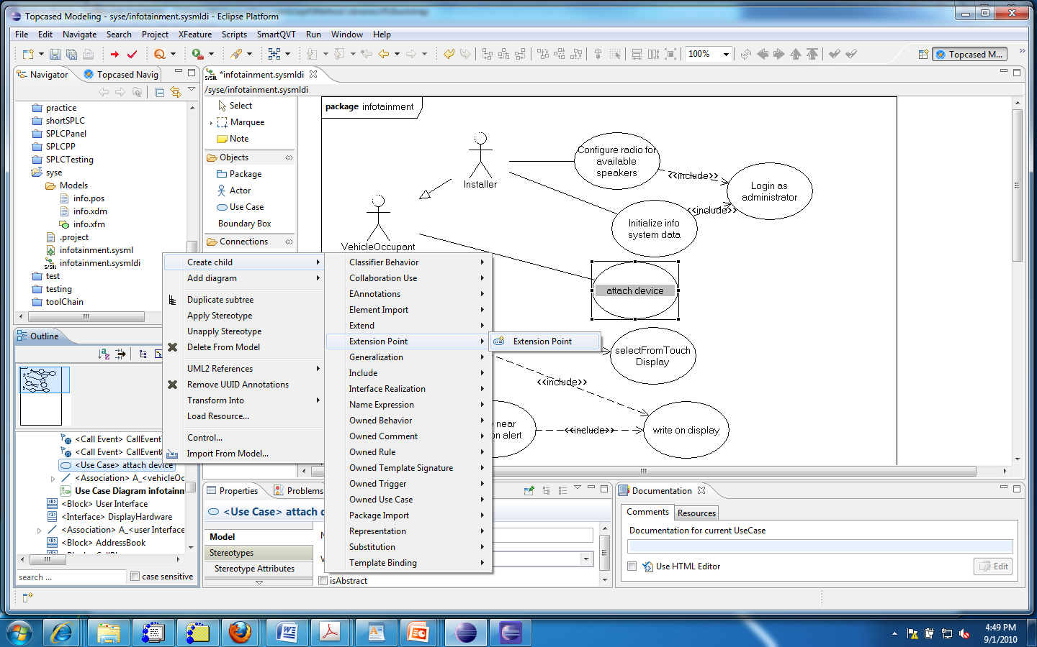
Adding an extension point
#2
#1

Slide 21
Extension points
To be able to use the “extends” relationship, you first create an extension point in the use case to be extended
This can only be done in the Outline view (as is true for several operations)
Select the use case in the outline view (#1)
Select Create child | Extension point | Extension point
Give the extension point a name

Slide 22
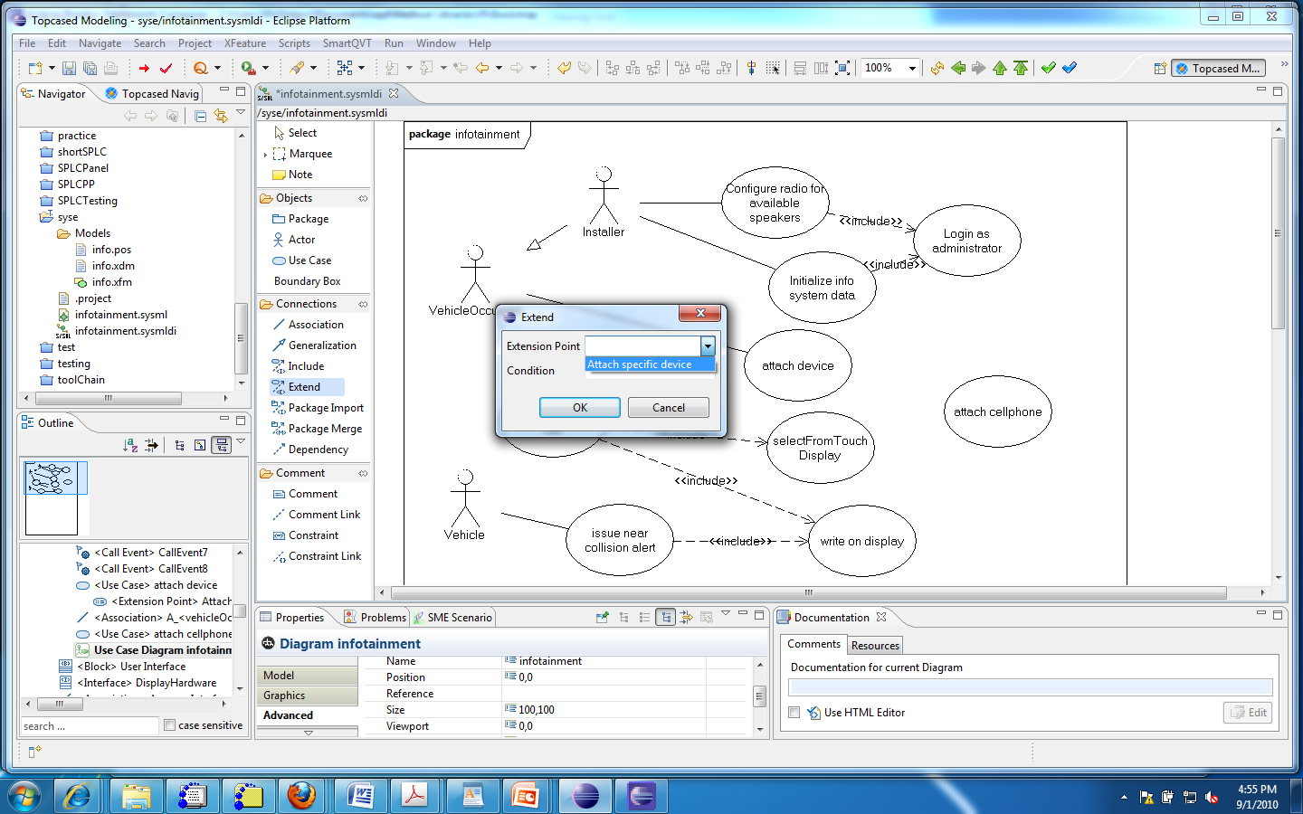
Using the extension point

Slide 23
Using
Create the new use case
Select the “extends” relationship and drag from the extending to the extended use case
Select the extension point you created previously
The relationship will be created as shown in the next slide

Slide 24
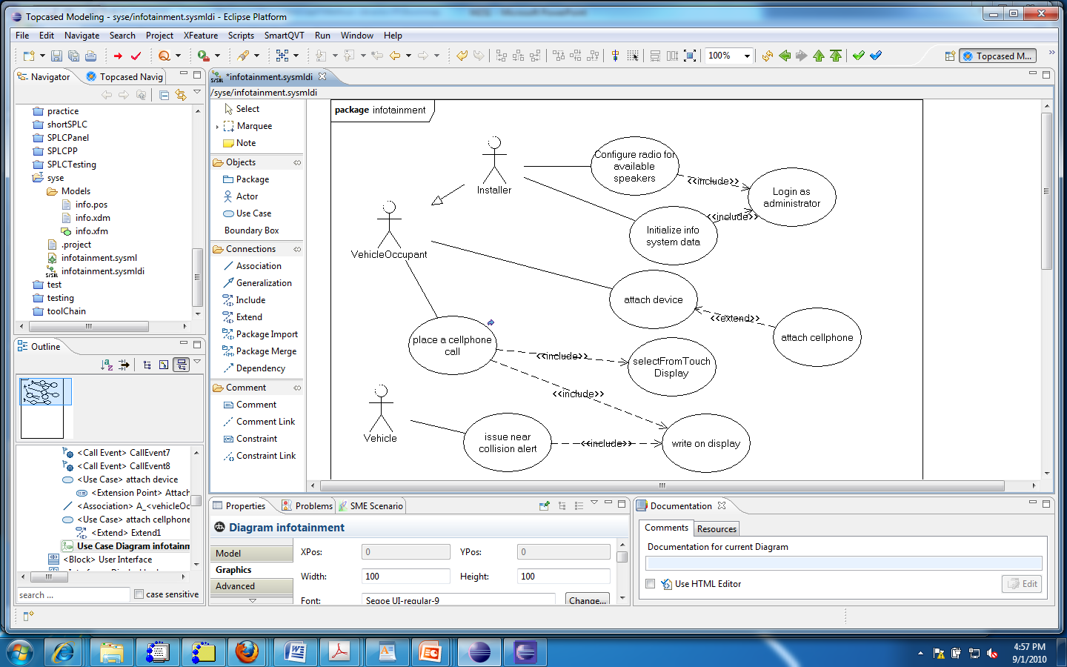
The added use case

Slide 25
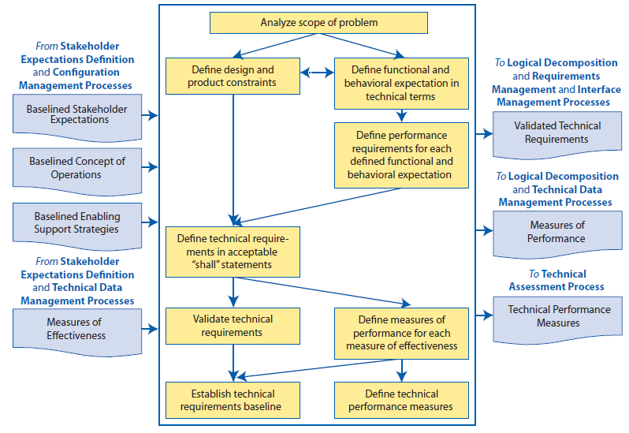
NASA requirements process - Fig 4.2-1

Slide 26
Baselined
The term baselined is used in the NASA process to denote artifacts that have been completed to a sufficient level of detail that further change will be managed.
There may be a formal evaluation or some other milestone to mark the change from free changes by the developers of the artifact to changes that are “managed”.

Slide 27
Management
Change happens for many reasons during product development
Customers change their minds
Context changes (maybe the market climate)
Mistakes are discovered
The requirements model must change in reaction to these changes, but all dependencies must change as well.

Slide 28
Change
A change control board (CCB) analyzes each change for impact on the web of dependencies among requirements, tests, constraints, and other relationships.
The approved change is managed in the change management system. The initial change may be decomposed into several smaller changes being defined in the change management system.

Slide 29
Change - 2
The smaller changes are carried out by people who own the affected artifacts.
For example, a change to a use case will result in changes to one or more requirements. Each change to a requirement will likely affect one or more tests.
Using tools such as Bugzilla, for change requests, Topcased, for its diagrams, and DOORS, used for requirements databases, makes this process manageable.

Slide 30
Tailoring the requirements process
Any general process must be tailored to fit the specific situation in a given development effort.
See Module 2 Session 2 for more

Slide 31
Summary
Section 4.5 of the INCOSE Handbook lists a large number of different types of analysis. See which ones apply to your project.
The systems engineer selects the analyses that are useful in their domain.
The requirements statements must provide sufficient information to support those analysis techniques.

