Slide 1

SYSE 802
John D. McGregor
Module 2 Session 3
Assignment

Slide 2
Initial Requirements Model
Begin the development of the requirements model for your approved project by
  Choose a set of sources to use in elicitation
  Give a brief description of why each source was chosen
  Develop a domain model that provides vocabulary for your problem – use the SysML block diagram
  Develop a set of use cases including actors – use SysML use case diagram
  Create a high-level set of requirements – use SysML requirements diagram include both functional and non-functional requirements

Slide 3
Initial Process Model
Begin to create your own systems engineering process
The deliverable is a process package but there must be the individual definitions in the Method Content to back it up.
Submit the “Published” method by zipping up the directory that contains the website that is created by publishing.

Slide 4
Getting ready to publish
A method configuration is the basic unit of publication.
On the following slides I will show in reverse order what you do to get ready to publish.

Slide 5
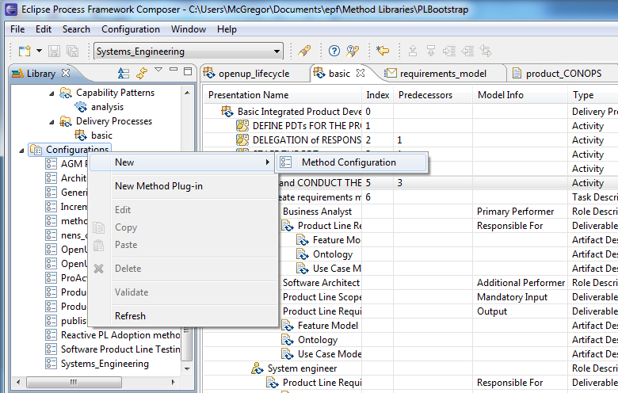
Create a method configuration

Slide 6
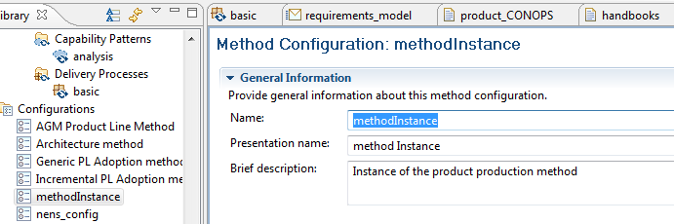
Give the configuration a name

Slide 7
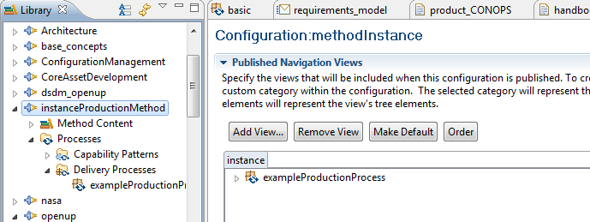
Select the “Views” tab
Select the Views tab
Select Add View
In the Library select the delivery process you wish to publish

Slide 8
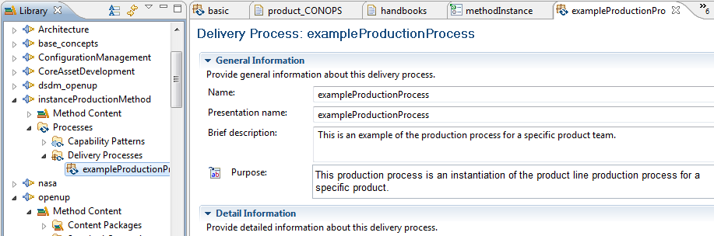
This is the process that will be published

Slide 9
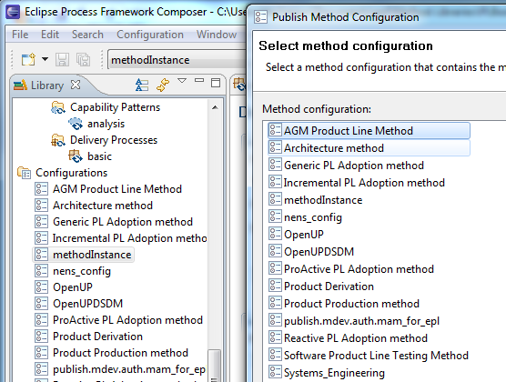
Publishing
Under Configuration on the main menu select Publish and then from the list of configurations that pops up select the one you just created.

Slide 10
Publishing
If you click next you will work through additional pages in the wizard and this gives a lot of possibilities for customizing your final website.
For now it is sufficient to click on Finish and accept all the defaults.

Slide 11
Due
Submit
  The written justification for source selection
  The SysML models
  Written evaluation of your model against the criteria of complete, correct, and consistent.
  Submit the EPF published site by zipping the directory and mailing that in.

