Slide 1

SYSE 802
John D. McGregor
Module 3 Session 1
System Architectures

Slide 2
Session Objective
To consider how to use a system architecture to build a high-quality system.

Slide 3
Systems Engineer as Architect
The systems engineer is responsible for the systems architecture.
  The SE may lead a team that includes systems architects
  The SE may actively participate in developing the architecture
  The SE may solely choose the architecture
The SE and team begin by looking to existing products and existing literature.

Slide 4
Warning!!
The following single pictures are NOT architectures but simplified architecture cartoons.

Slide 5
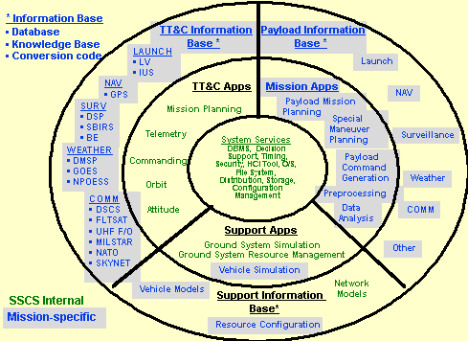
Ground Satellite System
valerdi.com/cosysmo/RefSystem(Reifer-Valerdi).ppt

Slide 6
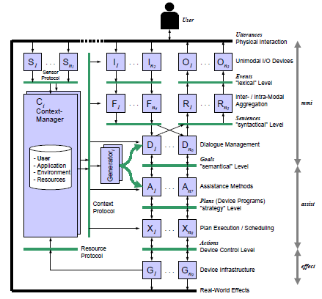
Conceptual architecture
http://www.igd.fhg.de/igd-a1/projects/sodapop/dsv-is02.pdf

Slide 7
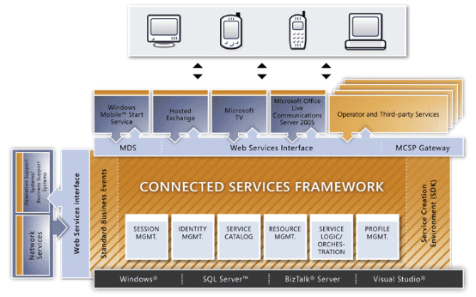
Connected Services
http://msdn.microsoft.com/en-us/library/aa306115.aspx

Slide 8
System architecture
The overarching structures combine hardware and software architectures.
Increasingly, the hardware is generic and the software carries the majority of the problem-specific load, but the systems engineer still makes the decisions about allocating requirements to each.
Special purpose embedded products often begin with hardware to satisfy weight, power, and performance constraints before allocating the remaining functionality to software.

Slide 9
System architecture - 2
Architecture is the first step toward solving the problem, or satisfying the need, that was identified and described by the requirements activity.
There is always an architecture whether one has been explicitly designed or not.
The architect is charged with creating structures that accommodate the behavior needed in the system and that possess the quality attributes the system needs.

Slide 10
System architecture - 3
The attribute-driven design approach (ADD) to architecture uses the high-priority non-functional requirements to identify the qualities that should be emphasized in designing the system.
A pattern-based approach selects patterns that enhance the qualities of interest.
This approach has resulted in a large number of patterns, here is one article on a set of patterns (please read):
http://hillside.net/plop/plop2k/proceedings/Parssinen/Parssinen.pdf
There are books of patterns such as (scan if security is of particular interest to you): Security Patterns: Integrating Security & Systems Engineering
by Marcus Schumacher, Fernandez-, Eduardo Buglioni, Duane Hybertson, Frank Buschmann, Peter Sommerlad

Slide 11
Example - Layered
Many systems use the “layered” pattern as an underlying structure. The architecture for my infotainment example begins as a layered system.
“Layered” requires that an element in one layer only communicate with elements in adjacent layers.
This improves several attributes including maintainability, testability, and portability.

Slide 12
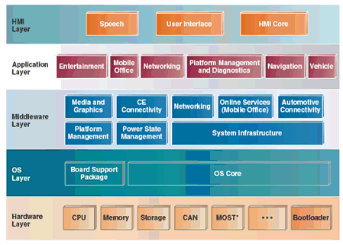
Infotainment Architecture
http://www.drdobbs.com/embedded-systems/222600438;jsessionid=2CWUXIXKB5KHRQE1GHRSKH4ATMY32JVN

Slide 13
Layered - 2
The infotainment architecture illustrates a very useful division – hardware in one layer and software in the others.
As you go up in the diagram the software is independent of the hardware and can more easily be used in other products.
The application layer is also a common element in many architectures. It separates the infrastructure (all layers below the application layer) from the user-visible functional features. This allows new applications to be added easily, supporting expandability of the feature set.

Slide 14
Middleware
The inclusion of a Middleware layer adds another pattern. Middleware encapsulates how elements communicate with each other.
In the infotainment system this layer includes connectivity of the automobile to personal devices such as cell phones and connectivity with the internet for broader communication.
This pattern enhances the introduction of additional means of communication.

Slide 15
Patterns
Architecture design patterns can either be general as we have seen in the layered pattern or capture domain knowledge and experience.
Applying patterns allows the systems engineer to keep their generality while using domain-specific expertise.
Systems patterns are not as advanced as detailed design patterns, but the literature is growing.

Slide 16
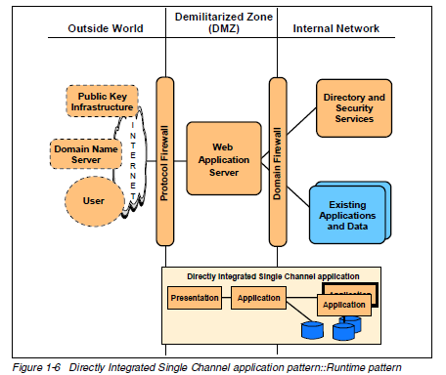
Patterns - 2
http://www.redbooks.ibm.com/redbooks/pdfs/sg246303.pdf

Slide 17
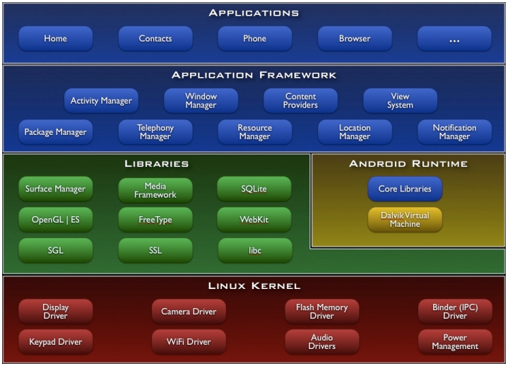
Open architecture

Slide 18
Open architecture - 2
There is nothing in the diagram that indicates an architecture is “open”
Openness is a policy, not just a structure
Provides a means for extending the platform
Handles unanticipated opportunities
Implemented by exposing an interface(s) that users can access to add their own behavior
Often implemented via a “plug-in” mechanism
This really means that there is a mechanism that allows the registration of additional modules

Slide 19
Open architecture - 3
Has to address security
Costs
More complexity
Benefits
faster time to market; flexibility; user satisfaction; longer relevant life

Slide 20
Case study
NASA provides a good case study in system architecture. It is too big to ask you to read the entire document, but scan it to understand the level at which system architecture documents are written. Look at the table of contents and the introduction.
I will use this to illustrate several current and previous points.
http://www.nasa.gov/pdf/140649main_ESAS_full.pdf

Slide 21
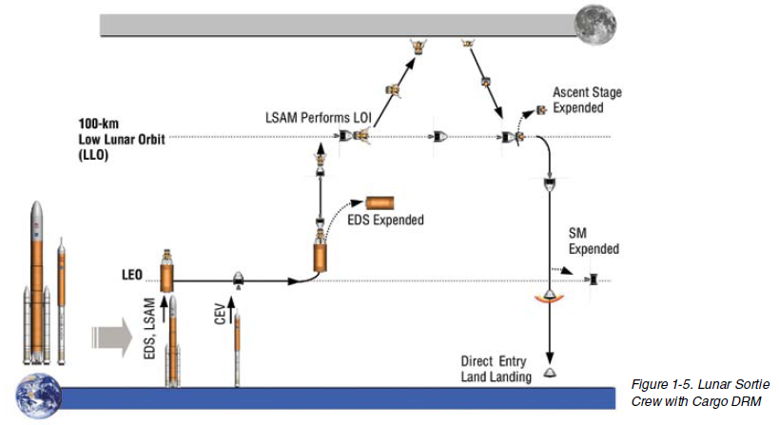
Design Reference Missions (Scenarios)
A set of DRMs give the architect a context in which to work.

Slide 22
Roadmap
Beyond guiding the construction of the system elements, the system architecture guides the evolution of an organization.
An architecture roadmap tells the sequence in which additions will be made to the architecture and the timing of those additions.
Note that in the EPF, one of the types of guidance is a Roadmap page.

Slide 23
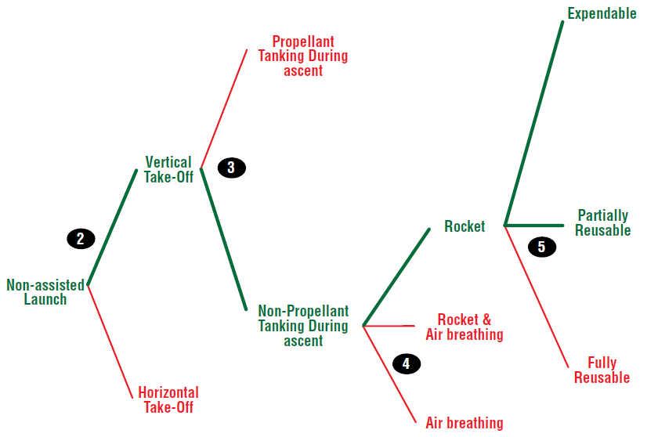
NASA – Trade Studies
A decision tree is a tool for organizing trade studies.

Slide 24
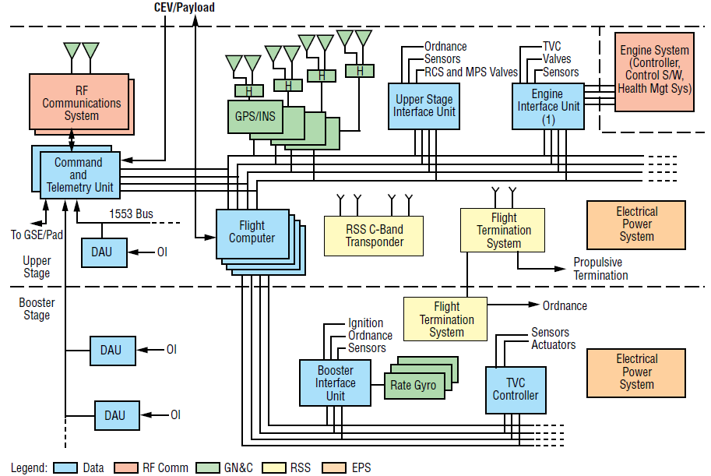
NASA - Layered

Slide 25
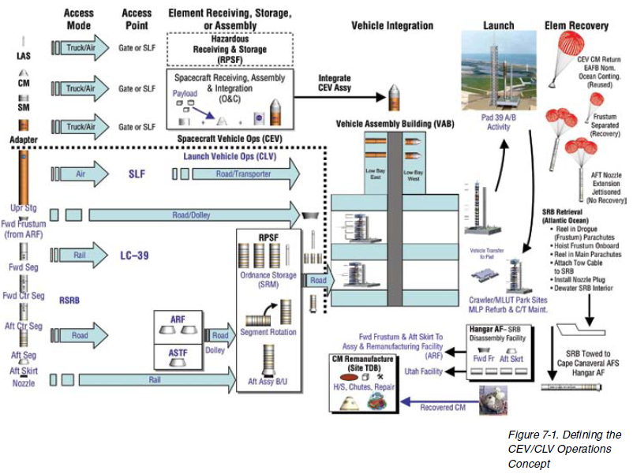
NASA - CONOPS

Slide 26
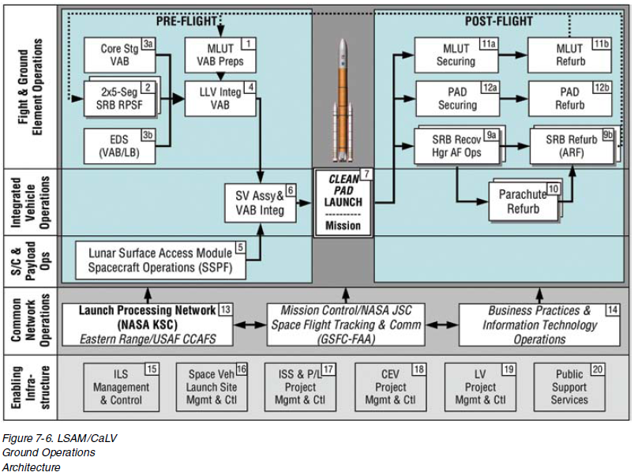
NASA - Architecture
This view incorporates time to show pre-flight
and post-flight information in one picture.

Slide 27
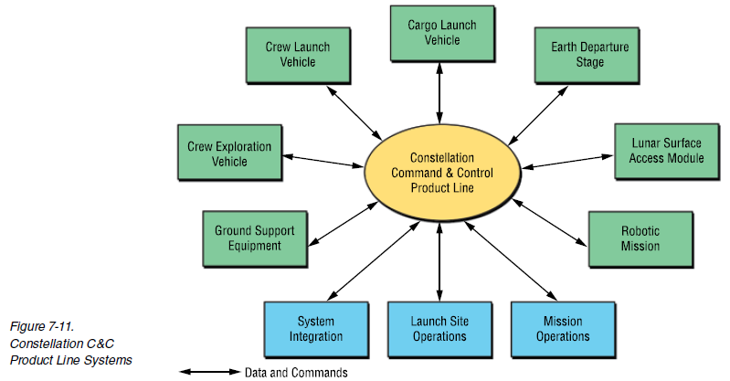
NASA – Product Line
Later we will dive into product line issues.

Slide 28
Open Process Framework
Architects make a distinction between the architecture and the description of the architecture and we will make the same distinction
The Open Process Framework initiative gives a structure for a systems architecture document that follows a de facto standard.
http://www.opfro.org/index.html?Components/WorkProducts/ArchitectureSet/SystemArchitectureDocument/SystemArchitectureDocument.html~Contents
I will use their outline in the next few slides to illustrate the structure and content of the document.

Slide 29
Views
The mistake that many people make is to try to use one picture to represent the architecture. A view presents a subset of the architecture elements.
The elements in the subset are related in some way, such as being designed to support a specific purpose.
The elements are selected to tell a story to a selected audience.
There are as many views as there are different audiences (usually stakeholders).
The next slide has a number of different views.

Slide 30
Views
Summary Views:
  Configuration Views
  Function Views
  Interface Views:
    Programmatic Interface Views
    User Interface Views
  State Views
Element Type Views:
  Data Views
  Hardware Views
  Personnel View
  Software Views
Discipline-Specific Perspectives:
  Content Management Perspectives
  Safety Perspectives
  Security Perspectives

Slide 31
Structure of a view description
Overview,
which provides an introduction to the hierarchical configuration of the tier or component in terms of its lower-level tiers and components
View Diagrams,
which show the hierarchical configuration of the tier or component in terms of its lower-level tiers and components and the relationships (e.g. hierarchical decomposition, data flow, control flow, interaction sequencing) between them:
  Configuration Diagram,
  which shows the hierarchical decomposition structure of the tier or component
  Data Flow Diagram,
  which shows the flow of data between elements in the configuration
  Sequence Diagram,
  which shows the sequential communication between elements in the configuration

Slide 32
Structure of a view description - 2
Element Catalog,
which lists and describes the relevant architectural elements:
  Components in terms of their externally-visible characteristics, behavior, and component type: systems, subsystems, segment, sub-segment, assembly, subassembly, data, hardware, personnel, software, procedures, materials, and facilities (whereby hardware includes computer hardware, network hardware, devices such as sensors and actuators, equipment, structural elements, etc.)
  Relationships between components including decomposition, data flow, and communication
View Context,
which shows how the components of the configuration interface with externals
Variability Guide,
which documents how the hierarchical decomposition structure of the tier or component provides any necessary variability (e.g., when the architecture is used to support multiple systems within a product line)

Slide 33
Structure of a view description - 3
Analysis and Rationale,
which documents the reasons why the hierarchical decomposition structure was selected (e.g., functional decomposition of the configuration with “form following function”). This section briefly lists the relevant architectural drivers and provides compelling evidence that the configuration architecture fullfils them
Alternatives Considered and Rejected,
which briefly describes alternative hierarchical decomposition structures that were considered and rejected including the reasons for their rejection
Assumptions,
which briefly lists any assumptions on which the hierarchical decomposition structure was based

Slide 34
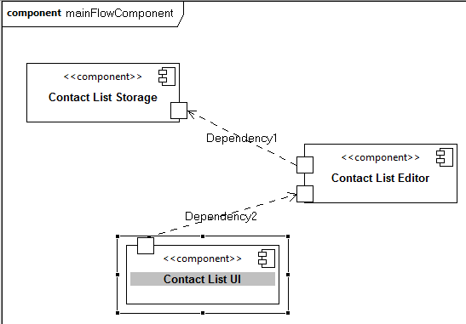
Data flow
The contact list used for the cell phone and navigation device
touches the UI, has an editor, and ultimately stored.

Slide 35
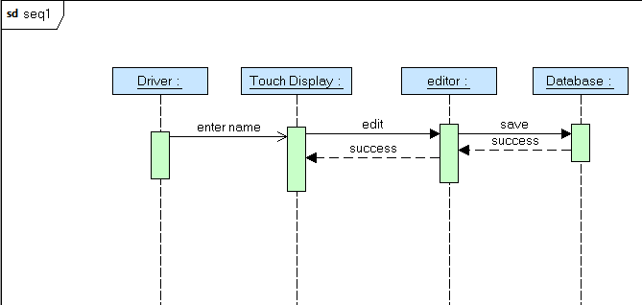
Sequence diagram
Documents the sequence and timing of actions.

Slide 36
Element catalog
Touch UI – Hardware with a proprietary library. Provides virtual keyboard; list selection
Editor – WordPad compatible editor entering addresses
Storage – This component encapsulates the SQL compliant database. An implementation such as SQL-lite should be used for mobile products with limited power available.

Slide 37
View context
This view shows a thread of activity related to the contact list.
It would work in parallel to other applications accessed through the touch screen.
The information it manages would be available to other applications such as the touch dialer and the voice dialer through the common access to the database.

Slide 38
Variability guide
This thread has variation on each end.
The TouchScreen device might be replaced by a hardware keyboard or in some configurations there may be both virtual and real keyboards
Any SQL-compliant database can be used. Queries are made using standard SQL.

Slide 39
Analysis and Rationale
Several apps that are traditionally in an infotainment system use information structured as a list.
The interface must be very simple to use while driving. A touch screen can be designed to display whatever is desired.
Storage could be simple linear access or a relational database.

Slide 40
Alternatives/Assumptions
Alternatives - An alternative to having a dedicated contact list would be information stored in text files. Applicable to more situations but takes much longer to find and make a call.
Assumptions – Certain standard functions are expected with certain types of devices.

Slide 41
Viewpoint
A viewpoint is the perspective from which a view is constructed. Here is a paper that presents some practical experience using viewpoints.
http://www.viewpoints-and-perspectives.info/doc/woods-viewpoint-experiences.pdf

Slide 42
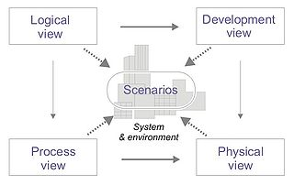
Viewpoint - 2
Krutchen’s 4+1 views is a famous example.
Each view establishes a viewpoint.
http://www.cs.ubc.ca/~gregor/teaching/papers/4+1view-architecture.pdf

Slide 43
Viewpoint - 3
A systems architecture document should present a viewpoint that is appropriate for each stakeholder.
This can result in a large number of views but it still saves time in the sense of reduction of time spent explaining to each stakeholder.

Slide 44
Viewpoints
Consultative Committee for Space Data Systems (CCSDS) has developed a reference architecture for space data systems.
A reference architecture is a very good starting point for product line architectures.
http://public.ccsds.org/publications/archive/311x0m1.pdf

Slide 45
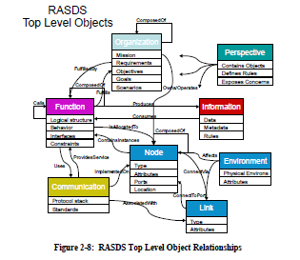
Meta-model

Slide 46
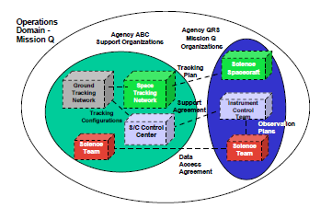
Enterprise View

Slide 47
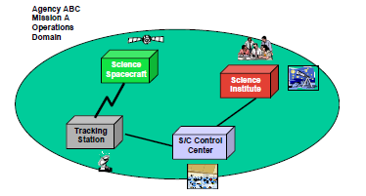
Connectivity View

Slide 48
Infotainment system context
Open-System Architecture Is the Key to Cost Reduction
One possible way out of this dilemma would be to dispense with in-house development, restricting it to interfaces to the portable units from the entertainment-electronics sector—the question of infotainment would then no longer be an automotive topic. Another obvious way to resist the pressure of price and functionality from the entertainment electronics sector over the long term is an open, standardized microcontroller architecture, such as that which has long existed in the PC market, where it is advantageous to all involved. There are already signs that the traditional automotive microcontroller will soon be superseded. Every motorist who is interested in an infotainment system already is more or less familiar with the PC, using it to organize music or videos, for communication, or just to surf the Internet. This is precisely the target group for the concept of the Auto PC, which aims to put the home multimedia world on four wheels.

Slide 49
Infotainment system context
The present obstacles to this concept are the excessively high price of processors and the power consumption of the chip sets. But standardization, as the “secret of success,” will prevail here, too, and the ideal architecture for future infotainment systems must thus fulfill the following basic requirements:
The command set of the processor and the basic architecture must be open and freely available, so that more than one manufacturer can be selected as a supplier. The semiconductors must, of course, meet the stringent requirements of the automotive sector.
The performance and functionality of the processor must be scalable over a wide range. Both entry-level and premium units must be covered by the processor architecture, so that, in principle, the same software can run on any unit.
The system architecture must ensure strict separation of vehicle-specific and multimedia- specific data processing, to prevent the infotainment unit from influencing the vehicle characteristics under any circumstances.

Slide 50
Infotainment system context
In addition, it is also important for the ideal system architecture to fulfill the specific requirements of the car manufacturers and their suppliers:
For the car buyer, the equipment must be clearly distinguishable from aftermarket products, but at a cost that is not significantly higher. The main differentiating features are scope of functionality and system quality.
The vehicle manufacturer must be able to achieve the greatest flexibility in the integration of infotainment platforms from different suppliers on the vehicle platform.
The automotive supplier must give the infotainment platform the greatest possible flexibility, with regard to a wide range of car manufacturers and to the integration of future customer requirements.
The investment in a platform generation must also be protected, so that hardware cost optimization (such as changing to new types of memory) can be implemented quickly and flexibly.

Slide 51
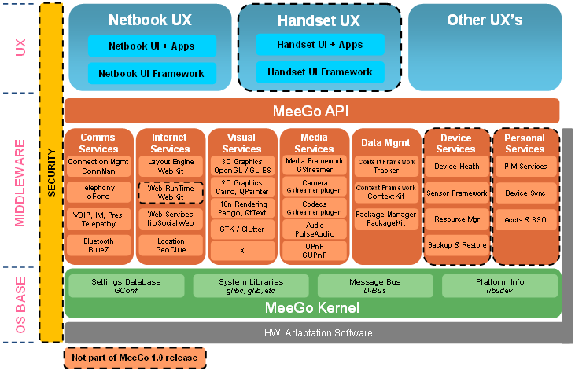
MEEGO Architecture
http://meego.com/developers/meego-architecture

Slide 52
Summary
Architecture is a maturing field that contributes to understanding the system and controlling the system development process.
Standard architectures contribute to efficient product development.
Take a look at this tutorial on Autosar http://www.autosar.org/download/conferencedocs/03_AUTOSAR_Tutorial.pdf

