Slide 1

SYSE 802
John D. McGregor
Module 4 Session 0
Where are we?

Slide 2
V model
I was asked about how what we are doing compares to the traditional V Model process of systems engineering. I was confused since we are explicitly following that model til I followed the reference I was given to page 10 of the Buede book.
That V model is only the design and integration portions of the full V model shown on page 6.

Slide 3
V Model - 2
Two responses:
Waiting until the upward bound leg of the V model to do verification and validation is too late. You have already wasted work on incorrect requirements. Taking the model-driven approach that we are is much more likely to find defects earlier but does not negate the overall V.
Second response, we are following a V-Model. The standard given in ISO 15288 is shown first…

Slide 4
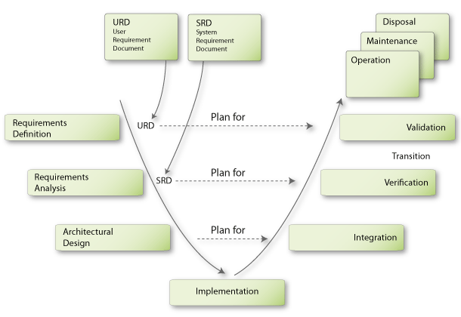
V Model from ISO 15288 – Systems Engineering
Module 0
Module 1,2
Module 3,4
Module 5

Slide 5
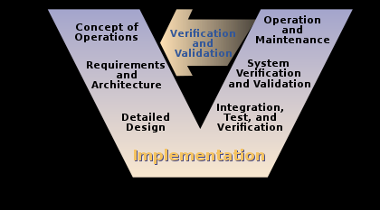
V model -3
This picture is the high level V Model used by the US Dept of Transportation
Module 0
Module 1,2
Module 3,4
Module 5
http://en.wikipedia.org/wiki/V-Model

Slide 6
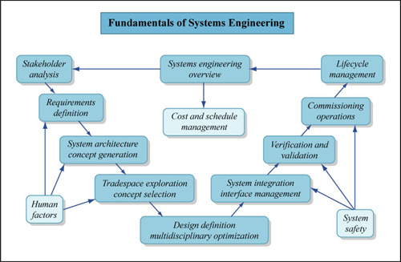
MIT’s V Model for Systems Engineering
Module 0
Module 1,2
Module 3,4
Module 5

Slide 7
Tools
The EPF tool is equivalent to IBM’s Composer tool. A large number of companies, in order to meet multiple demands, blend ISO 9000, CMMI, and a variety of other criteria. They build a unique method for each project to include tools, techniques, and processes.
EPF, Composer, and other similar tools give the ability to take the V model and develop explicit process definitions for each project.

Slide 8
Tools - 2
Topcased including SysML and AADL support a model-driven approach to systems engineering. After a very large (billions of dollars) mistake Airbus vowed not to make that mistake again and began development of an environment for end-to-end systems engineering including hardware and software. They have selected specific standards such as SysML and AADL to build dependable systems.

Slide 9
More questions?
Keep the questions coming

