Slide 1

SYSE 802
John D. McGregor
Module 5 Session 4
Prototypical Solution

Slide 2
Expectations
You may need to constrain the analysis to keep it manageable. Do a complete analysis but on only part of the product rather than doing a partial analysis by only getting started before you run out of time.
My example on the next page is the same as that used in the Session 1 slide set. It shows the functions being aggregated into a larger but more self-contained chip.

Slide 3
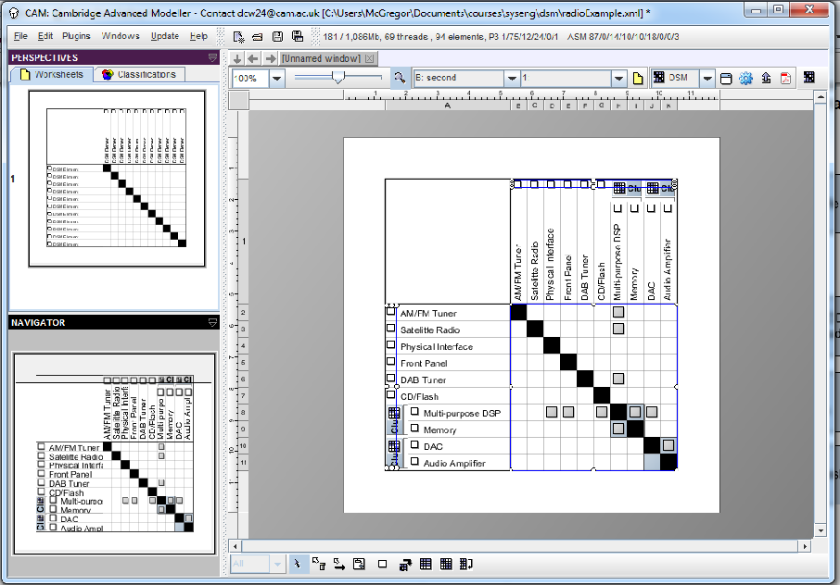
Analyses

Slide 4
Expectations
You should be able to identify 2 similar products. For may infotainment system other similar systems include a home automation and entertainment system that changes settings in the house based on where people are, who is there, and what day of the year it is among other features; and an office environment in which a person sits in whichever cubicle is available and their settings customize the environment and give them access.

Slide 5
SPL
Our infotainment product is intended to be used in a particular brand of vehicle. A similar type of product will be needed by every vehicle manufacturers. In fact several already exist, each targeting a single manufacturer. There is an opportunity to create a product line serving multiple lines within a manufacturer and across manufacturers.
  They would all accept a wide range of devices needing audio and visual outputs.
  They provide antennas but the individual devices must provide the transmitting components.
  The systems have multiple storage devices including hard drive and SD cards.
  Each has fast boot capability and treats the vehicle as just another device attached to its bus.

Slide 6
SPL - 2
Variations include
  The different device connections such as Blue Tooth
  Different sensors leading to different displays, different types of information and different algorithms
  Optional features such as gaming, video
The business case for this product line shows that there is the potential for large savings since the commonality among the products is very high.
The reference architectures examined in Module 3 are a good basis for the product line architecture.

