Slide 1

SYSE 802
John D. McGregor
Module 7 Session 4
Prototypical Solution

Slide 2
Session Objective
To present the prototypical solution

Slide 3
Expectations
Show at least two levels in the hierarchy if they exist.
Show concurrency if it exists. Have at least two concurrent machines.
The states can be hardware, software, or a combination of the two.
The infotainment model on the next slide shows 4 concurrent machines.
In the connectivity region the On state is a “submachine” state. That is it refers to another machine. In this case it refers to the “activate” state machine on the next slide.

Slide 4
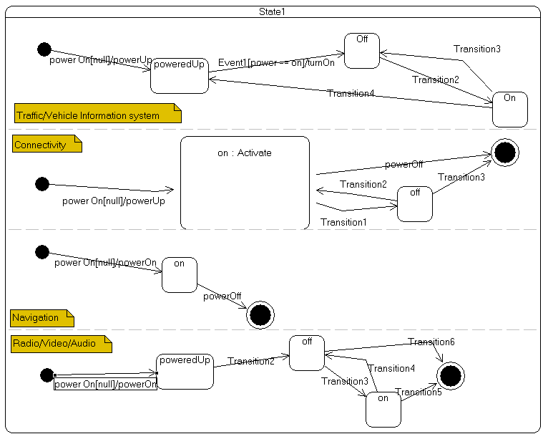
Here is a partial infotainment state model

Slide 5
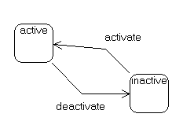
Submachine
This submachine can be pointed to from multiple top level states. So the On state in Navigation could also have pointed to this machine.

