Slide 1

SYSE 802
John D. McGregor
Module 8 Session 1
Management by Interfaces

Slide 2
Session objective
To consider how interface management impacts the systems engineering process.

Slide 3
In the beginning
We started this semester using the use case notation.
We defined the external system interfaces at a notional level by identifying those external things with which our system would interact.
The actors were human operators and other hardware-based system.

Slide 4
Then …
We discussed architecture and began to define internal interfaces.
Subsystem and module interfaces allow concurrent engineering.
If some of these internal interfaces are to be satisfied by subcontractors, the interface definition becomes part of the contract.

Slide 5
Since then …
We have examined several types of analysis that clarified and deepened our understanding of the problem and more completely specified a solution.
And we have iterated over earlier decisions and documents and perhaps changed a bit along the way.
A tighter definition of interfaces is the next step.

Slide 6
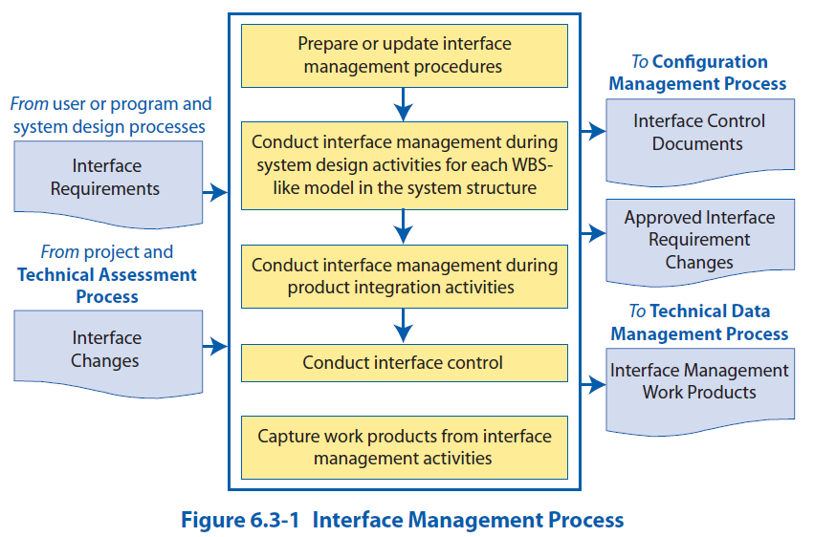
Interface management process/NASA

Slide 7
Management
The key quality in interface management is stability.
As early as possible we want to define interfaces and then not change them any more than necessary.
Changes to interfaces need to be through a change control board that includes both sides (if possible).
The way to achieve stability is to perform sufficient analyses, both architectural and detailed design, prior to defining the details of the interface.
One component of the interface description are budgets for factors such as latency.

Slide 8
Budgets
We have already talked about “allocation” of functions to subsystems.
These functional requirements are further subdivided among the units within the subsystem.
We also allocate non-functional requirements such as weight, power, and others.

Slide 9
Error Budgets
Error budgeting explores the effects of various kinds of manufacturing and runtime deviations that can occur and their impact of satisfying requirements.
Each type of product has different parameters and the analysis is specific to those parameters and the equations that use them.
Statistical methods, such as Monte Carlo, are used to model the distribution of errors.
Error budgeting is employed for complex entities for which there are many different potential sources of error and where exacting tolerances have significant implications.

Slide 10
Error Budget Process
Critical design factors and associated design parameters are identified.
For example, a radio’s antenna, frequency, and power are all critical to satisfying the requirements of the radio.
Identify all possible types of errors that can occur.
Power fluctuations from the power supply affect the power of the antenna.

Slide 11
Error Budget Process - 2
Design requirements such as tolerances are linked to actions in the manufacturing process that can influence the tolerances.
The process that shapes the antenna can affect the quality of the signal.
The manufacturing process is modified to reduce these effects.
A different type of machining may be used that can increase precision if analysis finds that the proposed process will fail to meet tolerances a significant amount of time.

Slide 12
Budgets and Domains
This discussion on budgets and analyses should make more clear the importance of domain to the systems engineer.
As a systems engineer leading the radio project I am not expected to know about the manufacture of antennas.
I am expected to manage a team that provides expert analysis of that and other manufacturing factors and to make decisions based on that data.
The different disciplines involved in a manufacturing process have different degrees of flexibility.
Budgets are negotiated among the participants in a manufacturing step and often re-negotiated.

Slide 13
Budgets and Scenarios
Each use case we created was intended to be a complete use of the system, but the purpose at that time was a high level view of the system.
At this point we need more complete end-to-end detailed information. They can still be associated with the use cases.
The important thing at this point is to not digress into isolated pockets of scenarios by individual specialties. This often fails to notice significant interactions.
The detailed scenarios provide profiles of important factors across the length of the scenario. For example, when will peak power loads occur, when will secure files be accessed, etc.

Slide 14
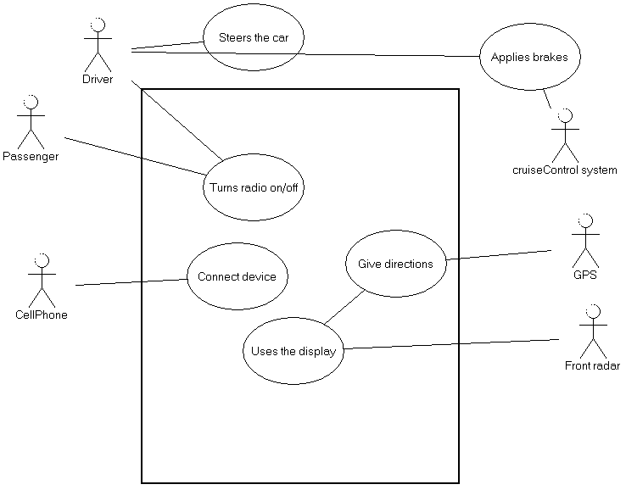
Extending scenarios
“Turns radio on/off” is expanded to include how to turn the radio on and off and what kinds of errors can be encountered.
“Turn the radio on using the control on the steering wheel…”
“Turn the radio on using the controls on the face of the radio…”

Slide 15
Extending scenarios - 2
The driver turns the radio on using the controls on the steering wheel and searches for a particular station by repeatedly pressing the channel advance button. Current station number and available format information is displayed on the AV display located on the dashboard. When the correct channel is found the driver adjusts the sound using the steering wheel controls. A volume indication is displayed on the AV screen.
This gives a more complete view of the elements in the system.

Slide 16
Management - 2
Besides budget, another important factor in the management of interfaces is any applicable standard that defines the entire interface or some portion of it.
The standard may be only a locally defined interface. It may be one-sided in that it may advertise what a module must do to interface with our system and make no assumptions about what the other module is.

Slide 17
Standard Interfaces
RS 232 and Bluetooth are just two examples of interface definitions that are used routinely.
Standard interfaces typically open options for multiple implementations. There are usually many products available to implement a standard interface.
The written description already exists saving time and resources.
While this is often more true for external interfaces, using a standard design may result in standard internal interfaces among components.

Slide 18
Built-to-purpose systems
Systems that are built to fulfill a specific purpose have a fixed relationship between pairs of modules.
In this case the interface can be a two-way contract that is negotiated between the parties.
The interface may be physical or in software.
An Interface Working Group (IWG) is formed from both sides.

Slide 19
Interface Control Document
Basically an interface is a contract between the suppliers of implementations and the users of those implementations.
The interface control document (ICD) is the written contract that defines the interface.
The next slide has several examples of ICDs that may interest you. Just scan each.

Slide 20
Interface Control Document
http://www.everyspec.com/NASA/NASA+-+JSC/NASA+-+SSP+PUBS/SSP_30256-001_REVF_7FEB1997--PDF__17774/
http://services.eoportal.org/massRef/documentation/icd.pdf
http://hirise.lpl.arizona.edu/pdf/HiRISE_EDR_SIS_2007_03_15.pdf
http://www.justice.gov/jmd/irm/lifecycle/appendixc16.htm

Slide 21
Interface Definition Document (IDD)
If a component is designed to work in a variety of systems a two-way interface is not possible.
The IDD describes the inputs and outputs from the single interface and is used by any SE who must integrate with that interface.

Slide 22
Summary
Interfaces are where modules come together and where accidents happen.
Tight control with well specified interfaces, even if all the teams are in-house, is necessary to ensure that the pieces of the system will fit together.

