Slide 1

SYSE 802
John D. McGregor
Module 8 Session 2
Platforms, Ecosystems, and Innovations

Slide 2
Session Objective
In this session we will explore techniques for identifying alternatives during system decomposition by considering innovation and how to bound it as described in INCOSE Handbook section 4.3.2.2.

Slide 3
Innovation
The system engineer tries to find new ways to satisfy customer needs. Ways that may not be standard practice.
Innovation comes with risk. The SE evaluates the risk against the potential reward of not only solving the immediate problem but also discovering a new pattern that can be applied to many future problems.
To manage risk innovation has to be controlled.

Slide 4
Platform
Product development researchers first used the term “platform” to describe projects that created a new generation or family of products for a particular firm.
technology strategists identified platforms as valuable points of control (and rent extraction) in an industry, in particular at the interfaces
Industrial economists subsequently adopted the term “platform” to characterize products, services, firms, or institutions that mediate transactions between two or more groups of agents (Rochet and Tirole, 2003).

Slide 5
Examples
Early on, the brand and model of the CPU chip established a basis for compatibility – was the program written in the object code of that chip or some other?
Later, the operating system (OS) was added the defining characteristics of the platform.
Still more recently the term has been applied to a collection of software standards that are embodied in a set of products.
The platform can be thought of as a set of interfaces used by the complementing software to utilize the services of the platform.

Slide 6
Platform architecture
architecture - “an abstract description of the entities of a system and how they are related”
platform architecture - certain components remain fixed over the life of the platform, while others are allowed to vary in cross-section or change over time
the interfaces between components creates specific thin crossing points in the network of relationships between the elements of the system
Interfaces in turn establish the boundaries of modules
http://www.hbs.edu/research/pdf/09-034.pdf

Slide 7
Platform characteristics
Platforms evolve
Modular interfaces reduce both coordination costs and transaction costs across the module boundary
Just as technology platforms provide economies of scale and scope within and across firms, multi-sided market platforms exhibit economies of scale for the platform and economies of scope for the various groups that transact with each other.
All platform systems exhibit tensions between platform owners and complementors

Slide 8
Example
http://www.kauffman.org/advancing-innovation/innovation-3-0.aspx
http://www.ow2.org/xwiki/bin/download/About/OW2Consortium/CedricThomasPlatformStrategy0903.pdf

Slide 9
Platforms as strategy
When should the platform owner encourage outsiders to develop complements to the platform? In other words, when should the owner adopt a “platform strategy”?
The answer is when those complements do not intersect with any of the future plans of the developer.

Slide 10
Option value of platform
Option value is low when consumer tastes are homogeneous and predictable, and designs are on a tightly determined technological trajectory.
Option value is high when consumer tastes are heterogeneous or unpredictable, and technological trajectories are uncertain.
Outside complementors will be attracted to the platform if there is option value in the complements, provided the platform owner does not expropriate all the value they create.

Slide 11
Components
In any platform system, there are three types of components: (1) the complements, which exhibit high variety and high rates of change over time; (2) the core components, which remain stable as the complements change; and (3) the interfaces, which are the design rules that allow the core and the complements to operate as one system.

Slide 12
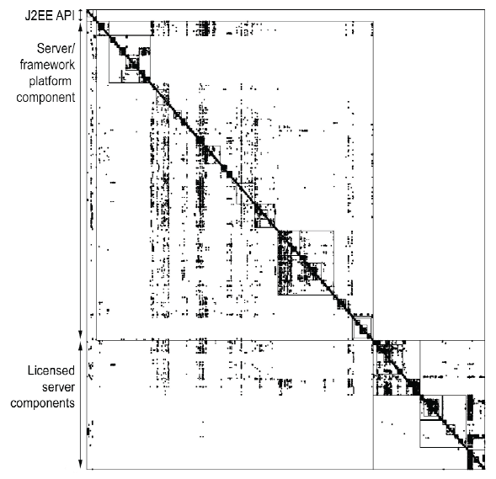
DSM – 2 modules

Slide 13
Ecosystems
Platforms give rise to modular clusters or business ecosystems of complementary and competing firms.
Example:
  “Aside from Eclipse (and Atlassian), none of these other platforms leverage OSGi. Yet each are wildly successful because of two reasons:
  An environment was created that allowed an ecosystem to form and flourish. This environment includes a platform and a marketplace.
  A group of customers and developers converged on the marketplace and fueled growth of the platform. The result is a self-sustaining ecosystem.”
A growing thriving ecosystem means business for many of the members

Slide 14
Ecosystem - 2
The platform has
  Suppliers
  Complementors
  Customers
Events affecting one of these may affect others; some positively and some negatively
The SE may have the opportunity to select a platform upon which to base their product or they may be faced with needing to be compatible with multiple platforms.
In which case their development organization may be participating in multiple ecosystems.

Slide 15
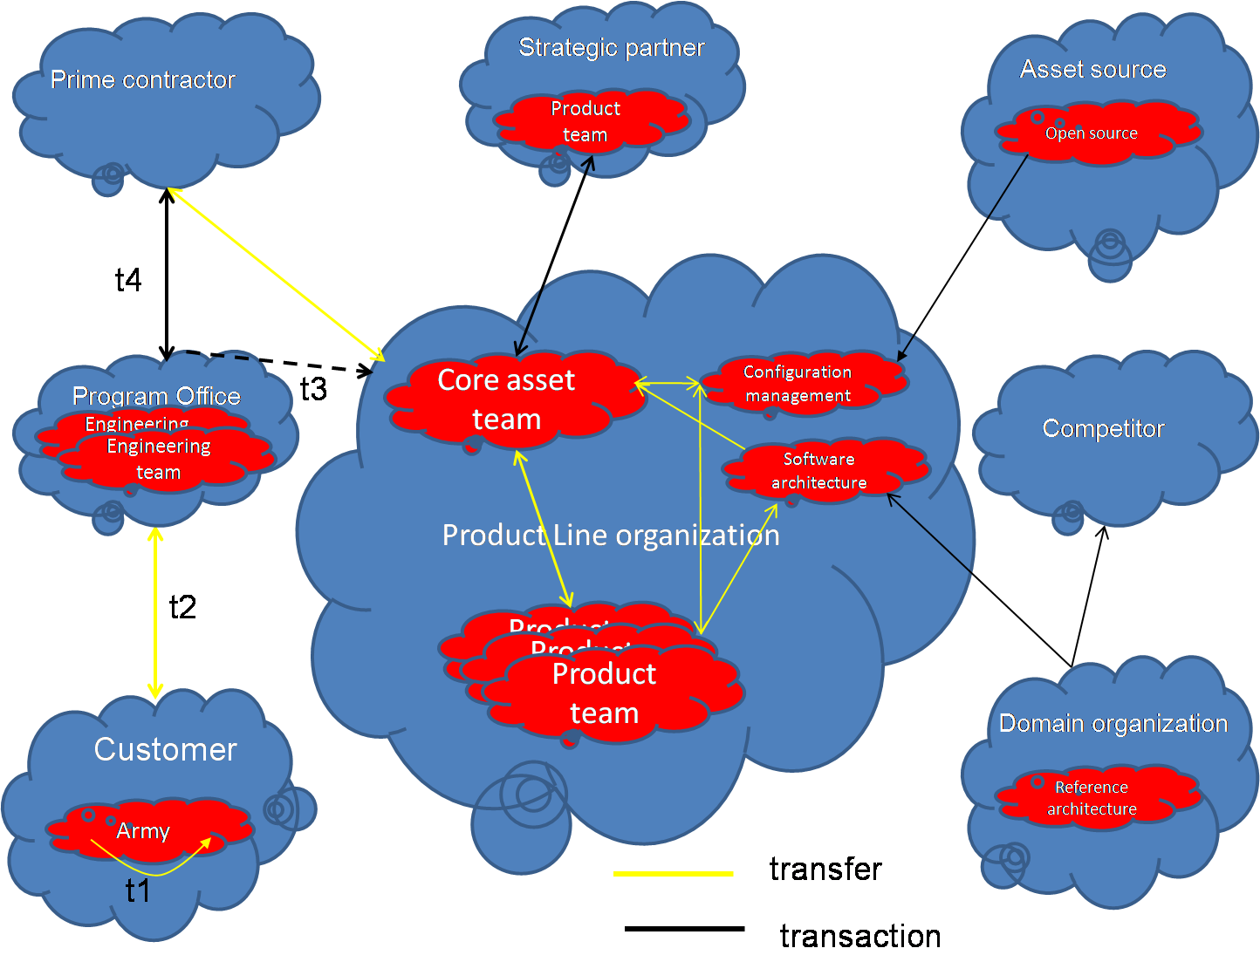
A DoD SPL Ecosystem Model

Slide 16
Innovator models
A producer innovator is a single, non-collaborating firm. Producers anticipate profiting from their design by selling it to users or others: by definition they obtain no direct use-value from a new design.
An open collaborative innovation project involves contributors who share the work of generating a design and also reveal the outputs from their individual and collective design efforts openly for anyone to use.
A single user innovator is a single firm or individual that creates an innovation in order to use it.

Slide 17
Innovation costs
The basic costs of innovation
  design cost
  communication cost
  production cost
  transaction cost

Slide 18
Interactions among models
 | design | communication | production | transaction
Producer innovators
Single user innovator
Open collaborative innovator

Slide 19
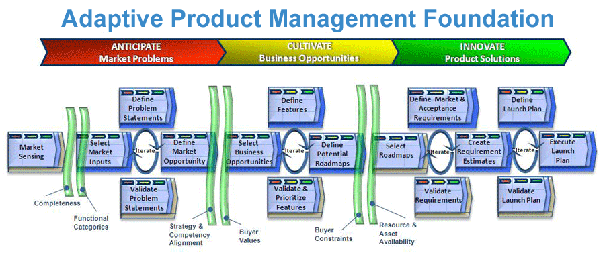
Innovation
Innovation in a software product line is facilitated by allowing the product manager to quickly dispense with that portion of product implementations covered by the core asset base and focus on innovation.
http://grandview.rymatech.com/

Slide 20
Summary
A platform provides a focus for system developers.
The interfaces of the platform inform users of the requirements for integrating with the platform.
Innovation takes the form of changes either to products built on the platform or to the platform itself.

