Slide 1

SYSE 802
John D. McGregor
Module 3 Session 4
Solution

Slide 2
Expectation
For the candidate architectures use Google and give the basic description of your product plus words such as architecture to find examples of architectures being used.
Also try images.google.com
An additional search or two will get the in-depth information for the architecture you have selected.

Slide 3
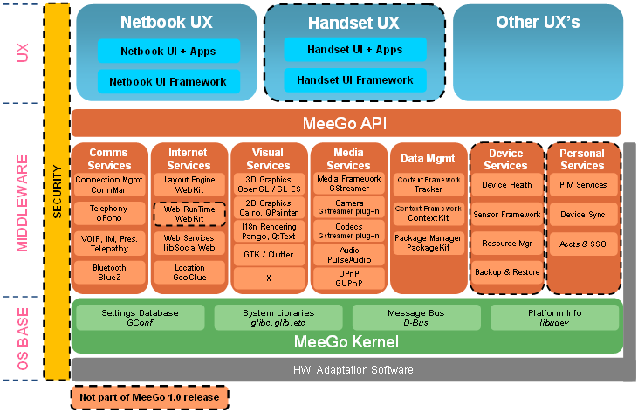
Candidate architectures - Meego

Slide 4
Meego
http://meego.com/developers/meego-architecture
Open source, Linux-based
X-window system interface

Slide 5
Genivi
http://www.genivi.org/Portals/9/documents/mrd/GENIVI_IVI_Software_Architecture_Report.pdf
No cartoon available to general public
Open/closed project – open for membership, closed otherwise

Slide 6
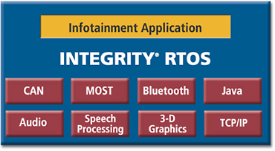
Integrity

Slide 7
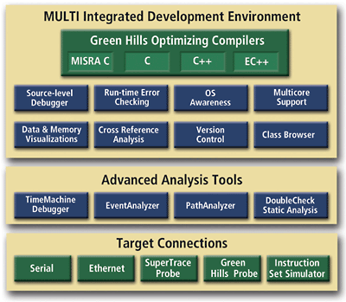
Integrity
Dedicated development environment

Slide 8
In-depth - Meego
Meego was selected because it is available not just in-vehicle but on many other platforms
Portability of applications is assured
Intel 32 bit-based Atom processor
Compatible graphics chip set such as US15W chipset
Bluetooth - 2402-2480 MHz; Packet-based protocol; range – 100 meters

Slide 9
In-depth – Meego - 2
Uses a layered architecture
Middle layer is service-oriented

Slide 10
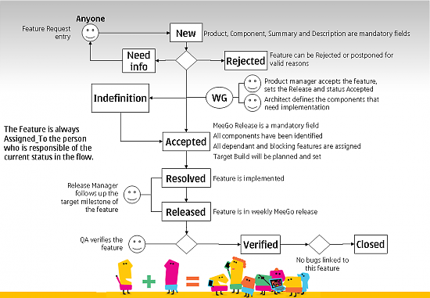
Not architecture, but interesting
Requirements process

Slide 11
Expectation
You are not responsible for defining a property set.
Just setup a system definition for each module shown in the architecture graphic you have found.
Add connections that reflect the connections in the graphic. This is intended to be practice in using a formal description language for architecture.

Slide 12
AADL solution
Powerpoint is not a good format for this, but one package is better than several
First is the top level definition of a vehicle that includes an infotainment feature
Then I repeat the property set from the example
Then I give a package that contains all the needed definitions to support the meego.basic used in the top level.

Slide 13
AADL – very top level
system vehicle
end vehicle;
system implementation vehicle.basic
subcomponents
--instances of subsystems defined in other packages
--braking system
--steering system
infotainment_system: system infoSys::meego.basic;
end vehicle.basic;

Slide 14
Property set
property set Clemson is
MbitPerSec : type units (MPS, GPS => MPS*1000);
Band_width: type aadlinteger units Clemson::MbitPerSec;
Radio_band_width: Clemson::Band_width applies to (all);
Band_width_802_11g: constant Clemson::Band_width => 54 MPS;
Band_width_802_11n: constant Clemson::Band_width => 300 MPS;
Band_width_fast_ethernet: constant Clemson::Band_width => 100 MPS;
end Clemson;

Slide 15
A Package of definitions
package infoSys
public
processor Intel
end Intel;
processor implementation Intel.Atom
end Intel.Atom;
bus MOST
end MOST;
bus implementation MOST.basic
properties
--this will probably generate an error in Topcased
--Topcased can not find the correct property set
Latency => 5ms;
end MOST.basic;
system layer
end layer;
system implementation layer.basic
end layer.basic;

Slide 16
system OSBaseLayer extends layer
end OSBaseLayer;
system implementation OSBaseLayer.basic
end OSBaseLayer.basic;
system MiddlewareLayer extends layer
features
commIn: in data port;
commOut: out data port;
netIn: in data port;
netOut: out data port;
end MiddlewareLayer;
system implementation MiddlewareLayer.basic
subcomponents
commnication: system commService.meego;
internet: system internetService.meego;
--other services
end MiddlewareLayer.basic;
system UXLayer extends layer
end UXLayer;
system implementation UXLayer.basic
end UXLayer.basic;

Slide 17
system commService
end commService;
system implementation commService.meego
end commService.meego;
system internetService
end internetService;
system implementation internetService.meego
end internetService.meego

Slide 18
system Meego
features
radioConnection : requires bus access;
bluetoothConnection: requires bus access;
gpsConnection: requires bus access;
end Meego;
system implementation Meego.basic
subcomponents
main_processor: processor Intel.Atom;
main_bus: bus MOST.basic;
ux:system UXLayer.basic;
middleware:system MIddlewareLayer.basic;
os: system OSBaseLayer.basic;
properties
Clemson::Radio_band_width => value (Clemson::Band_width_802_11g);
end Meego.basic;
end infoSys;

