Slide 1

What’s Making That Sound ?
Kai Li
Department of Electrical Engineering and Computer Science
University of Central Florida

Slide 2
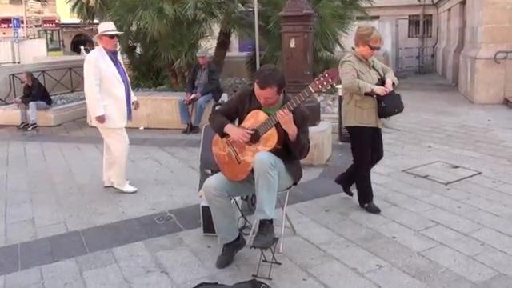
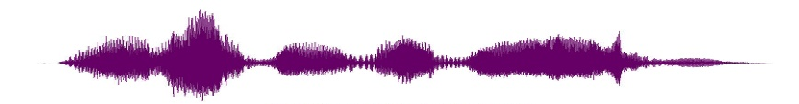
Audiovisual Correlation Problem
Find the visual object whose motion generates the audio.
Distracting Moving Object
Video can be made using a single microphone
Object can be musical instrument, speaker, etc.
Assume a primary audio source dominates the audio signal.
A special case of general cross-modality correspondence problem
Video frame
The audio source
Audio
(Guitar Music)

Slide 3
The Challenge
Significantly different resolutions.
Temporal resolution: audio @ kHz vs. videos @ 20-30 fps.
Spatial resolution: video @ 1 million pixels per frame vs. audio with 1 numerical value per sample.
Semantic gap between modalities.
Audio and visual signals are captured using different sensors, their numerical values take essentially different semantic meanings.
Prevalent noises and distractions.
Both modality contain noises.
Multiple distractions may exist in both modalities.

Slide 4
Existing Solutions
Pixel-level correlation methods.
Objective: Identify image pixels that are most correlated with audio signals.
Methods: CCA and its variants, Mutual Information etc.
Limitation: pixel-level localization is noisy and doesn’t carry too much high-level semantic meaning.
Object-level correlation methods.
Objective: Identify object (i.e. image structure) that are most correlated with audio signals
Methods: correlation measures are first obtained at fine-level (e.g. pixels), then cluster pixels based on the fine-level correlation.
Advantage: Correlation results are segmented visual objects which are more semantically meaningful.

Slide 5
Existing Approach
Existing object-level solutions also have problems.
Segmentation step is susceptible to the previous correlation analysis.
Extracted object hardly observe true object due to the noise of fine-level correlations.
How to address it ?

Slide 6
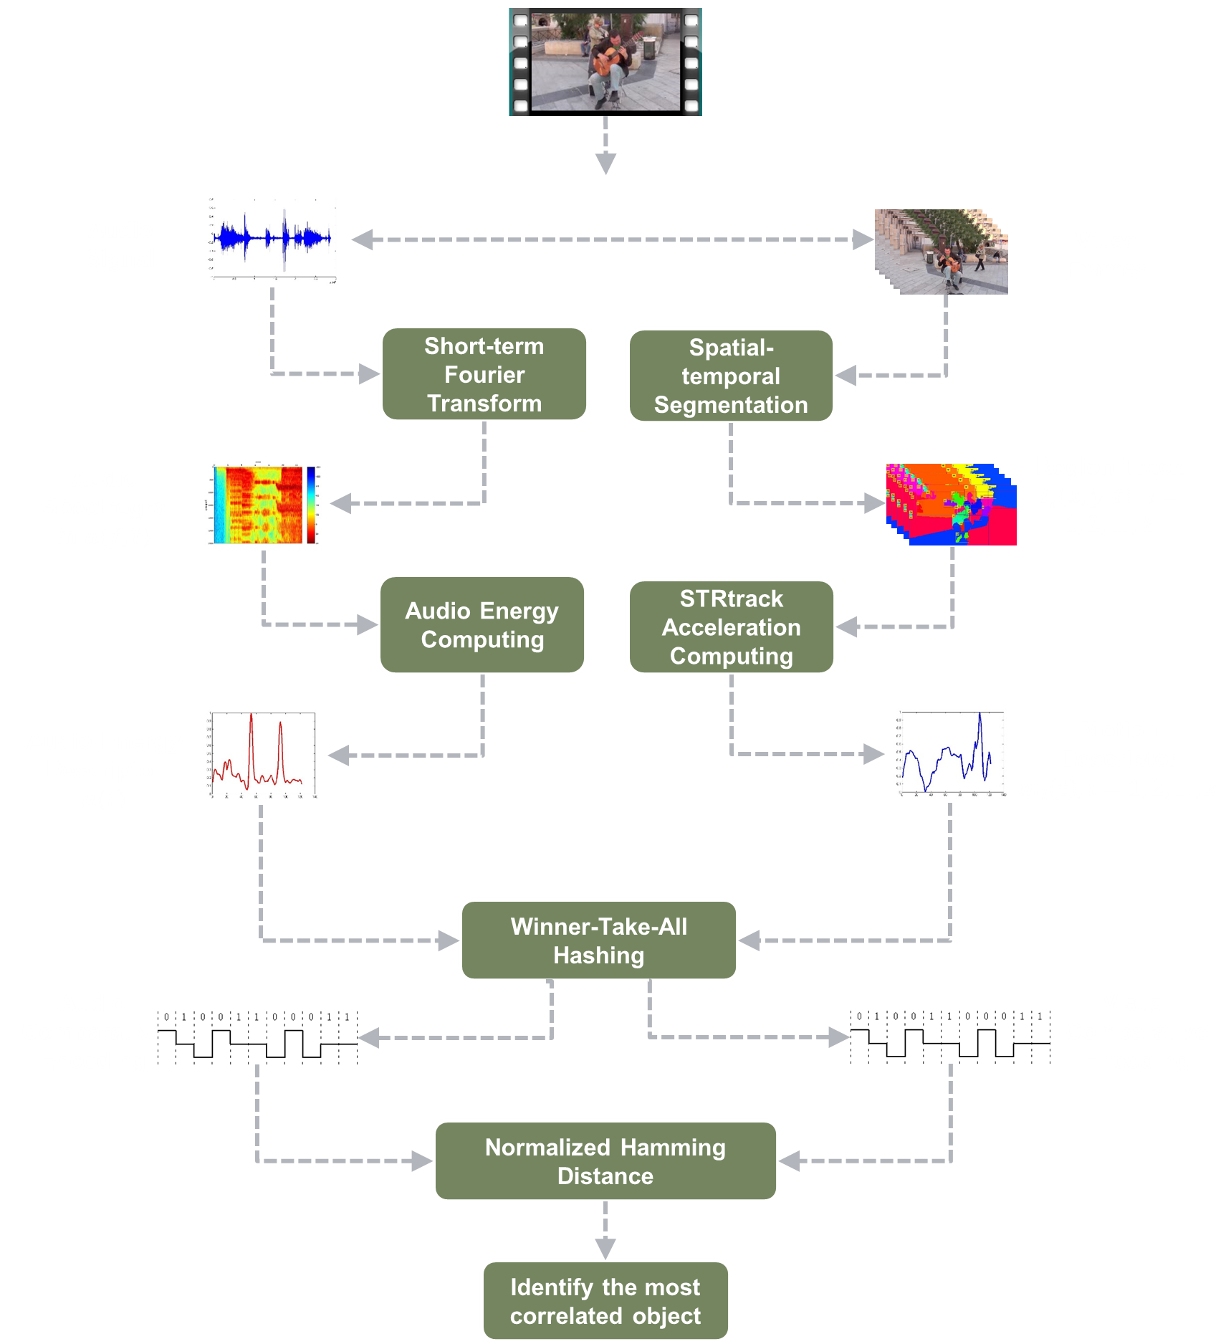
An Overview of Our Approach
Video Input
Audio Feature Computing
Visual Feature Computing
The general idea: first apply video segmentation, and analyze correlation afterwards
Audio signal strength is correlated with the object’s motion intensity
Find audio features that represent audio signal strength
Find visual features to represent object’s motion intensity
Audiovisual Correlation

Slide 7

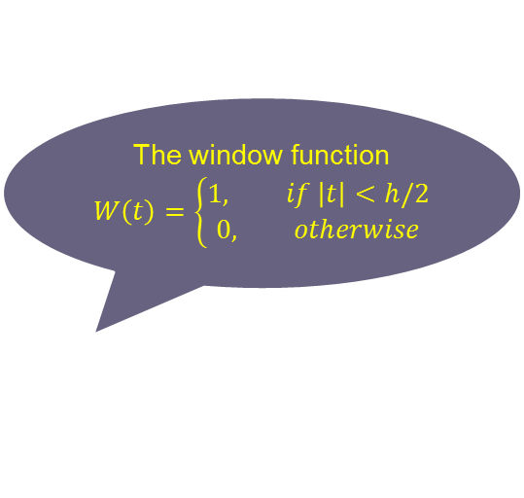
Audio Representation
Audio energy features
The window function
$$W\left(t\right)=\left\{\begin{aligned}1, if \left|t\right|<h/2 \\ 0, otherwise\end{aligned}\right.$$
$$a\left(t\right)=\int_{0}^{∞}{\int_{0}^{T}{f\left(t^{′}\right)W(t^{′}−t)e^{−i2πft^{′}}dt^{′}df}}$$
Short-term Fourier Transform (STFT)
Audio signal is framed according to the video frame rate.
Compute the audio energy for each audio frame using the above equation.

Slide 8

Video Representation
Block diagram of spatial-temporal video segmentation
Intra-frame Processing
Inter-frame Processing
Motion Clustering
Distance Computation & Thresholding
New Regions
Region Tracks
Optical flow
Color Segmentation
Region Similarity Computation
Image Relabeling
New frame
Region Tracks Update
Video Frames

Slide 9
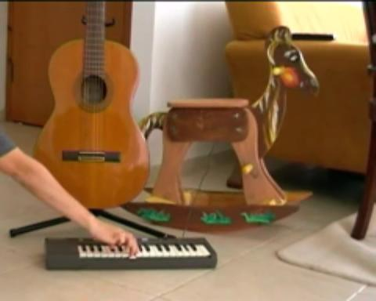
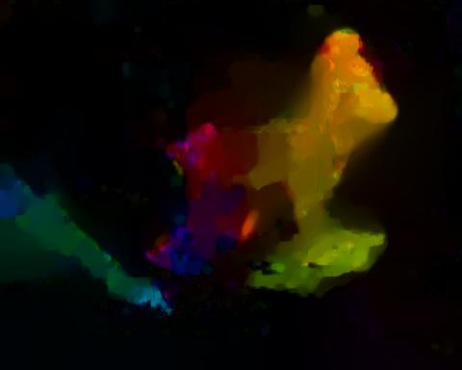
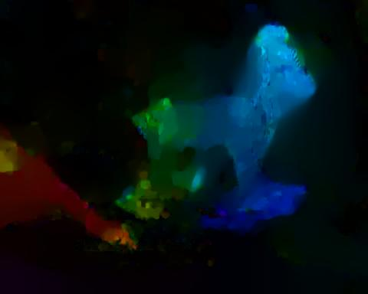
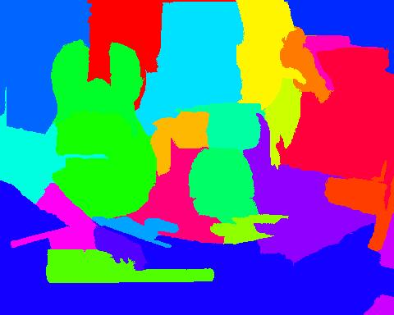
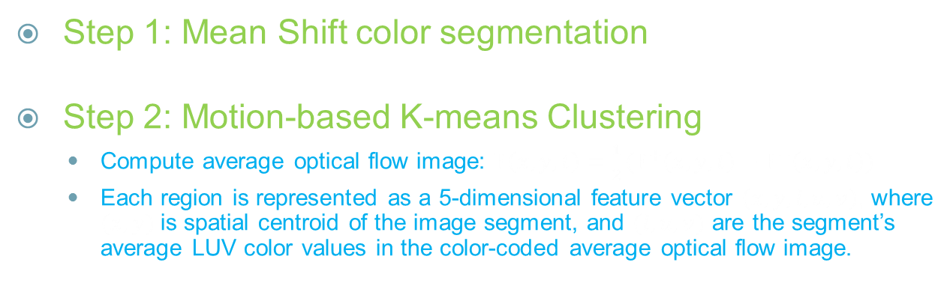
Video Representation
Intra-frame processing (2-step segmentation)
Step 1: Mean Shift color segmentation
Step 2: Motion-based K-means Clustering
Compute average optical flow image: $F\left(x, y, t\right)=\frac{1}{2}(F^{+}\left(x,y,t\right)−F^{−}\left(x,y,t\right))$
Each region is represented as a 5-dimensional feature vector $\left(x, y, l, u, v\right)$, where $(x, y)$is spatial centroid of the image segment, and $(l, u, v)$ are the segment’s average LUV color values in the color-coded average optical flow image.
Color Image
Optical Flow (forward)
Optical Flow (backward)
Segmentation
Input
Output

Slide 10
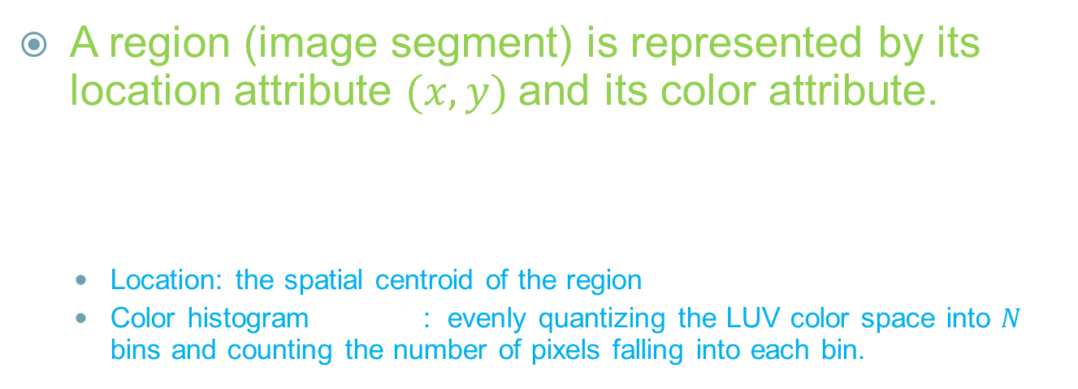
Video Representation
Inter-frame Processing: Region representation.
A region (image segment) is represented by its location attribute $(x, y)$and its color attribute.
$$Region: \{Location: (x, y), Color: h\}$$
Location: the spatial centroid of the region
Color histogram $h ∈Z^{N}$ : evenly quantizing the LUV color space into $N$ bins and counting the number of pixels falling into each bin.

Slide 11
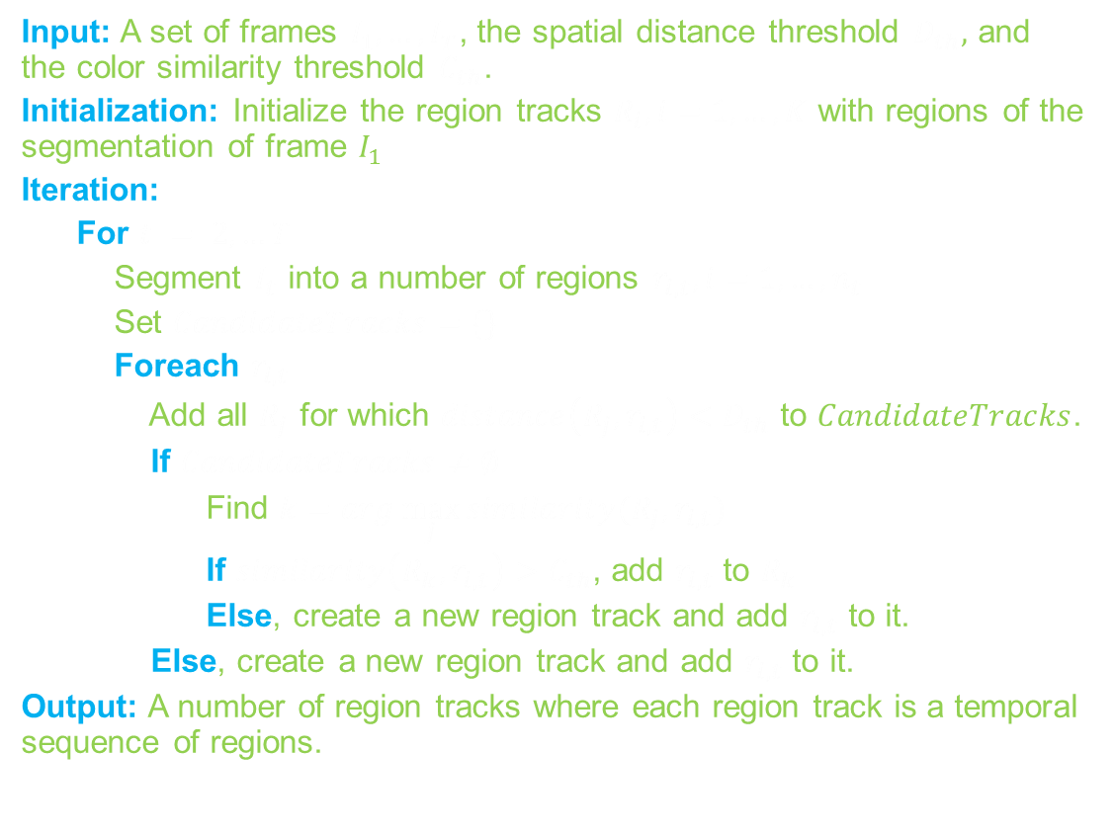
Video Representation
Inter-frame region tracking
Input: A set of frames $I_{1}, …,I_{T}$, the spatial distance threshold $D_{th},$ and the color similarity threshold $C_{th}$.
Initialization: Initialize the region tracks $R_{i}, i=1, …, K$ with regions of the segmentation of frame $I_{1}$
Iteration:
For $t = 2,…T$
Segment $I_{t}$ into a number of regions $r_{i, t},i=1, …, n_{t}$
Set $CandidateTracks=\{\}$
Foreach $r_{i, t}$
Add all $R_{j}$ for which $distance\left(R_{j},r_{i, t}\right)<D_{th}$ to $CandidateTracks$.
If $CandidateTracks≠∅$
Find $k=arg⁡\max_{j}{similarity(R_{j},r_{i, t})}$
If $similarity\left(R_{k},r_{i, t}\right)>C_{th}$, add $r_{i, t}$ to $R_{k}$
Else, create a new region track and add $r_{i, t}$ to it.
Else, create a new region track and add $r_{i, t}$ to it.
Output: A number of region tracks where each region track is a temporal sequence of regions.
The distance is computed as the Euclidean distance between current region’s spatial centroid, and that of the region track’s most recently added region
The similarity is computed as the cosine angle between current region’s color histogram and the average color histogram of all regions in the region track

Slide 12
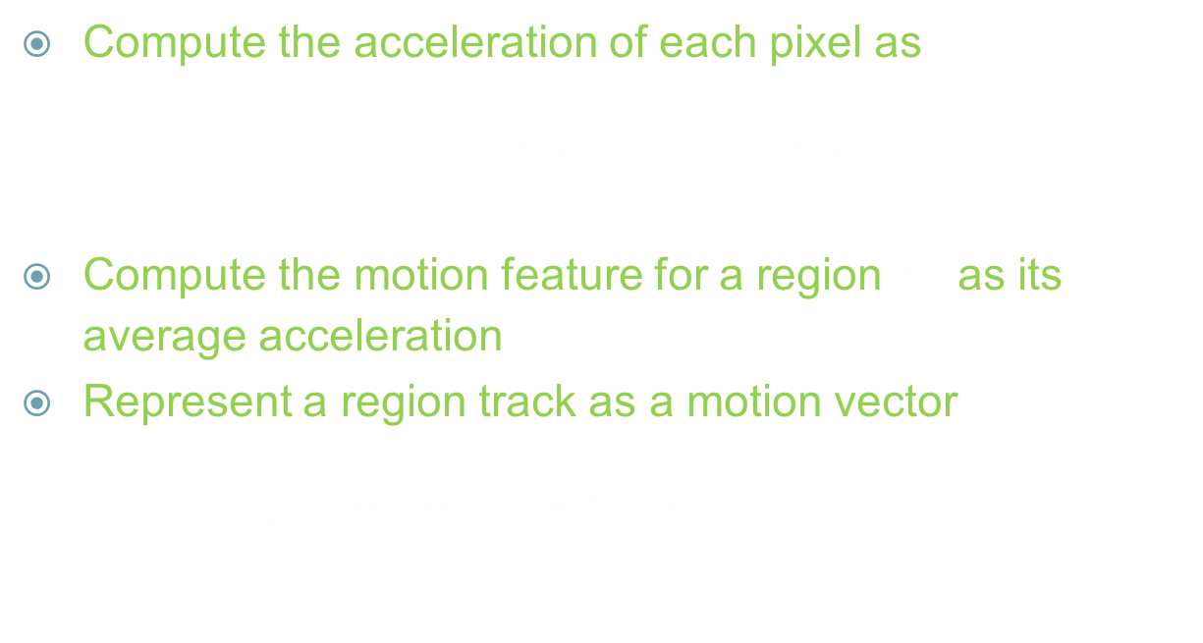
Video Representation
Visual feature extraction
Compute the acceleration of each pixel as
$$M\left(x, y, t\right)= F^{+}\left(x,y,t\right)−(−F^{−}\left(x,y,t\right))$$
Compute the motion feature for a region $r_{t}^{k}$ as its average acceleration $m_{t}^{k}$
Represent a region track as a motion vector
$$V_{k}={[m_{1}^{k},m_{2}^{k},⋯,m_{T}^{k}]}^{T},k=1,2,⋯, K$$

Slide 13
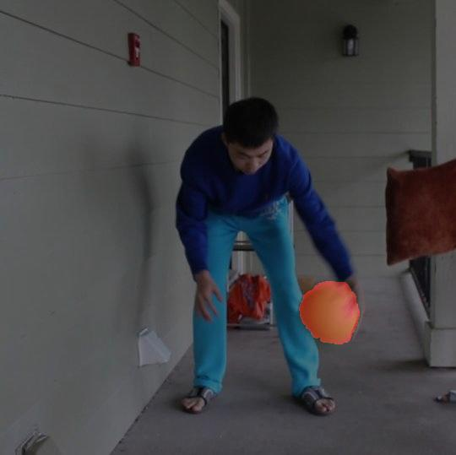
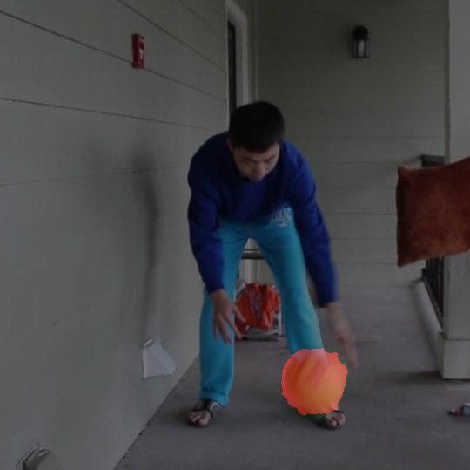
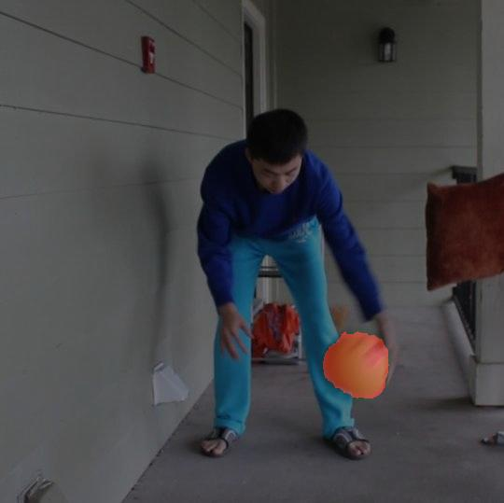
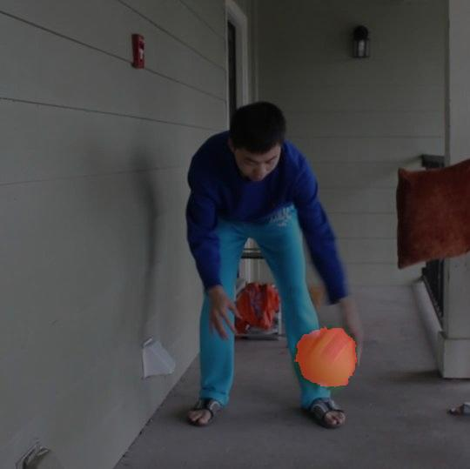
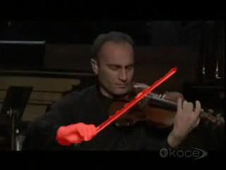

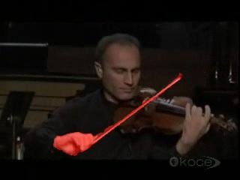

Audiovisual Correlation
Some interesting observations
Discrete Sound
(i.e. with clear intervals of silence)
We need a feature embedding technique to encode such similarity of multimodal features.
Continuous Sound
Video
Audio visual features

Slide 14
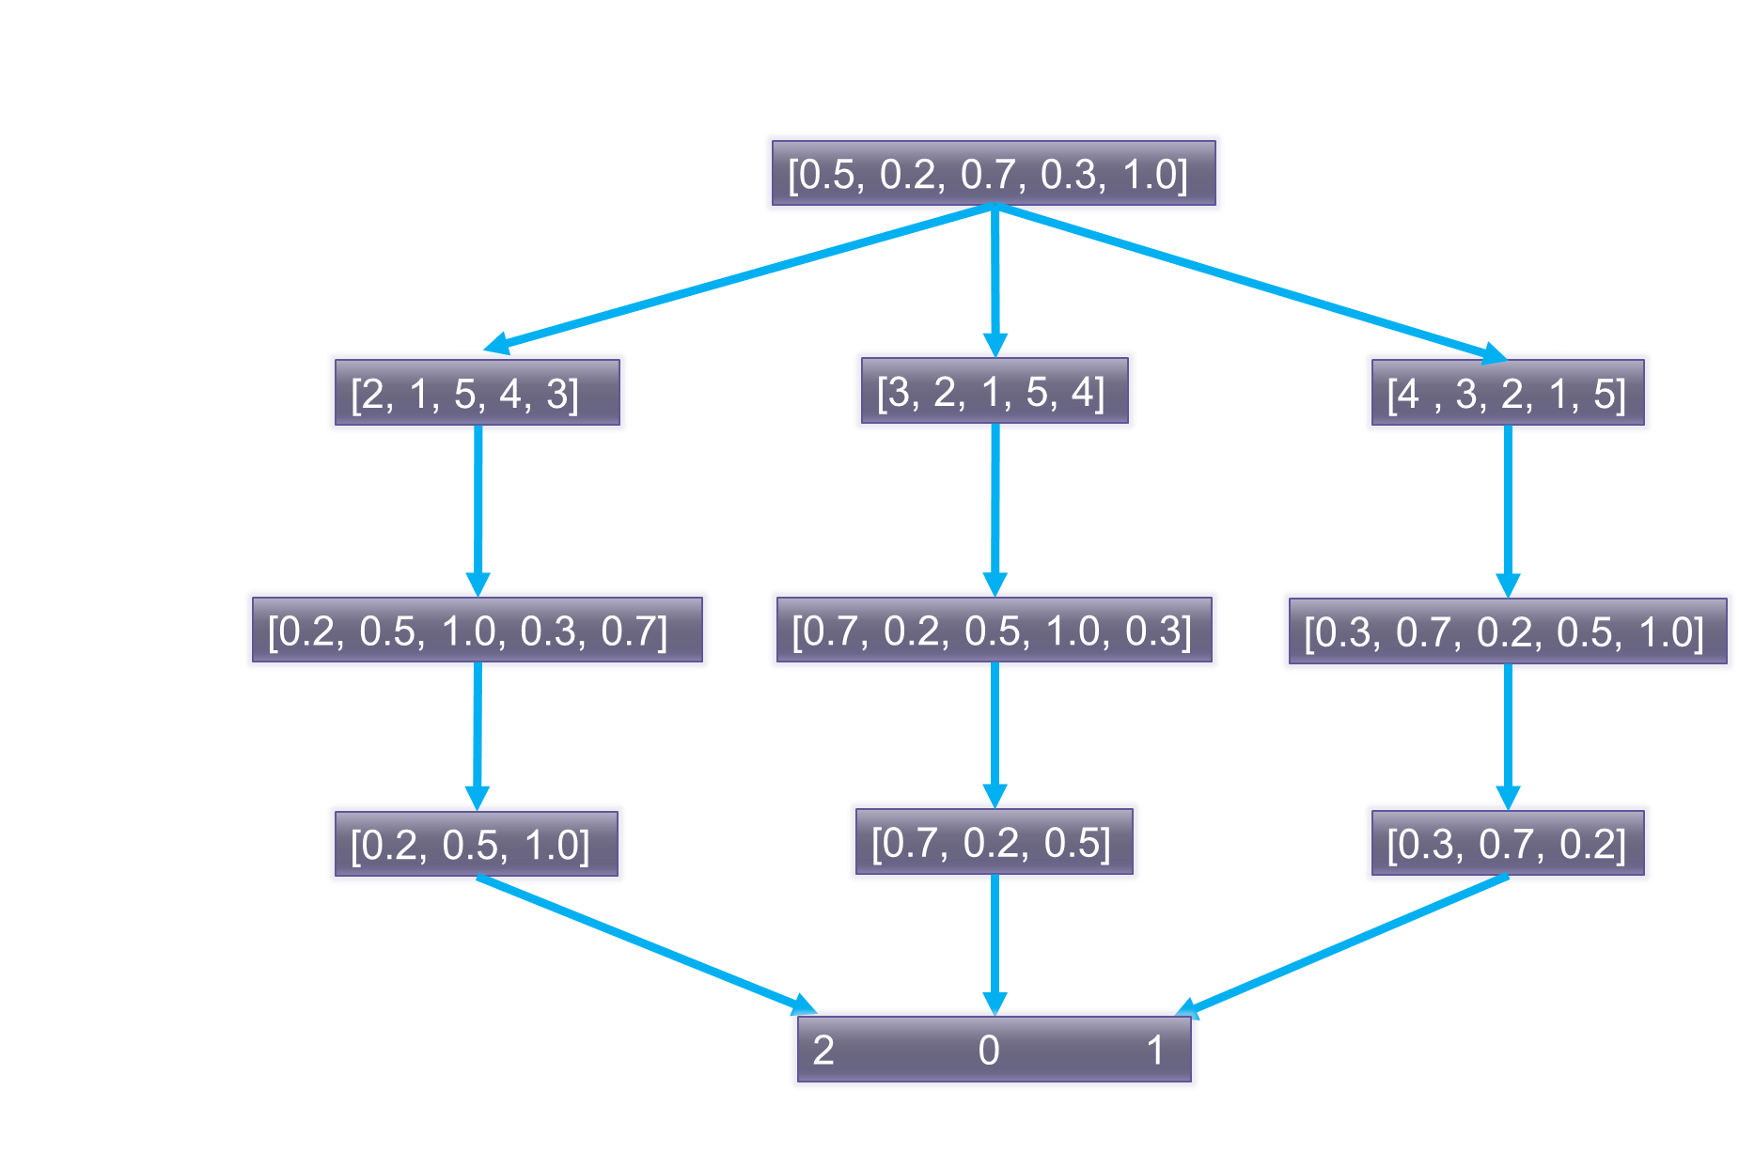
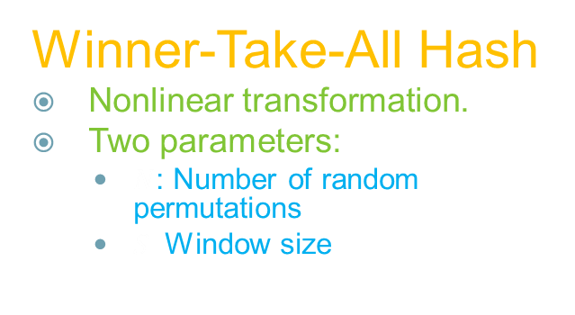
Audiovisual Correlation
Winner-Take-All Hash
Nonlinear transformation.
Two parameters:
$N$: Number of random permutations
$S:$Window size

Slide 15
Audiovisual Correlation
How does WTA work ?
X = [A, B, C]
A<C<B
B
X’ = [A’, B’, C’]
A’<C’<B’
B’
C’
A
C
A’
X = X’ in ordinal space; not the case in metric spaces with distances based on numerical values.
We use the same WTA function to embed multimodal features into the same ordinal space.
Similarity can be computed efficiently (e.g. Hamming distance).

Slide 16






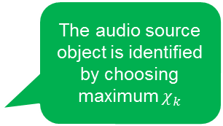
Audiovisual Correlation
Audiovisual correlations
$$V_{k}={[m_{1}^{k},m_{2}^{k},⋯,m_{T}^{k}]}^{T}$$
$$A={[a_{1}\text{, }a_{2}, ⋯, a_{T}]}^{T}$$
Winner-Take-All Hash
$$HashFunc(∙)$$
$$HashFunc(∙)$$
$$HammingDist(∙,∙)$$
The audio source object is identified by choosing maximum $χ_{k}$
$$Correlation χ_{k}$$

Slide 17
Experiments
Dataset
5 challenging videos from Youtube and previous research
Video Name | Frame rate (fps) | Resolution | Audio Spl. Freq. (kHz) | Source
Basketball | 29.97 | 540 x 360 | 44.1 | Made
Student News | 29.97 | 640 x 360 | 44.1 | Youtube
Wooden Horse | 24.87 | 480 x 384 | 44.1 | [1][2]
Guitar Street | 25.00 | 640 x 360 | 44.1 | Youtube
Violin Yanni | 25.00 | 320 x 240 | 44.1 | [1]
[1] Izadinia, H.; Saleemi, I.; Shah, M.,“Multimodal Analysis for Identification and Segmentation of Moving-Sounding Objects”, Multimedia, IEEE Transactions on , vol.15, no.2, pp.378,390, Feb. 2013
[2] Kidron, Einat, Yoav Y. Schechner, and Michael Elad.“Cross-modal localization via sparsity”, Signal Processing, IEEE Transactions on 55.4 (2007):1390-1404

Slide 18
Experiments
Baseline Method [1]
Spatial-temporal segmentation with K-means
Video features: optical flows and their 1st order derivatives
Audio features: MFCCs and their 1st order derivatives
CCA is used to find the maximum projection base for video
[1] Izadinia, H.; Saleemi, I.; Shah, M.,“Multimodal Analysis for Identification and Segmentation of Moving-Sounding Objects”, Multimedia, IEEE Transactions on , vol.15, no.2, pp.378,390, Feb. 2013

Slide 19
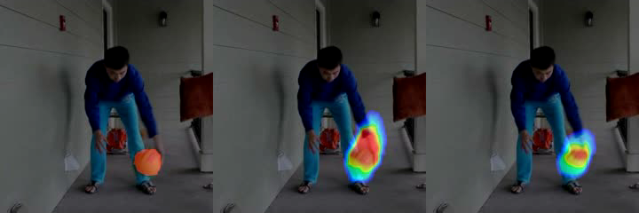
Qualitative Results
Short demo on video clips.
Ground Truth
Baseline [1]
Proposed Method

Slide 20

Quantitative Experiments
Performance metrics
Spatial localization
$precision= \frac{|P∩T|}{|P|},recall=\frac{|P∩T|}{|T|}$
P: pixels detected by the algorithm.
T: ground truth pixels.
Temporal localization
$$Detection rate=\frac{\# of succesfull detections}{Total number of frames}$$
$$Hit ratio=\frac{\# of accurate localization}{Total number of frames}$$
Successful detection: $recall>0.5$
Accurate detection: $precision>0.5$

Slide 21
Quantitative Results
Precision & Recall
Precision
Recall

Slide 22
Quantitative Results
Precision & Recall (another view)
Precision-Recall

Slide 23
Quantitative Results
Hit ratio & Detection rate.
Hit ratio
Detection Rate

Slide 24
Thank You !

