Slide 1

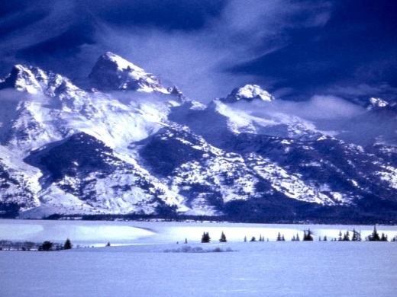
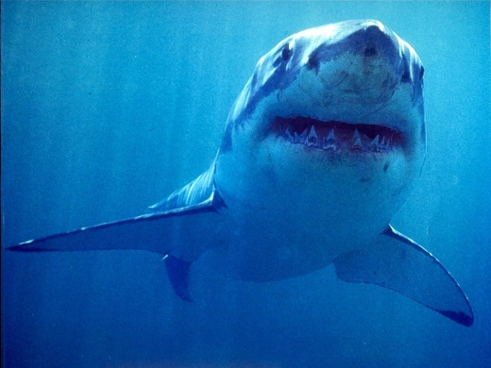
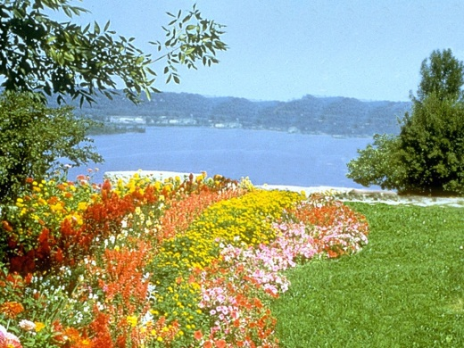
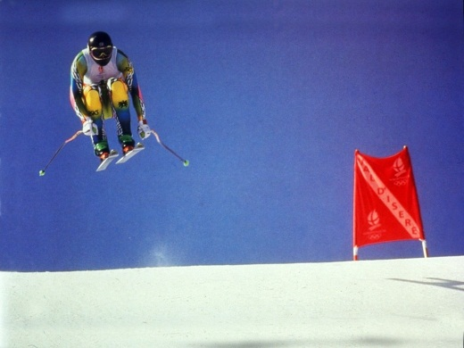
Exploring Principles-of-Art Features For Image Emotion Recognition
Sicheng Zhao¹, Yue Gao², Xiaolei Jiang¹, Hongxun Yao¹, Tat-Seng Chua², Xiaoshuai Sun¹
¹Harbin Institute of Technology, China; ²National University of Singapore, Singapore
Notes:
[remarks]
The emotions of the four gifs are amusement, anger, awe, disgust.

Slide 2
Outline
Background and Motivation
Principles-of-Art Features
Experiments and Applications
Conclusions
Notes:
This is the outline of this presentation.
[press]
First part, background and motivation.

Slide 3
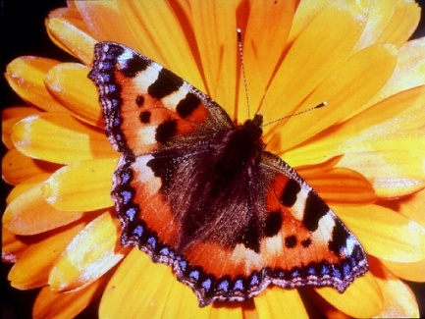
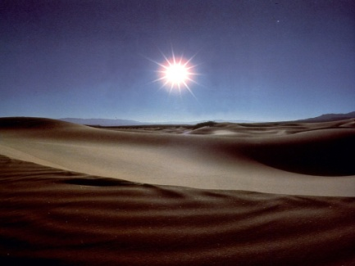
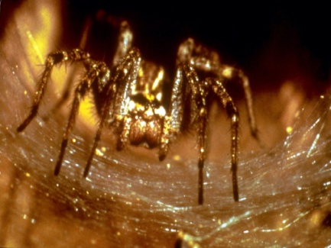
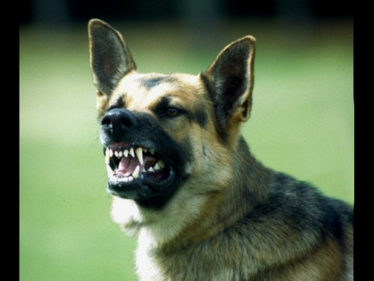
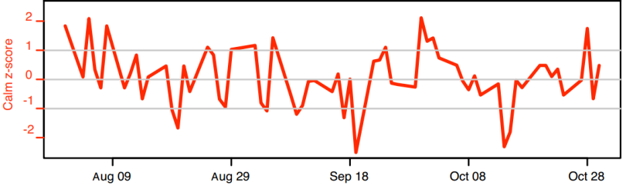

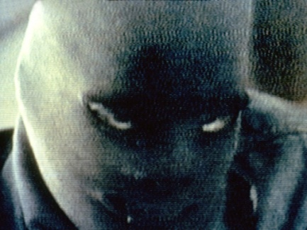
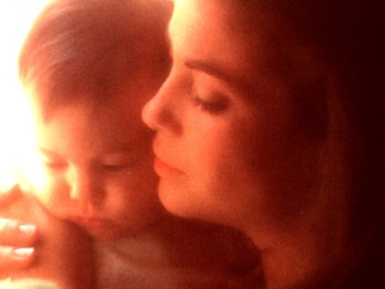
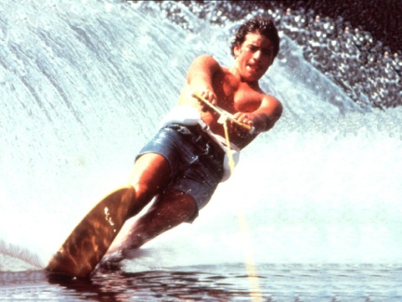
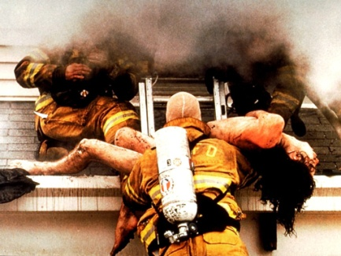

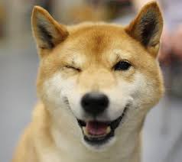
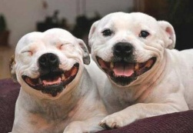
Images and Emotions
Stock market prediction
amusement awe disgust fear
applications
Decision making
Affective image retrieval
Happy
dog?
anger contentment excitement sadness
Notes:
Rich emotions can be evoked in humans by images.
[press]
Understanding the implied emotions in images is of vital importance to behavior sciences and enables wide applications, such as stock market prediction, decision making and affective image retrieval.

Slide 4
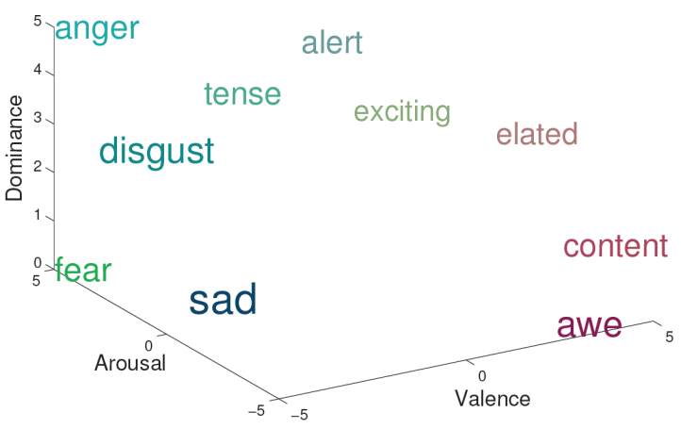
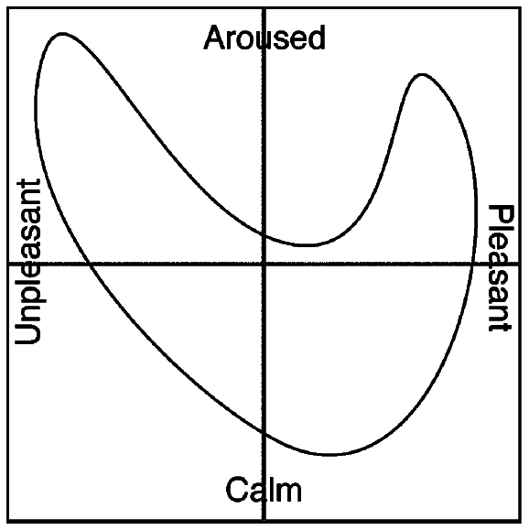
Emotion Models
Categorical Emotion States (CES)
happiness, surprise, anger, disgust, fear, sadness
amusement, anger awe, contentment, disgust, excitement, fear, sadness
joy, sadness, anger, fear, surprise, ……
Dimensional Emotion Space (DES)
Valence-Arousal-Dominance/Control
Natural-Temporal-Energetic
Activity-Weight-Heat
Valence-Arousal (VA)
Notes:
To represent emotions, there are generally two typical models: categorical emotion states (CES), and dimensional emotion space (DES).
[press]
In this paper, we use 8 emotion categories for CES. That is, classify the emotion of an image into one of the 8 categories.
VA space is adopted for DES. Dimensional scores on valence and arousal are assigned to the emotion of an image.

Slide 5









Affective Content Analysis
Category | Classification |  | Examples
Data types | Still images
 | Dynamic videos
Emotion models | Categorical
 | Dimensional
Features | Generality | Generic | SIFT, HOG
 |  | Specific | Color, Texture, Composition
 | Level | Low | SIFT, Color, Shape
 |  | Mid | Composition, BOW
 |  | High | Face, Skin
 | Art theory | Elements | Color, Line, Shape
 |  | Principles | Emphasis, Variety
Notes:
This table presents the related works on affective content analysis, which can be divided into different types, according to the analyzed multimedia types, the adopted emotion models and the extracted features.
[press]
The most widely used features for image emotion analysis are elements-of-art-based low level features.

Slide 6

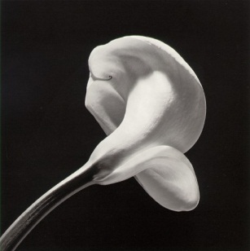
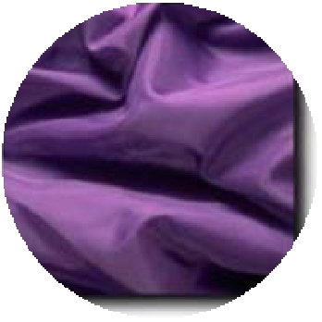
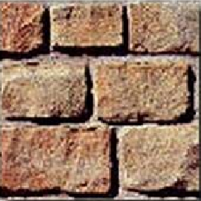
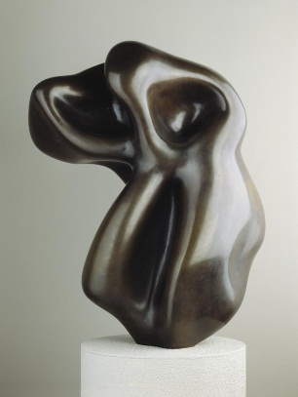
Elements-of-Art
Color, value, line, texture, shape, form and space
Shade
Tint
Values
Space
Colors
Lines
Textures and Shapes
Form
Notes:
Elements of art are the basic properties of a work of art that may be perceived through the senses, including color, value, line, texture, shape, form and space.

Slide 7
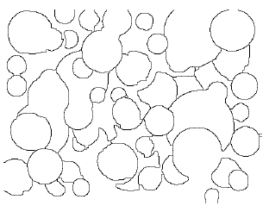
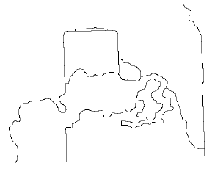
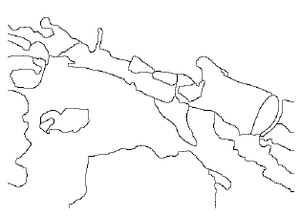
Elements-of-Art: Limitations
Uninterpretable by humans
Uninterpretable by humans
Weak link to emotions
Notes:
However, there are some limitations using elements-of-art features for image emotion recognition.
[press]
First, they are not easily interpreted by humans. We cannot understand the meanings of these features and why such a set of features induce a particular
emotion.
For example, given these shapes, it is hard to tell the emotions they convey.

Slide 8
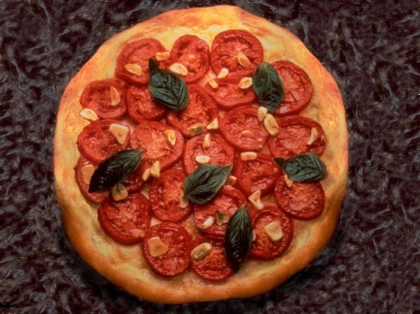
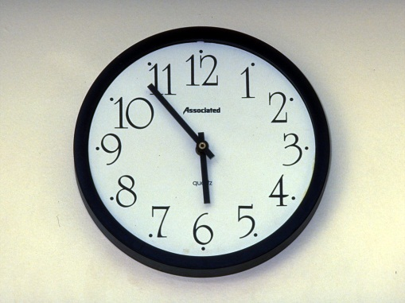
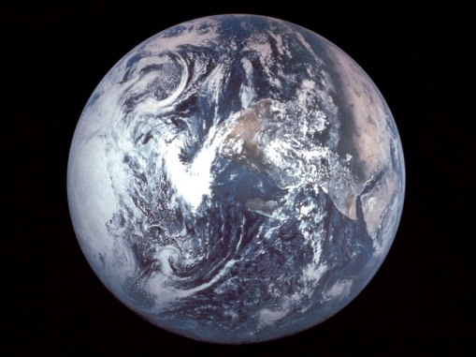
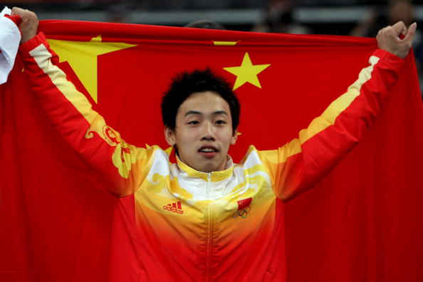
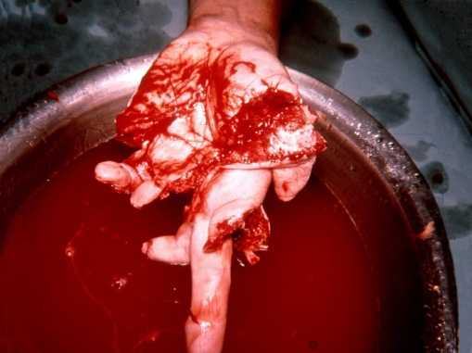
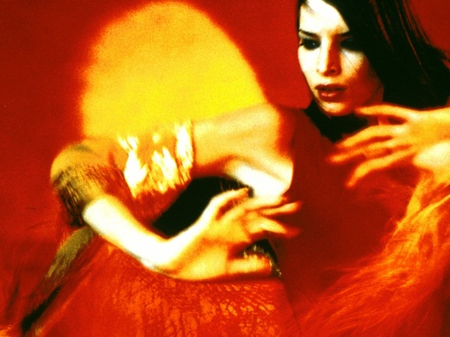
Elements-of-Art : Limitations
Uninterpretable by humans
Weak link to emotions
Using elements-of-art features to recognize emotions may fail!
Shape
Color
Notes:
Second, weak link to emotions. The low level elements cannot represent high level emotions well.
For example, the dominated shape of the first three images is a circle. But they express different emotions
And the main color of these images is red. They also convey different emotions.
[press]
In such cases using elements-of-art based features to recognize emotions may fail!

Slide 9
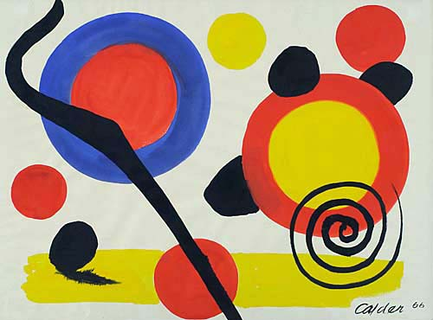
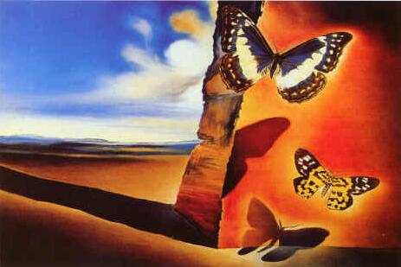
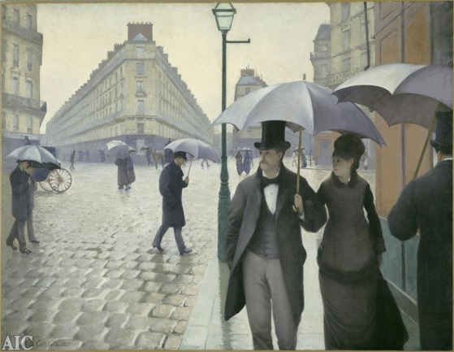
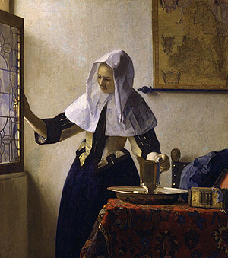
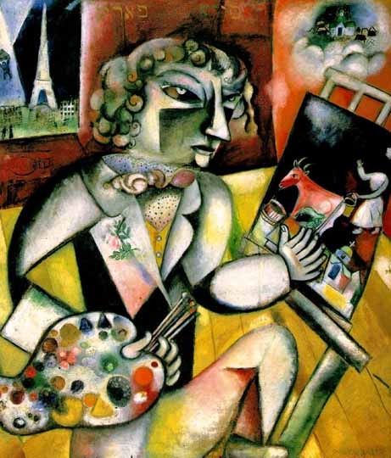
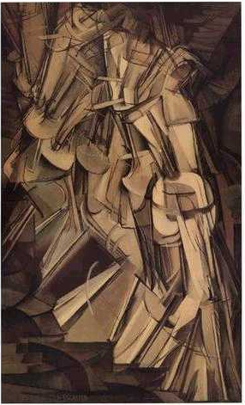
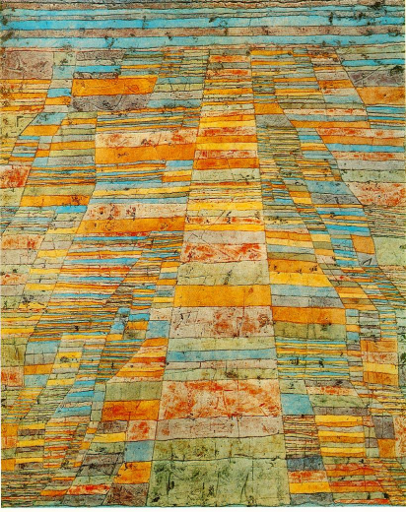
Motivation
Features based on principles-of-art
Balance Emphasis Proportion
Harmony Variety Movement Gradation
Notes:
Therefore, we motivate to use features based on principles-of-art, which are the rules, tools or guidelines of arranging and orchestrating the elements-of-art in an artwork.

Slide 10
Outline
Background and Motivation
Principles-of-Art Features
Experiments and Applications
Conclusions
Notes:
Second part, Principles-of-Art Features.

Slide 11
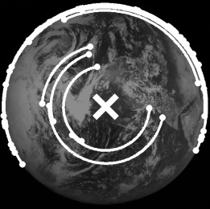
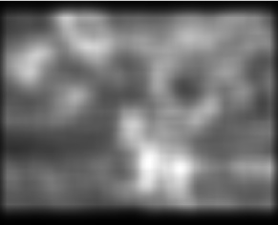
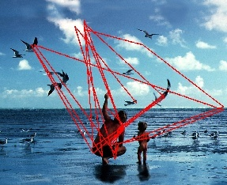
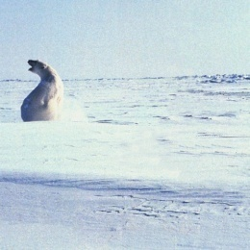
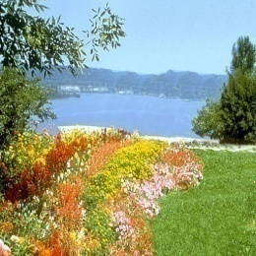
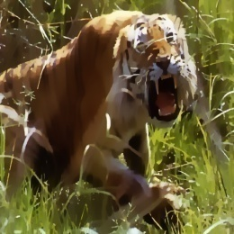
Framework
Classification image dataset
Principles-of-art Emotion Features
Training and Testing
Symmetry
Emphasis
Movement
Training set
+
Manual labels
Preprocessing
Test set
Resizing
Harmony
Variety
Gradation
Classifier
Segmentation (Selectable)
RGB HSV
Emotion labels
Evaluation
Notes:
The framework is similar to traditional classification tasks, including preprocessing, feature extraction, training and testing.
Our main contributions are the principles-of-art-based emotion features, lying in the blue solid rectangle.

Slide 12
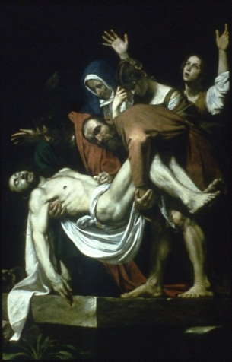
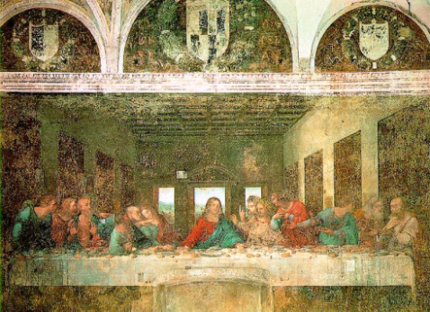
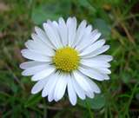
Principles-of-Art
Balance
Emphasis
Harmony
Variety
Gradation
Movement
the sense of
equilibrium or stability
Notes:
Balance, also known as symmetry, refers to the feeling of equilibrium or stability of an art work.
There are three types of balances: symmetrical, asymmetrical and radial.

Slide 13
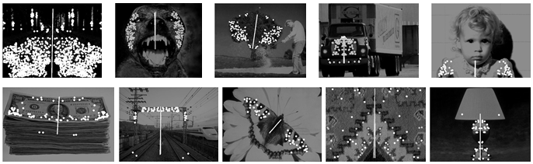
Balance Features
Bilateral symmetry
Bilateral symmetry
Rotational symmetry
Notes:
As the asymmetrical balance is difficult to measure, we only consider symmetry, including bilateral symmetry and rotational.
[press]
[optional]The symmetry is detected by matching symmetrical pairs of feature points represented by rotationally invariant SIFT.
For bilateral symmetry, we compute the symmetry number, the radius, angle and strength of the maximum symmetry.

Slide 14
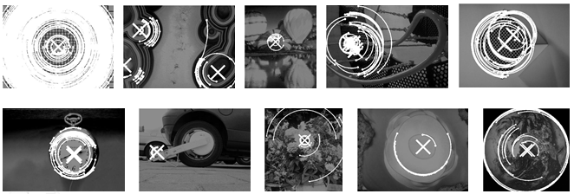
Balance Features
Bilateral symmetry
Rotational symmetry
Notes:
For rotational symmetry, we compute the symmetry number, the center and strength of the maximum symmetry.

Slide 15
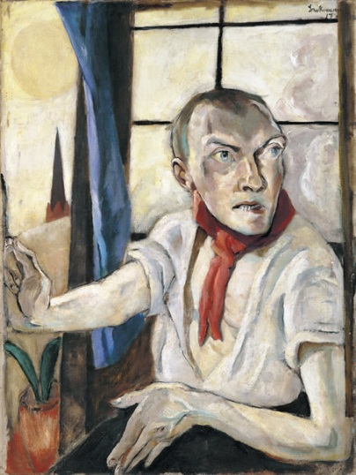
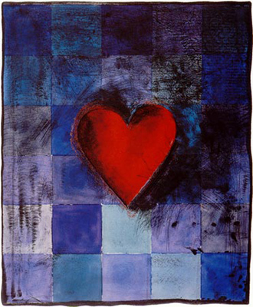
Principles-of-Art
Balance
Emphasis
Harmony
Variety
Gradation
Movement
sudden and abrupt changes
to stress the difference
Notes:
Emphasis (contrast) is accomplished by using sudden and abrupt changes in elements to stress the difference.

Slide 16














Emphasis Features
Itten color contrast
Itten color contrast
Rate of focused attention
light and dark
hue
saturation
complements
warmth
extension
simultaneous
Notes:
We use Itten color contrast and the rate of focused attention to represent emphasis.
[press]
Itten color contrast include seven color combinations, such as contrast of hue, saturation.
[remarks]
contrast of saturation, contrast of light and dark, contrast of extension, contrast of complements, contrast of hue,
contrast of warm and cold, and the simultaneous contrast.

Slide 17



Emphasis Features
Itten color contrast
Rate of focused attention
Notes:
Rate of focused attention is used measure the focus rate of an image when people watch it.
Three masks are used, including statistic subject mask, diagonal mask and back diagonal mask.
The first column shows different masks. The three rows of each entry on the right are related images, saliency maps and RFA scores.

Slide 18

Principles-of-Art
Balance
Emphasis
Harmony
Variety
Gradation
Movement
combining similar elements
to accent similarity
Notes:
Harmony, also known as unity, refers to a way of combining similar elements in an artwork to accent their similarities.

Slide 19








Harmony Features
The rangeability of hue and gradient direction
Notes:
The harmony intensity of each pixel is computed on its hue and gradient direction in a neighborhood.
The harmony of an image is the sum of all pixels’ harmony intensity.
The first row shows some images with high color harmony intensity.
The second row shows some images with low color harmony intensity.

Slide 20

Principles-of-Art
Balance
Emphasis
Harmony
Variety
Gradation
Movement
complicated images
diverse changes
Notes:
Variety is used to create complicated images by combining different elements with diverse changes.

Slide 21

Variety Features
Basic color numbers and each color’s amount
Notes:
We use basic color numbers and each color’s amount to measure variety.
The first row shows images of high color variety with their color distributions in terms of 11 basic colors shown in row 2.
The third and fourth rows respectively show images of low color variety and related distributions of the 11 basic colors.

Slide 22


Principles-of-Art
Balance
Emphasis
Harmony
Variety
Gradation
Movement
connecting elements with
gradual changes
Notes:
Gradation refers to a way of combining elements by using a series of gradual changes.

Slide 23

Gradation Features
Windowed total variation, windowed inherent variation, relative total variation
Notes:
Windowed total variation, windowed inherent variation, relative total variation are used to measure gradation.
These are images of different texture gradations, but with similar content meanings and emotions.
Windowed inherent variation ensures that our features still make sense for cartoons.

Slide 24


Principles-of-Art
Balance
Emphasis
Harmony
Variety
Gradation
Movement
create the look of action
directs viewers’ gaze
Notes:
Movement is used to create the look and feel of action. It guides the viewers’ eye throughout the work of art.

Slide 25

Movement Features
The distribution of eye scan path
Notes:
The distribution of eye scan path is used to measure movement.

Slide 26








Principles-of-Art: Advantages
More interpretable and semantic; Easier to understand
Symmetry and variety vs. texture and line
More relevant to emotions
Consider the arrangements and orchestrations of elements
Notes:
The advantages of principles include:
Principles are more interpretable and semantic than principles; and are easier for humans to understand.
For example, humans can understand symmetry and variety better than texture and line.
[press]
Besides, principles take the arrangements and orchestrations of elements into consideration and are more relevant to emotions.
For example, the first image is more harmonious than the second one.
The third image is more bilateral symmetry than the last one.

Slide 27
Outline
Background and Motivation
Principles-of-Art Features
Experiments and Applications
Conclusions
Notes:
Third part, experiments and applications.

Slide 28













Datasets
IAPS: International Affective Picture System
1,182 natural color images
Labelled in VAD space
Used for DES modelling
A subset of IAPS dataset (IAPSa)
395 images from IAPS
8 emotion categories
Used for CES modelling
amusement anger awe contentment disgust excitement fear sadness
Notes:
IAPS dataset is a standard emotion evoking image set in psychology. It contains 1,182 documentary-style natural color images.
Each image is associated with an empirically derived mean and standard deviation of valence, arousal and dominance.
This dataset is used for DES modelling.
[press]
Mikels et al. selected 395 images and classified them into 8 discrete categories. We label it as IAPSa, which is used for CES modelling.
[press]
This figure shows the emotion distribution.

Slide 29














Datasets
Abstract dataset (Abstract)
228 abstract paintings
8 emotion categories
Used for DES modelling
Artistic dataset (ArtPhoto)
806 artistic photographs
8 emotion categories
Used for DES modelling
Notes:
Abstract dataset contains 228 peer rated abstract paintings without contextual content.
[press]
ArtPhoto dataset contains 806 artistic photographs searched from a photo sharing site.
These two datasets are both classified into 8 emotions and used for CES modelling.

Slide 30
Settings
K-fold cross-validation
K=5, 80% for training, 20% for testing
10 runs
Affective image classification
Classifier: SVM with RBF kernel
One vs. all
Measurement: True positive rate and STD
Affective image regression
Regressor: SVR with RBF kernel
Measurement: MSE and STD
Notes:
Experimental settings.
We use 5-fold cross validation to test the performance. That is, 80% for training and 20% for testing.
We conduct the experiment for 10 runs.
[press]
For affective image classification, we use RBF based SVM as classifier. True positive rate per class and the standard deviation are used as measurement.
[press]
For affective image regression, we use RBF based SVR as regressor. Mean squared error and the standard deviation are used as measurement.

Slide 31



Affective Image Classification
IAPSa
Abstract
Our method outperforms the state-of-the-art
with about 5% improvement.
ArtPhoto
Notes:
This is the average true positive rate on the three datasets.
[press]
We can see that our method outperforms the state-of-the-art, achieving about 5% improvement on classification accuracy.
The improvement benefits from the fact that the principle features take the elements’ arrangements and orchestrations into account.

Slide 32










Affective Image Classification
Average accuracy:
Perform better on ArtPhoto and Abstract than IAPSa.
ArtPhoto, Abstract: taken by artists using principles better
IAPSa | Abstract | ArtPhoto
63.5% | 65.7% | 66.9%
IAPSa: the emotions are evoked by certain objects
Notes:
The average accuracy of the three datasets are 63.5, 65.7 and 66.9.
[press]
The classification accuracy on the Abstract and ArtPhoto datasets is better than that on the IAPSa dataset.
[press]
This is because in the ArtPhoto and Abstract datasets, the images are taken by artists who understand and utilize the principles-of-art better.
While in the IAPSa dataset, the emotions are usually evoked by certain objects in the images.
In such cases, our method may fail. Combining the visual concept detection method, such as SentiBank, may help to tackle this problem

Slide 33

Affective Image Classification
a | Bilateral symmetry | b | Rotational symmetry | c | Radial symmetry
d | Itten color contrast | e | RFA | f | Rangeability of hue and gradient direction
g | Color names | h | Distribution of gradient | i | Absolute variation
j | Relative variation | k | Relative total variation | l | Gaze scan path
Notes:
To evaluate the effectiveness of the measurements for emotion classification, we build classifiers for each measurement and sort them based on the classification accuracy in a descending order.

Slide 34






Affective Image Classification
The roles of different principles
Balance and harmony tend to express positive emotions.
Emphasis and variety are more effective than others.
Relative variation performs better than absolute variation.
The eye scan path mainly focuses on the emphasis area.
RFA is extremely effective on Abstract dataset.
Notes:
To evaluate the effectiveness of the measurements for emotion classification, we build classifiers for each measurement and sort them based on the classification accuracy in a descending order.
From these results, we find that
Balance and harmony tend to express positive emotions more often.
[press]
Emphasis and variety play an important role in classifying all the 8 categories of emotions.
[press]
Relative variation performs better than absolute variation.
[press]
The eye scan path (movement) mainly focuses on the emphasis area.
[press]
RFA is extremely effective for emotion classification in the Abstract dataset.

Slide 35



Affective Image Classification
Confusion matrix
Some pair-wise emotions are difficult to classify
Amusement vs. contentment, fear vs. disgust
One image can evoke different emotions
Notes:
This is the average confusion matrix on the 3 datasets.
[press]
We can see that some pair-wise emotions are difficult to classify, such as amusement vs. contentment, fear vs. disgust.
This is because sometimes one image can evoke different emotions.
[press]
For example, the snake image may evoke fear and disgust emotions.

Slide 36


Affective Image Regression
IAPS dataset.
Findings:
1. Both valence and arousal are more accurately modeled by our features.
2. Arousal is better predicted than valence by both elements and principles.
3. Variety and emphasis perform better.
Notes:
We conduct experiments on the IAPS dataset for affective image regression.
This table shows the regression results of mean squared error.
[press]
We also conducted the VA emotion regression task using each of the six principles. The results are shown in this figure.
[press]
Some findings include:
1.Both valence and arousal are more accurately modeled by our features.
2.Arousal is better predicted than valence by both elements and principles.
3.Variety, emphasis, gradation and balance have higher correlations with valence, while emphasis, variety, harmony and movement are more correlated with arousal.

Slide 37

Applications
Inferring van Gogh’ moods
IAPSa:
Abstract:
ArtPhoto:
Ground truth:
Fear Awe Contentment Sadness
The training results in ArtPhoto dataset perform best.
Notes:
Applications.
The firs application is inferring van Gogh’s moods based on his artworks.
This figure shows some representational paintings and our predicted emotions based on different training models.
[press]
Based on the ground truth, we can see that the training results in ArtPhoto dataset perform best.

Slide 38


Applications
Inferring van Gogh’ moods
Negative emotions dominate!
Unsatisfied with the society!
Notes:
Using the training result of ArtPhoto, we predict the emotions of all the artworks. These are the prediction results.
[press]
The statistics of positive and negative emotions is illustrated in this figure.
[press]
We can see that negative emotions dominate, which reflects van Gogh’s unsatisfaction with the society.

Slide 39

Applications
Image musicalization
Notes:
PAEF can also be used in other applications, such as emotion based image musicalization.
The VA scores of images are predicted by our methods. The VA scores of music are predicted based on commonly used features, such as MFCC, spectrum descriptor. The emotion distance between images and music is then computed. The images and music are matched by selecting the pairs with the smallest distance.
[remarks]
The red and blue points in the left denote the VA emotion values of images and music. The yellow and black rectangles denote
the sub-regions with emotions of happiness and sadness. The first and third rows in the right are some images in the sub-regions, while the second and fourth rows are the selected music, represented by its bilinear channel time domain wave forms, to musicalize the images.
[music VA prediction method]
1. Features: commonly used in music processing
Mel-frequency cepstral coefficients (MFCCs) (#20)
Octave-based spectral contrast (#14)
Statistical spectrum descriptors (#4)
EchoNest (#40)
Chromagram (#12)
Regressor: SVR with RBF kernel
2. MoodSwings Turk
3. ground truth: transform from (-160, 160) to (1, 9) for matching with image emotions
[Selecting method] Based on the computed VA of images and music, we compute the distance between the emotions of images and music. And pairs with the smallest distance are matched.

Slide 40





Applications
Affective image retrieval
Graph 1
Mid-level Features
Elements-of-art
Based Features
Principles-of-art
Based Features
Graph 2
Attributes
Graph 3
Fused Graph
Amusement Contentment
Generic Features
Graph 4
Low-level Features
Adjective Noun Concepts
Graph 5
Retrieval Result
Image
Dataset
Facial Expressions
Graph 6
Query
High-level Features
Fear Sadness
Notes:
And affective image retrieval.
We extract features of different levels and construct multiple graphs. Via multigraph learning, we can obtain the relevance score to the query image.
[press]
These are some retrieval results.
The first image of each group is the query image. Correct retrieval results are surrounded by green and thick frames while incorrect
ones by red and dashed frames.
[remarks: detailed method]
We extract features of different levels. GIST, color and texture are extracted as low level features. Attributes and principles-of-art based features are viewed as mid-level features. Semantic concepts described by adjective noun pairs and facial expressions are extracted as high-level features. We construct single graph for each kind of feature and combine the multiple graphs together in a regularization framework. Via multigraph learning, we can obtain the relevance score of all the images to the query image.

Slide 41
Outline
Background and Motivation
Principles-of-Art Features
Experiments and Applications
Conclusions
Notes:
Finally, conclusions.

Slide 42
Conclusions
Principles-of-art features can model image emotions better and are more robust in image emotion recognition.
Especially useful for abstract and artistic images.
Future works
More effective measurements
Content understanding methods (SentiBank)
Large-scale image emotion dataset
Expected emotions vs. actual emotions
Notes:
The proposed principles-of-art features can model image emotions better and are more robust in image emotion recognition than the elements-of-art features.
[press]
The features are especially helpful and accurate to handle the abstract and artistic images, the emotions of which are mainly determined by the composition.
[press]
Some future works include:
Quantize the principles using more effective measurements and improve the efficiency for real time implementation.
Try to apply content detection and recognition methods, such as SentiBank
Build a large-scale image emotion dataset using social network data
And distinguish expected emotions and actual emotions.

Slide 43





Thanks Q & A
Notes:
Thanks for your attentions!
Any question?
[remarks]
The emotions of the four gifs are contentment, fear, excitement, sadness.

